Slide 1

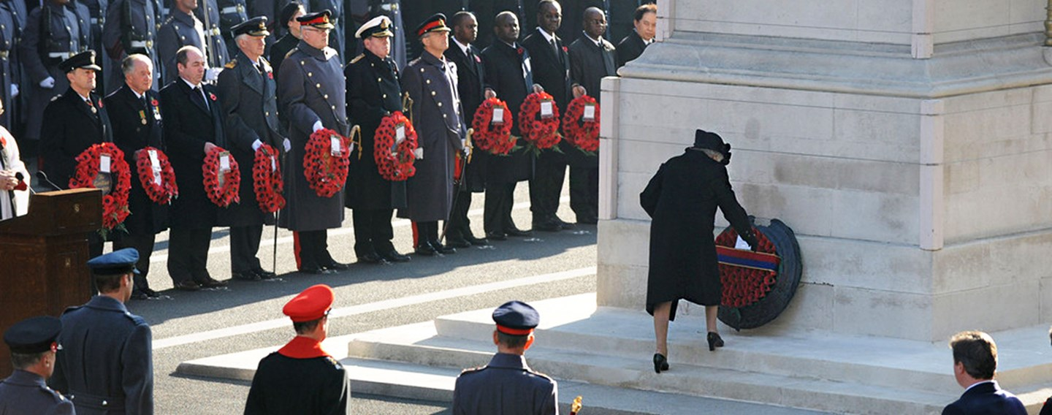
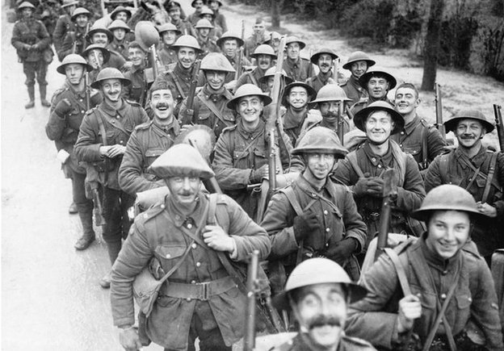
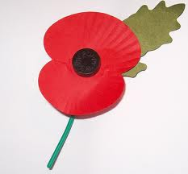
Article 38 – Every child has the right to be protected and cared for in countries affected by war

Slide 2
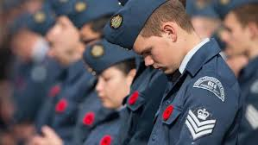
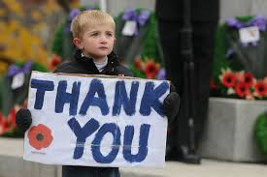
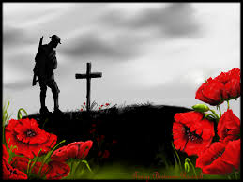
Why should we remember?

Slide 3
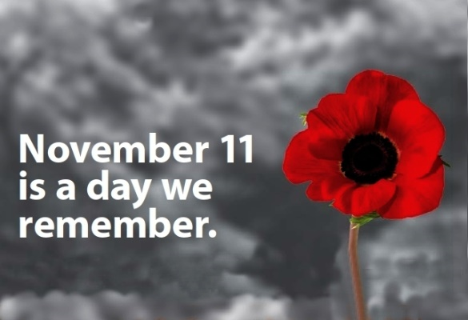
Why the 11th November?
Why poppies?

Slide 4
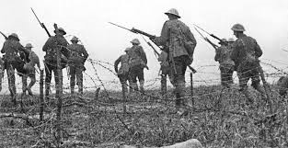
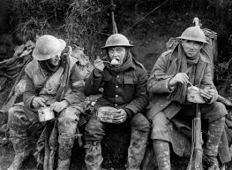
141 DAYS
The Battle of the
Somme lasted from 01
July – 18 November 1916.
19,240
British soldiers had been killed
by the end of the first day
TOTAL CASUALITIES
20 4, 25 3 FRENCH CASUALTIES
419, 6 5 4 BRITISH CASUALTIES
5 0 0,0 0 0 GERMAN CASUALTIES

Slide 5
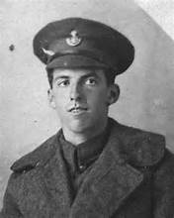
“THE SHORT BUT TERRIBLE RUSH…”
1 July 1916
Diary of Private William Roberts, 18th Durham Light Infantry
Opened a violent bombardment on the German lines. 7am a village blown up by our mine and 7.30am advance started. We were the 4th Battalion to go over, which we did about an hour later. The short but terrible rush through the fierce curtain fire with men falling on all sides I shall never forget. High explosive shells fell all round us. The sights I saw are too terrible to write about.
Killed at Etrun, Pas-de-Calais on 15 June 1917, age 23.
From: Durham County Record Office

Slide 6
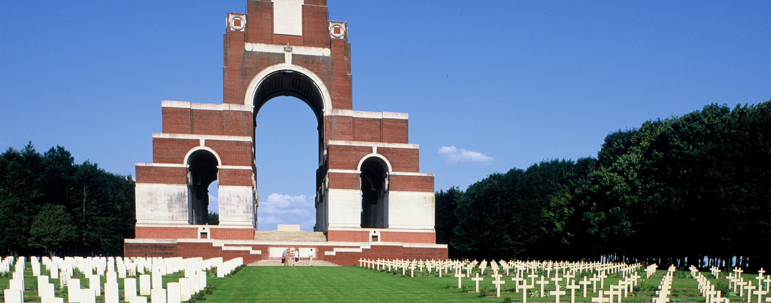
As day breaks through wind and rain we form a line on rough terrain, to face a foe we’ll never know, we will fall and die where poppies now grow. Remember us the chosen ones, the lads the dads and someone’s sons. Be not sad, just be glad, knowing we gave all we had. As you walk on our fields of doom, places where our bodies were strewn, we will gaze on you through heaven’s door and hope our words stay for evermore. When you leave save a tear, for here we stay year on year, the lads the dads and someone’s sons, the boys who fell before German guns.
Dave Callaghan
Taken from the wall of remembrance at www.somme-battlefi elds.com

Slide 7
Peace is flowing like a river
Flowing out through you and me,
Spreading out into the desert,
Setting all the captives free.
Love is flowing like a river,
Flowing out through you and me,
Spreading out into the desert,
Setting all the captives free.
1/3

Slide 8
Joy is flowing like a river,
Flowing out through you and me,
Spreading out into the desert,
Setting all the captives free.
Hope is flowing like a river,
Flowing out through you and me,
Spreading out into the desert,
Setting all the captives free.
2/3

Slide 9
Christ brings peace to all creation,
Flowing out through you and me,
Love, joy, hope and true salvation,
Setting all the captives free.
Last page

Slide 10
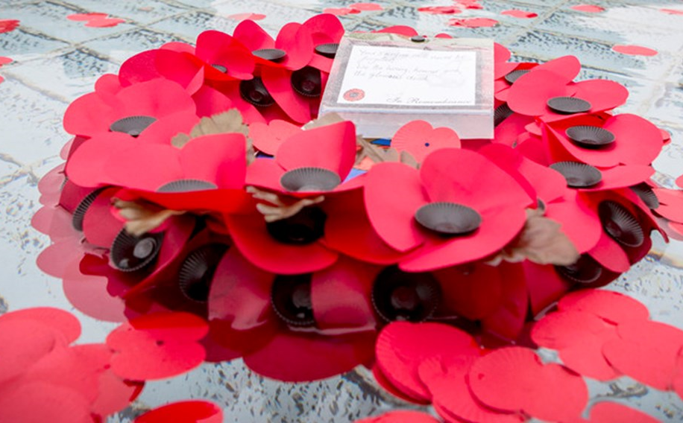
O God of truth, justice and compassion we hold before you those men and women who have died and been injured on active service: in the two world wars and more recently in Iraq, Afghanistan and elsewhere. As we honour their courage and cherish their memory, we place our hope in you for a better future for our world.
Amen.

