Slide 1

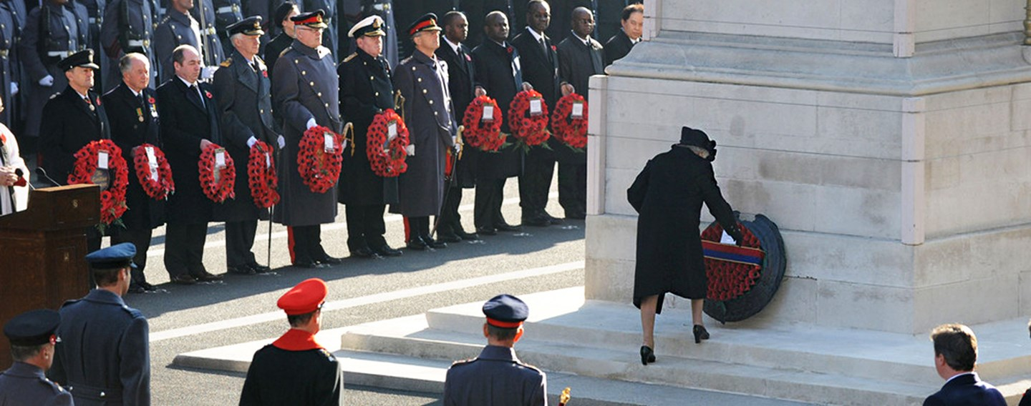
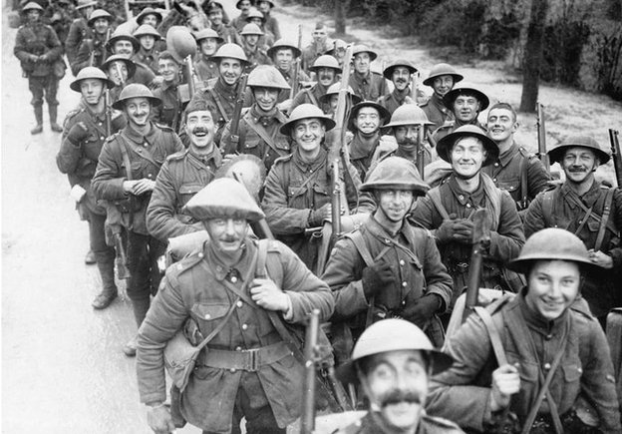
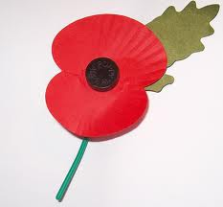
Article 38 – Every child has the right to be protected and cared for in countries affected by war

Slide 2
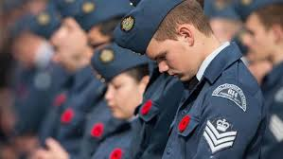
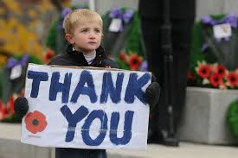
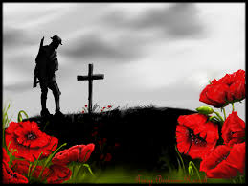
Why should we remember?

Slide 3
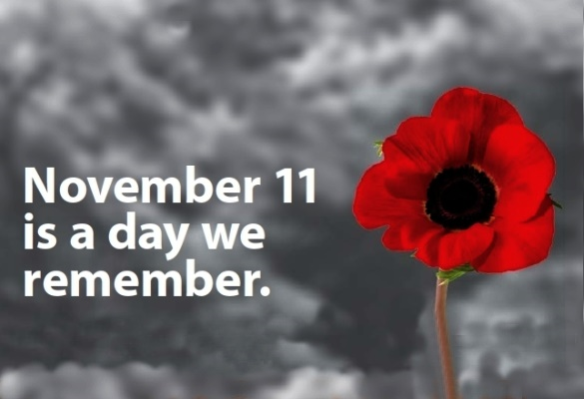
Why the 11th November?
Why poppies?

Slide 4
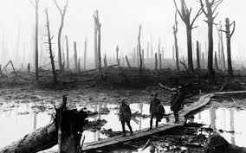
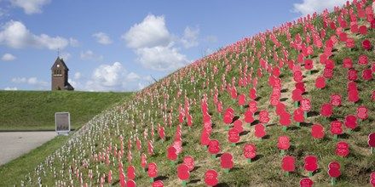
Passchendaele 100
Passchendaele, also known as the Third Battle of Ypres was one of the more controversial battles of World War I. In three-and-a-half months between July and November 1917, an advance of less than five miles cost an estimated 550,000 Allied and German troops, killed, wounded or lost. Around 90,000 British and Commonwealth soldiers were missing; 50,000 buried without being identified and 42,000 never recovered.

Slide 5
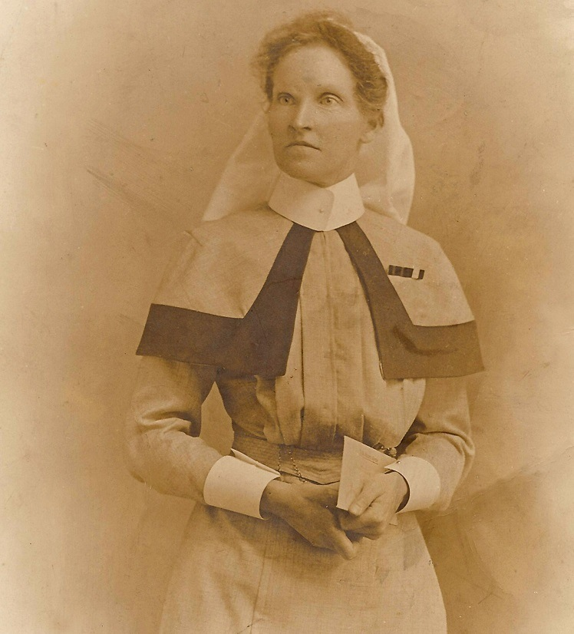
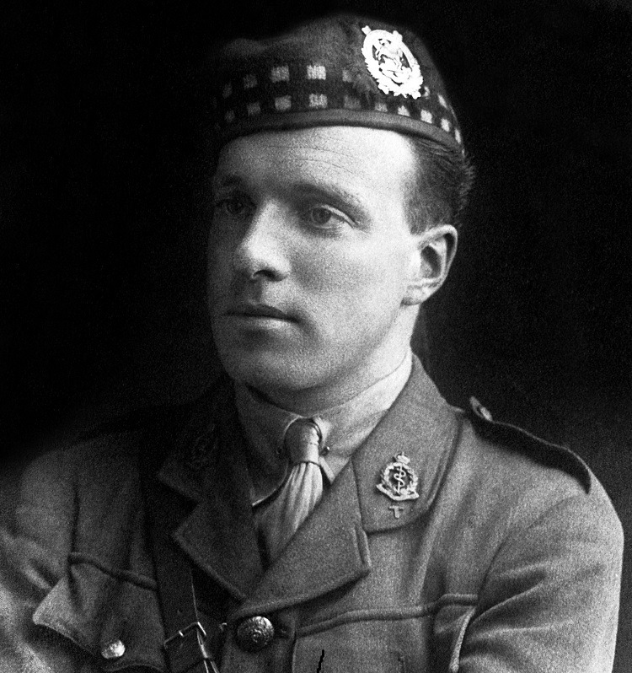
Sister Kate Luard
Noel Chavasse
The only VC and bar of WW1

Slide 6
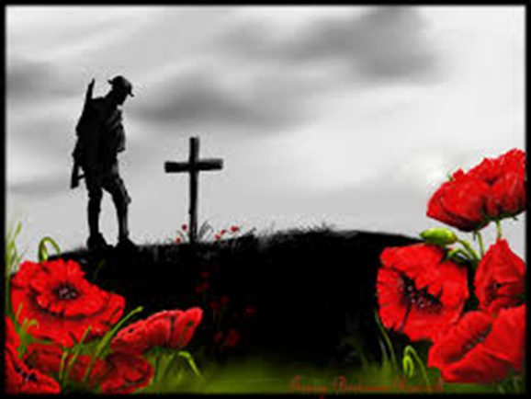

They shall grow not old, as we that are left grow old:
Age shall not weary them, nor the years condemn.
At the going down of the sun and in the morning
We will remember them.

Slide 7
Peace is flowing like a river
Flowing out through you and me,
Spreading out into the desert,
Setting all the captives free.
Love is flowing like a river,
Flowing out through you and me,
Spreading out into the desert,
Setting all the captives free.
1/3

Slide 8
Joy is flowing like a river,
Flowing out through you and me,
Spreading out into the desert,
Setting all the captives free.
Hope is flowing like a river,
Flowing out through you and me,
Spreading out into the desert,
Setting all the captives free.
2/3

Slide 9
Christ brings peace to all creation,
Flowing out through you and me,
Love, joy, hope and true salvation,
Setting all the captives free.
Last page

Slide 10
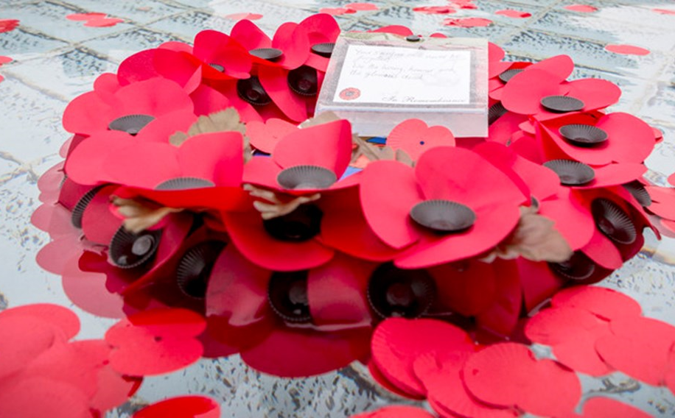
O God of truth, justice and compassion we hold before you those men and women who have died and been injured on active service: in the two world wars and more recently in Iraq, Afghanistan and elsewhere. As we honour their courage and cherish their memory, we place our hope in you for a better future for our world.
Amen.

