Slide 1
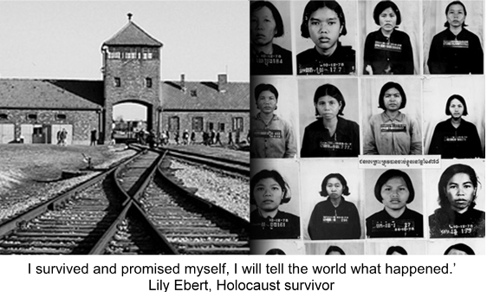
One Family
United Nations Rights of the Child:
UNCRC: Article 38 – Every child has the right to be protected and cared for in countries affected by war

Slide 2
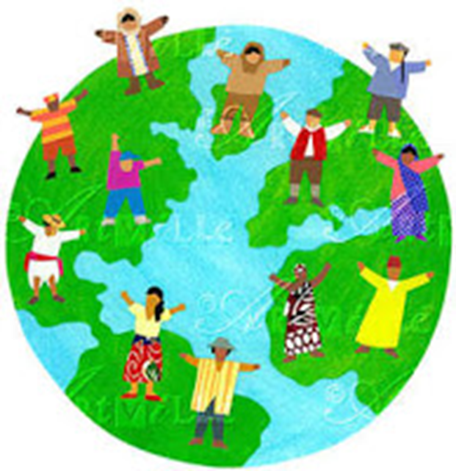
Then God said, “ I shall make human beings in my image, in my own likeness. Let them rule the animal Kingdom and be responsible for the whole earth.”
So God created human beings. He made them in his own image, creating both male and male.
(Exodus)
Article 1: Everyone under 18 years of age has all the rights in this Convention.
Article 2: The Convention applies to everyone, whatever their race, religion, abilities; whatever they think or say, whatever type of family they come from.
“All men are created equal"
(American declaration of independence)
“One Family – achieving more together” (St Mary’s Junior School)

Slide 3
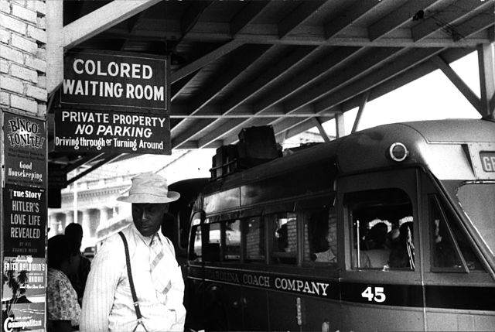
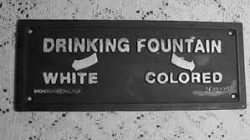
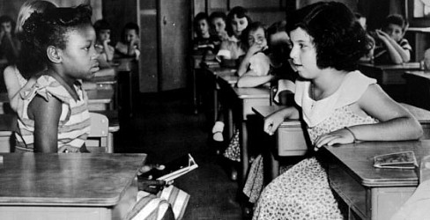

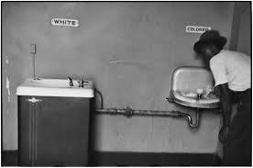

Slide 4
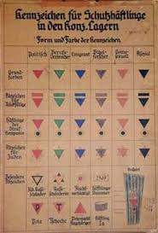

Slide 5
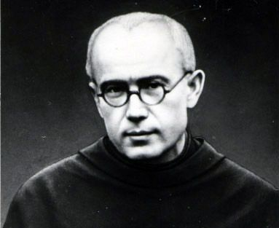
Father Maximillian Kolbe

Slide 6
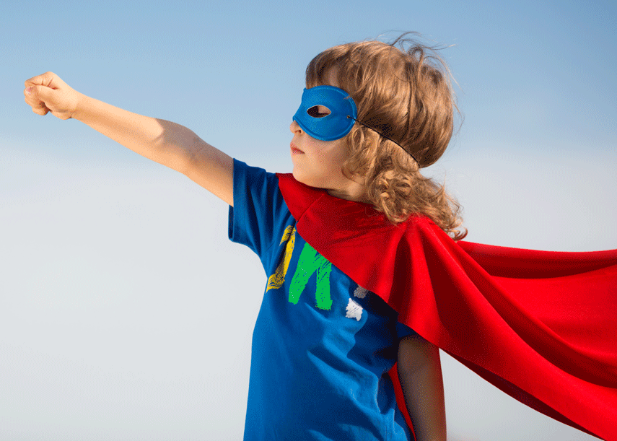
In John’s Gospel Jesus said to his disciples:
12 This is my commandment, That you love one another, as I have loved you.
13 Greater love hath no man than this, that a man lay down his life for his friends.
What small sacrifices can we make for those we know, those we may meet in the future and those we will never meet?
How can you be a courageous advocate?

Slide 7
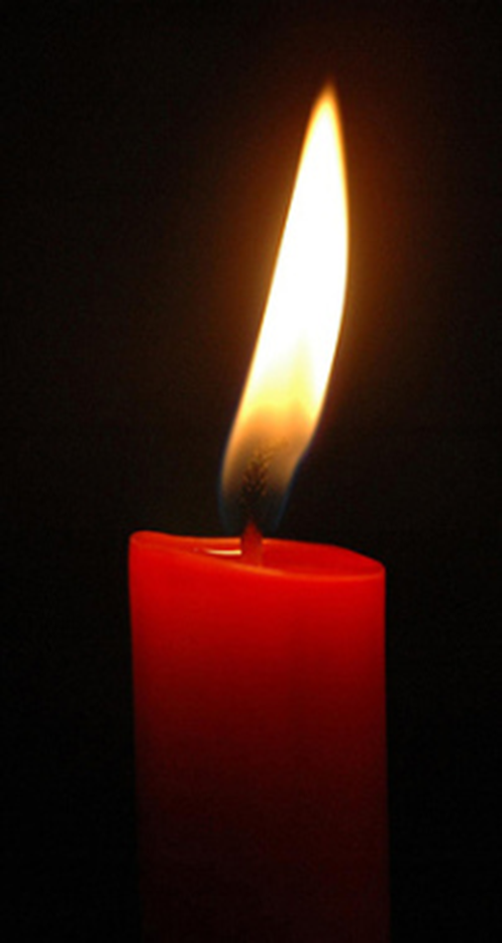
Dear God,
Please help us to learn from the past to protect our future.
Let us celebrate our differences and remember we were made in your image.
Thank you for giving us the responsibility of loving each other unconditionally. With this we hope we can make your world a better place.
Amen

Slide 8

Sing a song in unison,
Give your heart a voice,
Sing a global melody
And let the world rejoice.
Sing a song of hopefulness,
Make the future fair,
Sing of love for everyone
And show them that you care.

Slide 9
Sing together,
celebrate the world we share,
Sing together,
celebrate the people there,
Sing together, every girl and every boy
With a voice that sings of hope and peace and joy.

Slide 10
Joining hands around the globe,
Linking time and place,
Understanding differences,
We are the human race.

Slide 11
Sing together,
celebrate the world we share,
Sing together,
celebrate the people there,
Sing together, every girl and every boy
With a voice that sings of hope and peace and joy.

Slide 12
Sing together,
celebrate the world we share,
Sing together,
celebrate the people there,
Sing together, every girl and every boy
With a voice that sings of hope and peace and joy.
Last page

Slide 13
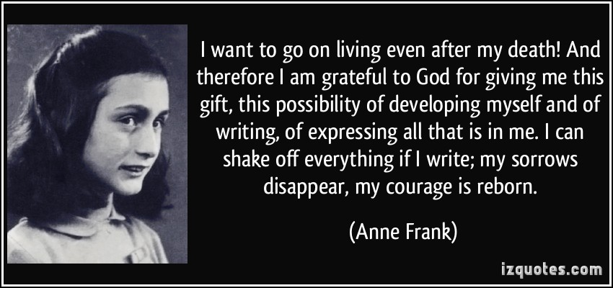
How can we help to keep the memory alive?

