Slide 1


Slide 2
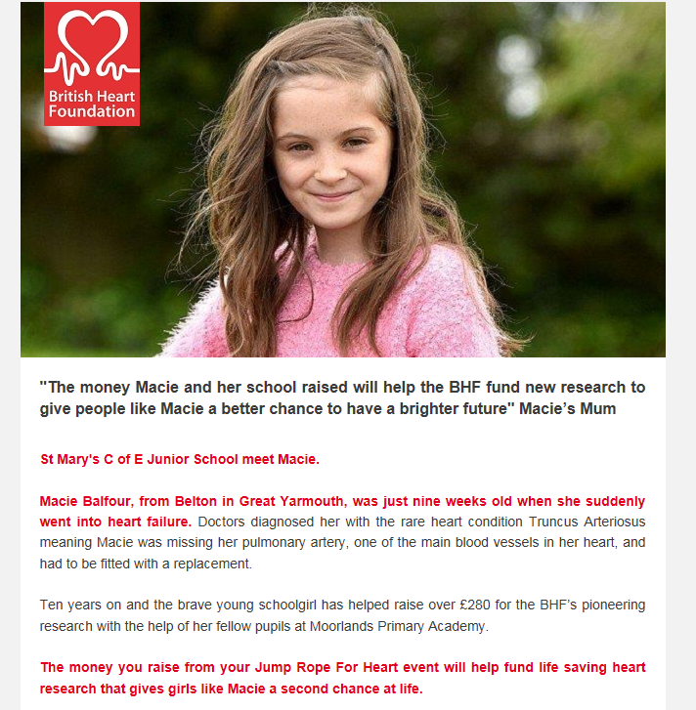

Slide 3
Jump Rope for Heart!
This event will take place on Friday 1st February in the hall.
You will have been given a sponsorship form to take home tonight and your parents have been informed by Parent Mail.
Each child will be partnered with another child and they are responsible for counting the number of skips their partner can complete in a 5 minute period. Then the partners will swap over.
The winning child from each class will be awarded with a certificate during celebration AoW. There will also be a certificate for the most money raised in each class!
Get practising now!

