Slide 1


Slide 2


Slide 3
Ofsted and SIAMs still to come
The first-class curriculum contributes greatly to pupils’ personal development.
Writing across the curriculum is top notch
Pupils learn a wide range of subjects and love the variety of activities they undertake
Pupils throughout the school make excellent progress in mathematics
Leaders at all levels are ambitious and well informed. They possess a deep and detailed understanding of the school’s strengths and weaknesses, using this to continually improve the school

Slide 4
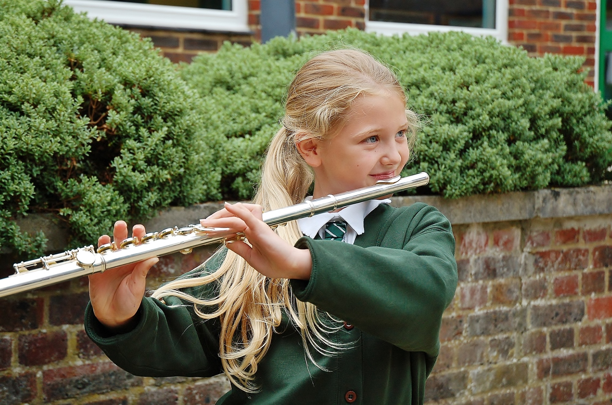
End of Key Stage SATs results continue to be significantly above both national and county levels
Winners of Basingstoke Primary School Sports award for the sixth time – top of the Basingstoke medals table
Music continues to be strength strength – we have the music mark, were mentioned in the Hampshire Music Services Advent calendar and continue to take part in numerous music events

Slide 5

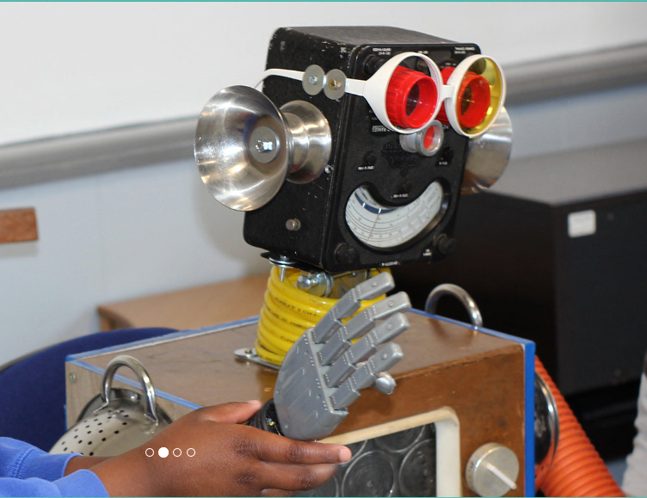
HeartSmart
HeartSmart is a new approach that Primary schools use to build character, emotional health and resilience in children.
The exciting programme connects all of our school values, RE, PSHE and wellbeing.
Boris, HeartSmart’s very own purpose-built robot, provides a fun, interactive and dynamic way for children to explore each HeartSmart principle.

Slide 6
Why HeartSmart at St Mary’s?
Our core Christian Value is Love. The value of ‘love’ underpins everything we do at our school.
Love is what holds everything together in perfect unity.
Colossians 3:14
Love your neighbour as yourself.
Matthew 22:38
HeartSmart is about loving and accepting ourselves as well loving and responding well to others.
It’s a creative way of enabling children to adopt a growth mindset whilst maintaining a healthy epicentre.
Notes:
In our school this is described in terms of being One Family, where each member is encouraged to love and respect themselves, others, God and his world.

Slide 7


High Five!
These five principles help us be smart with our heart, help us love ourselves and others, help us guard our heart and process how we feel. They help us build resilience and active empathy.
Don’t Forget To Let Love In!
Learning how important, valued and loved we are.
Too Much Selfie Isn’t Healthy!
Exploring the importance of others and how to love them well.
Notes:
There are five simple truths that we use to unpack what it means to be HEARTSMART.

Slide 8



Don’t Rub It In, Rub It Out!
Understanding how to process negative emotion and choose forgiveness to restore relationships.
Fake Is A Mistake!
Unpacking how to bravely communicate truth and be proud of who we are.
‘No Way Through,’ Isn’t True!
Knowing there is a way through every situation, no matter how impossible it may seem.

Slide 9

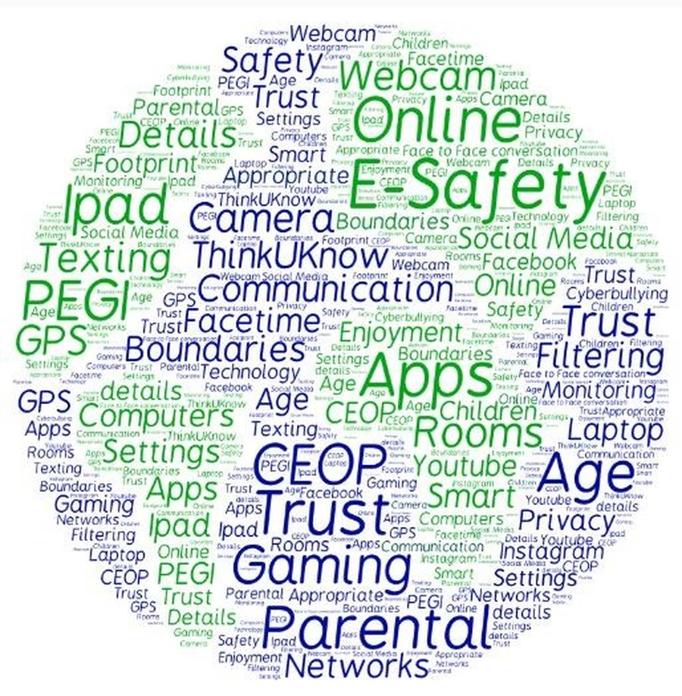
Internet Safety
There is so much to talk about when it comes to Internet Safety! It looks at:
How to be safe
Personal details
Cyber bullying
Gaming
Mobile phone use
Apps
Passwords
Consent/permission
Social media
Pictures

Slide 10


The Internet and Social Networking
1
5
9
2
6
10
3
7
11
4
8
12
Notes:
1. Musical.ly
Users upload live videos of themselves lip-syncing and or dancing to music with the objective of gaining likes & followers. This app is incredibly popular with young people. But there are underlying risks including grooming and cyberbullying, as well as inappropriate sexualised or self harm content. Children often upload videos in their school uniforms, providing an easy means for predators to locate them.
2. Meetme
Users create an account to communicate with other random users anywhere in the world. The app currently has 129k daily active users. Young people are at risk of being contacted by predators, being bullied by other users and are also incentivised to make in app purchases in order to boost their popularity on the app.
3. Yellow
Often dubbed "Tinder for teens", users swipe left or right on profiles. Yellow has exacerbated the risks on Snapchat (where teens are sharing sexting images thinking they will disappear when they are actually being screenshotted and shared). Matches are automatically provided with a platform to chat and link to each other's Snapchat accounts, to increase their Snapchat followers. This app is rapidly gaining popularity.
4. Live.ly
Users upload live videos of themselves doing anything and everything with the objective of gaining likes & followers. The freedom users have to upload anything they want results in a huge risk of young children viewing highly inappropriate content such as nudity and self harm. This app is not as popular as Musical.ly, however there is a greater risk of inappropriate content given the theme of posts is 'anything goes'.
5. Twitch
Users broadcast themselves playing video games for other users to watch. Users can also chat with each other. Twitch's online community promotes a pack mentality among users who are predominantly young males. Users who don't align with this attitude are ridiculed heavily.
6. Facebook
A recent study found only 62 percent of teens have their Facebook account set to private. A staggering 17 percent have all of their information, including contact information and whereabouts, public.
7. Twitter
Twitter is a messaging service that lets you post public messages called tweets. These can be up to 140 characters long. As well as tweets, you can send private messages and post pictures/videos.
8. Instagram
Instagram is a picture and video sharing app. Users can post content and use hashtags to share experiences, thoughts or memories with an online community. You can follow your friends, family, celebrities and even companies on Instagram. Instagram allows live streaming. The risks of IG include being exposed to harmful images and cyber-bullying.
9. Snapchat
Research indicates one in seven 15yr olds have taken a nude or semi-nude photograph of themselves, and over half of those photographs taken have been shared with another person via the internet. It is important to note once something crosses the internet, there is no way to remove it - even via snapchat images and messages can be screen-shotted. All images still exist on Snapchat’s server.
10. sayat.me
sayat.me is a website not an app but it links to social media. Here’s how the site describes itself:
1. Create your personal feedback web address
2. Spread the link through Twitter, Facebook, Skype, etc.
3. Read what people think about you
4. Publish your favourite feedback
Except young people being young people - they see an anonymous feedback tool and use it offensively. There is growing evidence of the harm that this site has already created, and DSLs talking about the damaging cyberbullying they are having to deal with as a result.
11. Calculator%
Calculator% is a calculator app for iOS devices (i.e. iPhones, iPads, and iPods) that has a hidden purpose. This app is titled "Calculator%", hence the apparent typo in the article title. On the surface, it is a basic (and functional) calculator app. However, if you enter a secret code (a four-digit PIN between two periods, such as .1234.), the app reveals a second function: it allows the owner to hide documents and image files so they are not readily accessible to someone that does not know the passcode.
12. After School
The After School app is an anonymous messaging app for young people. The app only allows school pupils to join. To keep parents and teachers off, students must register via their Facebook profile. The app checks their Facebook friends and location to make sure they go to the school. Once registered, they can only see the feed from their school. Before a young person downloads After School, parents should talk to them about the potential for adults to use the app, the risks of sexting and the myth of complete anonymity. The founders created this app “to enable teenagers to freely communicate while providing them safety from judgment.” While anonymous apps can create a private place to connect with friends, these apps are not a place where young people can go wild with impunity.

Slide 11
Being SMART online
Safe – Be careful, do not give out your full
name, address, phone number, school name, Date of Birth, password or photos with location information
Meeting – People online can be dangerous
Accepting – Attachments can lead to cyber attacks
Remember – It’s easier to write and put something online without thinking.
Tell – Your parents, carer or teacher if someone makes you uncomfortable

Slide 12
Talking about the Internet
There is an age limit on games and social media, normally 13 and upwards however, if these aren’t followed at your discretion, then play it with them and have that discussion with them.
Difficult with peers and gaming in this current age.
They will hear about it and speak about it in the playground.
See this website for a guide on age limits from books to apps to games. https://www.commonsensemedia.org/

Slide 13
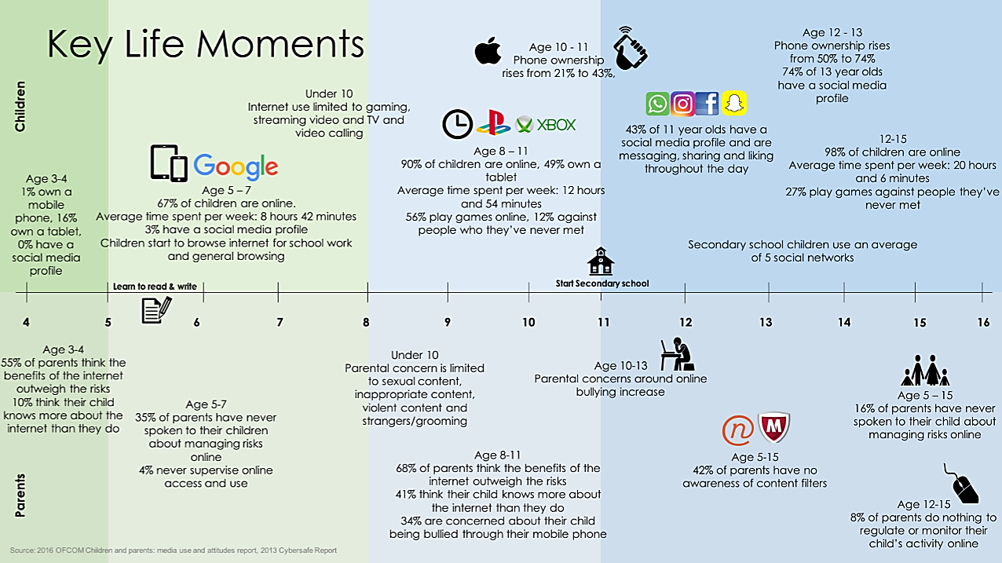

Slide 14


