Slide 1
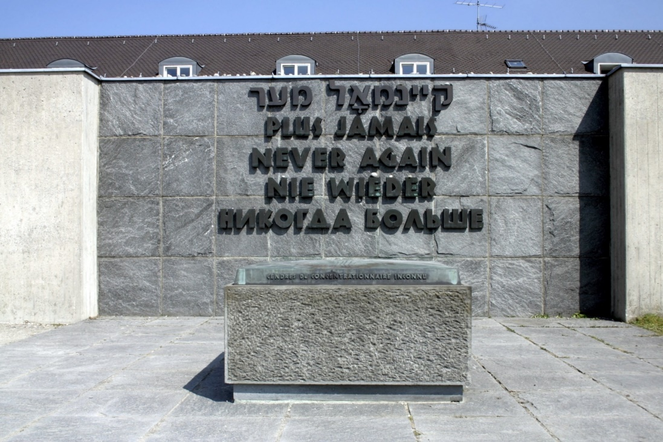
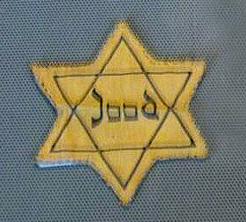

Responsibility
Genesis 1:26
UNCRC:1 – Everyone under the age of 18 has all the rights in the convention. We have the responsibility to respect the rights of others

Slide 2
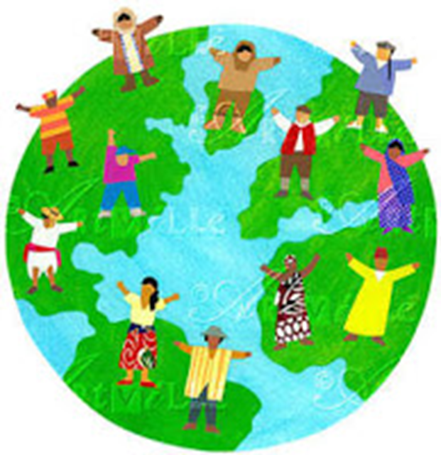
Then God said, “ I shall make human beings in my image, in my own likeness. Let them rule the animal Kingdom and be responsible for the whole earth.”
So God created human beings. He made them in his own image, creating both male and male.
(Exodus)
Article 1: Everyone under 18 years of age has all the rights in this Convention.
Article 2: The Convention applies to everyone, whatever their race, religion, abilities; whatever they think or say, whatever type of family they come from.
“All men are created equal"
(American declaration of independence)
“One Family – achieving more together” (St Mary’s Junior School)

Slide 3
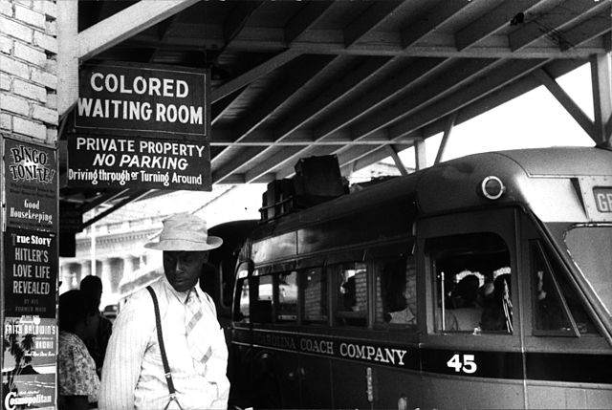
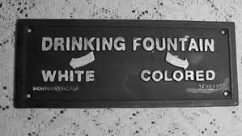
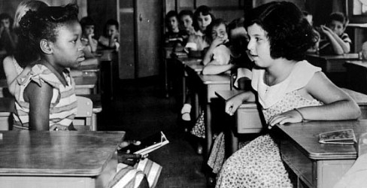
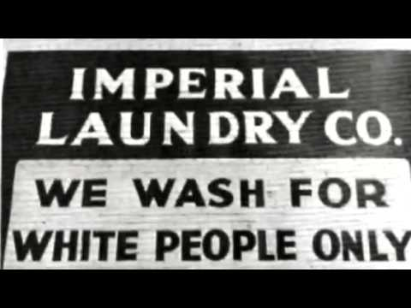
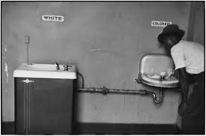

Slide 4
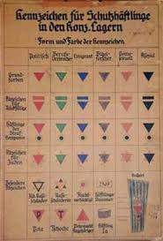

Slide 5
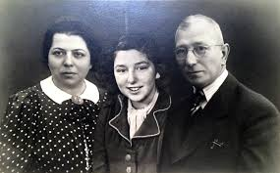
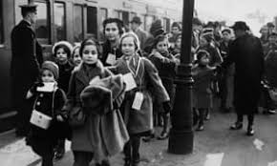
Susanne Kenton a Survivor

Slide 6
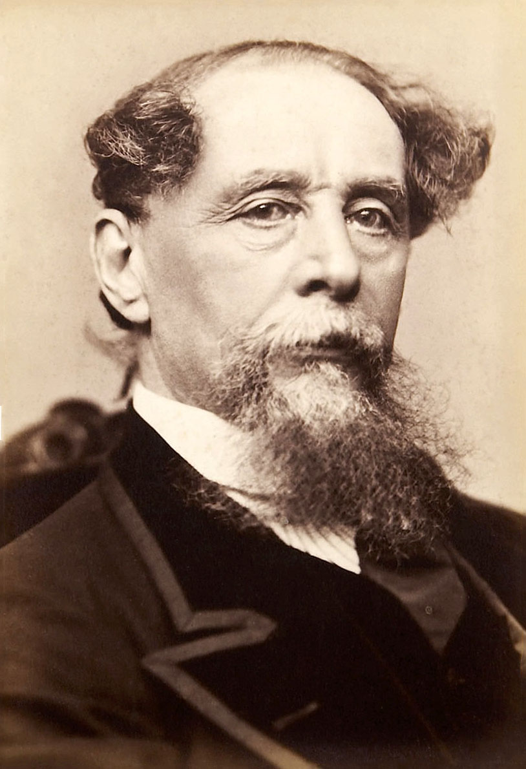
Charles Dickens

Slide 7
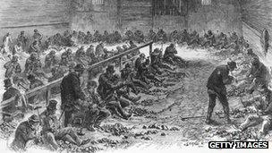
'Dickensian' poverty
One of the things Dickens cared about most was those at the bottom. He was one of the first to offer a look at the underclass and the poverty stricken in Victorian London through his books such as Oliver Twist.
After he became famous, Dickens helped make popular the term "red tape" to describe the way those in positions of power particularly hurt the weak and poor.
"Dickensian" has now become the easiest word to describe an unacceptable level of poverty.

Slide 8
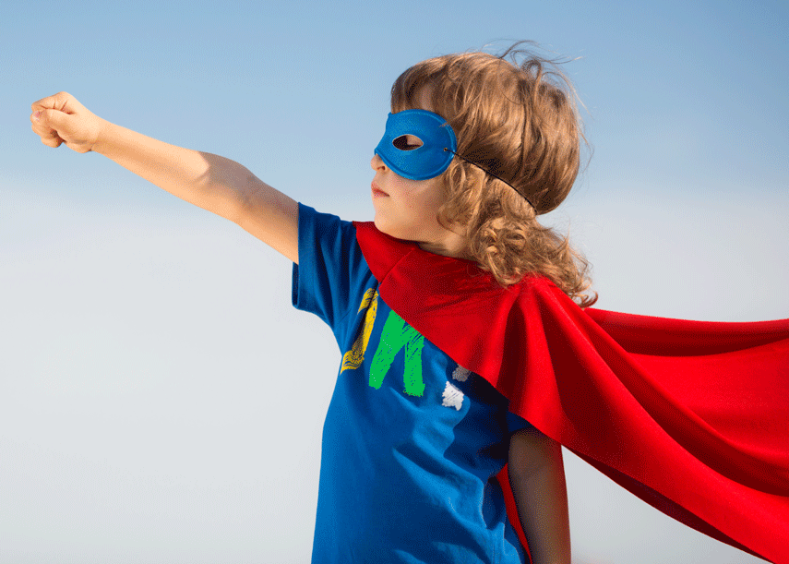
In John’s Gospel Jesus said to his disciples:
12 This is my commandment, That you love one another, as I have loved you.
13 Greater love hath no man than this, that a man lay down his life for his friends.
What small sacrifices can we make for those we know, those we may meet in the future and those we will never meet?
How can you be a courageous advocate?

Slide 9
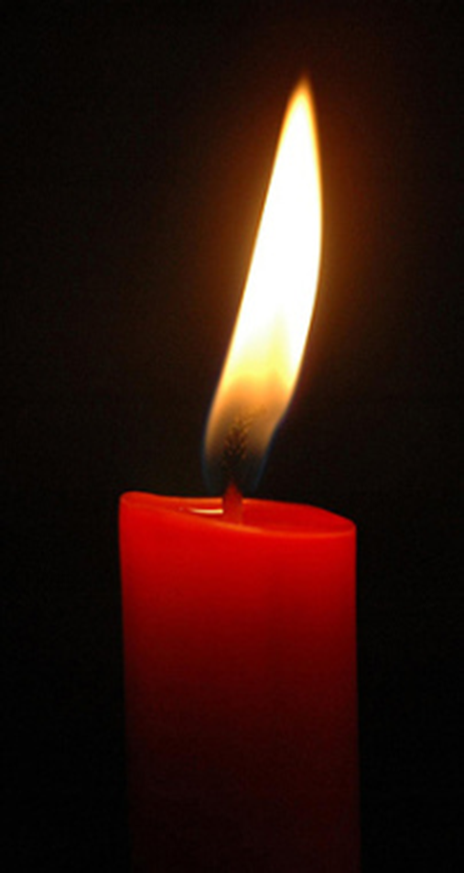
Dear God
We thank you that we live in a safe country where we can be ourselves without being hurt by others.
Today we especially remember people who suffered in the Holocaust, or have been hurt by others just because they are hated for being themselves.
We pray that they may feel brave because you love and care for them.
Please give us the courage to stand together when we know things are wrong.
We pray that people who are filled with hatred, especially against Jewish people, may have a change of heart and show kindness in the world instead.
We ask all this in Jesus’ name.
Amen

Slide 10
BE STILL

Slide 11
Be still, for the presence of the Lord,
the Holy One, is here;
Come bow before him now
with reverence and fear:
In him no sin is found –
we stand on holy ground.
Be still, for the presence of the Lord,
the Holy One, is here.

Slide 12
Be still, for the glory of the Lord
is shining all around;
He burns with holy fire,
with splendour he is crowned:
How awesome is the sight –
our radiant King of light!
Be still, for the glory of the Lord
is shining all around.

Slide 13
Be still, for the power of the Lord
is moving in this place;
He comes to cleanse and heal,
to minister his grace -
No work too hard for him.
In faith receive from him.
Be still, for the power of the Lord
is moving in this place.
Last slide

Slide 14
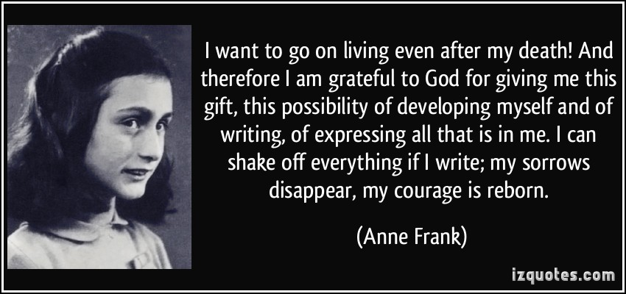
How can we help to keep the memory alive?

Slide 15
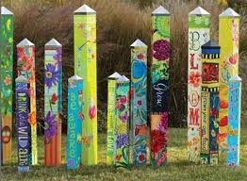
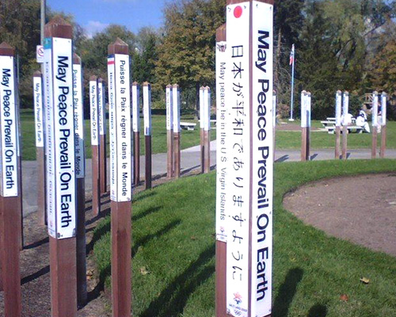
Peace Poles

