Slide 1
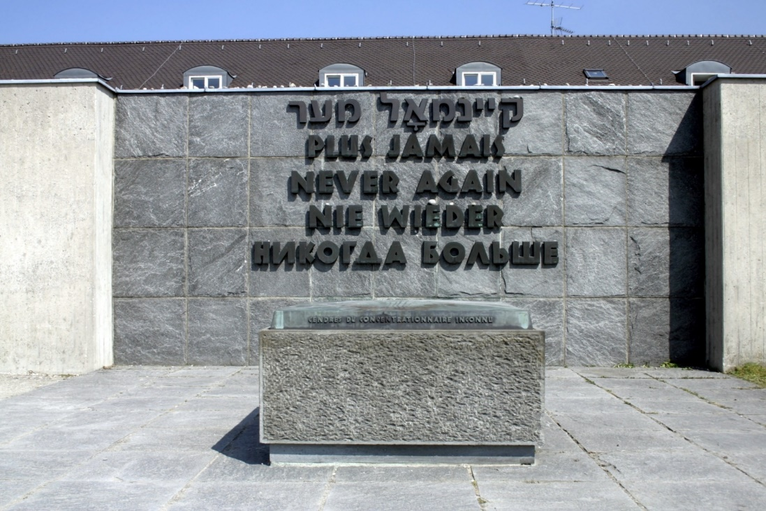
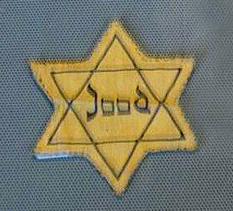

Responsibility
Genesis 1:26
UNCRC:1 – Everyone under the age of 18 has all the rights in the convention. We have the responsibility to respect the rights of others
https://www.youtube.com/watch?v=MTXjrQAl-9w

Slide 2
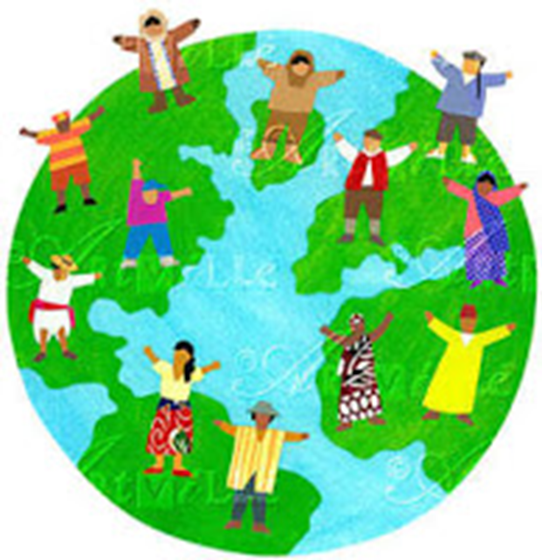
Then God said, “ I shall make human beings in my image, in my own likeness. Let them rule the animal Kingdom and be responsible for the whole earth.”
So God created human beings. He made them in his own image, creating both male and male.
(Exodus)
Article 1: Everyone under 18 years of age has all the rights in this Convention.
Article 2: The Convention applies to everyone, whatever their race, religion, abilities; whatever they think or say, whatever type of family they come from.
“All men are created equal"
(American declaration of independence)
“One Family – achieving more together” (St Mary’s Junior School)

Slide 3
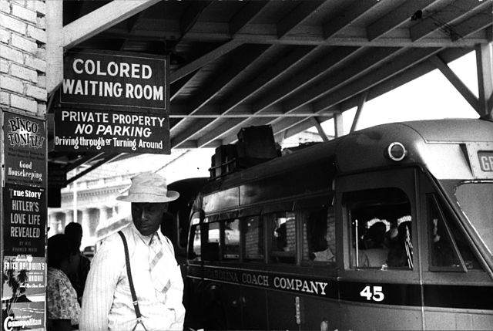
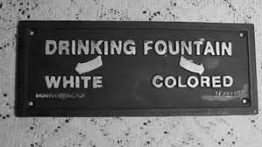
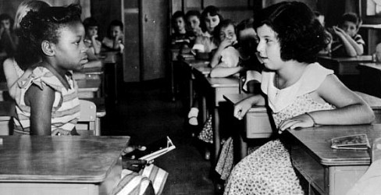
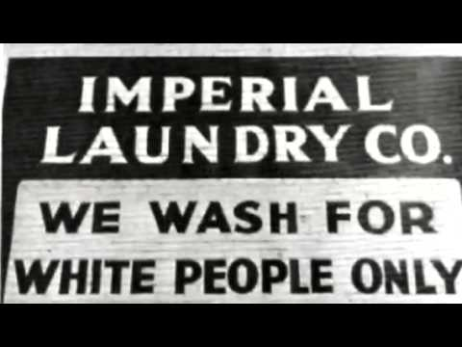
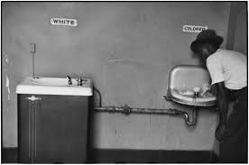

Slide 4

This year’s theme is:
One Day
One Day – everything changed
One Day – in history
One Day – at a time
One Day – when people unite across the world to remember
One Day – at a time

Slide 5
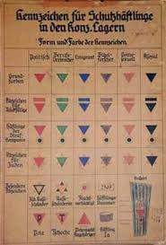

Slide 6
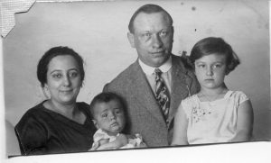
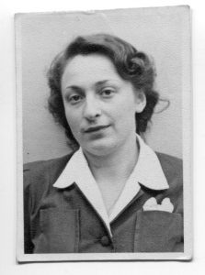
Iby Knill a Survivor
Iby after the liberation
Iby with her parents and younger brother
Read the rest of Iby’s story with your teacher

Slide 7
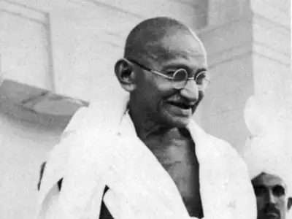
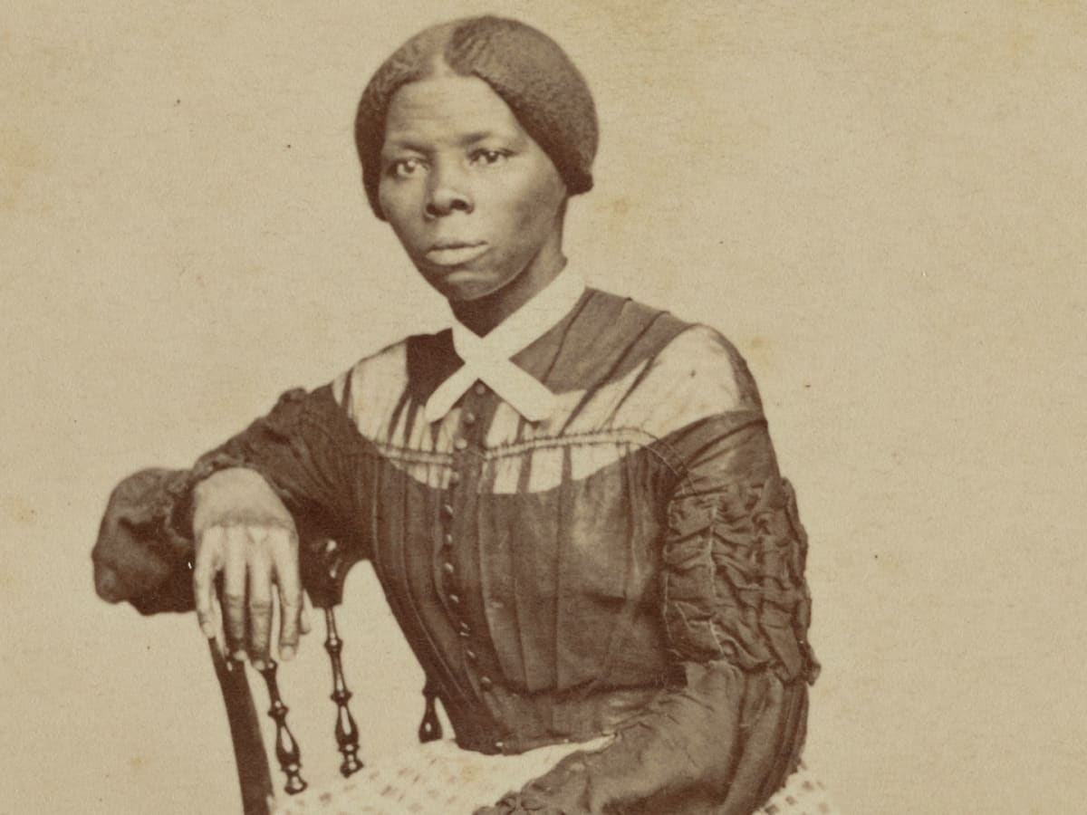
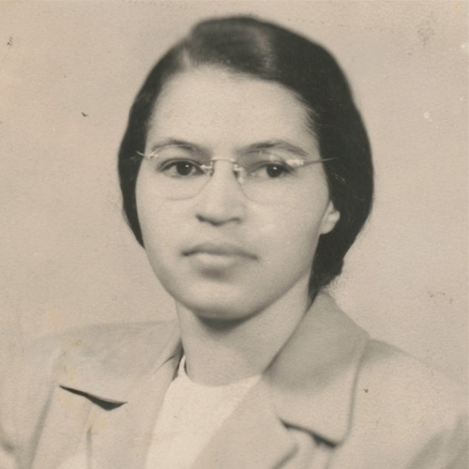
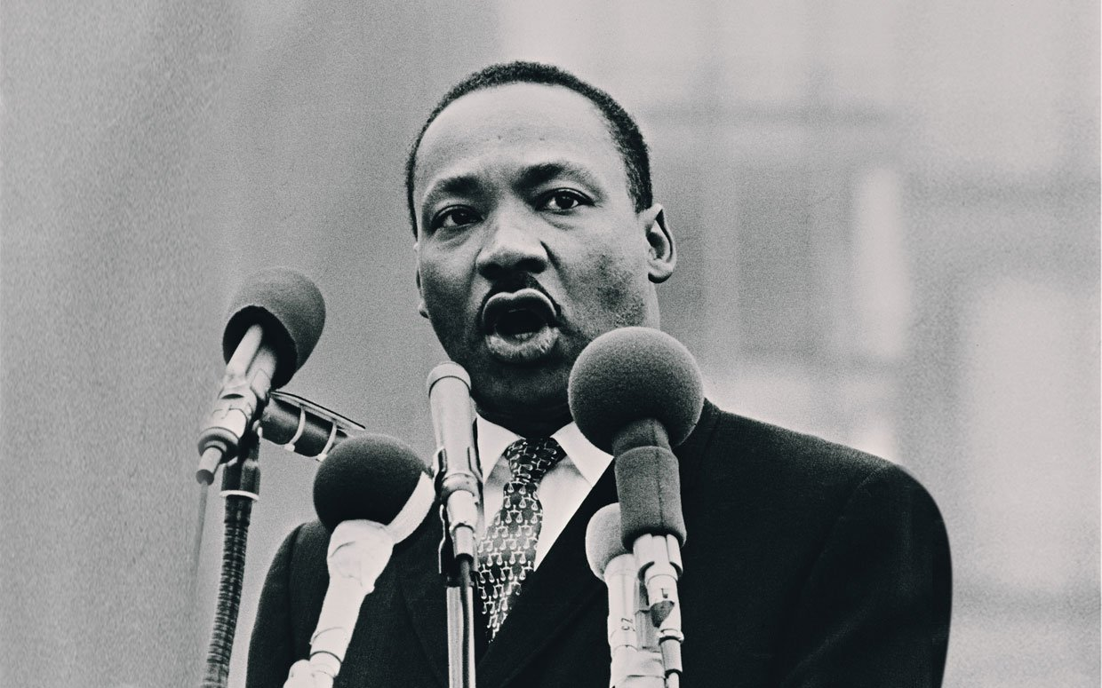
Be the Change
Mahatma Gandhi
Harriet Tubman
Rosa Parks
Martin Luther King

Slide 8
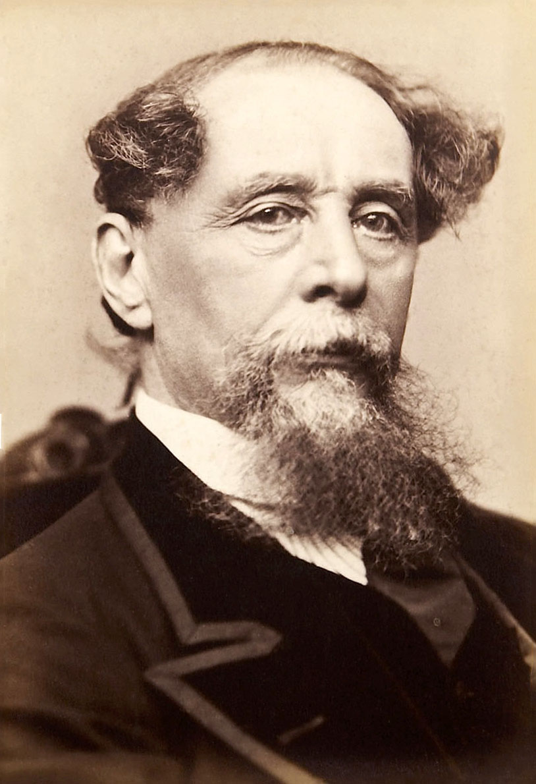
Charles Dickens

Slide 9
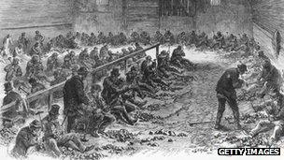
'Dickensian' poverty
One of the things Dickens cared about most was those at the bottom. He was one of the first to offer a look at the underclass and the poverty stricken in Victorian London through his books such as Oliver Twist.
After he became famous, Dickens helped make popular the term "red tape" to describe the way those in positions of power particularly hurt the weak and poor.
"Dickensian" has now become the easiest word to describe an unacceptable level of poverty.

Slide 10
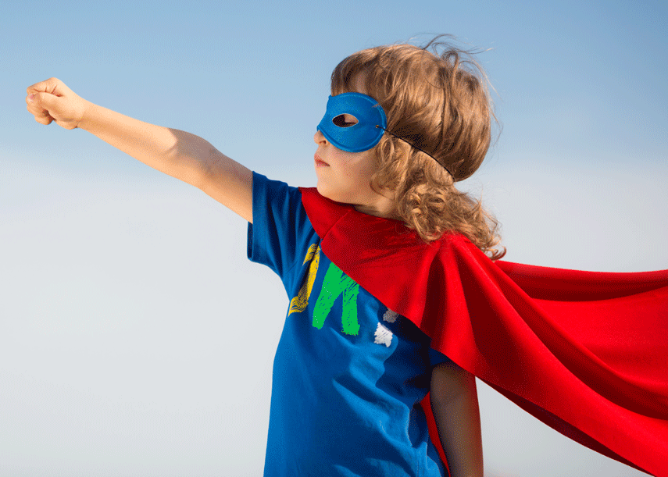
In John’s Gospel Jesus said to his disciples:
12 This is my commandment, That you love one another, as I have loved you.
13 Greater love hath no man than this, that a man lay down his life for his friends.
What small sacrifices can we make for those we know, those we may meet in the future and those we will never meet?
How can you be a courageous advocate?

Slide 11
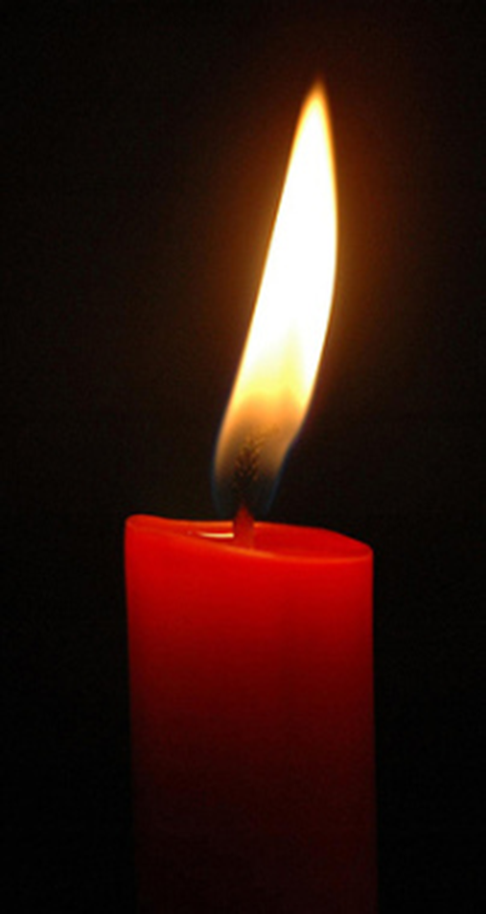
Dear God
We thank you that we live in a safe country where we can be ourselves without being hurt by others.
Today we especially remember people who suffered in the Holocaust, or have been hurt by others just because they are hated for being themselves.
We pray that they may feel brave because you love and care for them.
Please give us the courage to stand together when we know things are wrong.
We pray that people who are filled with hatred, especially against Jewish people, may have a change of heart and show kindness in the world instead.
We ask all this in Jesus’ name.
Amen https://www.youtube.com/watch?v=rCtPhSZS3CE

Slide 12
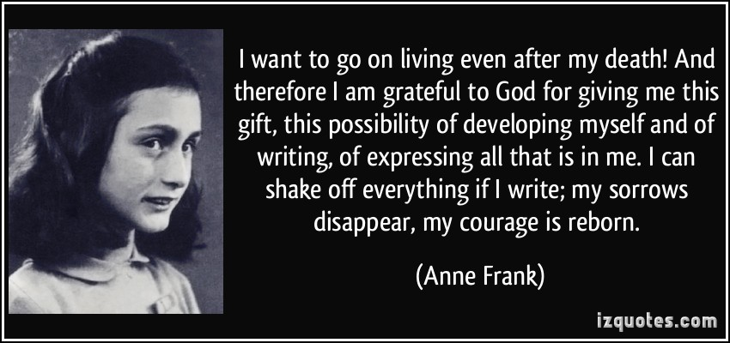
How can we help to keep the memory alive?
https://www.youtube.com/watch?v=MTXjrQAl-9w

