Slide 1
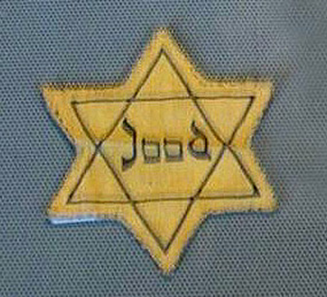
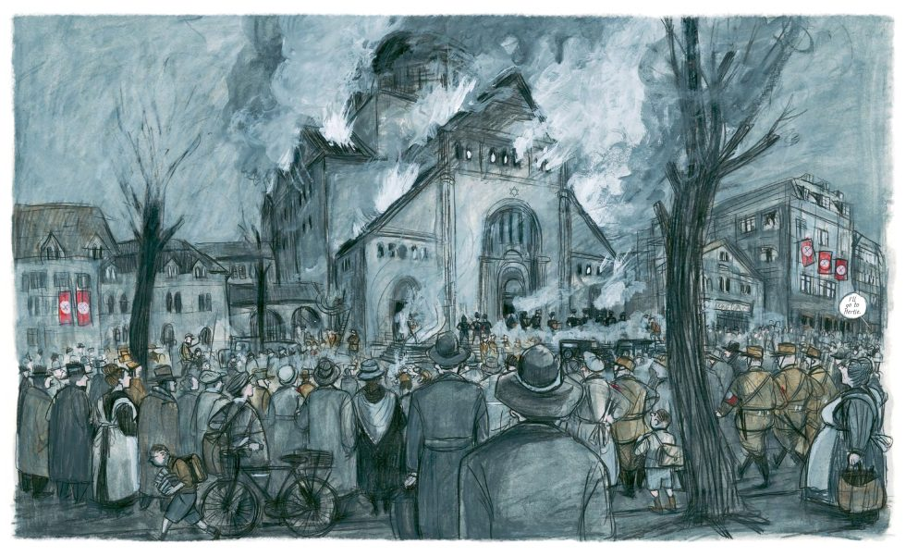



Responsibility
Bible passage: MATTHEW 25: 40-45
https://www.youtube.com/watch?v=MTXjrQAl-9w

Slide 2
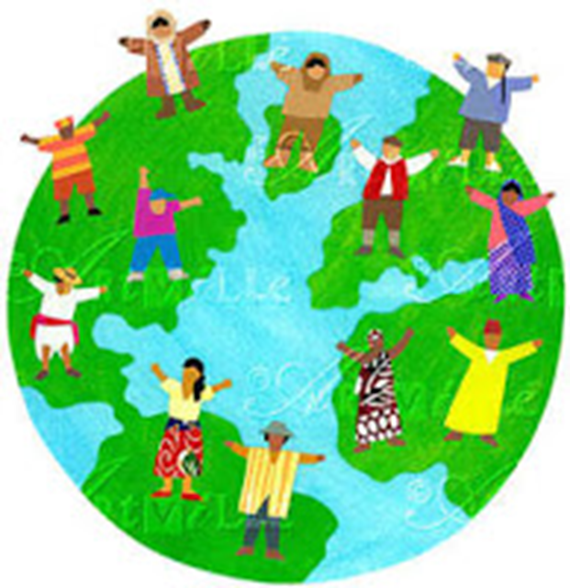
Then God said, “ I shall make human beings in my image, in my own likeness. Let them rule the animal Kingdom and be responsible for the whole earth.”
So God created human beings. He made them in his own image, creating both male and male.
(Exodus)
Article 1: Everyone under 18 years of age has all the rights in this Convention.
Article 2: The Convention applies to everyone, whatever their race, religion, abilities; whatever they think or say, whatever type of family they come from.
“All men are created equal"
(American declaration of independence)
“One Family – achieving more together” (St Mary’s Junior School)

Slide 3
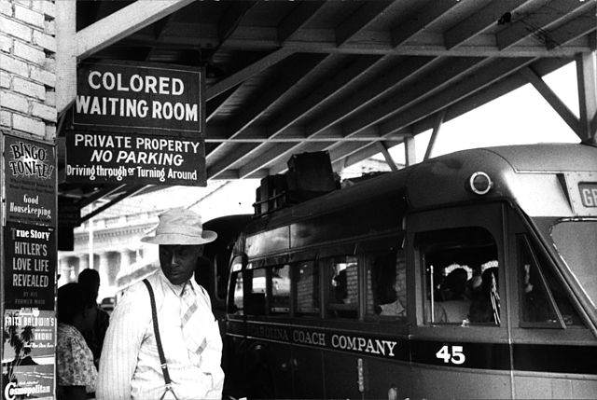
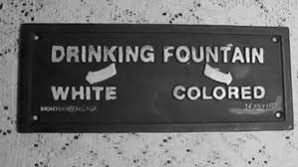
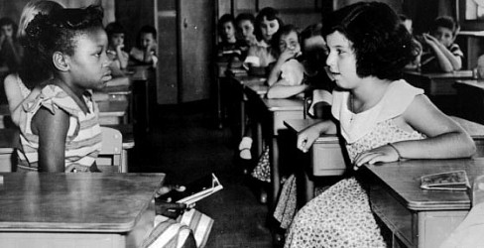
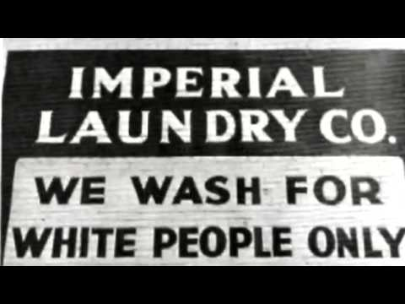
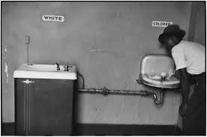

Slide 4

This year’s theme is:
Ordinary People
Our main focus this year is to look at how the Holocaust is about ordinary people and the part we can play today in challenging prejudice.

Slide 5
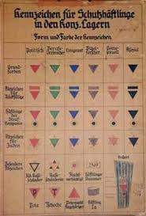

Slide 7
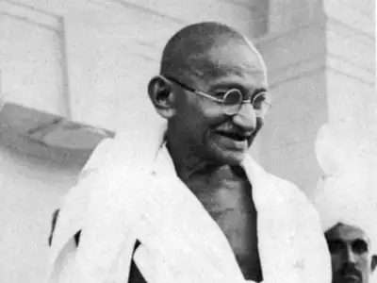
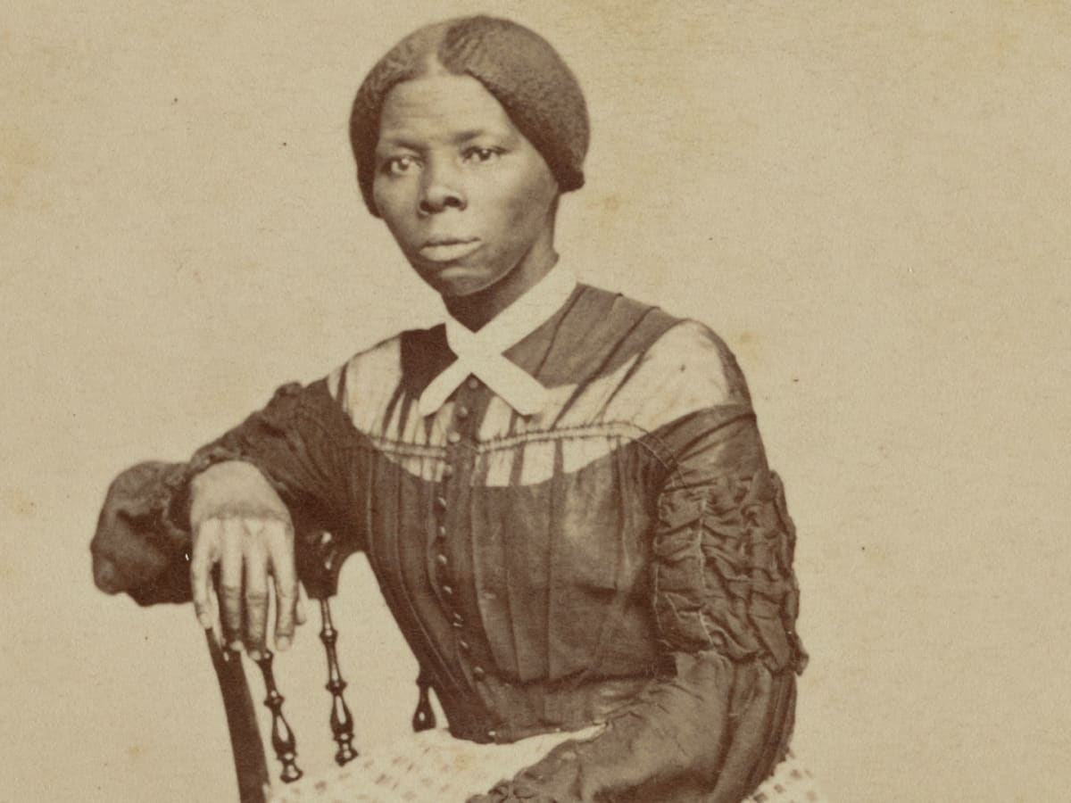
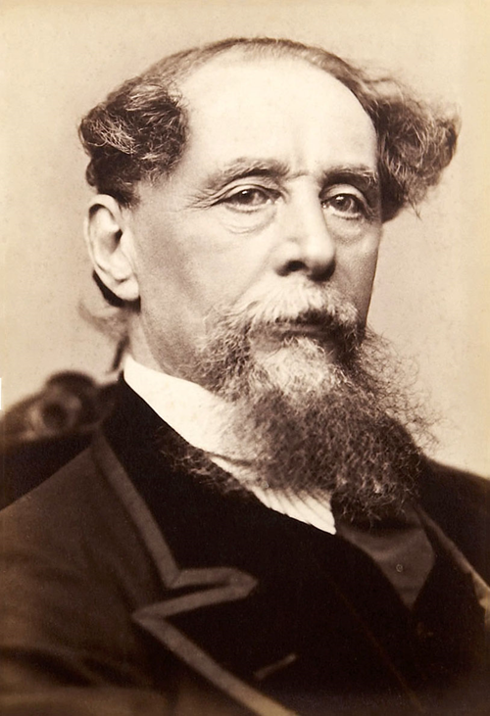
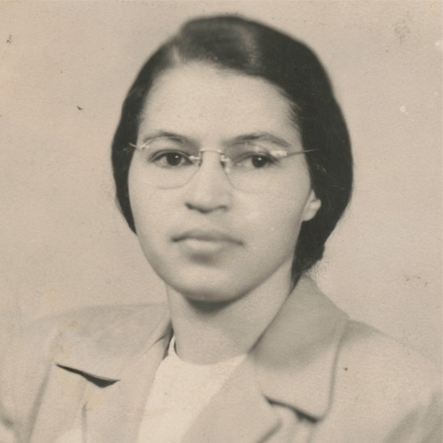
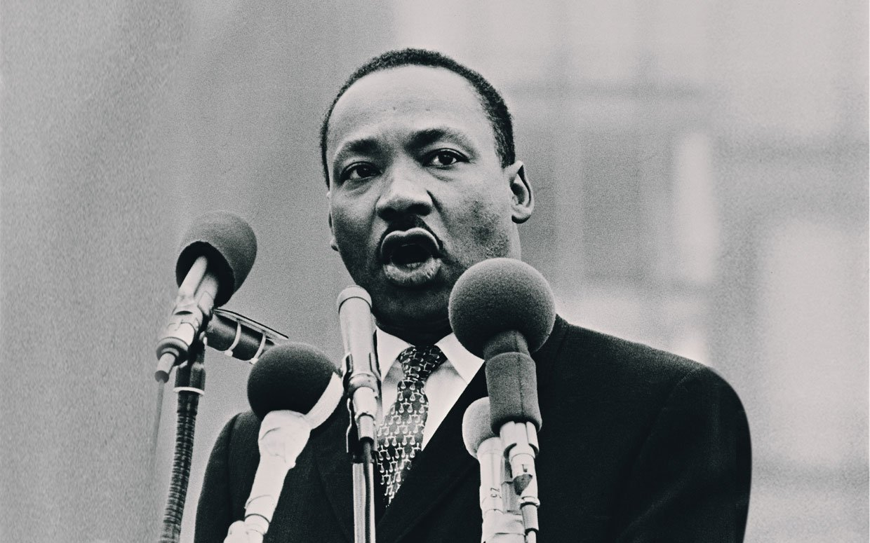
Ordinary People who did extraordinary things
Mahatma Gandhi
Harriet Tubman
Charles Dickens
Rosa Parks
Martin Luther King

Slide 8
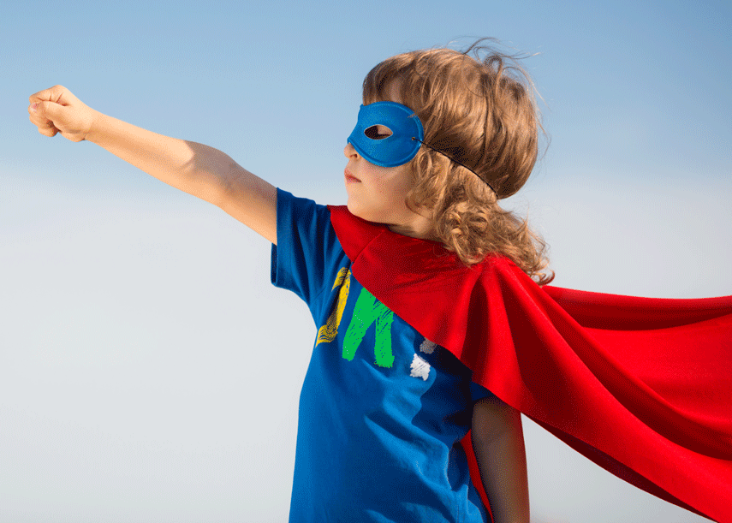
In John’s Gospel Jesus said to his disciples:
12 This is my commandment, That you love one another, as I have loved you.
13 Greater love hath no man than this, that a man lay down his life for his friends.
We are all ordinary people who can be extraordinary in our actions
What small sacrifices can we make for those we know, those we may meet in the future and those we will never meet?
How can you be a courageous advocate?

Slide 9
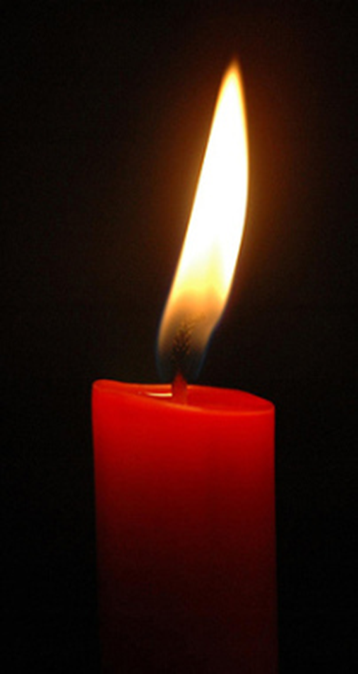
Dear God
We thank you that we live in a safe country where we can be ourselves without being hurt by others.
Today we especially remember people who suffered in the Holocaust, or have been hurt by others just because they are hated for being themselves.
We pray that they may feel brave because you love and care for them.
Please give us the courage to stand together when we know things are wrong.
We pray that people who are filled with hatred, especially against Jewish people, may have a change of heart and show kindness in the world instead.
We ask all this in Jesus’ name.
Amen

Slide 10

Hymn:
Make me a channel of your peace.

Slide 11
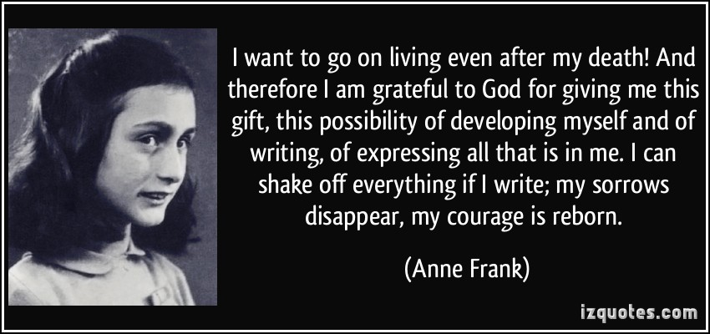
How can we help to keep the memory alive?
https://www.youtube.com/watch?v=MTXjrQAl-9w

