Slide 1
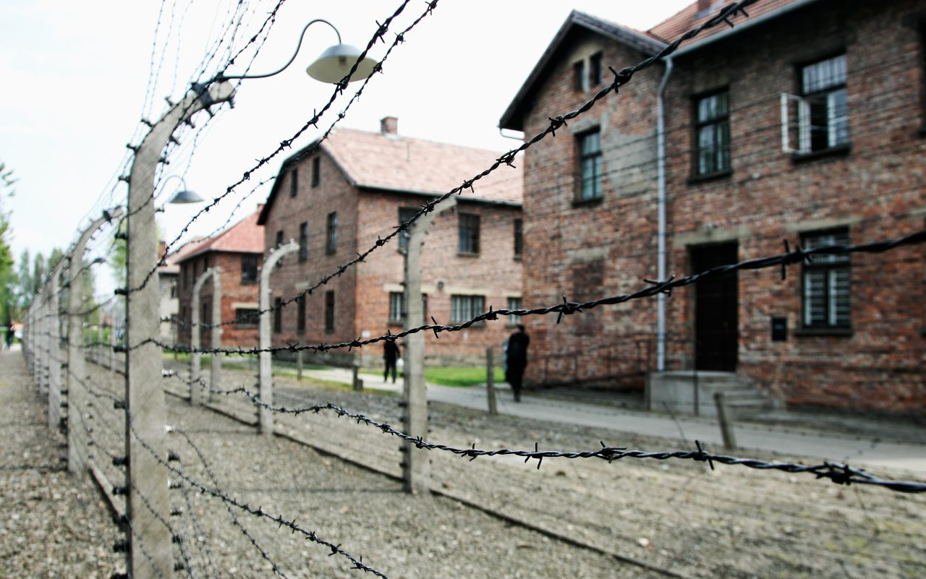



Responsibility
‘God created man in his own image.’ – Genesis 1:27
In John’s Gospel Jesus said to his disciples:
12 This is my commandment, That you love one another, as I have loved you.

Slide 2
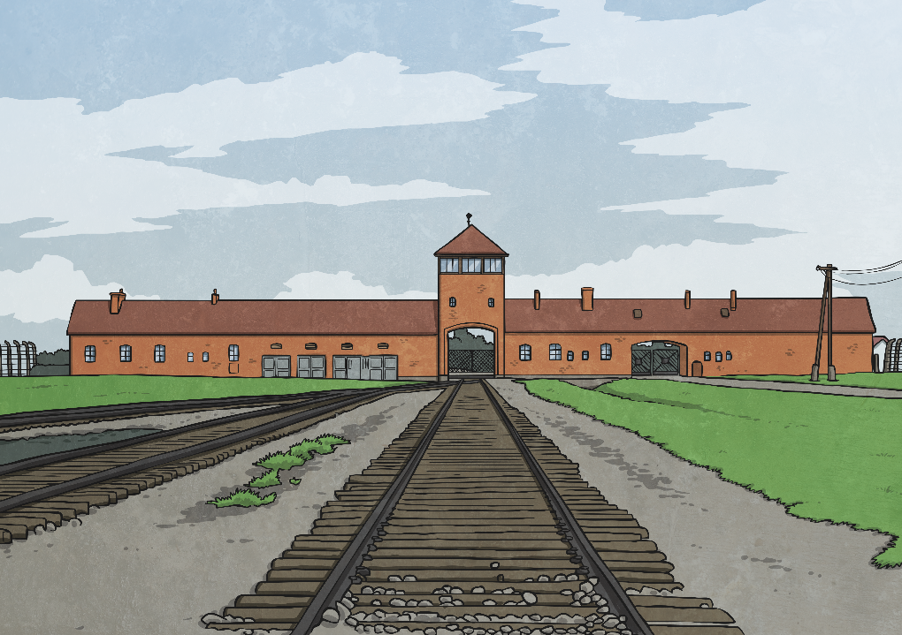
What Is Holocaust Memorial Day?
Holocaust Memorial Day is on 27th January every year. It is a day when we remember some specific events in the past when people were treated badly and some killed because of their race, their religion or the colour of their skin.
The Holocaust was when lots of Jewish people were killed because of their religion during World War 2.

Slide 3
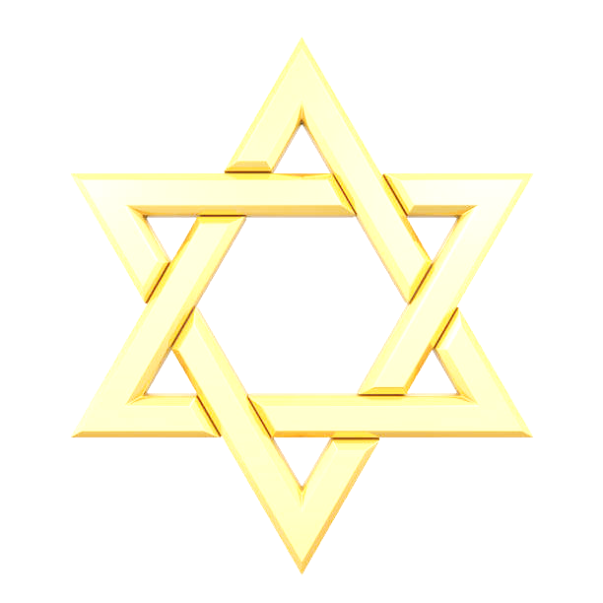
This year’s theme is:
Fragility of Freedom
Freedom is fragile and it cannot be taken for granted. Freedom means different things to different people.
Fragility of Freedom means that people can erode the freedom of the people they are targeting, demonstrating how fragile freedom is, they also restrict the freedoms of others around them, to prevent people from challenging or speaking freely.

Slide 4
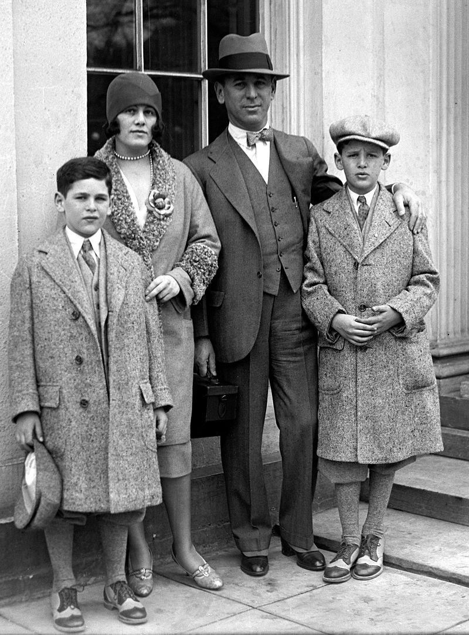
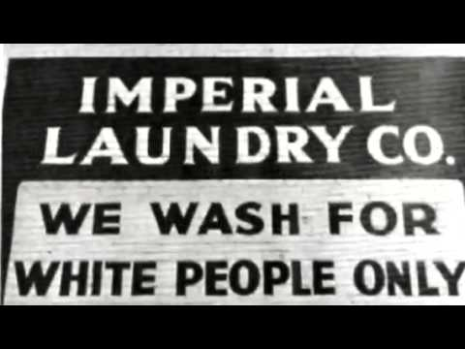
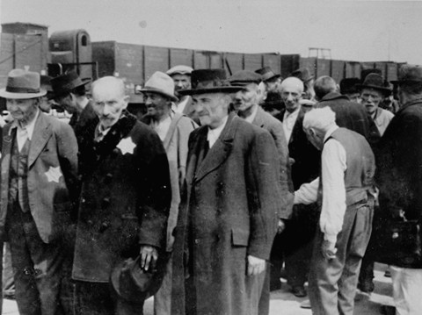
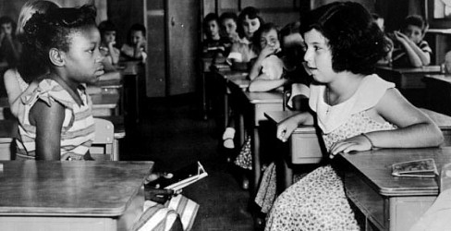
What Is Prejudice?
When you treat a group of people badly, and say mean and unfair things about them because of their race, religion or difference, this is called being prejudiced.
This is what happened during WW2 and to the Jews.
Why is this wrong?

Slide 5
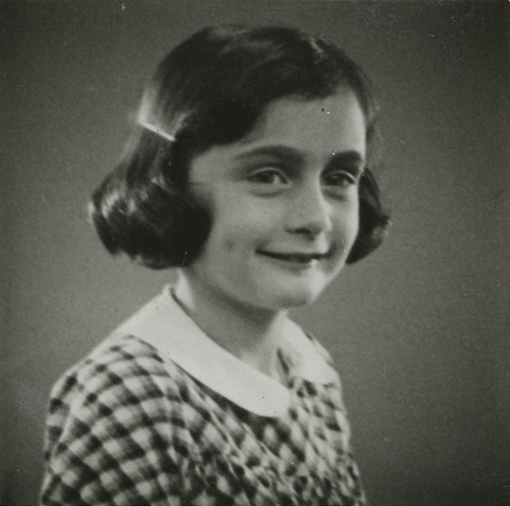
The Frank Family
Anne was born on 12th June 1929.
She had an older sister called Margot, a mother called Edith and a father, Otto. They were a Jewish family.
When Otto realised that life was going to get very difficult for Jewish people, he moved the family to Holland.
There was a young girl living in Frankfurt, Germany at that time.
Her name was Anne Frank.

Slide 6
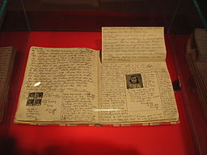
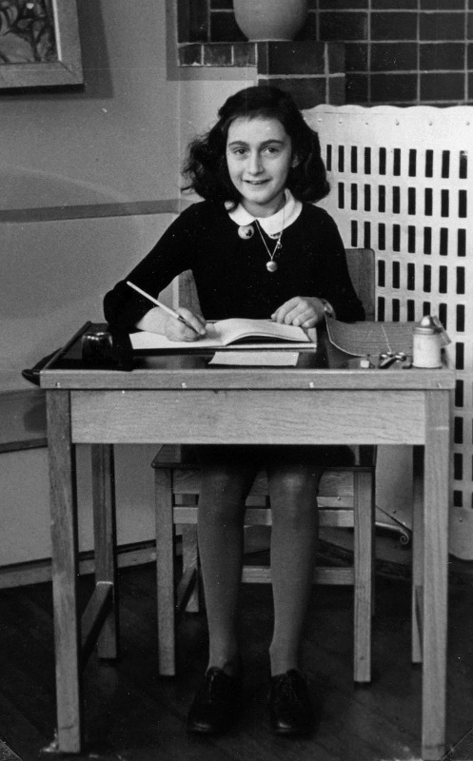
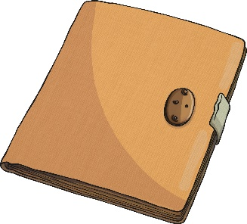
Kitty
Anne was an ordinary girl.
On her 13th birthday, Anne was given a diary.
She was very happy with this present, because she wanted to become a famous writer when she grew up.
Photo courtesy of By By Heather Cowper (@flickr.com) - granted under creative commons licence - attribution
Anne
click
here
Anne wrote, “I want the diary to be my friend, and I am going to call this friend, Kitty”.

Slide 7
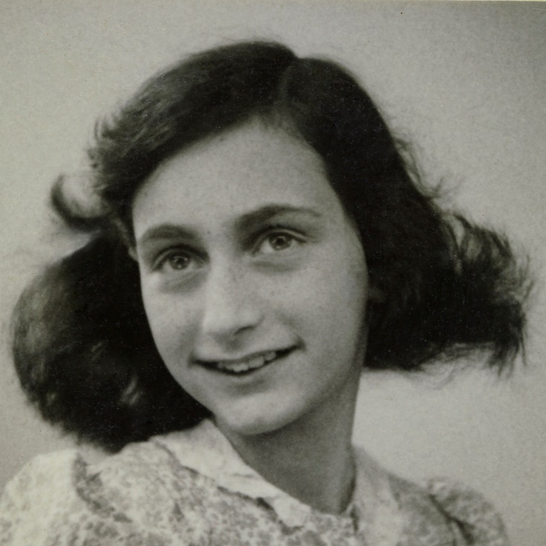
Missing Things
The people in the Annexe missed everyday things.
Because they had to be so quiet, Anne wrote a lot in her diary.
Anne wrote, “I long to ride a bike, dance, whistle, look at the world, feel young and know that I’m free”.
“Most of all I long to have a home of our own, to be able to move around freely and have someone help me with my homework again, at last. In other words, to go back to school!”
The last time Anne wrote in her diary was on the 1st August 1944.

Slide 8
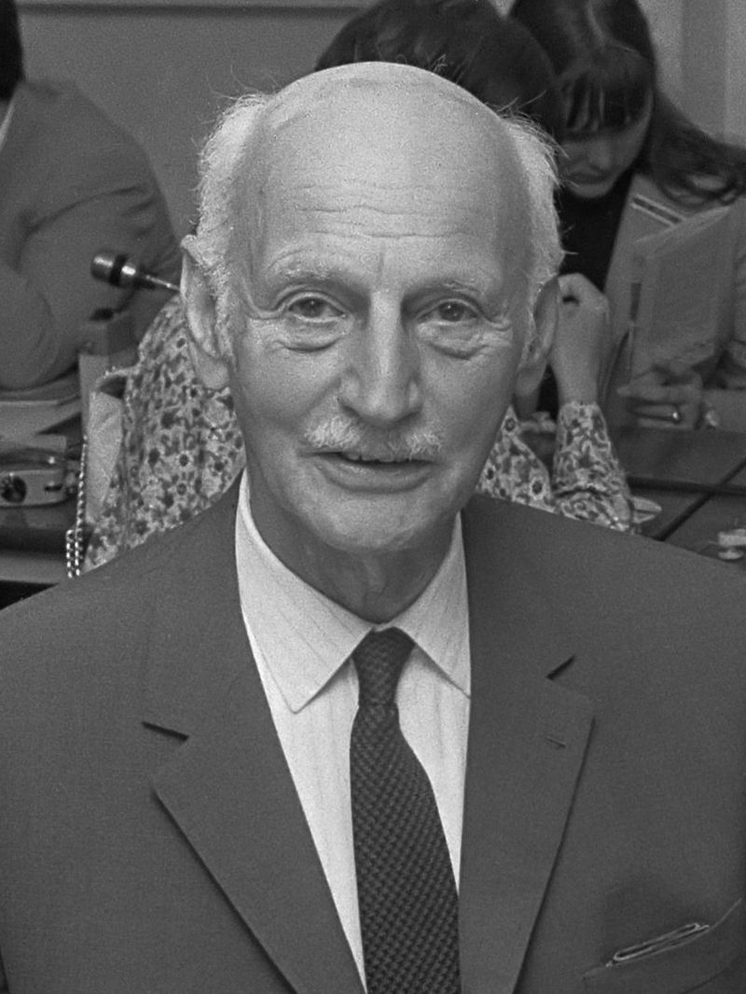
Anne’s Diary
Anne’s diary was found in the Annexe after they were arrested and was kept safe throughout the war.
The diary was given to Anne’s father, the only surviving member of the family and he decided to publish the diary in honour of his youngest daughter.
Photo courtesy of By Eric Koch / Anefo (@flickr.com) - granted under creative commons licence - attribution

Slide 9
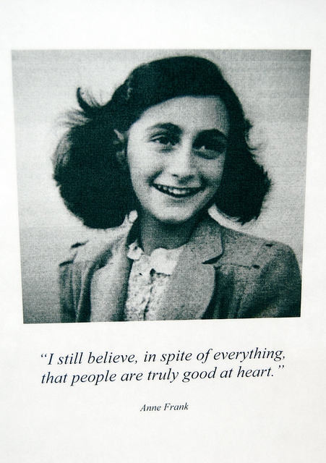
Anne’s Legacy
Anne’s book has been translated into 70 languages and has been read by millions of people.
Anne dreamed of becoming a famous writer, and now she is one, although she died without ever knowing it.
Her words have empowered young people and given them strength to stand up to all forms of prejudice, racism and discrimination. She is an inspiration to us all.
How can you use your words to do good in the world today?

Slide 10
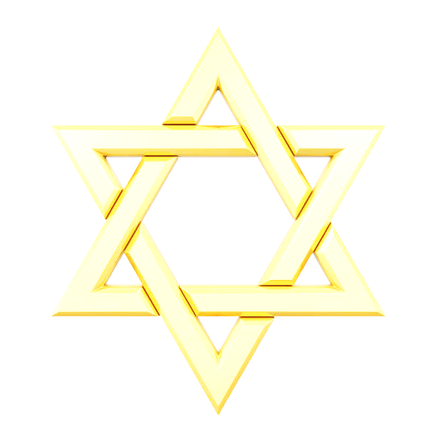
The Power of Words
How wonderful it is that nobody need wait a single moment before starting to improve the world.
I don’t think of all the misery but of the beauty that still remains.
What is done cannot be undone, but one can prevent it happening again.
We can all play our part in preventing this happening again. We can be kind towards everyone, even if they are not our special friend; we can try to understand how other people might be feeling; we can stand up for people; we can share these stories and ideas with other people through talking and writing.

Slide 11
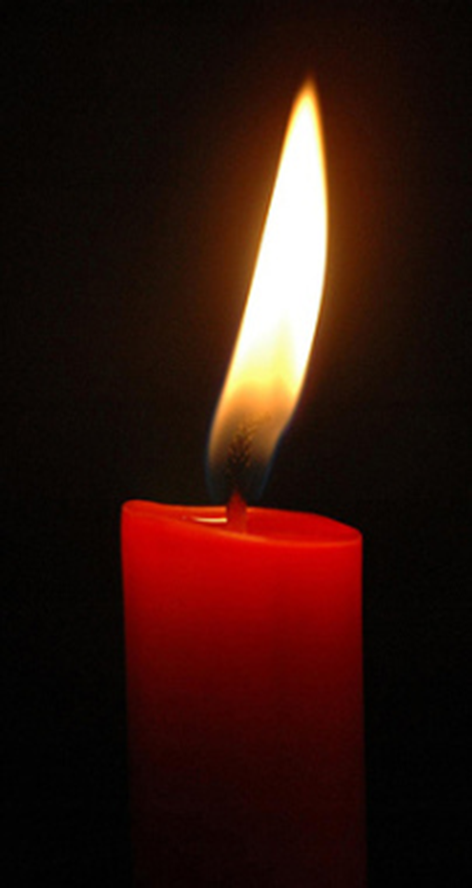
Dear God
We thank you that we live in a safe country where we can be ourselves without being hurt by others.
Today we especially remember people who suffered in the Holocaust, or have been hurt by others just because they are hated for being themselves.
We pray that they may feel brave because you love and care for them.
Please give us the courage to stand together when we know things are wrong.
We pray that people who are filled with hatred, especially against Jewish people, may have a change of heart and show kindness in the world instead.
We ask all this in Jesus’ name.
Amen https://www.youtube.com/watch?v=rCtPhSZS3CE

Slide 12

Hymn:
Everywhere around me

