Slide 1

Welcome to Year 3
Parents’ Briefing
Miss Bennison – Austen
Miss Fogarty– Conan Doyle
Miss Shore and Mrs Candy– Dickens
LSA Support: Mrs Squire, Mrs Bond and Mrs May
Music & French: Mrs Malone & Mrs Quick
Notes:
AS
This presentation will be on our school website so don’t worry too much about taking notes.

Slide 2
Communication
s.bennison@st-marys-jun.hants.sch.uk
c.fogarty@st-marys-jun.hants.sch.uk
e.candy@st-marys-jun.hants.sch.uk
ashore@st-marys-jun.hants.sch.uk
If there is something you need to discuss with your child’s teacher please do email and we will get back to you as soon as possible. We are also happy to make an appointment to see you in person.
We are also available at the end of the day to touch base quickly but please be mindful that the school gates are closed just after 3:30 and children should be escorted off site in a timely manner.
On our school website, you will find key dates on our events calendar.
Please make sure that you are registered with our ParentMail as key communication will also be sent via this.
Notes:
AS
Please do keep in touch- communication is key!
We will be having parents evening at the end of the half term where we will share how your children are settling in. We are still getting to know them! This evening there will be time for questions but tonight is not the time to catch up about individual children. The teachers have their diaries here if you wish to make an appointment.
Be mindful that the end of the day is not always the best time- we are trying to help children leave the site safely. Do ask for a phone call or email instead if needed.

Slide 3
What will we learn this year?
Notes:
SB

Slide 4

New Beginnings and settling in.
Sling, Spear or Sword?
Dahl, the Play and Me.
Romans: Ruthless or Remarkable?
What Shapes our Village?
River Deep, Mountain High
Notes:
SB
New Beginnings and settling in- PSHE led, School values, rights, resilience.
Sling Spear or Sword? is history led –Stone Age, bronze age Iron Age
Literacy around classic stories such as Roald Dahl. This term will include a year 3 performance!
Romans: History led, picking up from where we left off. History is taught chronologically.
Village study- answering the questions – is change a good thing in our village?
Rivers/ mountains: Geography led. What shapes our world.

Slide 5
What trips / enrichment do we provide in year 3?
Notes:
CF

Slide 6
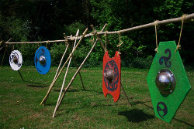
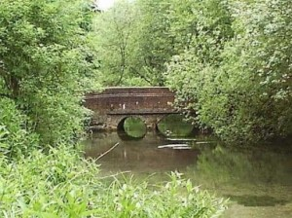
Iron Age Warrior day
Year 3 Performance
Roman Workshop (Openbox Theatre Company)
Church AoW
Music enrichment
Gilbert White Field Study Centre
QMC Science Centre
River Loddon Trip
Notes:
CF
You will be sent information in advance about all enrichment.
Iron Age Matt facilitates our day on our site. November.
Y3 show in the spring. Roald Dahl themed!
Drama day around the Romans- we dress up!
Church AoW termly. You are very welcome to attend these.
Anvil visit to watch the orchestra- TBC
Gilbert White- geography link- mapping.
QMC science centre- states of matter. Aspirations!
River lodden trip- river deep, mountain high!
DBS

Slide 7
How will homework be organised?
Notes:
LB

Slide 8

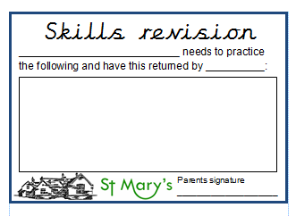
Scheduled on a Friday and due in on the following Thursday.
Home work will be set on Google
Classroom- Watch and learn!
Skills cards (on a needs basis) will be given to children throughout the week if necessary.
Please do not labour over homework. If there is a problem, stop and see your child’s teacher. Communication is vital and reading should always take priority.
Learning platforms that we use for homework are Times Tables Rock Stars & Anton. Log ons for this will be in your child’s reading record by the end of the week.
Notes:
LC
Due on a Thursday and sent home on a Friday.
NB some homework will also be set on Anton & TTRS- a primary school resource available online with unique logins for your child. DO NOT CHANGE PASSWORDS.
Spellings are sent home (10 a week) a mixture of spellings from the spelling rule we will be focussing on the following week and 3 words from the Y3/Y4 statutory list. SEND special words for some children.
Should I be helping my child with their homework? Please do help encourage your child to complete their homework but allow them space to try it on their own too and do not worry if they make mistakes! Break it into small times of doing it. Reading is the priority.

Slide 9
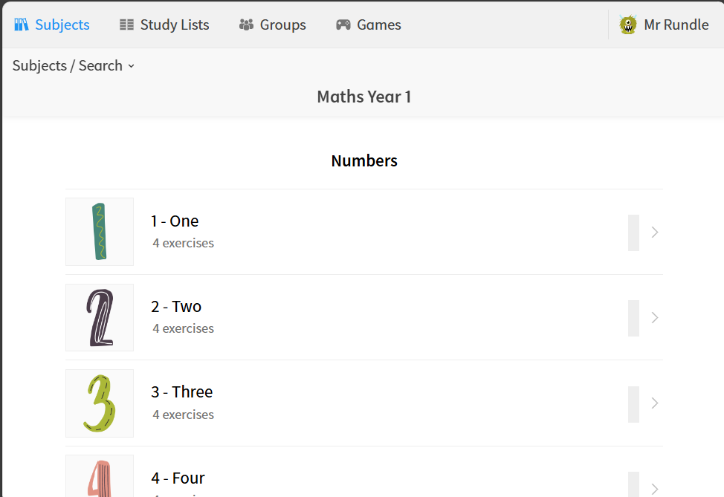
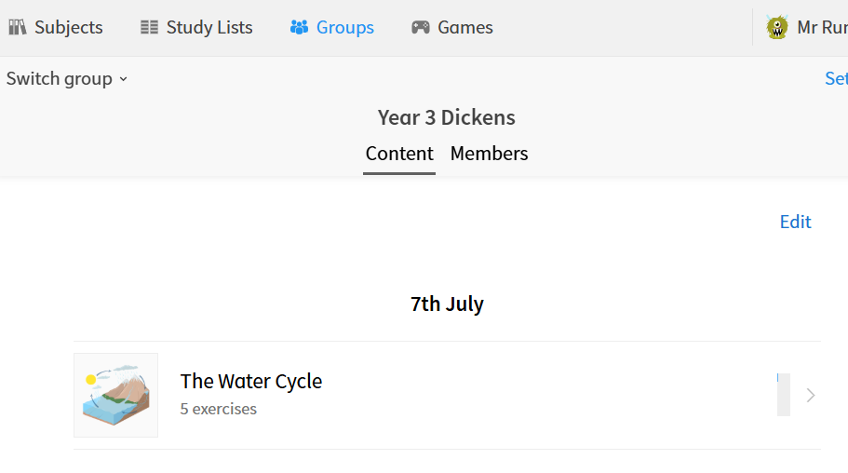
Log on to Anton anytime you like.
There are different places you can go for learning.
It is all helpful & there are “hints” too.
Home learning is set in the “groups” section tab & looks a bit like this:
Notes:
LC
This is what ANTON looks like.
Should I be helping my child with their homework? Please do help encourage your child to complete their homework but allow them space to try it on their own too and do not worry if they make mistakes! Break it into small times. Reading is the priority!

Slide 10
Online safety advice
https://www.youtube.com/watch?v=h_xwJ5u9I8o
  InternetMatters.org
  – because children deserve a safe digital world
  ChildNet.com
  - Helping make the internet a great and safe place for children and young people
  CommonSenseMedia.org
  - Ratings and reviews parents trust
  8-10s | CEOP Education
  - (ceopeducation.co.uk/8_10/) – for children to learn online but take a look yourself first
Notes:
SB
Any children out for the smartphone free video.
We are living in a digital world and as the homework is going to be online, here are some links to helpful websites around online safety.

Slide 11
How often should I read with my child?
Notes:
AS

Slide 12

Reading is the largest predictor of future success.
We recommend that you read with your child 3- 5 times a week.
Reading should always take priority over any other homework task.
To start with, we will have no
‘free readers’.
Notes:
3- 5 times a week
Books to come home over the next week.
Reading with your child is the number 1 way to help your child develop as a learner. The skill of reading is not just decoding the words. Reading is also about so many life skills, like inferring what the characters are up to based upon the description of their actions. So, please read to your child. Read with your child their reading book. Read their reading book to them as well from time to time if it is dragging on a bit! Read, read, read, read, read! How much reading? We encourage you and your child / children to read at least 3 times a week together.
Reading records—If you are able to write a note in here each time you read, brilliant. If you simply date and initial it that keeps things simple. So, please ensure you read, that is the number 1 priority. The reading record is helpful but not essential.
We encourage and train the children to record their reading as well as they gain more confidence.
The most important thing is that they are heard by an adult at home. Please do let your child’s teacher know should there be any major concerns regarding this.
More confident can write in reading record –
Parents can write about tricky words – fluency – decoding and clarification of unknown words but it does not have to be onerous

Slide 13
Your child will come home with 2 books. One reading book to help accelerate their reading and one library book of their choice.
We would like the children to primarily focus on their reading book. The library book may need parental support to access.
Notes:
We have a big library! Although there are books specifically for y5 and 6, it can still be difficult to chose the right level of book.

Slide 14
Supporting your child’s emotional wellbeing

Slide 15

Happy child = a successful learner
HeartSmart!
Heartsmart is an exciting programme which
connects all of our school values, RSHE and
wellbeing. Used at OBIS as well.
Encouraging open and positive mindsets.
Relaxation / Mindfulness after lunch
Chatter Matter
Circle Time
Notes:
LB

Slide 16
Additional Information
Notes:
AS

Slide 17
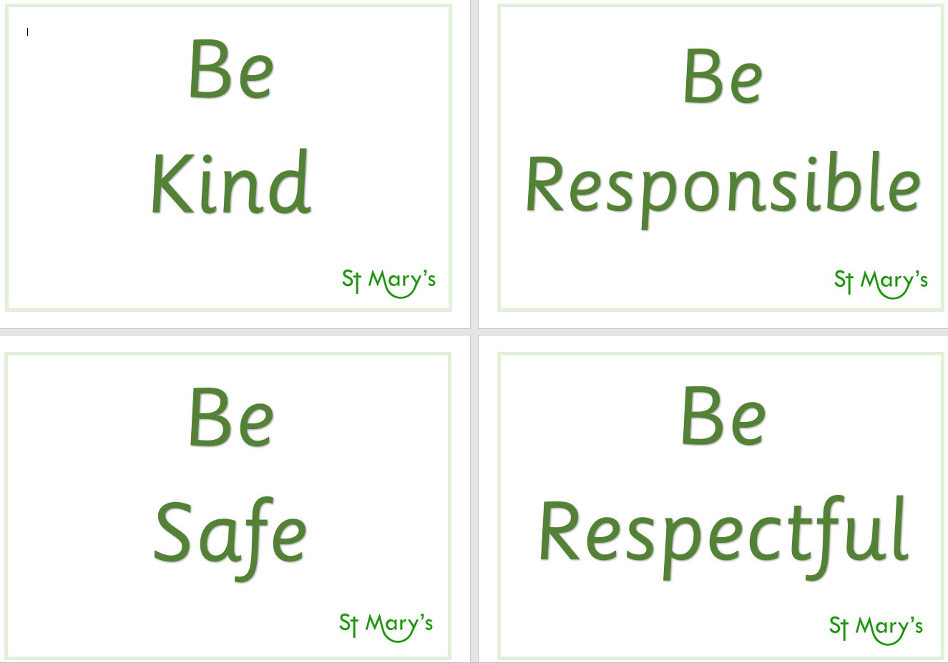

Behaviour
Positive – 4 rules & 3 values
Stamps- individual
Class points- whole
Turn it around & reflection
Notes:
Stamps may be given out for work, showing our school values etc. The stamp cards are in the back of the reading records so must be in school every day. Once they have filled their stamp chart, they will go to Mrs Lilywhite’s office for a reward.
Class points are given out for whole class achievements and they then earn a class treat once they reach 100 points.
Turn it around is used when we have to speak to a child more than once about their behavior. If the child is put on the turn it around, the have a chance to come off before the next natural break. If the behavior continues, the child completes a reflection form which is sent home and is expected to be signed and sent back to school the following day.

Slide 18
Parent helpers
Accompany us on class trips/ walks to the church/ reading.
Please arrange DBS (previously CRB)
Other reminders
A healthy snack for break time and a water bottle.
P.E. kit to be worn on a Tuesday (indoor) and a Friday (outdoor).
Jewellery – We are unable to remove earrings. Please ensure your child is able to do so independently, does not wear them at all on a PE day or alternatively they will need to bring earring tape into school.
Named uniform.
Fidgets!
Reading records and books to be brought in every day.
Notes:
We always need parent helpers!
Healthy snack- nothing wrapped. We do not provide fruit in the junior school (unlike the infants).
We have a lot of unnamed uniform currently, especially trousers and jumpers!
We will provide fidgets in school. Children should not be bringing anything like this unless a conversation has been had with the class teacher/SLT in advance.

Slide 19

Thank you for listening!
Any questions?

