Slide 1
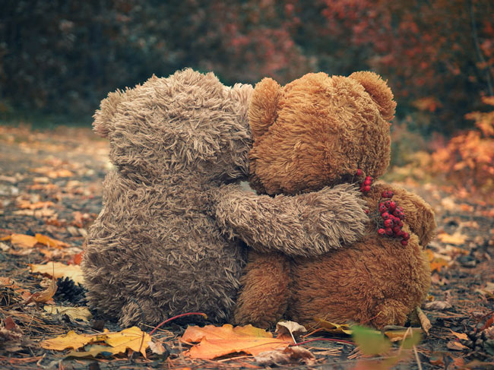

Compassion
Romans 8
United Nations Rights of the Child: Article 14 – Every child has the right to think and believe what they want and to practise their religion. We have the responsibility to respect the beliefs of others

Slide 2

How can we continue support each other if we can’t hug?

Slide 3
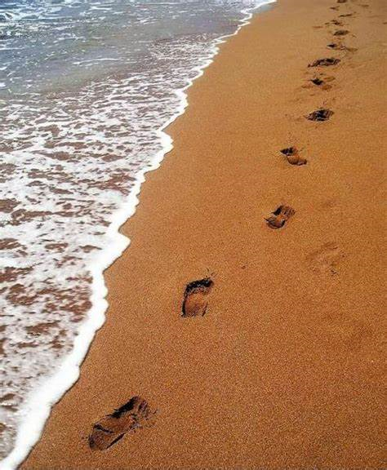
One night I dreamed a dream.
As I was walking along the beach with my Lord.
Across the dark sky flashed scenes from my life.
For each scene, I noticed two sets of footprints in the sand,
One belonging to me and one to my Lord.
After the last scene of my life flashed before me,
I looked back at the footprints in the sand.
I noticed that at many times along the path of my life,
especially at the very lowest and saddest times,
there was only one set of footprints.
This really troubled me, so I asked the Lord about it.
"Lord, you said once I decided to follow you,
You'd walk with me all the way.
But I noticed that during the saddest and most troublesome times of my life,
there was only one set of footprints.
I don't understand why, when I needed You the most, You would leave me."
He whispered, "My precious child, I love you and will never leave you
Never, ever, during your trials and testings.
When you saw only one set of footprints,
It was then that I carried you."

Slide 4
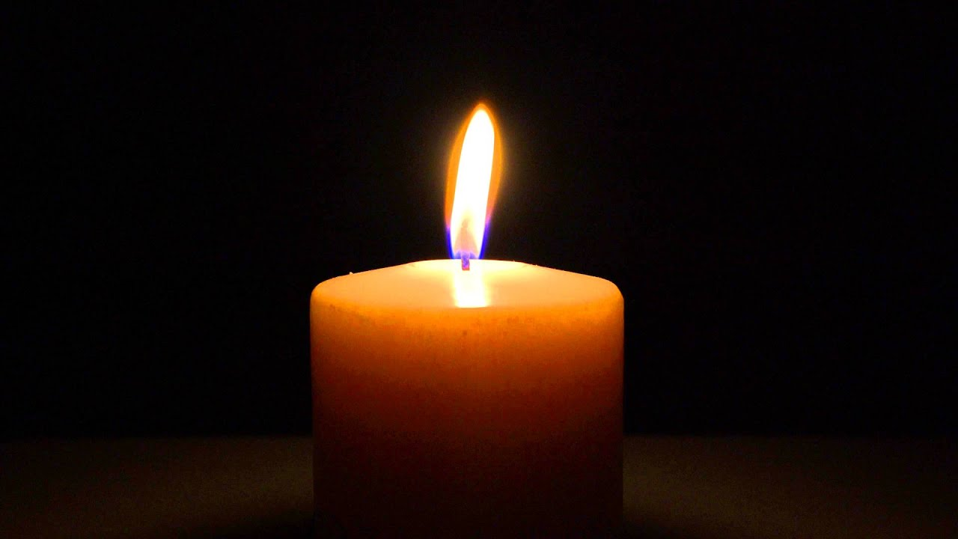
Dear Lord,
Please open my eyes.
Please let me see those around me who are in need of my compassion.
Help me to listen to them, to hear their needs.
Give me the heart to be interested in their troubles and provide for me the means to help them.
I want to be compassionate. I want to be like you.
I want to have that kind of heart for the world
that I will do all I can to be a voice for the oppressed, a giver to the poor, and encouragement for those in need.
Amen
Let us pray

