Slide 1

Compassion
Matthew 21: 1-11
United Nations Rights of the Child: Article 14 – Every child has the right to think and believe what they want and to practise their religion. We have the responsibility to respect the beliefs of others

Slide 2
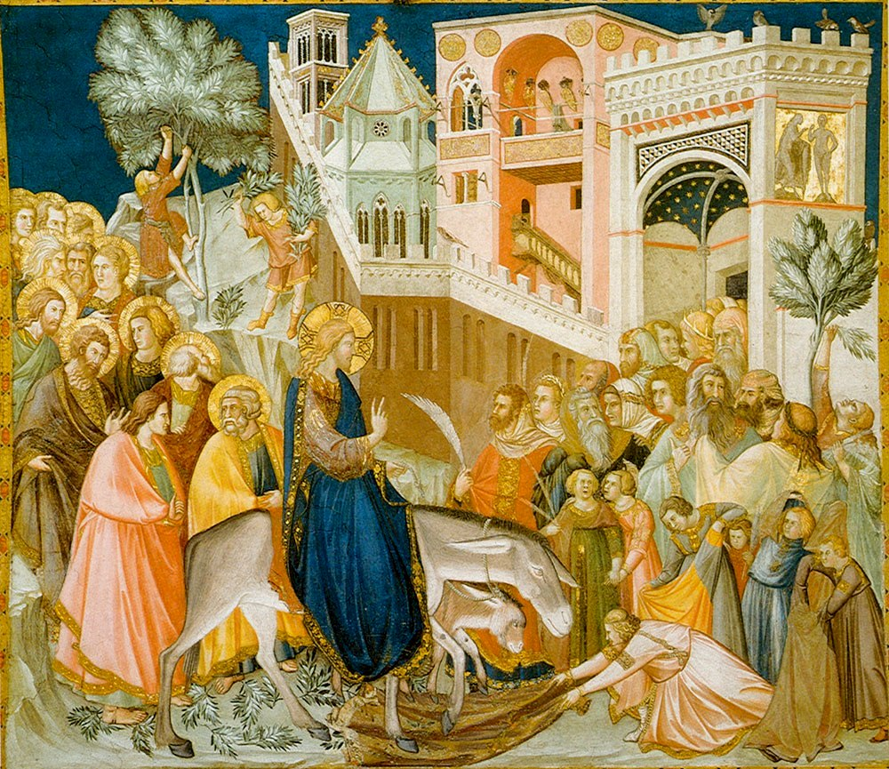
Next week we will be in what Christians refer to as Holy Week. This is the week before Easter, starting on Palm Sunday.
This coming Sunday, 5th April, is Palm Sunday. Palm Sunday commemorates the entrance of Jesus into Jerusalem (Matthew 21:1–9), when palm branches were placed in his path, before his arrest on Holy Thursday and his crucifixion on Good Friday. It marks the beginning of Holy Week, the final week of Lent.
Holy week is a time where we can reflect on the compassion Jesus showed to others through out his life and in the days and hours leading up to the crucifixion.

Slide 3
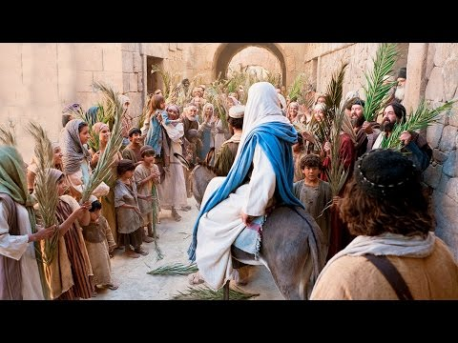
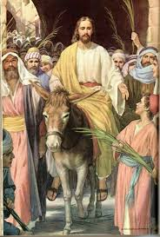
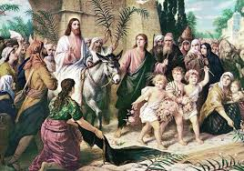
How do you think the different people in these pictures are feeling?

Slide 4
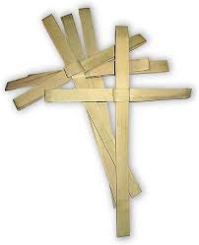
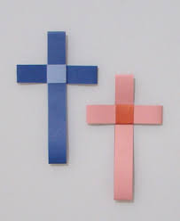
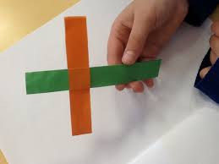
On Palm Sunday many churches pass out palm leaves. One way people have given more meaning to the palm leaf is to form it into the shape of a cross. These crosses are also given out in many churches around the work on Palm Sunday
Why not try to make you own paper palm crosses!
You can find some instructions here:
https://mommysnippets.com/paper-palm-crosses/

Slide 5

Time for reflection
Let’s spend a moment thinking about holy week. It started with a great parade: everyone was singing and shouting that Jesus was someone special, that he was the Son of God. However, later that week, the religious leaders who didn’t like Jesus spread rumours and made the crowds shout that they wanted Jesus dead. They created so much fuss that Jesus was killed by the Roman soldiers.
What they didn’t realize was that this was all part of God’s plan. Jesus would come back to life and the world would be changed.
Dear God,
Sometimes, we don’t understand it when difficult or sad things happen.
Help us to remember that you are always there for us.
Thank you that you always care.
Please help us to trust you.
Amen.

