Slide 1

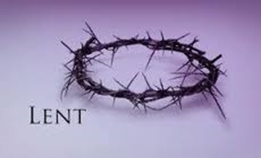
Compassion
United Nations Rights of the Child: Article 14 – Every child has the right to think and believe what they want and to practise their religion. We have the responsibility to respect the beliefs of others

Slide 2
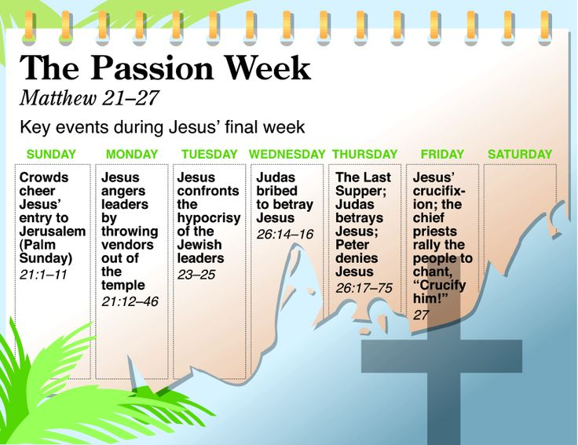
https://www.youtube.com/watch?v=Lu8_Zt5ir2o

Slide 3
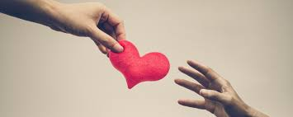
This week let us reflect on:
Those in our own lives who have helped and supported us
Those we hear about who are going above and beyond at this difficult time, especially those who work in the NHS
Those really special people we have learned about before e.g. Mother Theresa, Martin Luther King, Fr Maximilian Kolbe and many, many others

Slide 4
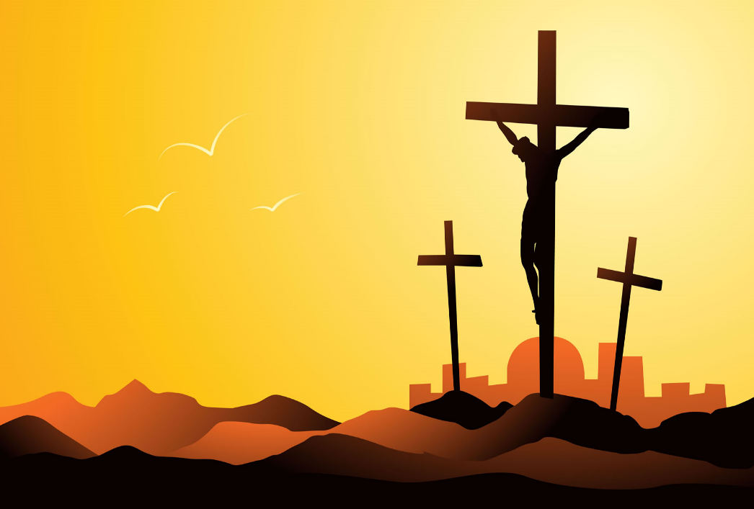
How can we show our appreciation to others and show them that we are thinking of them:
Make an Easter card and pop it through a letter box or drop it into the post
Make an extra phone or video call just to say thank you
Leave some flowers on someone’s doorstep
Make a donation in support of our NHS workers: gofundme.com/f/support-our-nhs-guardian-angels .

Slide 5
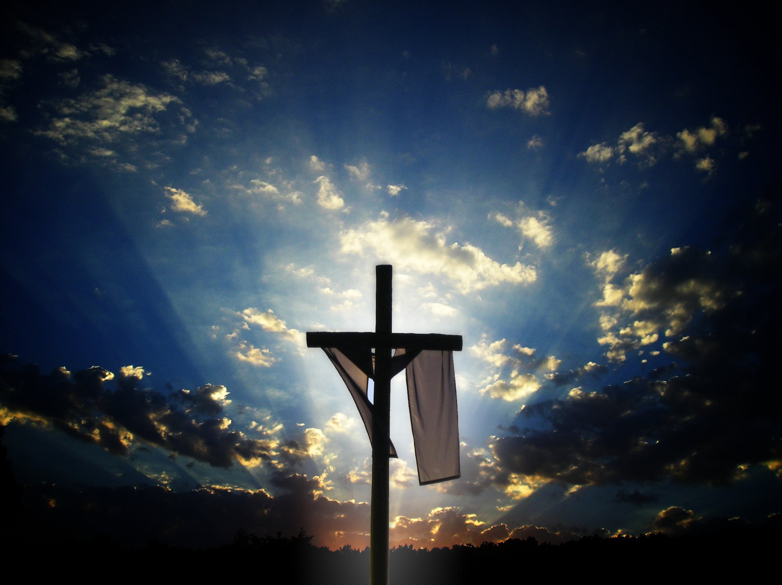
Let us pray
Dear Lord,
You taught us to love our neighbour,
and to care for those in need
as if we were caring for you.
In this time of anxiety, give us strength
to comfort the fearful, to tend the sick,
and to assure the isolated
of our love, and your love.
Amen.

