Slide 1
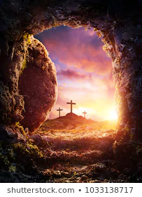
Hope
1 Peter 1:3
‘Praise be to the God and Father of our Lord Jesus Christ! In his great mercy he has given us new birth into a living hope through the resurrection of Jesus Christ from the dead.’
United Nations Rights of the Child:
UNCRC: 29 - Every child has the right to an education and the responsibility to work hard to realise their dreams for the future

Slide 2
On Easter Sunday Christians around the world would have remembered the resurrection of Jesus.
Christians believe Jesus’ death and resurrection – his coming back to life – mean that forgiveness, new life and the chance to start again are possible for everyone.

Slide 3
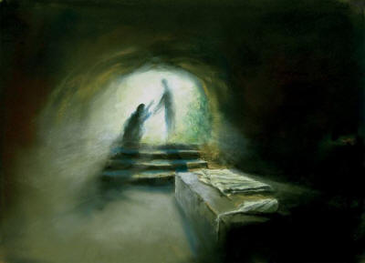
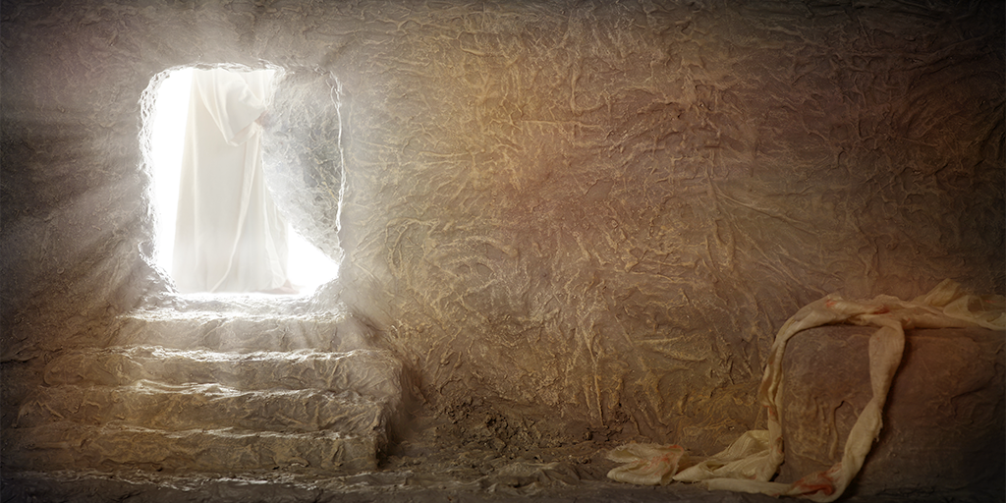
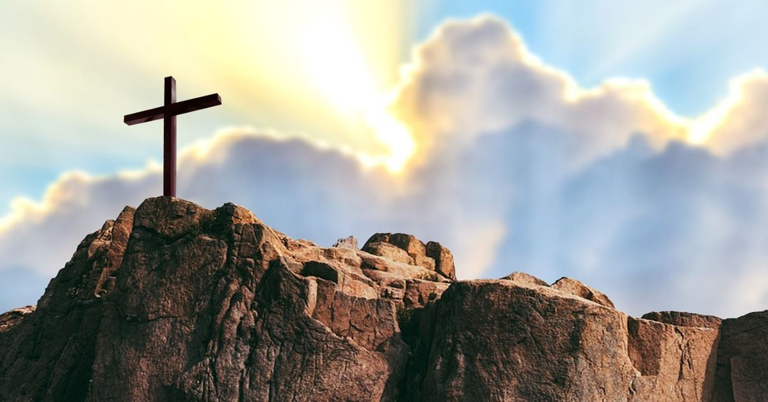
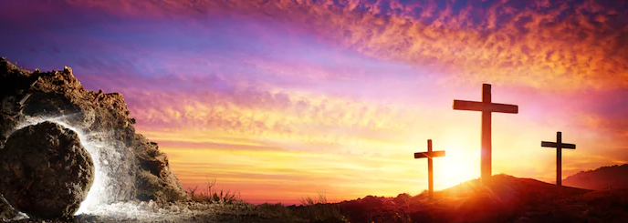
Are there any ways in which you need to make a new start?

Slide 4
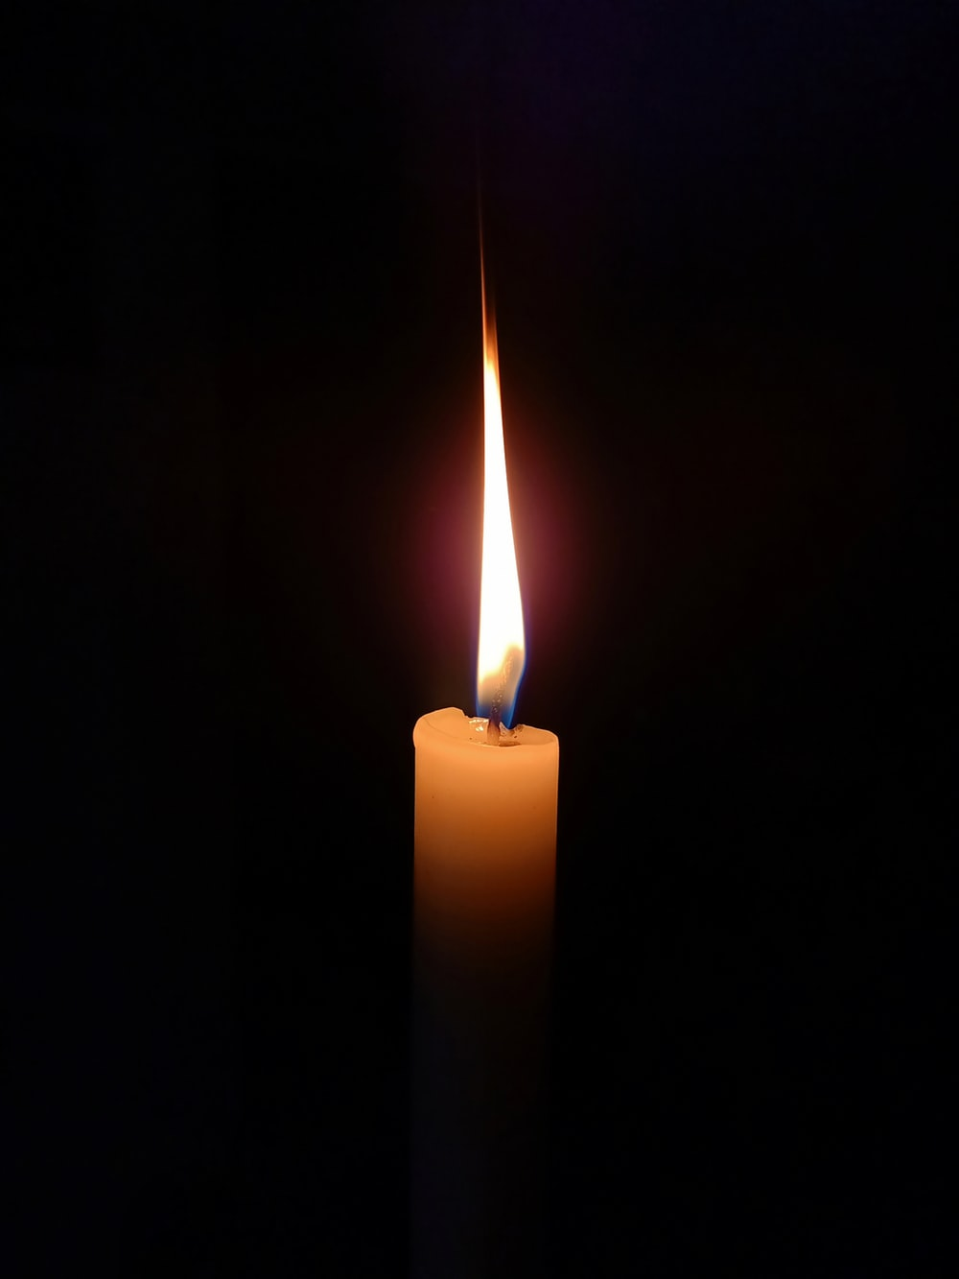
Jesus,
your resurrection changed the world.
Help us who have not seen it to trust and believe in the words of those who did.
As we tell others of our faith, open their hearts to see that you died, rose from the dead and will come again.
Amen.

