Slide 1
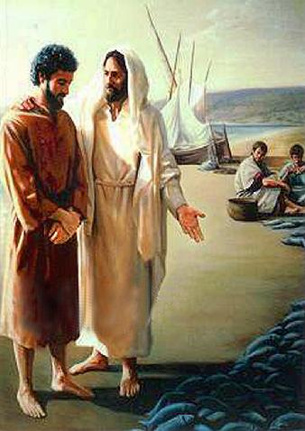
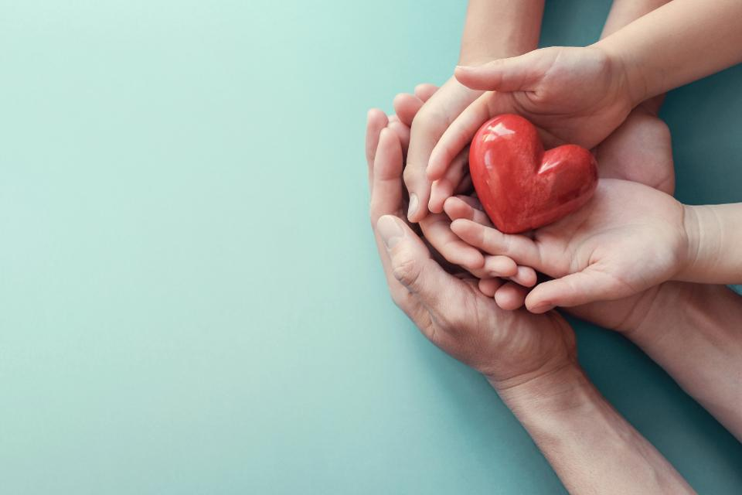
Compassion
John 21:15-29
UNCRC:1 – Everyone under the age of 18 has all the rights in the convention. We have the responsibility to respect the rights of others

Slide 2
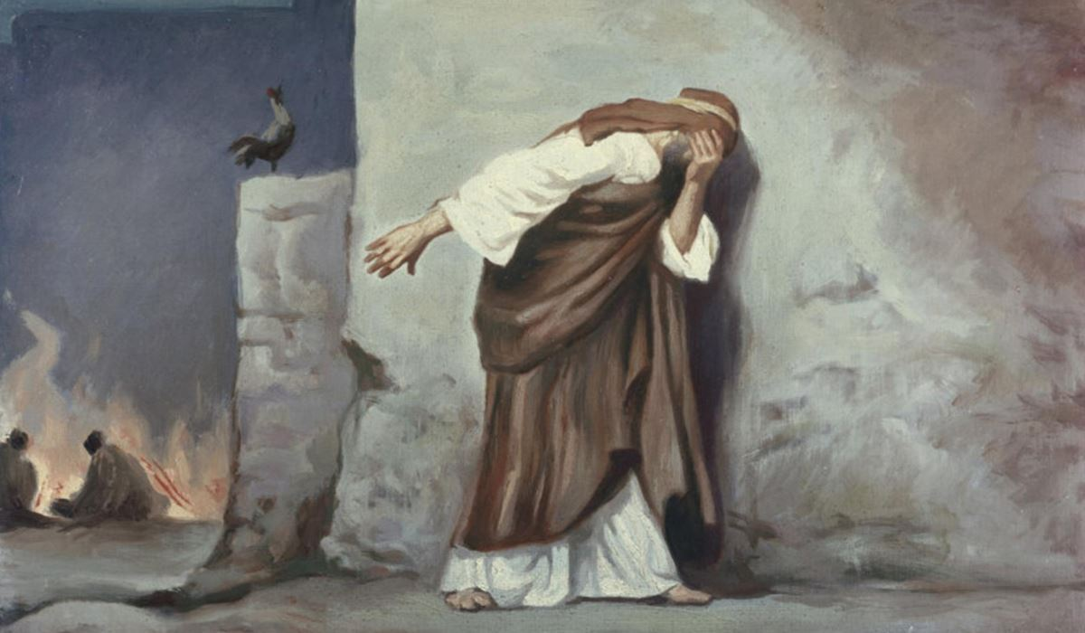
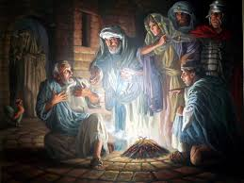
During the stories of Holy Week, we heard how Peter (one of Jesus’ disciples) denied knowing Jesus 3 times.
Why do you think Peter behaved as he did?
  Was he confused?
  Was he fearful of arrest?
  Was he fearful of the palace guards?
  Was scared?
How do you think Peter felt when he heard the cock crow and realised what he had done?
  Do you think he could ever be friends with Jesus again?

Slide 3
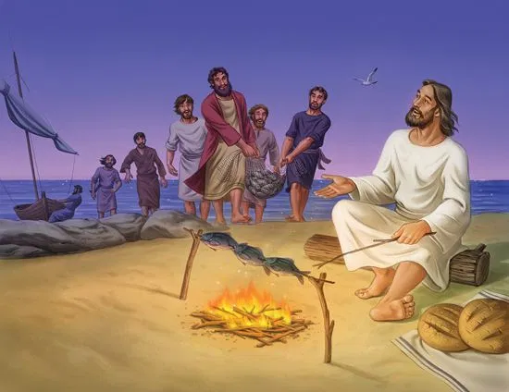
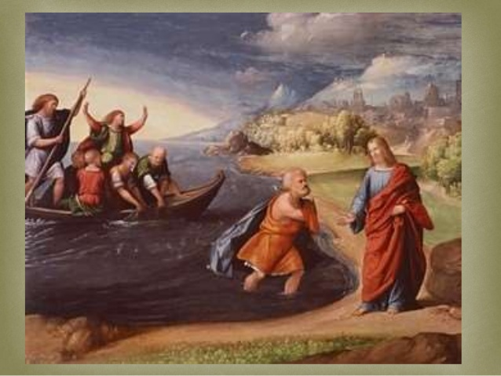
After Jesus rose from the dead, He came back and appeared to people several times. Peter had gone back to being a fisherman after Jesus rose from the dead, and he was out in his sailboat with James and John. They had fished all night and not had a single fish swim into their nets, and they were tired and hungry.
Jesus came by and told them to try putting their nets on the other side of the boat. When they did, they caught more fish than they could even hold! Peter realized that it was Jesus who was there on the shore, and he jumped out of the boat and swam as fast as he could to Him. Once there, Jesus built a campfire and cooked some fish for breakfast.
Then Jesus started talking to Peter and asked if Peter loved Him.
Jesus asked this three times, and three times Peter told Him he did love Him, and Jesus told him to “feed my sheep.” This meant that Jesus was giving Peter a very special job of taking care of people and working for the church. Jesus knew Peter would be good at this. He asked him three times probably because Peter had denied knowing him three times, and now he could make up for that and have a second chance.
God loves us and has special plans for us. Even when we make mistakes, He always forgives us and gives us start fresh!
How do you think Peter felt to be forgiven?
What special job was he given by Jesus?
Why did Jesus forgive him?
What did he mean when Jesus asked Peter to “feed my sheep?”
Who showed compassion in this story?

Slide 4

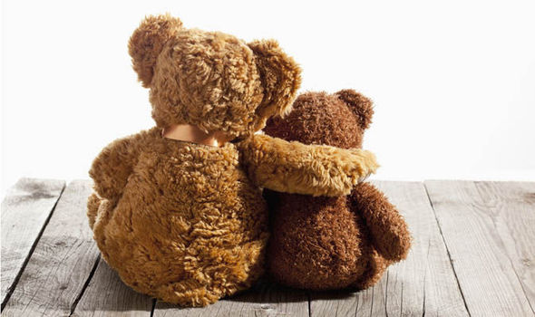
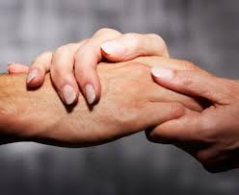
Who do you know that might need your compassion or forgiveness?
Who needs a fresh start?
How can you support your friends and family during difficult times?

Slide 5
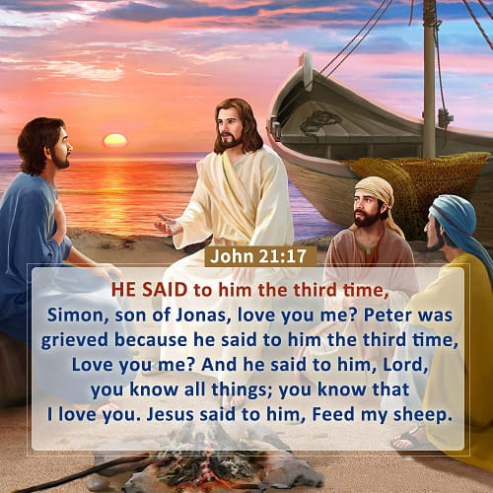
Dear God,
When we are frightened:
Please help us.
When we don't know what to do:
Please help us.
When we are sorry and want to make amends:
Please help us.
Please help us to forgive and show compassion to others.
Please help us to support each other in difficult times.
Amen.

