Slide 1

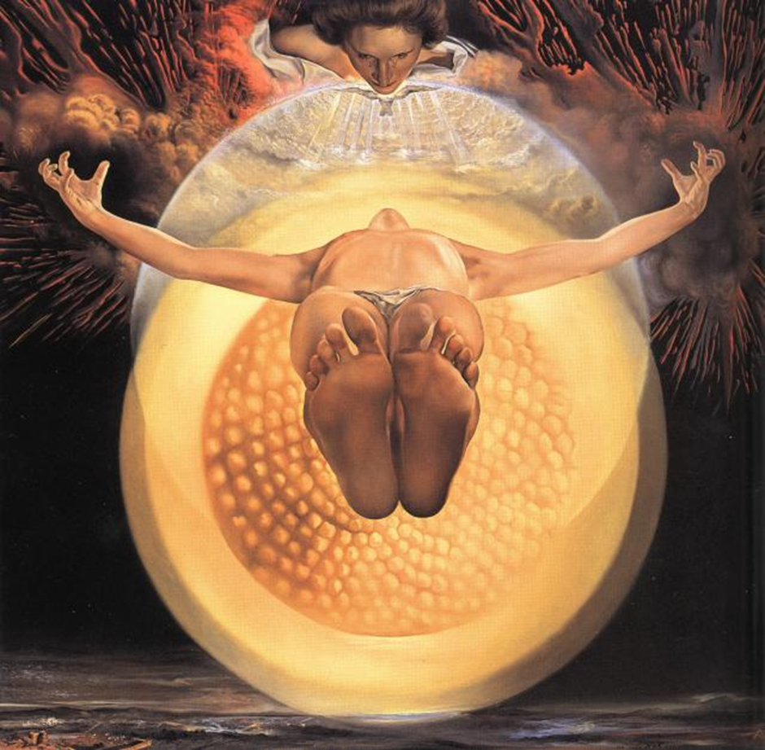
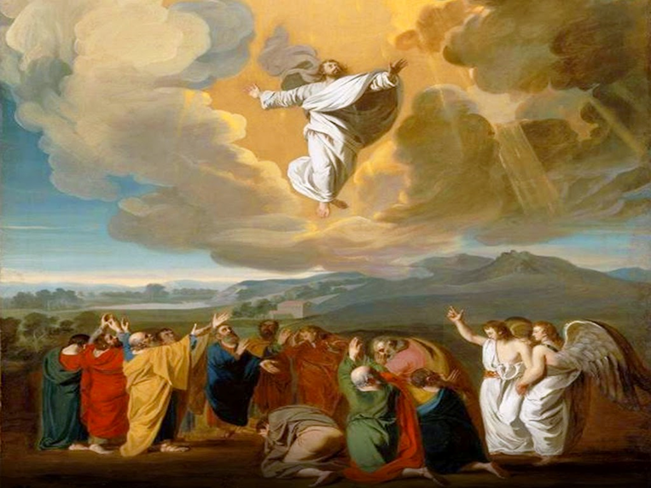
Bible reference Acts of the Apostles 1: 6-11
UNCRC Article 13: Children have the right to get and to share information, as long as the information is not damaging to them or to others.

Slide 2
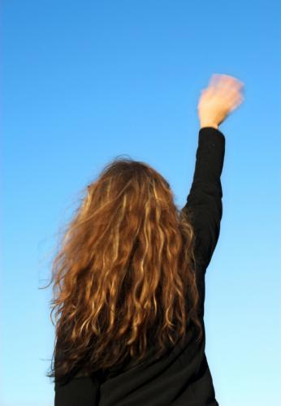
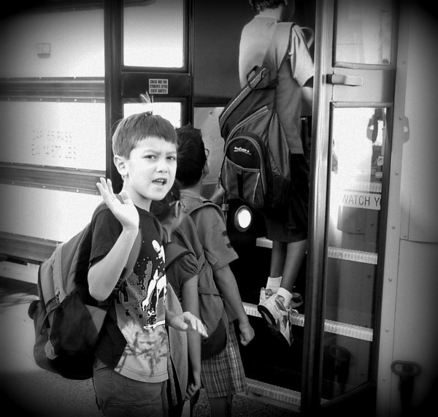
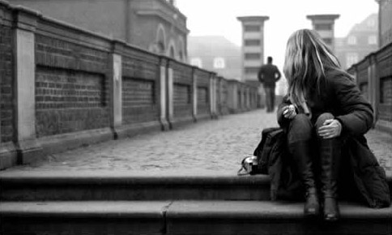
Notes:
Think about what you can see in each picture. What is happening? How does each person feel? What have they got in common?

Slide 3
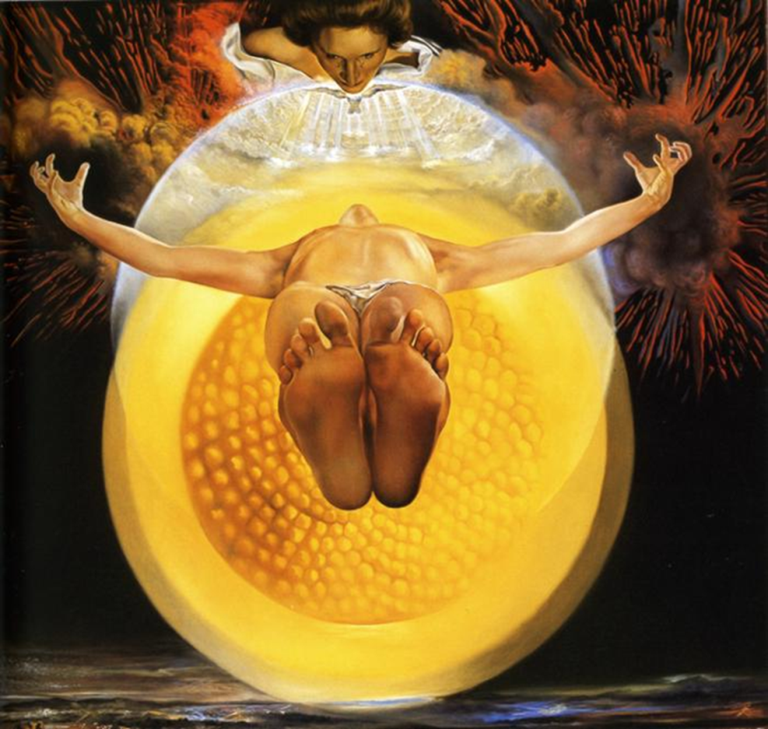
Notes:
Investigate this painting by Salvador Dali. What can you see? What do you think is happening in the painting?

Slide 4
Acts 1:6-11
When the apostles met together with Jesus, they asked him, “Lord, will you at this time give the Kingdom back to Israel?” Jesus said to them, “The times and occasions are set by my Father's own authority, and it is not for you to know when they will be. But when the Holy Spirit comes upon you, you will be filled with power, and you will be witnesses for me in Jerusalem, in all Judea and Samaria, and to the ends of the earth.” After saying this, he was taken up to heaven as they watched him, and a cloud hid him from their sight. They still had their eyes fixed on the sky as he went away, when two men dressed in white suddenly stood beside them and said, “Galileans, why are you standing there looking up at the sky? This Jesus, who was taken from you into heaven, will come back in the same way that you saw him go to heaven.”
Notes:
Read through the account of The Ascension together

Slide 5
Notes:
Having read the Bible story, relook at the painting. Now what can you see? What is happening? Where are the disciples? How do they feel?

Slide 6
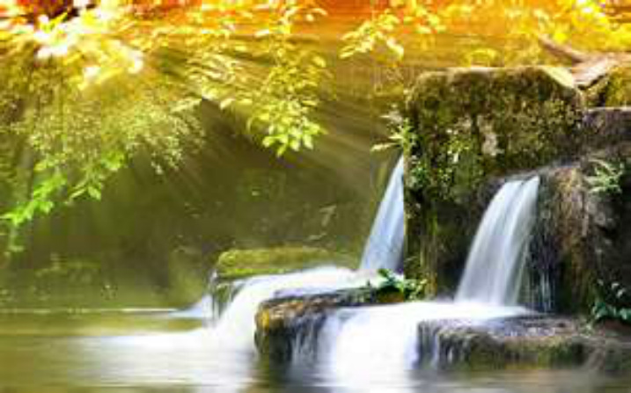
Reflection/prayer
I sat alone...
...but was not alone
for God was there around me,
In all created wonder surrounding me,
The sky, the earth, the water.

Slide 7
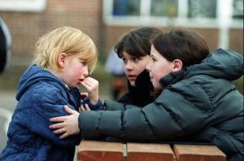
I sat alone...
...but was not alone
For Jesus was there beside me
In all His words and deeds,
Giving me hope and
An example of how to live.

Slide 8
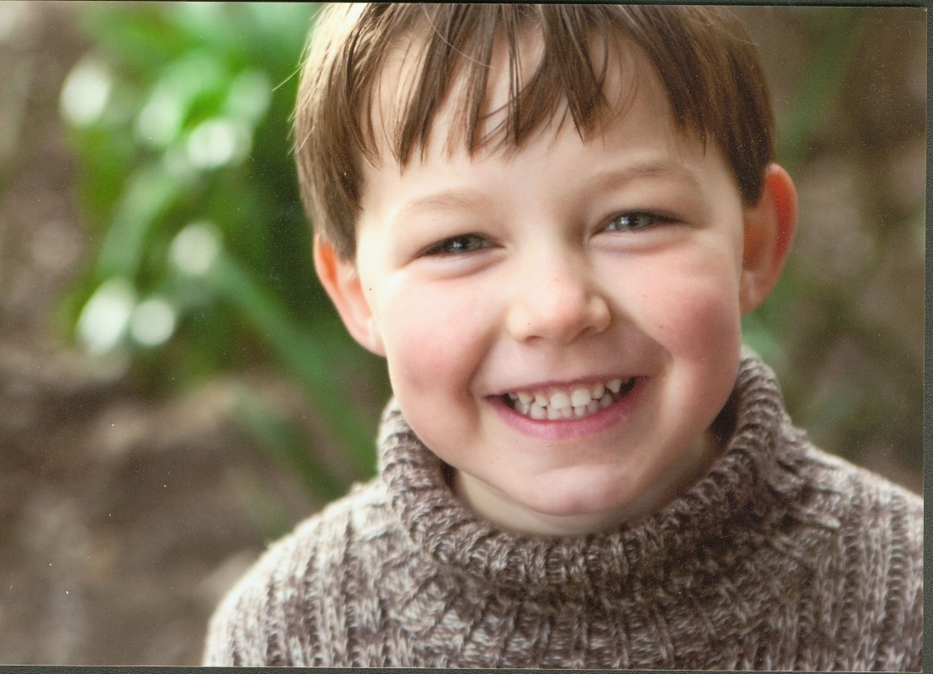
I sat alone...
... But was not alone
For I felt something within,
Life, love and joy of the Spirit
Deep inside me.

Slide 9

I embraced the God of all creation and
Thanked him for the world.
I embraced the human form of Jesus,
Who lived and died for me.
I embraced the Spirit within me and knew...
I had never been and would never be alone.
Amen

Slide 10
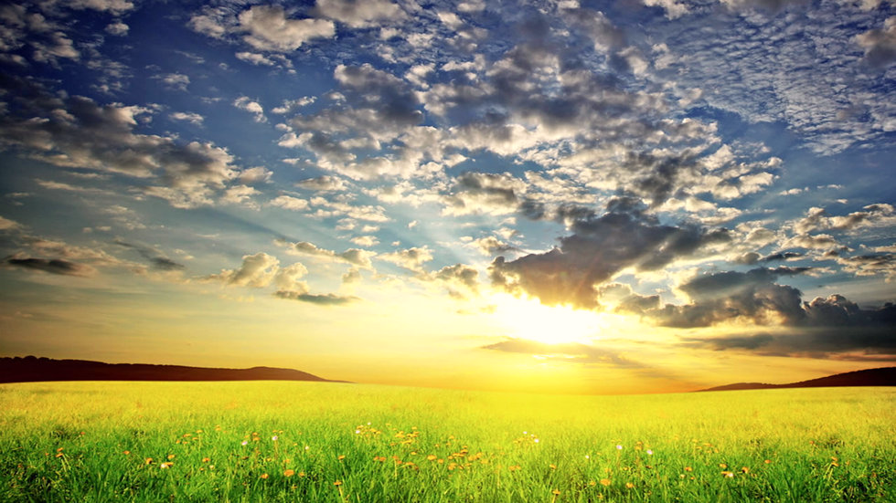
All human beings are naturally curious, but how often do we really look at the world around us?
On your next walk, take time to really look around you and appreciate the wonderful world we live in.
Perhaps you could take a photo to remind you and furthermore could you then send this photo on to someone you know who needs cheering up?
https://www.youtube.com/watch?v=CWzrABouyeE
Notes:
As you reflect on todays assembly, listen to the music and link about what you might see and capture during your walk

