Slide 1

One Family
Bible Reference:
Article 13 – Every child must be free to say what they think and to seek and receive all kinds of information, as long as it is within the law.
https://www.youtube.com/watch?v=H9owkOAXa70

Slide 2
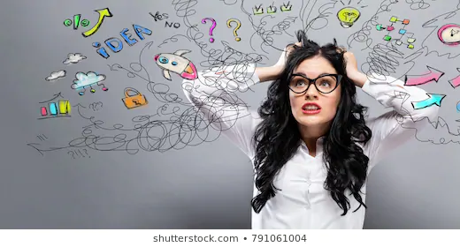
At times things can feel overwhelming, we concentrate on the negative and wonder if we can cope with it all.
Notes:
Discuss feelings. How might this make you react. We can become very self-centred and not think about how our actions can effect those around us. Let alone think about what we can do to make people feel better.

Slide 3
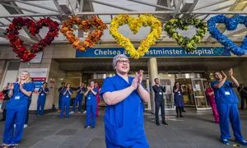
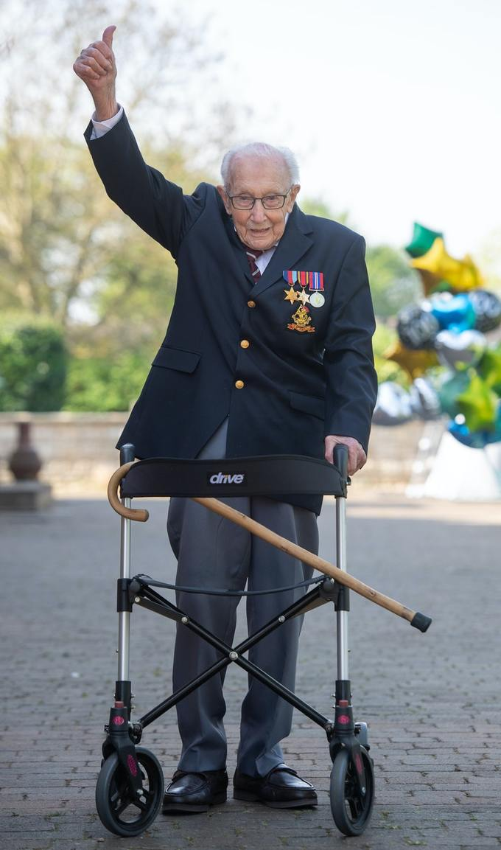
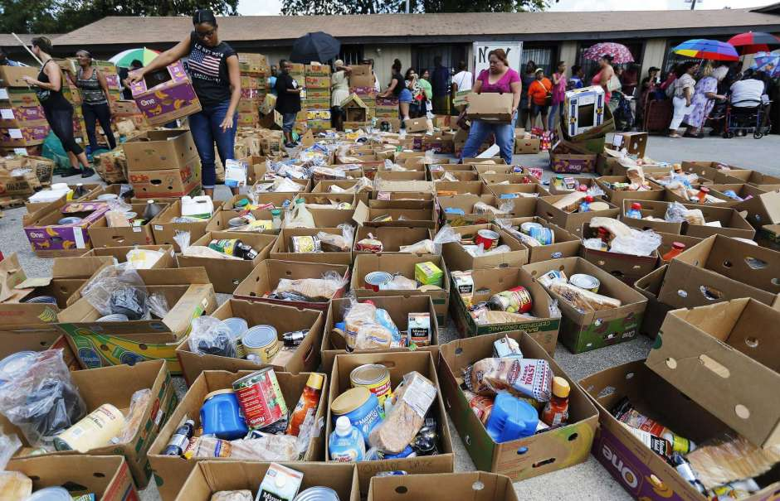
Clap for the NHS
Foodbanks
Inspirational fundraising
Notes:
Think about the things others have been doing for others during this time – how have these made you feel. I am sure that you can think of many other examples

Slide 4
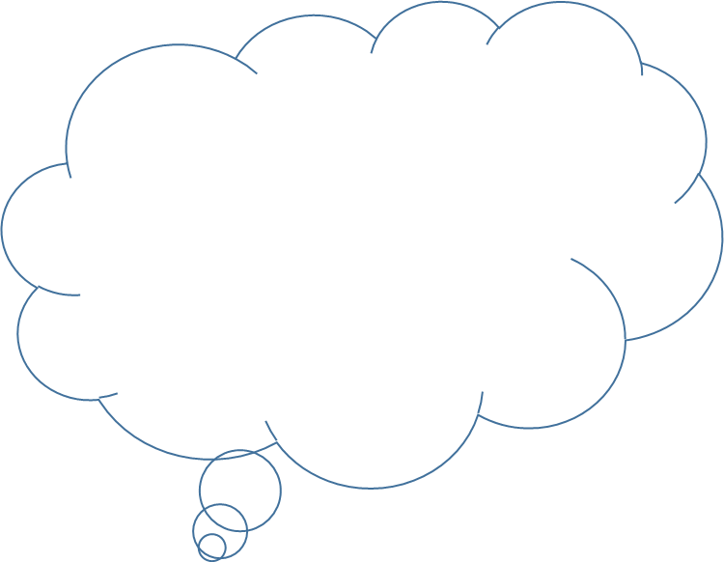
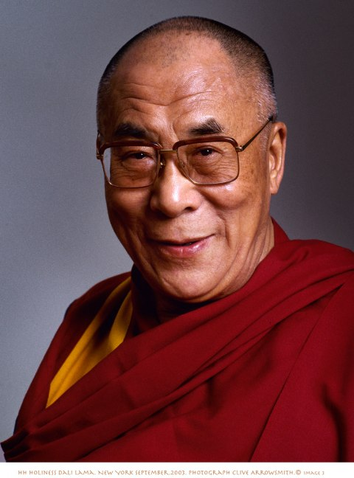

The Dalai Lama has often been described as the happiest person on earth. He has very few worldly possessions and spends almost all of his time in quiet meditation and prayer.
Happiness is not something ready made , it comes from our own actions
Smile if you want a smile from another face
Every day, think as you wake up, today I am fortunate to be alive, I have a precious human life, I am not going to waste it. I am going to use all my energies to develop myself, to expand my heart out to others
When we feel love and kindness toward others, it not only makes others feel loved and cared for, but it helps us also to develop inner happiness and peace
Notes:
Consider the opening statement – for many of this it doesn’t sound as if this is a way of life that would make us happy. Now consider some of the quotes. If you want to take this further look up 110quotes – Dalai Lama quotes on life, happiness and love

Slide 5
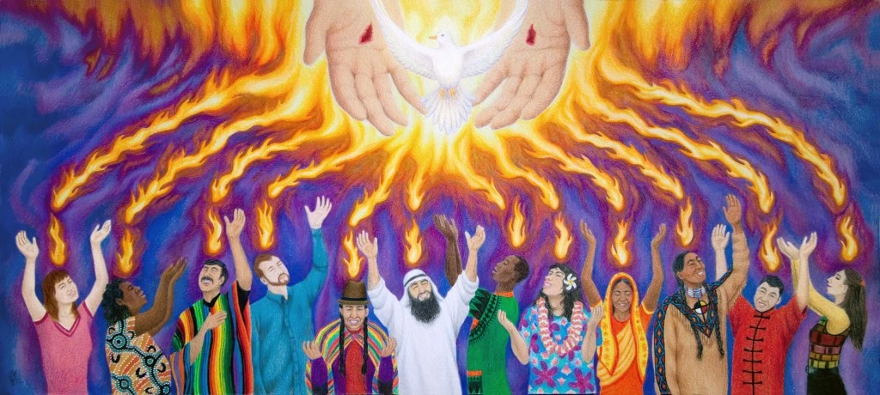
John: 14: 15-18
Before his ascension into heaven, Jesus told his disciples that he would ask the Father to give them another Advocate (someone to help and support them), the Holy Spirit, to be with them forever. He told them that he would not ‘be left as orphans’, without someone to love them and care for them and guide them.
We see this in a very visual way at Pentecost.
Notes:
You may want to look back at last week’s AoW which was about Pentecost

Slide 6

Let us reflect on our central value of One family – we can both gain strength from and give strength to others through our actions
Let us pray

Slide 7

While we listen to the song again, let us think about our Best Bit of yesterday and before we go home today let us share some of today’s
https://www.youtube.com/watch?v=H9owkOAXa70

