Slide 1


One Family
Bible Reference: Hebrews 13:16
‘and do not forget to do good and to share with others, for with such sacrifices God is pleased.’
Article 27: You should have the conditions you need for your physical,
mental, spiritual, moral and social development.

Slide 2
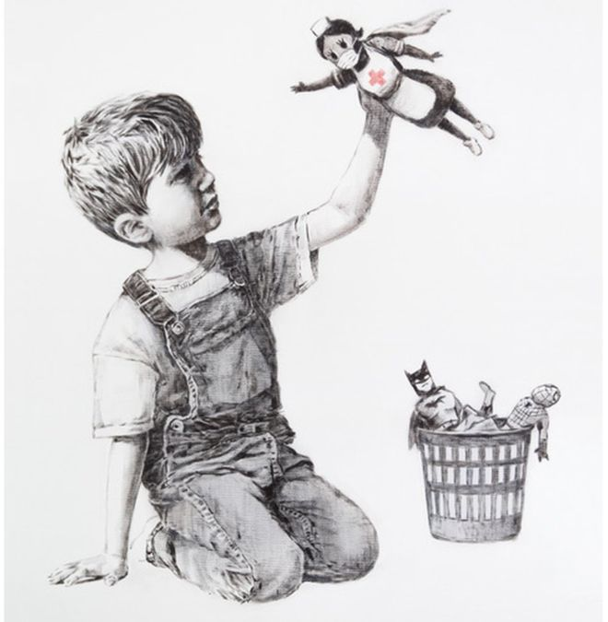
What do you see when you look at this picture?
Why do you think the artist has painted it?
Who do you think it was painted for?
Who is hiding in the basket?

Slide 3
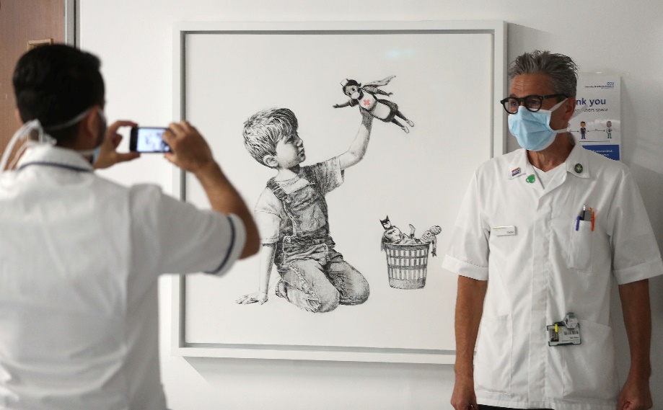
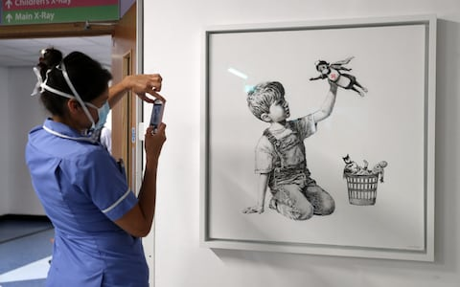
This painting has been created by an artist called Banksy. Banksy is an anonymous England-based street artist,
His latest work is called 'Game Changer' and it has been recently put on display in a corridor at Southampton University Hospital. Banksy left a note for workers saying: Thanks for all you're doing. I hope this brightens the place up a bit, even if it's only black and white. It is uncharacteristically for Banksy, a piece behind glass in a frame! It however means that everyone in the hospital can safely view it, and take a moment in their busy lives to pause, reflect and appreciate this piece of art. It will be put on public display later, then sold at auction to raise money for the NHS.
His work shows a nurse as a superhero – look at the other Superhero's left behind in the basket.

Slide 4
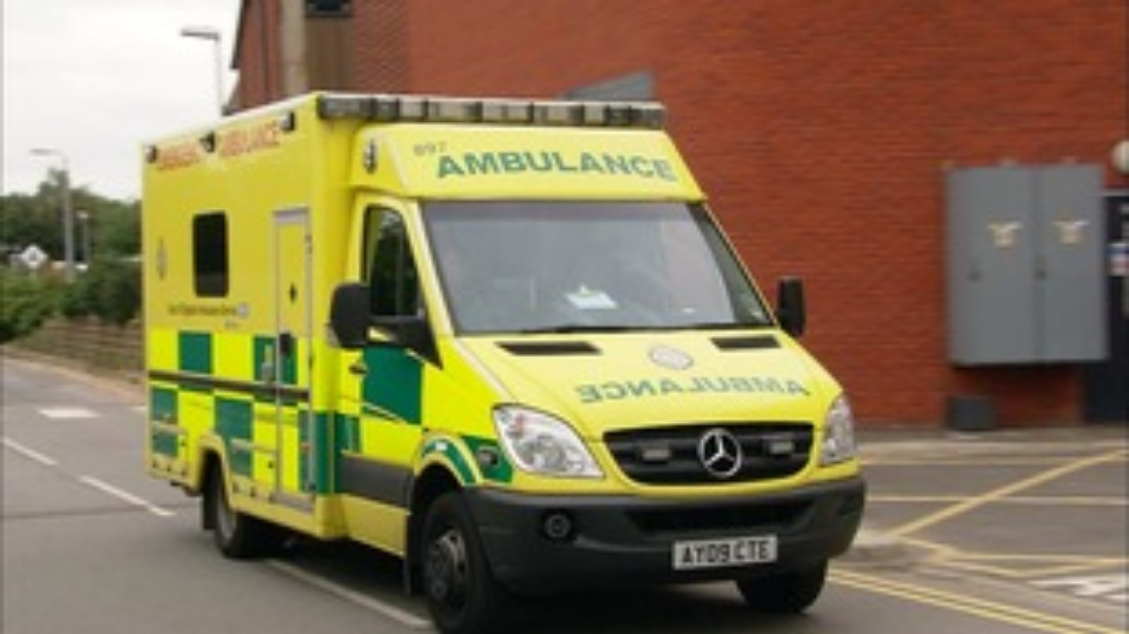
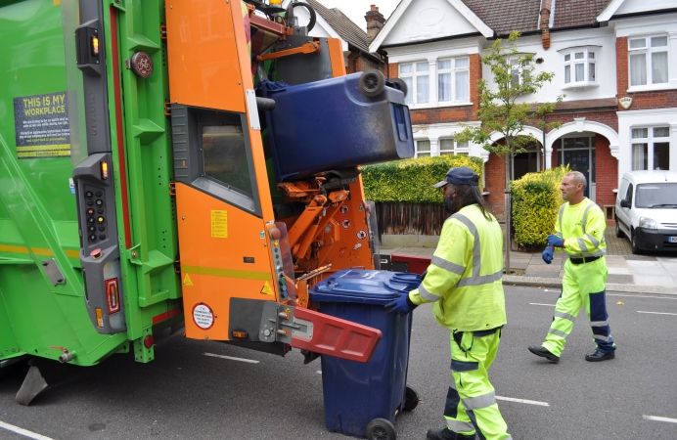
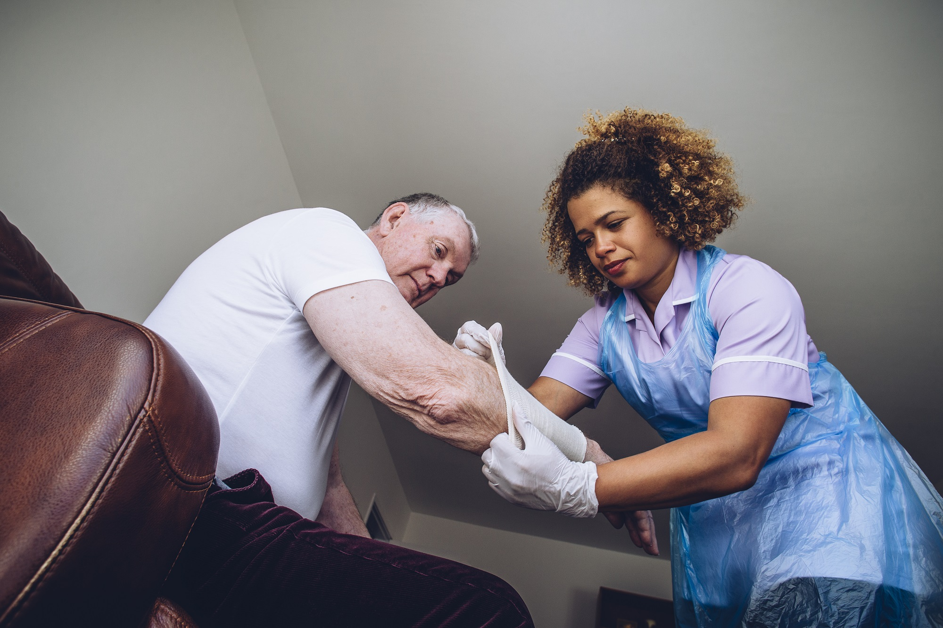
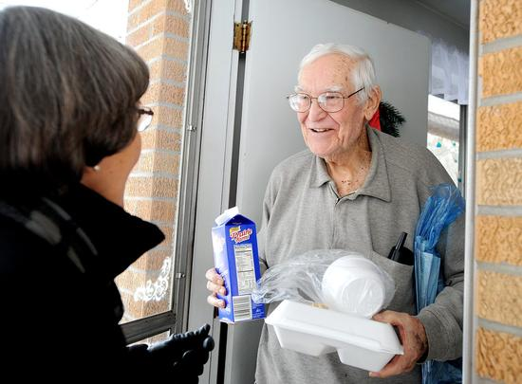
During the latest pandemic and lockdown we have seen lots of real life heroes working in our communities and lots of people doing great things for charities and for others in their local communities.
Who are your real life heroes?

Slide 5
The Dioceses would like to set up an Art display, using children’s responses to Banksy’s work.
This week can you produce your own piece of art under the theme ‘Everyday Heroes’ – this could involve refuse collectors, bus drivers, shop keepers, paramedics, charity workers, – the list goes on as we show our gratitude for those embodying the values that we all promote in our school every day.
The artwork needs to be: no bigger than A4 on paper, plastic, card, wood, stone, slate or anything that is available! It can be 2D or 3D, and in any media.
We would love to see photographs of your finished art work. Send your photographs into school and we will make a gallery of them on the school website and send some onto the Diocese.
adminoffice@st-marys-jun.hants.sch.uk

Slide 6
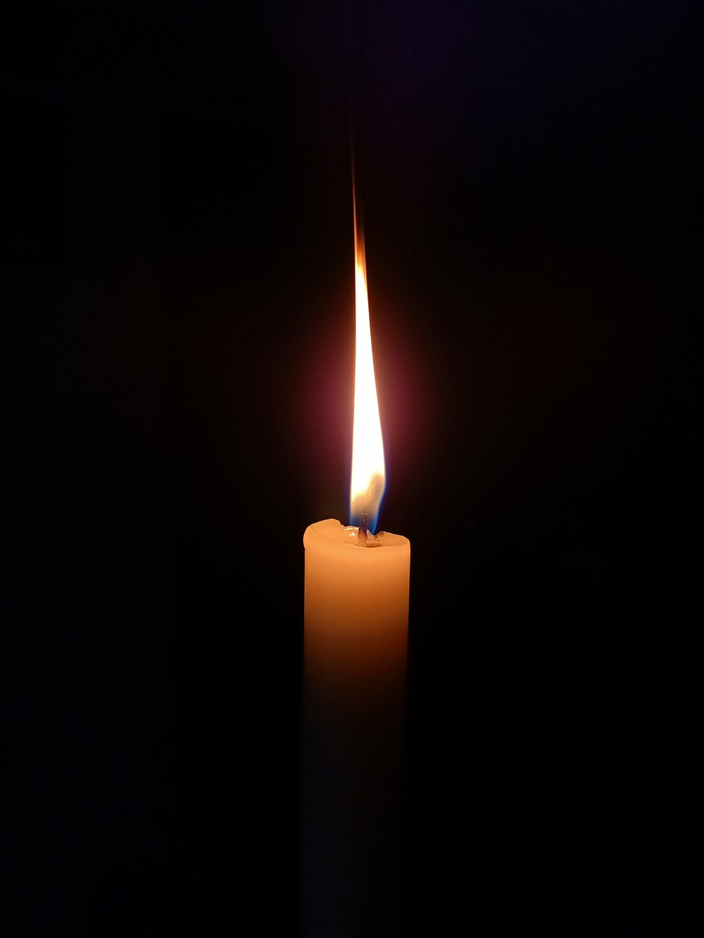
Dear God,
Throughout history, and now during the coronavirus pandemic, you have given people the gifts of courage, caring, strength, wisdom and love to help each other.
Help us to learn from these examples.
Help us to do good things because we care, not just so that we can receive praise and thanks.
Helps us always to seek to love and care for others.
Amen.

