Slide 1
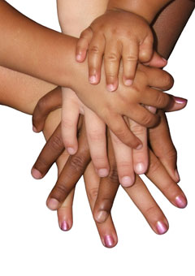
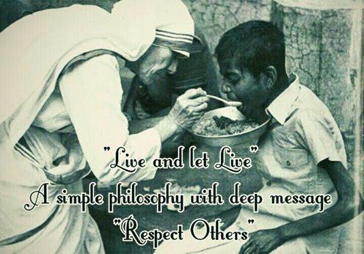
Respect
United Nations
Article 2 – The convention applies to every child whatever their ethnicity, gender, religion, abilities, whatever they say or think, no matter what type of family they come from.
https://www.youtube.com/watch?v=LpMWOZZfki0

Slide 2
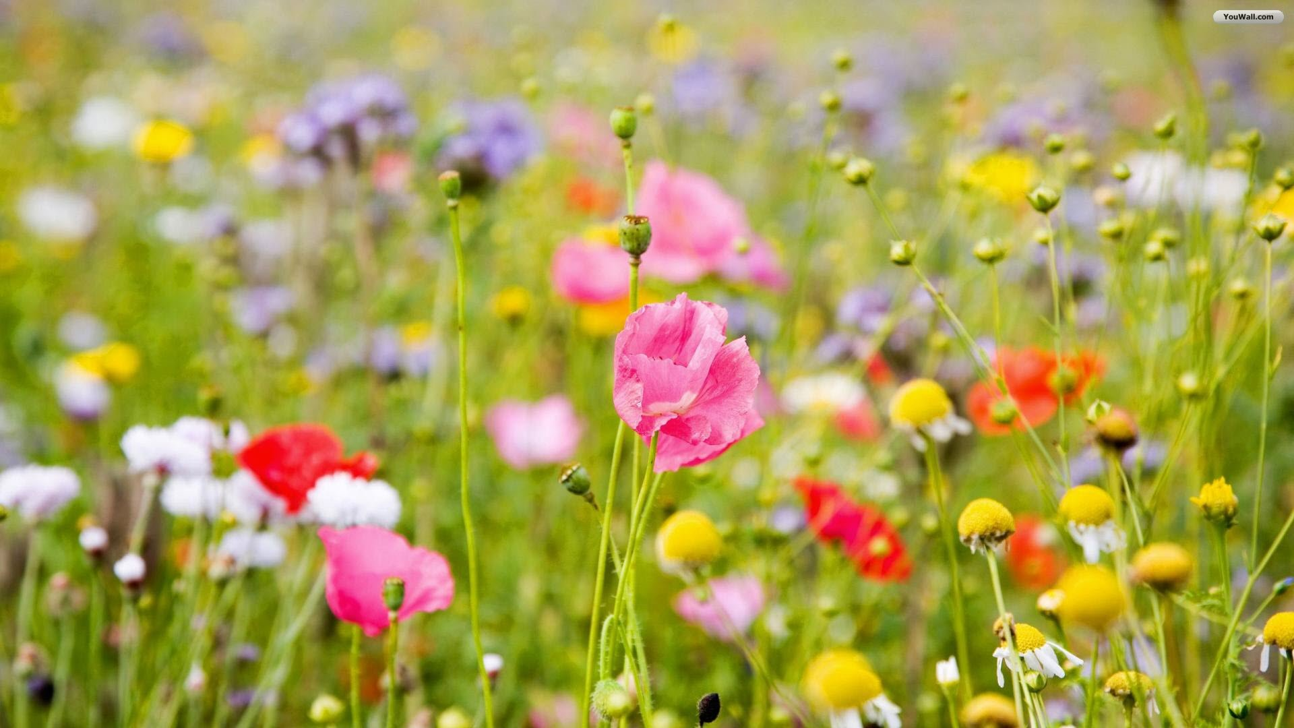

Look after everything I have created
Notes:
Ask the children to describe some of the flowers on the slide.
- What colour are they?
- Do they have a strong smell?
- At what time of year do they grow?
If you are out and about on your walk – how many different flowers do you see?

Slide 3
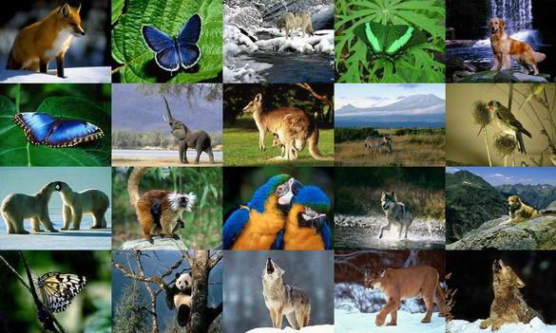
Notes:
Explain that Christians believe that, when God made the world, he didn’t just make one type of flower or one animal. He didn’t make every plant the same shade of green or give every animal four legs to walk on. He made a world full of colour and variety. A world full of interest, where there is always so much more to find out about and enjoy!

Slide 4

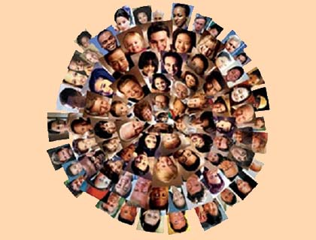
Everyone is a child of God, infinitely precious and worthy of reverence, respect and dignity. Mother Teresa
Notes:
Explain to the children that, just as God loves variety in nature, he also loves variety in us. He didn’t make us all the same and he doesn’t want us all to be the same.
Encourage the children to realize and accept that it is fantastic to be different from other people. Discuss the quote from Mother Teresa, consider what it means that everyone is ‘infinitely precious.’
You may want to revisit the work we did around Holocaust, when people were treated differently – especially those groups in school completing our Peace Pole

Slide 5
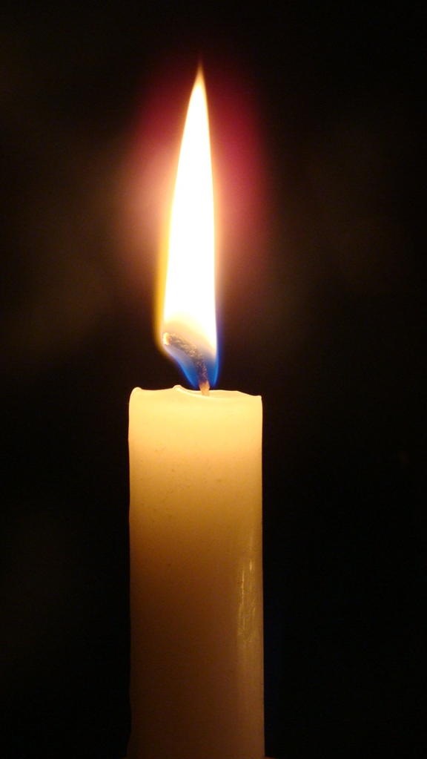
Dear God,
Thank you that we are all special.
Thank you that our world is full of variety.
Thank you for beautiful flowers and for animals that are so different from one another.
Please help us to realize that we don’t need to be the same as other people, but that we can be proud of who we are.
Amen.
Notes:
In the quietness, pause for a moment and think about yourself. Is there something about you that makes you different from other people? What do you enjoy doing most? What are you good at? Take a moment to realize that you are special just the way you are.

Slide 6
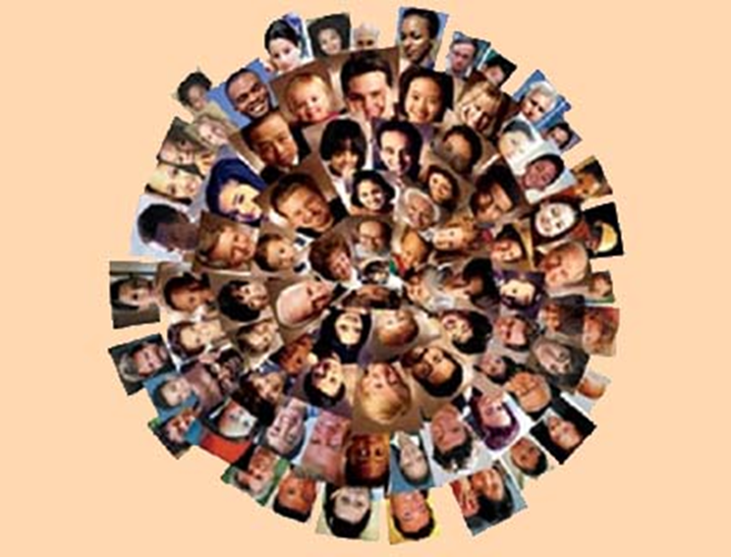
Listen to the music again and think carefully about the words.
Are you treating everyone with respect?
What could you do to make things better in your home and in the wider world?
https://www.youtube.com/watch?v=ut5_ZaEAS3s

