Slide 1
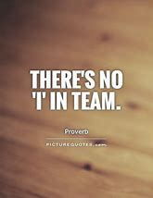
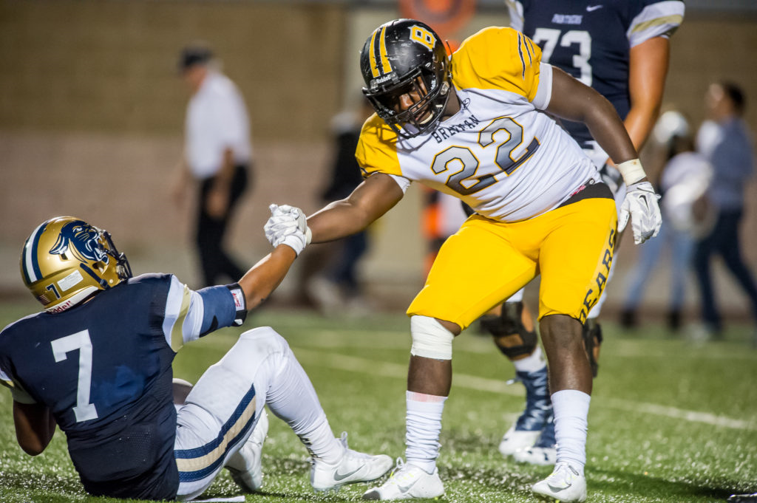
Respect
Bible reference: Hebrews 12:1-11
UNCRC: Article 31- Every child has the right to relax, play and take part in a wide range of cultural and artistic activities
https://www.youtube.com/watch?v=4cVrjFlt4hI

Slide 2
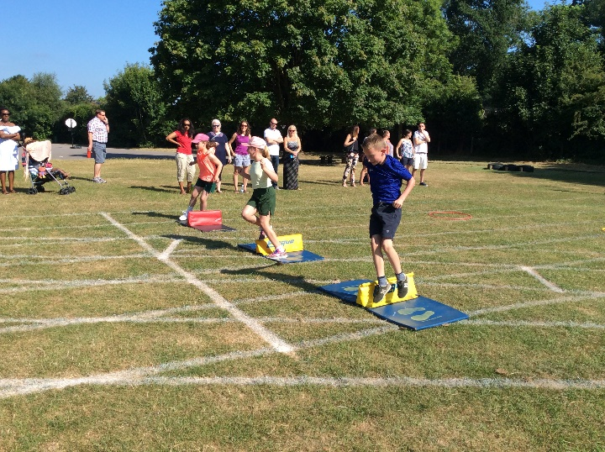
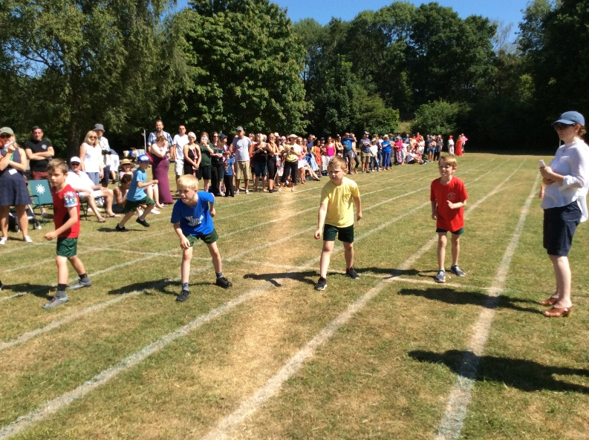
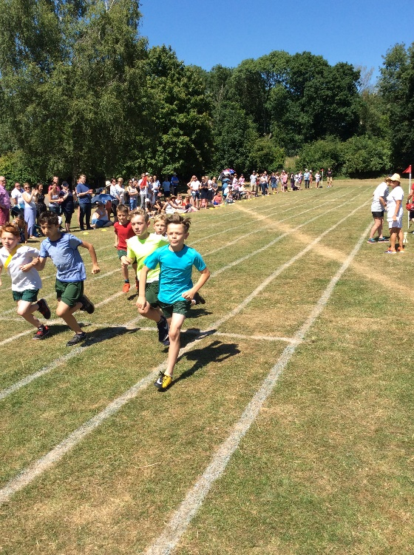
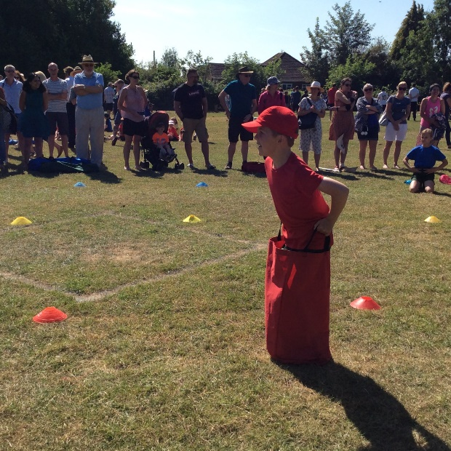
SPORTS DAY
Notes:
Have you ever run/biked/swum in a long raise? If so, what was it like? How did you feel at the end?
Were there spectators?
What pushed you to finish, even though you were tired

Slide 3
In St Paul’s letter to the Hebrews he compares life as a race:
‘Let us run the race we have before us and never give up. We should remove from our lives anything that would get in the way.’
‘Think about Jesus. He held on patiently while men did evil things against him. Look at Jesus’ example so that you will not get tired and stop trying.’
‘My son, don’t think that the Lord’s discipline of you is worth nothing. And don’t stop trying when the Lord corrects you. The Lord corrects those he loves.’
Notes:
What would it be like to run a race wearing a heavy backpack? Or trying to race with your legs tangled in a rope.
What could hinders us from living a really good life?
What do elite athletes do to help them perform their best?
Discuss discipline – what does it mean to us? Think about what it means to be self-disciplined. Who might help and support us?

Slide 4
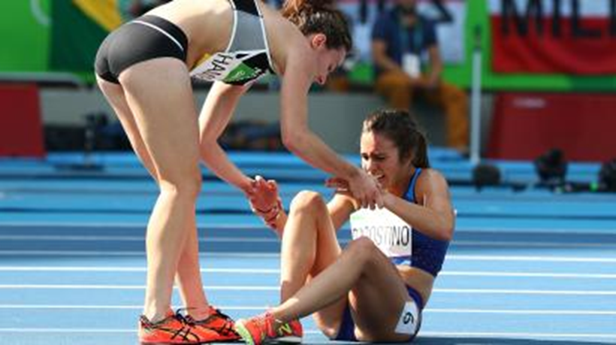
Watch the video first
https://www.youtube.com/watch?v=dCVlRFWOjgE
T
The collision could have led to tempers flaring, but the two runners both showed compassion and encouraged each other to get up and finish the race. Despite tearing ligaments in her knee, D'Agostino completed the final mile to cross the finish line, where she and Hamblin embraced.
The show of sportsmanship captured the hearts of people around the globe, and the duo was awarded the Fair Play Award, which recognizes athletes who exemplify sportsmanship at the Olympic Games, from the International Fair Play Committee
Notes:
Reflect on the video
How do you think each athlete felt in the first instance?
How doo you think they felt when they finished?

Slide 5

Sports day isn’t just about winning – it’s about taking part and the attitude with which we compete. Part of this year’s rather different day is also to challenge ourselves to think about others and to raise as much as we can for the Basingstoke Ark Cancer Charity.
Some of us love sport; some of us don’t. However, we can all try our best and we can all help, support and encourage each other as we take part. The two athletes didn’t win an Olympic medal in their event, but they did get a special award for fair play, sportsmanship and the compassion they showed for one another. Having these attitudes during a sports competition is far more important than winning a race.
So, during sports day, let’s be like the two athletes and Paul from the Bible: let’s not give up if we’re not winning. Let’s keep going because the main thing is to finish the race well and feel proud of your achievements.

Slide 6
Dear God,
Thank you that we all have different abilities and talents.
Help us to be grateful for what we have.
Help us not to be jealous of others.
Help us to keep trying when we find something difficult.
Help us to encourage others.
Help us to enjoy our sports days!
Amen.
https://www.youtube.com/watch?v=4cVrjFlt4hI

