Slide 1
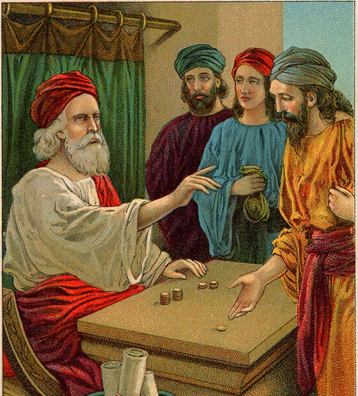

Responsibility
Bible Reference: Matthew 25:14–30
Article 31: Every child has the right to relax, play and take part in a wide range of cultural and artistic activities.

Slide 2
Do we always use the gifts we have been given responsibly?
What are you good at?
Talk with someone else about the things you are good at.
What does your friend or someone in your family think is your gift?
Do you have a sporting talent? A talent for music? Science? Kindness? Making friends? Drawing?
Everyone is good at something.

Slide 3
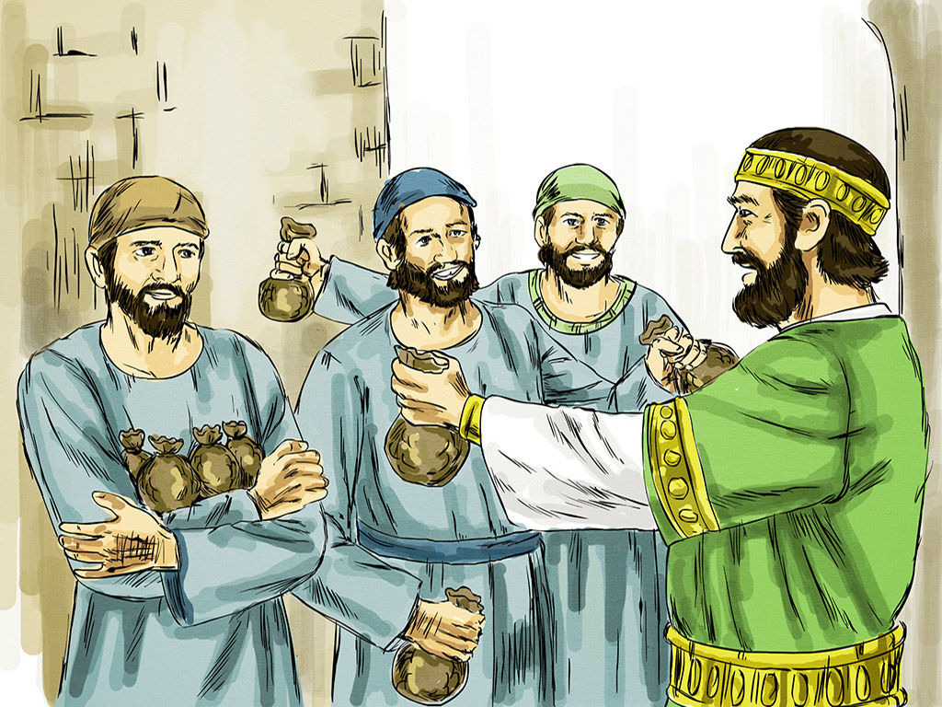
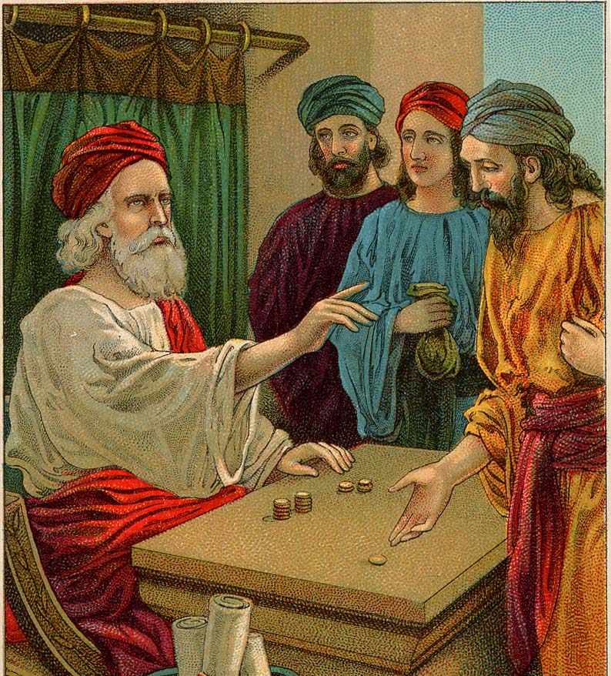
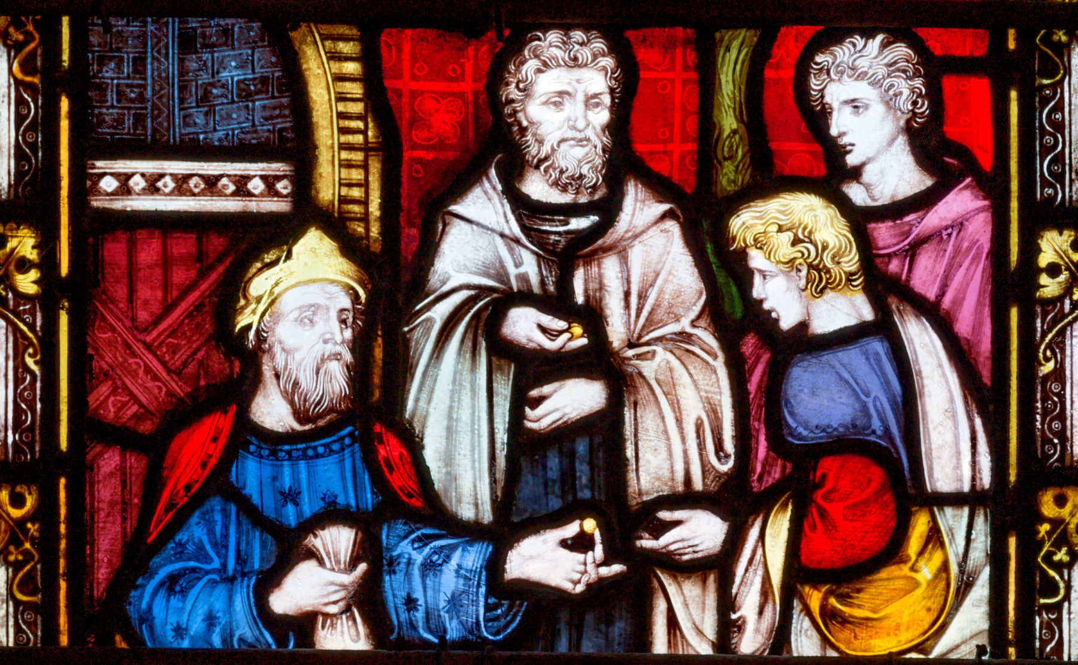
Share the following slides with your class or family. They tell the "Parable of the Talents", from Matthew 25:14–30.
It tells of a master who was leaving his house to travel, and, before leaving, entrusted his property to his servants. The property entrusted to the three servants was worth 8 talents, a ‘talent’ was a significant amount of money.

Slide 4
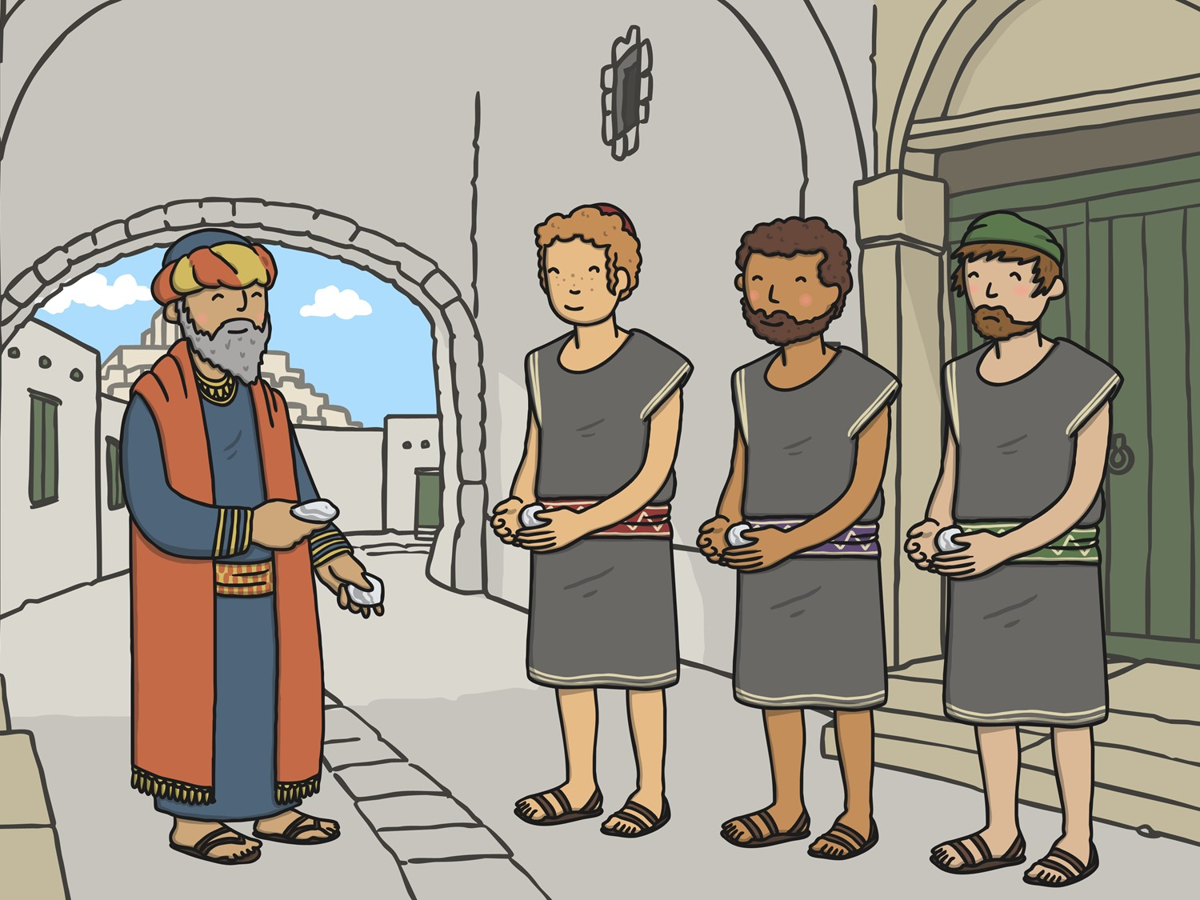


The Talents Parable

Slide 5
A man decided to go on a long trip, so he called his servants and asked them to take care of his house, his stuff and his money. The man decided to give one servant five talents of money, to another he gave two talents and to the last servant he gave one talent. He gave each servant a large amount he thought they could handle, or according to their ability.

Slide 6
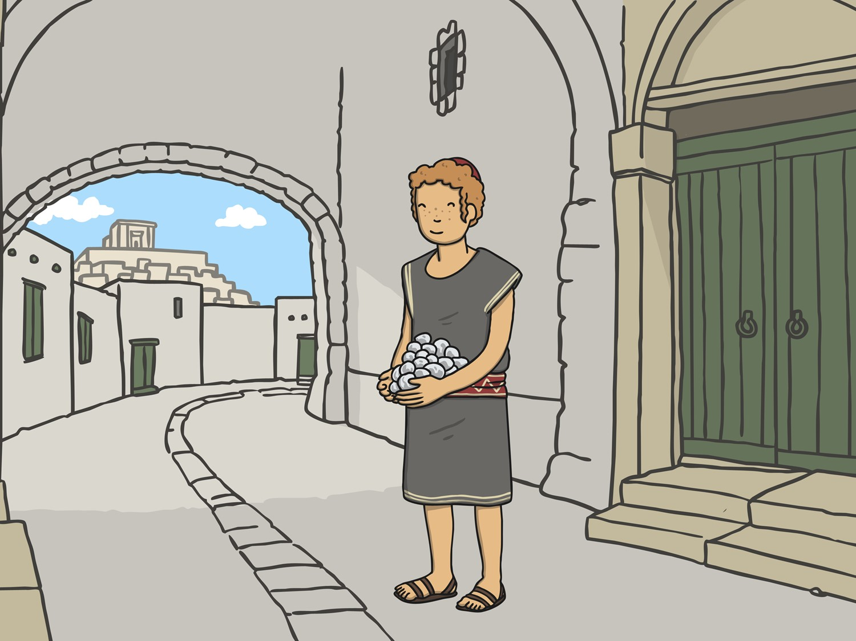
The man left on his trip and the servants each did something with the money that they received. The man with the five talents went right away and used his money and got
five more!

Slide 7
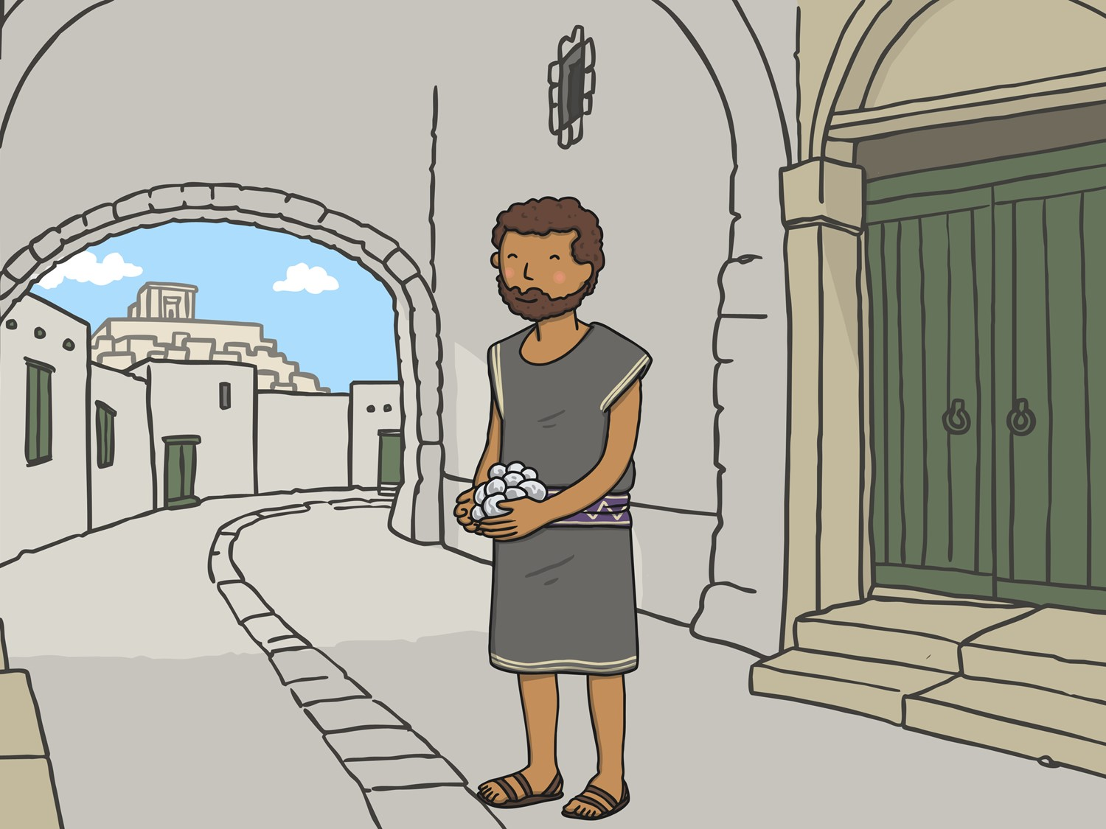
The man with the two talents also used his money wisely and gained two more talents.

Slide 8
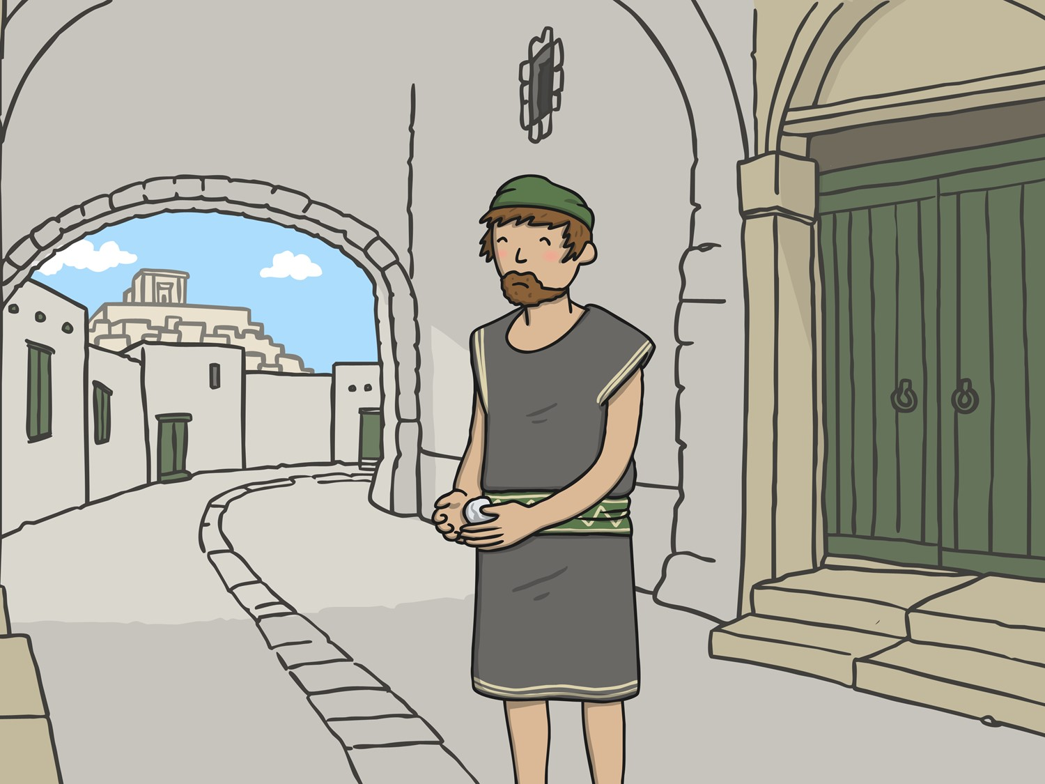
But the man with one talent took his talent and buried it in the ground to keep the money safe. He didn't even try to do something with it.

Slide 9
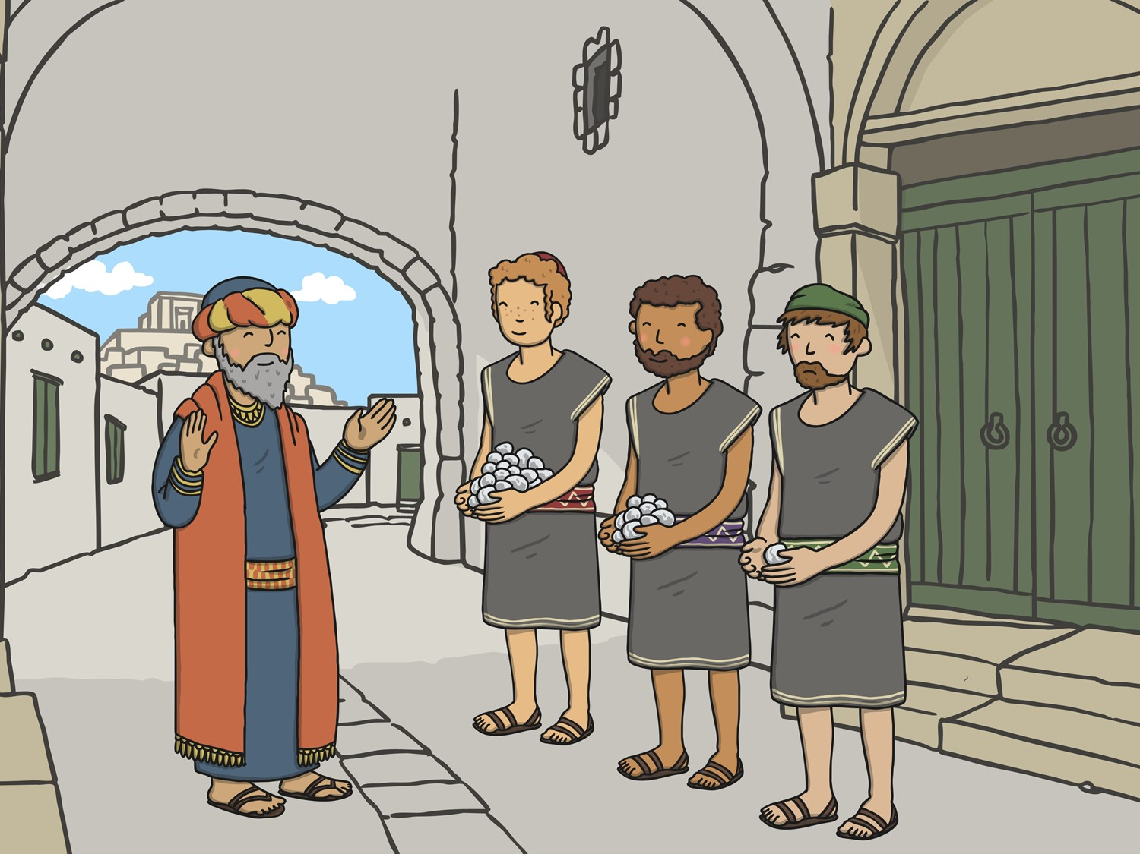
After a nice long trip the master came back and wanted to know what his servants did with his money. The first man with the five talents said, “You trusted me with five talents and I made five more!”

Slide 10
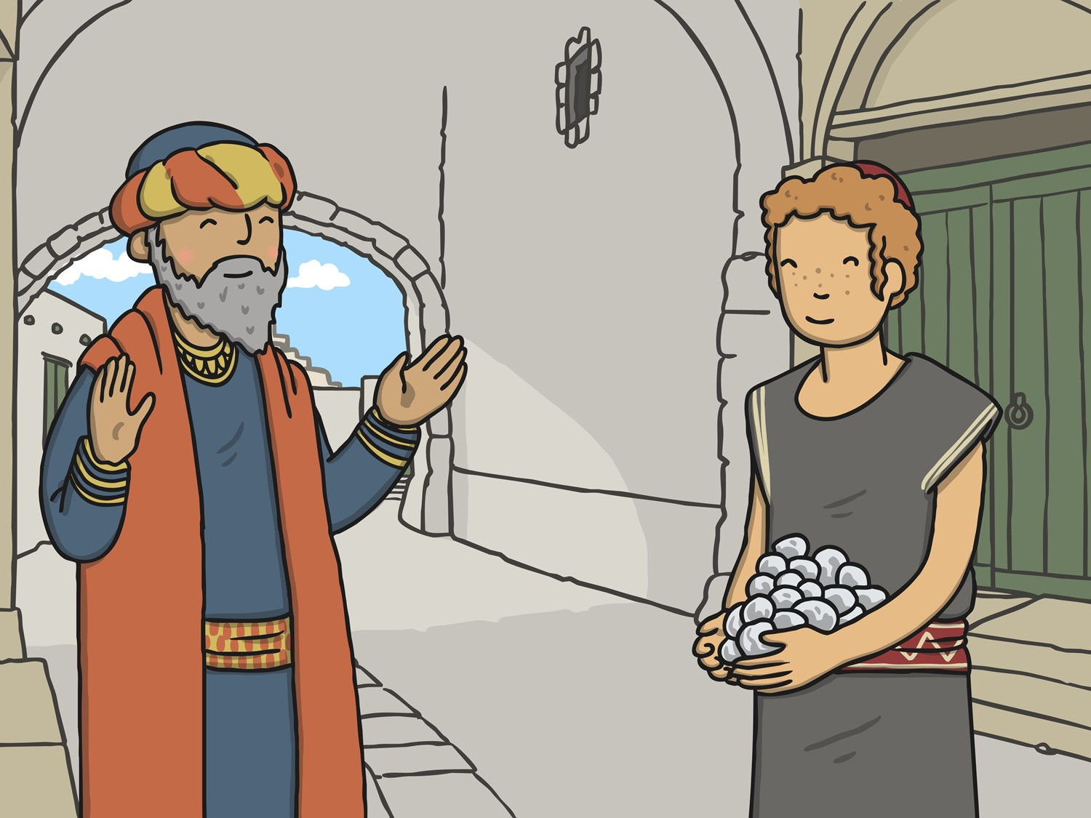
His master smiled and replied, “Great job, good and faithful servant! You are
trustworthy with a few things so I will put you in charge of lots of things. Come
celebrate with me!”

Slide 11
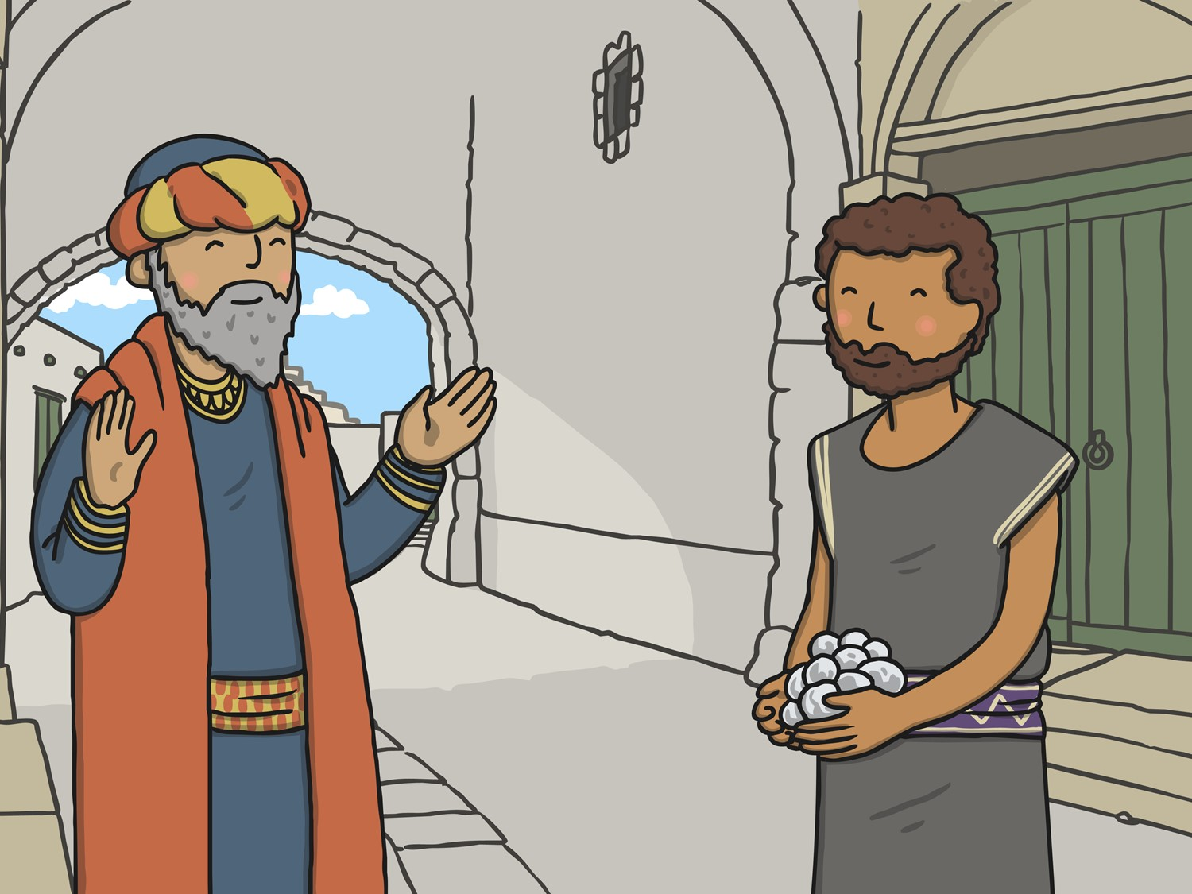
Then the man with the two talents came and said, “You trusted me with two talents and I made two more!” His master smiled and replied, “Great job, good and faithful servant! You are
trustworthy with a few things so I will put you in charge of lots of things. Come celebrate with me!”

Slide 12
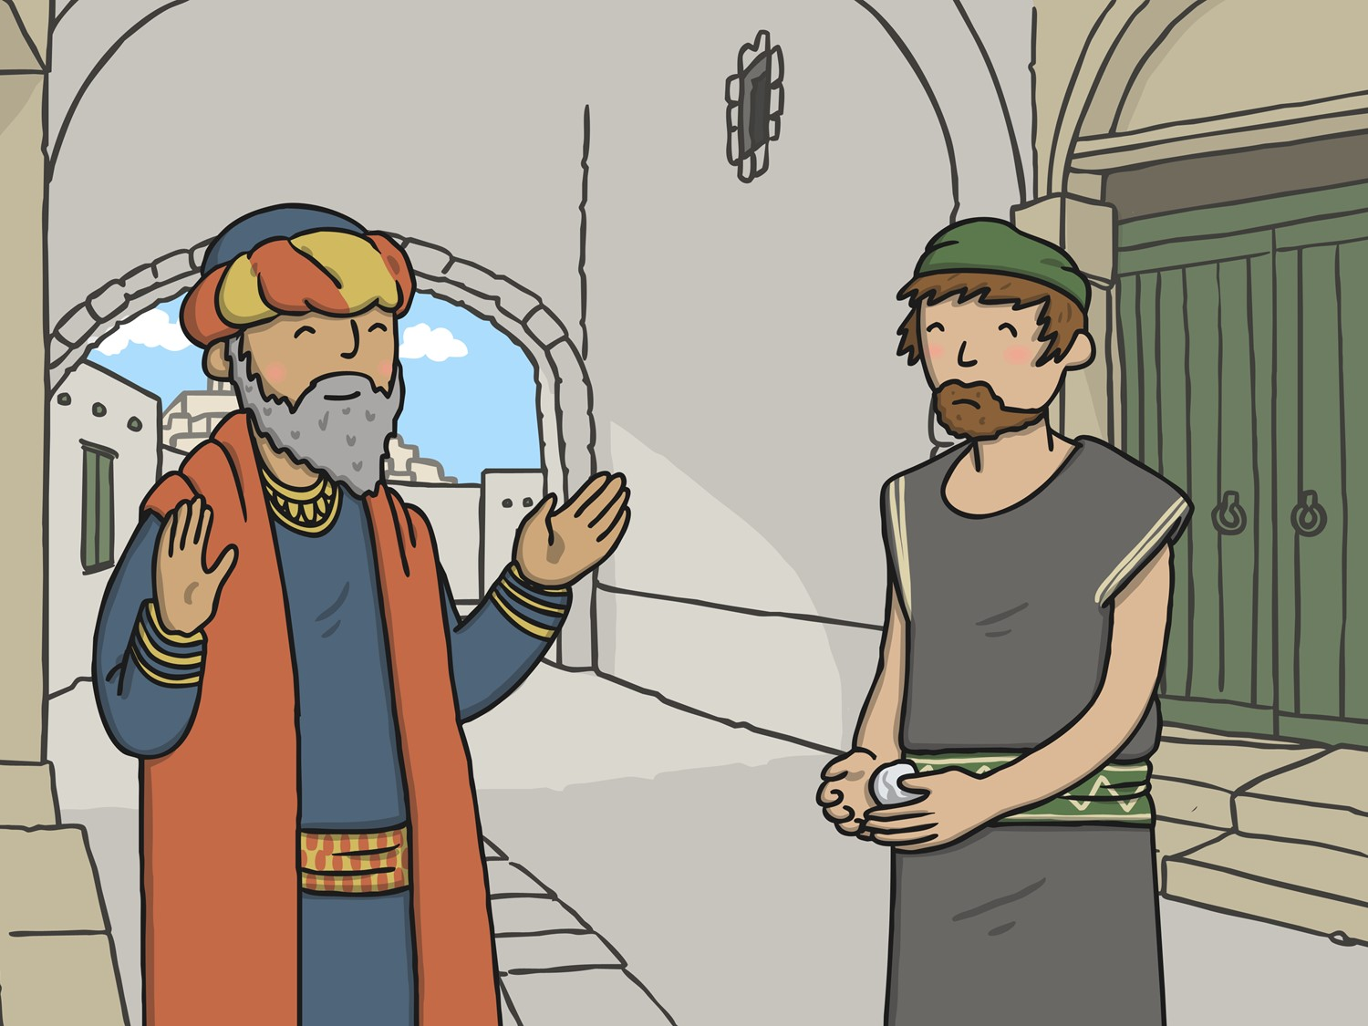
Then the man who received the one talent came and told his master, “I know you work hard for your money, so I was afraid to lose any of it. I decided to bury it and keep it safe. Here is your one talent back.”

Slide 13
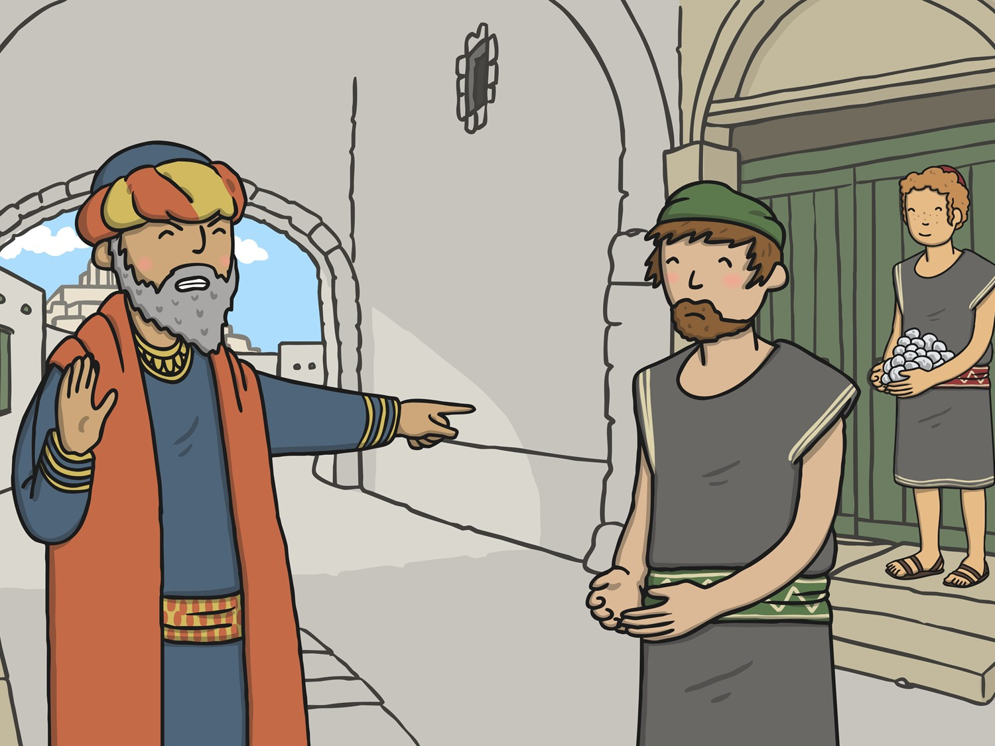
The master was not impressed and said, “You lazy servant! At the very least you could’ve taken the money to the bank and you would’ve at least collected some interest from it.”

Slide 14
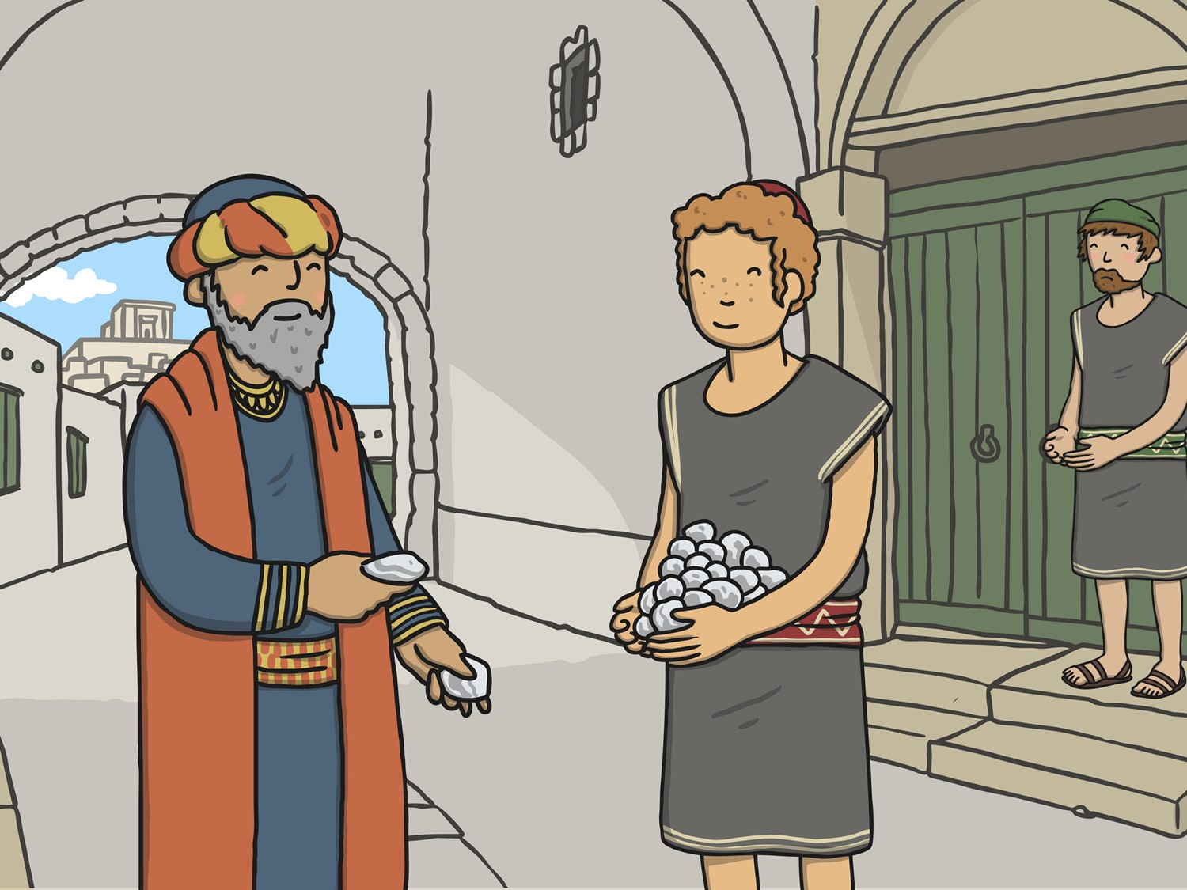
He immediately took the talent away from the man and gave it to the first man who used his money to make more.

Slide 15
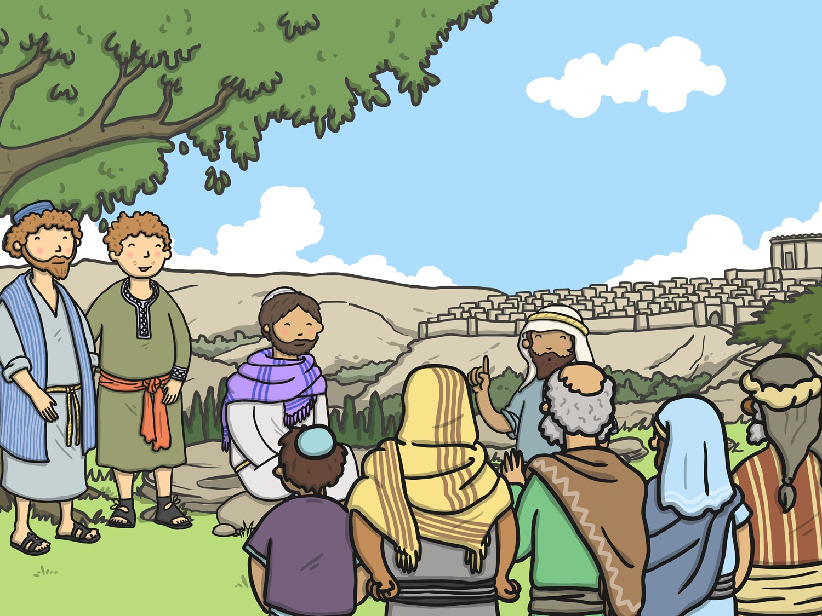
The point Jesus was trying to make is that if you use your special gifts and abilities, God will give you more to keep doing these things you are good at. He will trust you with so much more.

Slide 16
The End

Slide 17
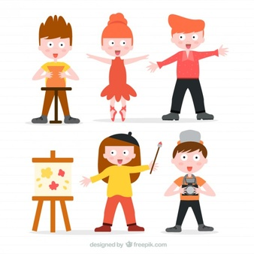
Many people think this story is about using the gifts that we have been given wisely, creatively and well.
Think back to those gifts you thought about at the start of this Act of Worship.
How might you develop your talent?
We have a responsibility to use our gifts and talents as best we can.

Slide 18

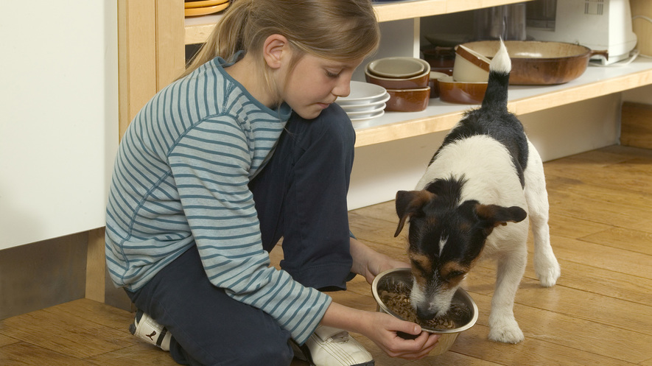
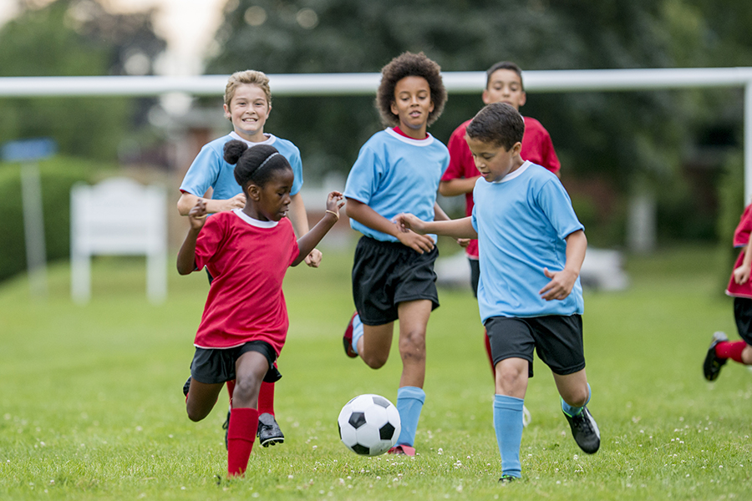
We all have something that we are good at. Some people make friends easily, some people are good at offering help to others. Some people are kind to their animals, some are good at sport.
Thin about a special gift you have, which you could use make your home, school or community a better place?

Slide 19

Dear God,
Thank you for the talents you have given us.
Help us all to use our talents to the best of our ability,
and to help others to use and develop their own talents and skills.
Amen.

