Slide 1


Respect
Bible reference: Ephesians 2:10
UNCRC: Article 31- Every child has the right to relax, play and take part in a wide range of cultural and artistic activities
https://www.youtube.com/watch?v=7PXV3dwaeNU
Notes:
Follow the link for the song – One more Step. Listen to the song – reflect on the lyrics as well as this first slide

Slide 2
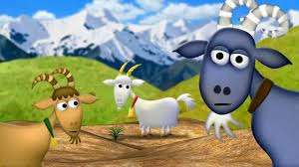
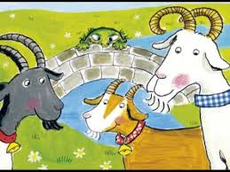
You will remember this story from when you were young. Let’s now think about it in terms of our own lives.
https://www.youtube.com/watch?v=f4kdZTnizG4
Notes:
Think about the story – the goats had outgrown their field, like you have now outgrown your current year group or school. We all get anxious about new things – what we perceive as the unknown. These can get in the way of us moving on – like the troll did in the story. However we can find ways to overcome these and look forward to knew things with a sense of excitement.

Slide 3
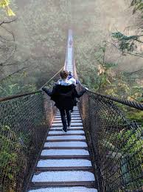
Crossing The Bridge
I cross the bridge and leave behind
The world so well I know,
A place without surprises,
Quite ordinary and dull.
Across the bridge, what lies there.
If only that I knew.
A land of possibilities,
Where all my dreams come true?
Every bridge I cross in life
Will take me to new ground.
Old things will be left behind,
But new things will be found.
Notes:
How does the poem make you feel? How are you feeling about crossing your bridge? How can we help each other with our understandable anxieties?

Slide 4

For many of you this week will be the end of your time with us at St Mary’s and for all of us it is a time of change as the school year comes to an end. Not only is it an end, but also the beginning of something new. Try to remember that as you face big changes you are not alone. We will be thinking of you (and God will be will be with you). There are good things waiting for you just around the corner. So step out with confidence and take new opportunities in your stride.
https://www.youtube.com/watch?v=7SxSnjL3nZ0

