Slide 2
Aim
Perform mental calculations, including with mixed operations and large numbers.

Slide 3

Mental Calculations and Estimation
Diving
Explain how you could use mental methods in order
to solve this calculation in the most efficient way.
12 499 + 2500 + 12 501 =
27 500
12 000 + 2500 + 12 000 = 26 500
499 + 501 = 1000
26 500 + 1000 = 27 500

Slide 4
Mental Calculations and Estimation
Diving
Explain how you could use mental methods in order
to solve this calculation in the most efficient way.
21 × 99 =
2079
21 × 100 = 2100
2100 – 21 = 2079

Slide 5


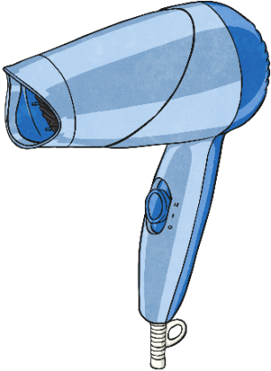



Mental Calculations and Estimation
Diving
Use your estimating skills and mental methods to quickly decide if Anita has enough money to buy the items she wants from the shop.
I have £70. Can I buy all these items?
£4.49
£1.99
£1.49
£47.99
£14.99
No. If we reorder the amounts to start with the greatest, and use estimation, we can see that the amount will be over £70 (£70.95).

Slide 6

Mental Calculations and Estimation
Deeper
Explain how you could use mental methods in order
to solve this calculation in the most efficient way.
2299 + 1201 + 1499
The thousands can quickly be added up mentally:
1000 + 1000 + 2000 = 4000
We are then left with 299 + 201 + 499.
If we use our number bonds, we can see that 299 + 201 = 500.
We are then left with 499 to add on. As 499 is close to 500, we can carry out this calculation mentally:
500 + 500 = 1000
1000 - 1 = 999
Our final answer is: 4000 + 999 = 4999

Slide 7

Mental Calculations and Estimation
Deepest
When a number from column A is added to or subtracted from a number in column B, the answer can be found in column C. All of the answers to these calculations can be found using mental methods of addition and subtraction.
Show which numbers match to make a complete calculation.
2501 1100 499 1299 | 3500 2499 1299 1900 | 5000 2598 3000 3001
A
B
C
2499 + 2501 = 5000
1299 + 1299 = 2598
3500 - 499 = 3001
1900 + 1100 = 3000

Slide 8


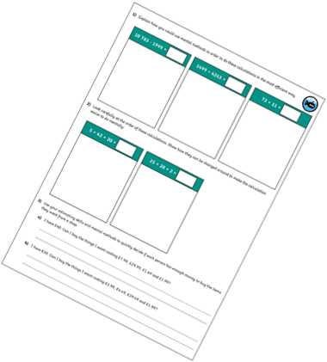
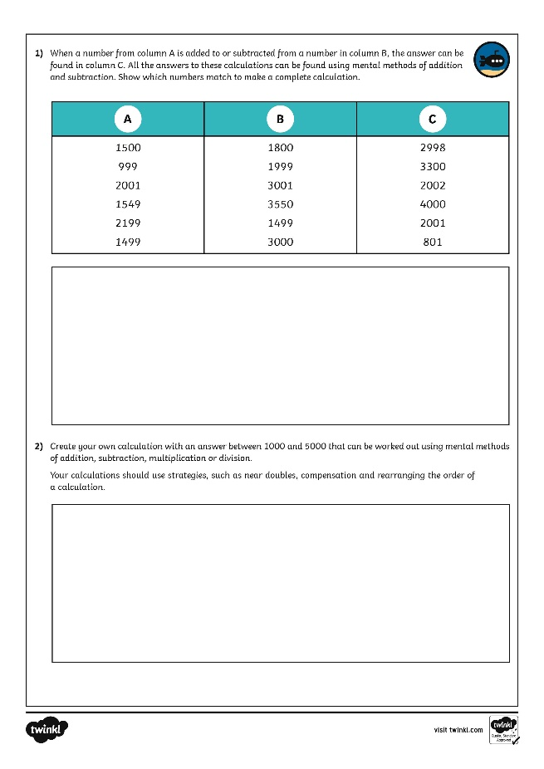
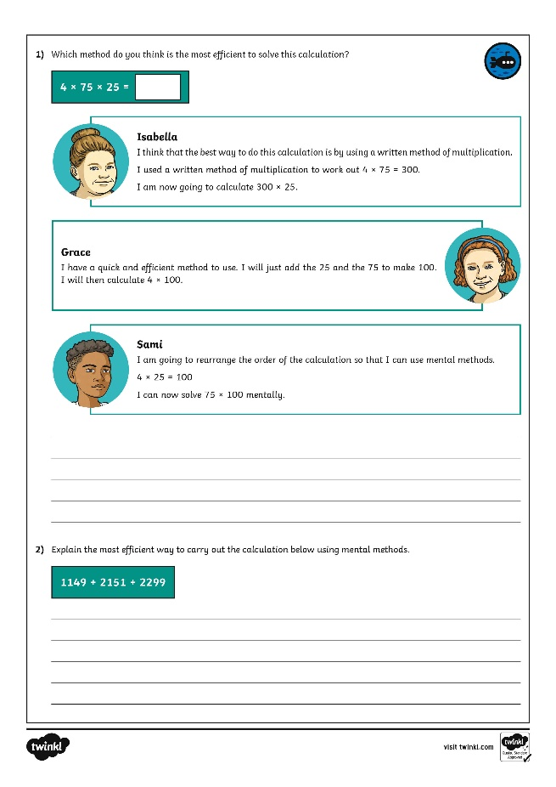
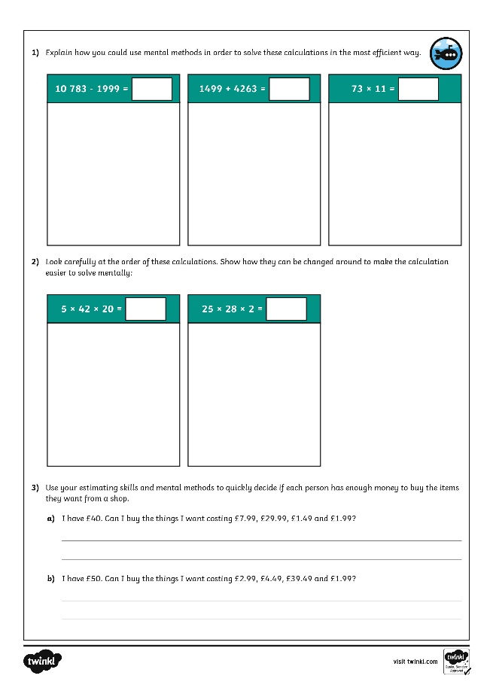
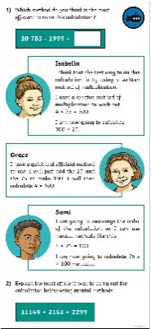
Mental Calculations and Estimation
Dive in by completing your own activity!

