Slide 2



Diving into Mastery Guidance for Educators
Each activity sheet is split into three sections, diving, deeper and deepest, which are represented by the following icons:
These carefully designed activities take your children through a learning journey, initially ensuring they are fluent with the key concept being taught; then applying this to a range of reasoning and problem-solving activities.
These sheets might not necessarily be used in a linear way. Some children might begin at the ‘Deeper’ section and in fact, others may ‘dive straight in’ to the ‘Deepest’ section if they have already mastered the skill and are applying this to show their depth of understanding.
Diving
Deeper
Deepest

Slide 3
Aim
Solve problems involving addition, subtraction, multiplication
and division.

Slide 4
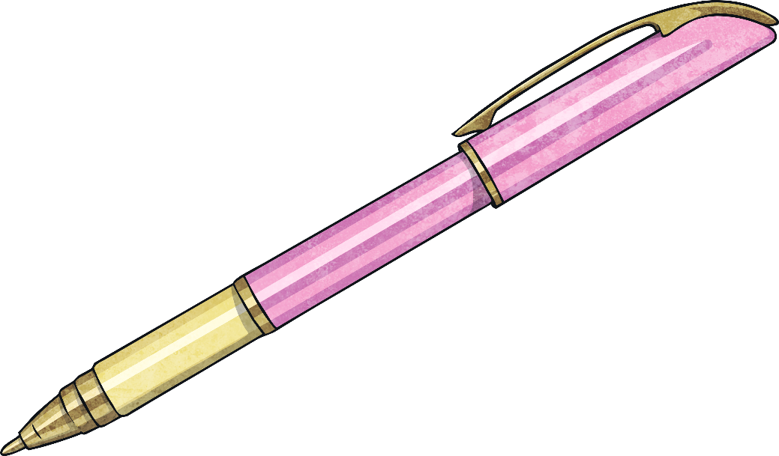




Reason from Known Facts
Diving
230 | ÷ | 20 | =
230 | ÷ | 20 | = | 11.5
Use known facts to complete these calculations.
 | = | 11.5 | × | 20
230 | = | 11.5 | × | 20
230 | ÷ | 10 | = | 23
230 | ÷ |  | = | 46
11.5 | × | 10 | = | 115
230 | ÷ | 5 | = | 46
23 | = | 11.5 | ×
23 | = | 11.5 | × | 2

Slide 5
Reason from Known Facts
Diving
7084 ÷ 23 = 308
We know the answer to
23 × 308 = 7084, so we only need to complete the calculation 7084 - 308 to find that 22 × 308 = 6776.
Use this calculation to find
the answer to:
22 × 308
Explain your working out.

Slide 6

Reason from Known Facts
Deeper
Use this calculation to decide if the following are true or false. For any false calculations, give the correct answer and explain the mistake that has been made.
345 + 257 = 602
 | True or False? | Correct Answer | Mistakes Made
345 + 247 = 692
445 + 157 = 602
34.5 + 25.7 = 6.02
 | True or False? | Correct Answer | Mistakes Made
345 + 247 = 692 | False | 592 | Tried to adjust the answer by 10, but forgot to regroup the hundred.
445 + 157 = 602 | True | - | -
34.5 + 25.7 = 6.02 | False | 60.2 | Answer is ten times too small.

Slide 7

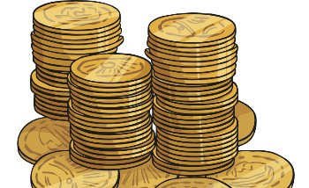
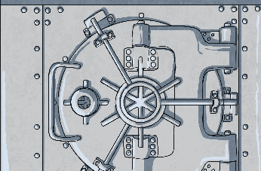
Reason from Known Facts
Deepest
315 | ÷ | 10 | =
 |  | 12.6 | 3150 | 6.3 | 0.63
 |  | 126 | 31.5 | 315 | 630
1.26 | 1260 | 3.15 | 0.315 | 6300 | 15.75
0.125 | 3.16 | 125 | 1575 | 1.575 | 63
6.03 | 603 | 0.316 | 316
3160 | 1250 | 6030 | 1.25
31.5
 |  | 12.6 | 3150 | 6.3 | 0.63
 |  | 126 | 31.5 | 315 | 630
1.26 | 1260 | 3.15 | 0.315 | 6300 | 15.75
0.125 | 3.16 | 125 | 1575 | 1.575 | 63
6.03 | 603 | 0.316 | 316
3160 | 1250 | 6030 | 1.25
 |  | 12.6 | 3150 | 6.3 | 0.63
 |  | 126 | 31.5 | 315 | 630
1.26 | 1260 | 3.15 | 0.315 | 6300 | 15.75
0.125 | 3.16 | 125 | 1575 | 1.575 | 63
6.03 | 603 | 0.316 | 316
3160 | 1250 | 6030 | 1.25
 |  | 12.6 | 3150 | 6.3 | 0.63
 |  | 126 | 31.5 | 315 | 630
1.26 | 1260 | 3.15 | 0.315 | 6300 | 15.75
0.125 | 3.16 | 125 | 1575 | 1.575 | 63
6.03 | 603 | 0.316 | 316
3160 | 1250 | 6030 | 1.25
 |  | 12.6 | 3150 | 6.3 | 0.63
 |  | 126 | 31.5 | 315 | 630
1.26 | 1260 | 3.15 | 0.315 | 6300 | 15.75
0.125 | 3.16 | 125 | 1575 | 1.575 | 63
6.03 | 603 | 0.316 | 316
3160 | 1250 | 6030 | 1.25
 |  | 12.6 | 3150 | 6.3 | 0.63
 |  | 126 | 31.5 | 315 | 630
1.26 | 1260 | 3.15 | 0.315 | 6300 | 15.75
0.125 | 3.16 | 125 | 1575 | 1.575 | 63
6.03 | 603 | 0.316 | 316
3160 | 1250 | 6030 | 1.25
 |  | 12.6 | 3150 | 6.3 | 0.63
 |  | 126 | 31.5 | 315 | 630
1.26 | 1260 | 3.15 | 0.315 | 6300 | 15.75
0.125 | 3.16 | 125 | 1575 | 1.575 | 63
6.03 | 603 | 0.316 | 316
3160 | 1250 | 6030 | 1.25
 | × | 20 | = | 315
15.75
 | = | 20 | × | 15.75
315
630
 | = | 31.5 | × | 20
126
630 | ÷ | 5 | =
Use known facts to complete these calculations. Find the path from the money to the bank vault. The answers are not necessarily in the right order.
63
 | = | 3.15 | × | 20

Slide 8


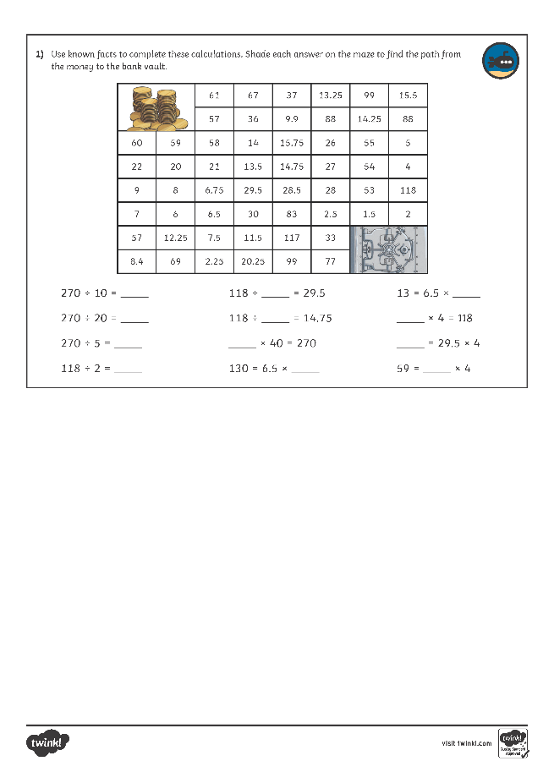
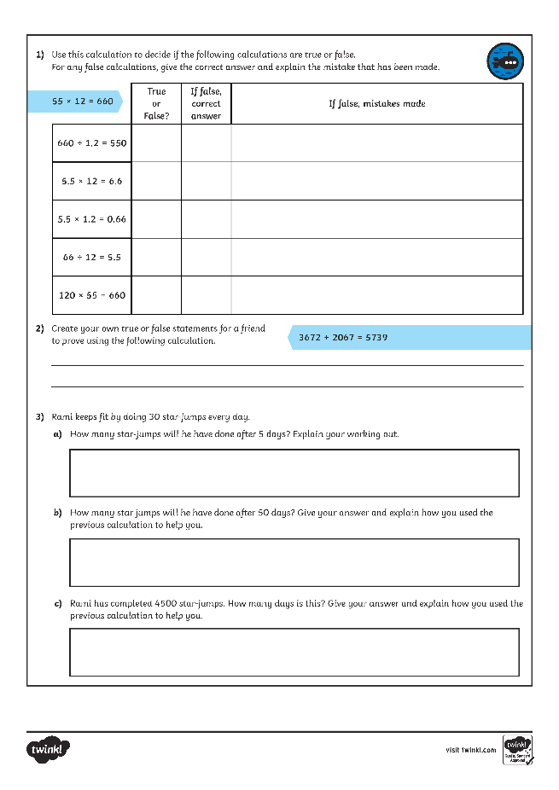
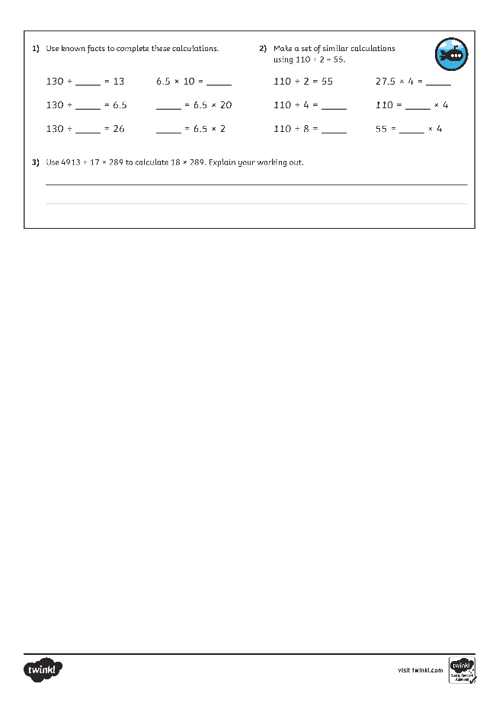
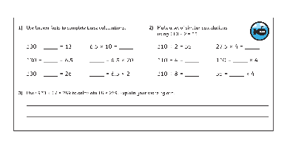
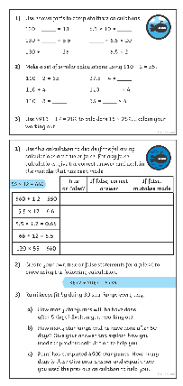
Reason from Known Facts
Dive in by completing your own activity!

Slide 9
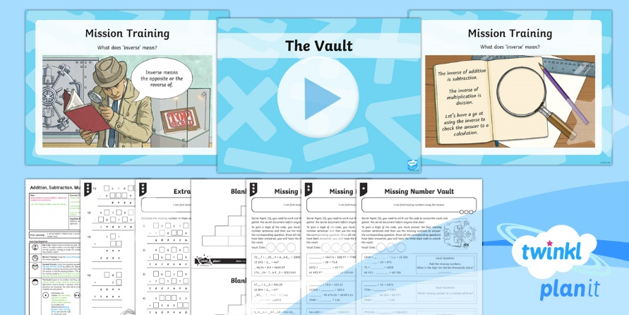
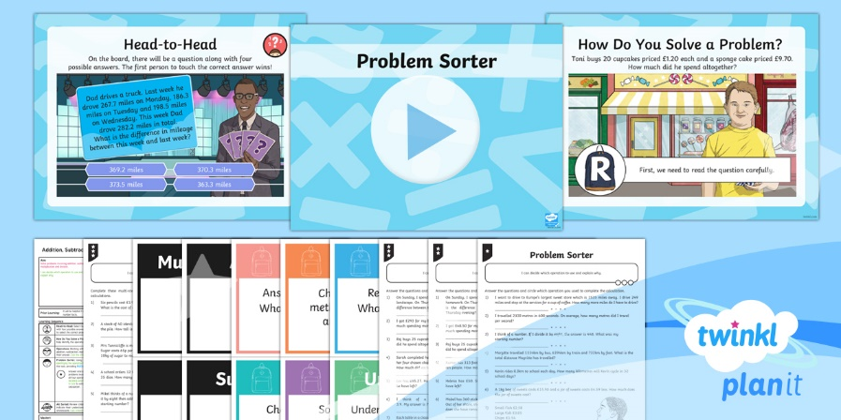

Need Planning to Complement this Resource?
National Curriculum Aim
Solve problems involving addition, subtraction,
multiplication and division.
For more planning resources to support this aim, click here.
Twinkl PlanIt is our award-winning scheme of work
with over 4000 resources.

