Slide 1
The Human Body
Part 1: Skeleton-Muscular System
Siemens Education

Slide 2
The Human Body
Overall learning objectives
To understand the functions of the skeleton
To be able to explain various features of the skeleton
To relate images of bones, muscles and joints to diagrams and the body

Slide 3
The Human Body
Learning Outcomes:
Clear identifications of key features of the skeleton
Explanation of form and function of parts of the skeleton

Slide 4
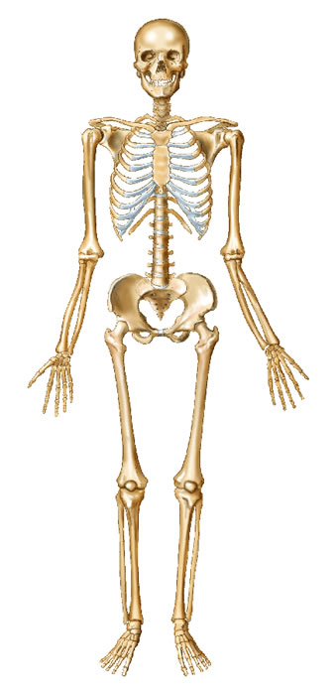
The Human Body
Skeletons
Do you have a skeleton?
How do you know?
Write down a list of evidence you have that you have a skeleton e.g. I can feel the bones in my fingers.

Slide 5
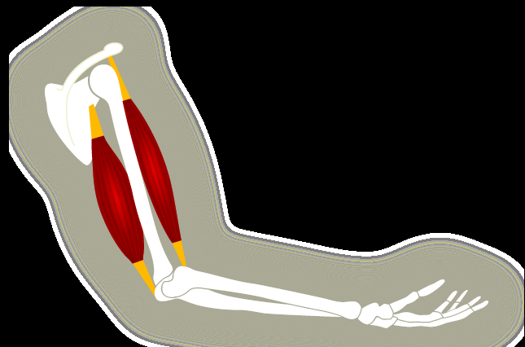
The Human Body
What makes your arm move?
Muscles move body parts by contracting and then relaxing. Muscles can pull bones, but they can't push them back to the original position. So they work in pairs of flexors and extensors. The flexor contracts to bend a limb at a joint.
I

Slide 6
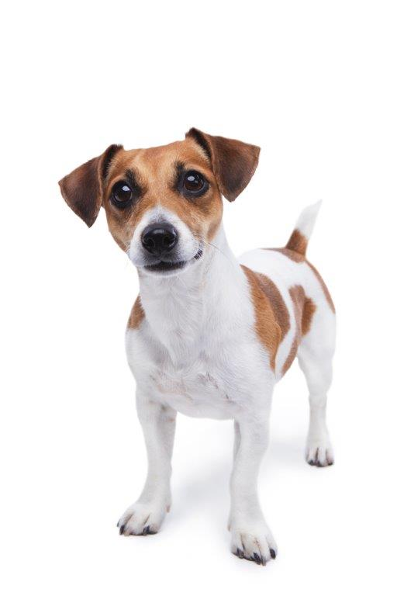
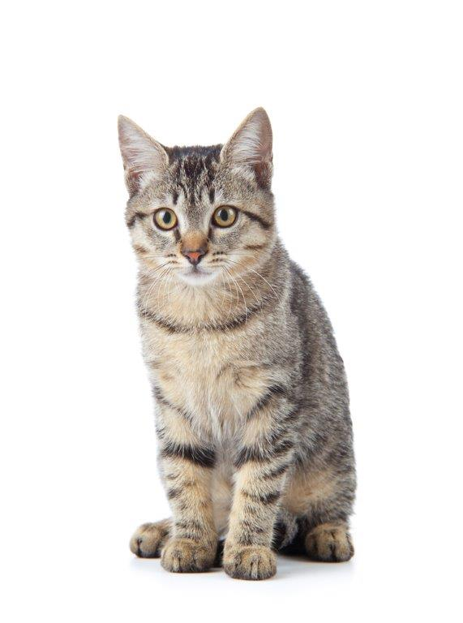
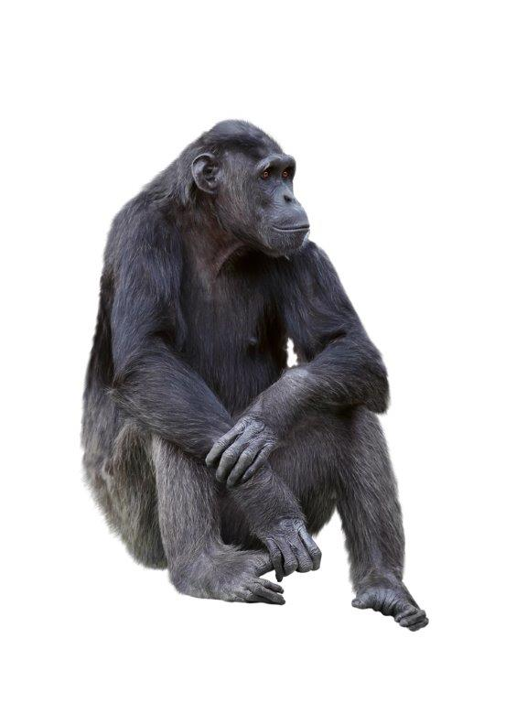
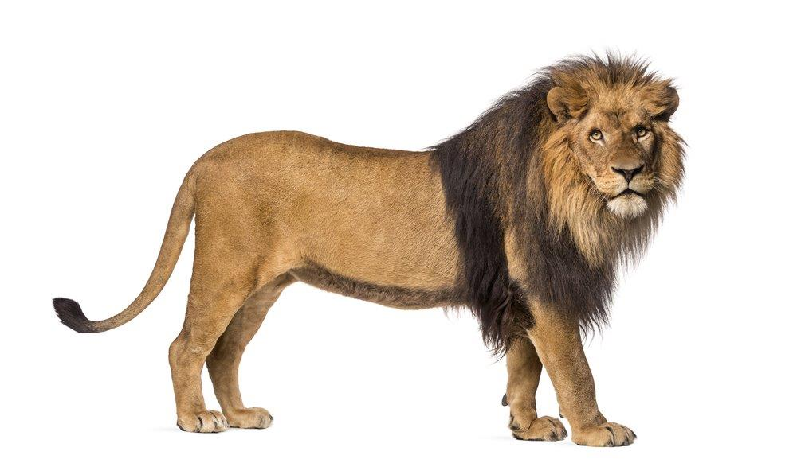
The Human Body
What other animals have skeletons?

Slide 7
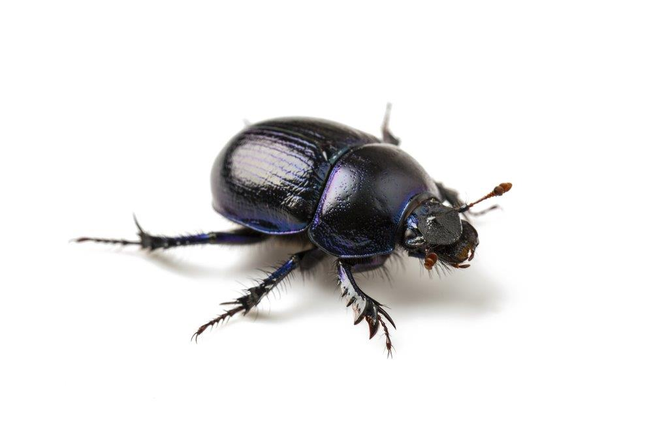
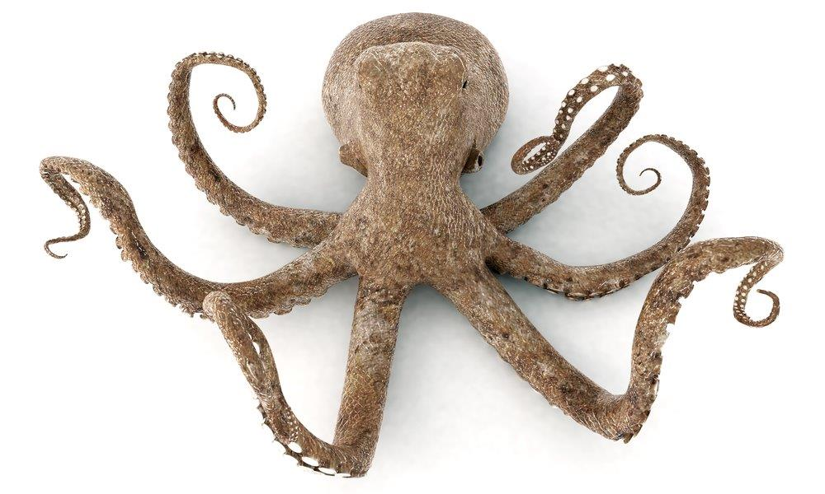
The Human Body
Not all animals have skeletons.
Can you name some that don’t?
Have a look on the internet to see if you can find out more animals that do not have a skeleton. What is the scientific name for these animals?

Slide 8
The Human Body
Why do we have a skeleton?
A skeleton provides protection, e.g. skull
and ribs
A skeleton provides support, e.g. legs
and backbone
A skeleton enables movement in
conjunction with muscles, e.g. arms and legs

Slide 9
The Human Body
Imagine if we didn’t have bones
What would our limbs feel like?
Could we move and, if so, how?
Could we stand?
Would our muscles still function?
How do animals that don’t have bones function (e.g. octopus, snail, spider)

