Slide 1
Islamic towns, cities and homes
As Islam spread the first towns were really military camps built to house soldiers. Soldiers were well paid so had money to spend. They also shared in the booty taken from the people they conquered. Their spending power encouraged traders to settle. The profits they made meant that they, too, had money to spend. This attracted even more settlers to the growing towns.
Ports like Basra and Alexandria and places on inland trading routes, like Baghdad and Mecca soon became wealthy. As the towns grew, more services were provided for the townspeople, such as baths, schools and street-cleaning. As a result, towns grew even more. Great mosques were built close to the centre. Other important town-centre buildings included the public baths, the governor's home and government offices. Rich merchants also built their homes near the town centre. Poorer people had further to travel from their homes. They lived in more distant suburbs outside the protection of the city walls.
ﭺلسﭻقلإجهلإسغقلإجهسغج

Slide 2
Islamic towns, cities and homes - major Islamic cities
By 800 CE Baghdad's houses and streets covered an area of over six miles (10 km) wide and its population was between one and two million. Baghdad was on an inland trade route. By this time its merchants were already trading with India, China, Sri Lanka, Madagascar, Russia and Scandinavian [both Viking lands] and even Indonesia.
Other great cities of medieval Islam were huge but not as big as this. Cairo, Samarkand (Central Asia) and Cordoba in Spain all had about half a million inhabitants each. This was at a time when London had less than 25,000 inhabitants!
By 814, Baghdad was the world's largest city.
ﭺلسﭻقلإجهلإسغقلإجهسغج

Slide 3
Islamic towns, cities and homes - Baghdad 1
In 762, the caliph, al-Mansur, founded a new capital city, Baghdad in Iraq. It was built where two great rivers, the Tigris and the Euphrates, came closest together, which was an important crossroads for trade.
Baghdad was built as a round city, about three kilometres across, surrounded by two strong walls. In the centre stood the palace of the caliph. As well as his palace, a mosque, the treasury (where his money, gold and other treasures were kept) and the barracks for his most trusted soldiers were built inside the walls. They were further protected by a huge deep ditch filled with water from the River Tigris.
The circular city had four main gates and four main streets crossing the centre. Each street had shops on either side under arcades which provided shelter from the sun. There were canals to supply water. Ordinary people lived in houses outside the walls, where a vast commercial area grew.
ﭺلسﭻقلإجهلإسغقلإجهسغج

Slide 4
Islamic towns, cities and homes - Baghdad 2
“I begin with Iraq because it is the centre of the world, and I mention Baghdad first because it is the centre of Iraq, the greatest city, which has no equal in the world in size, wealth, abundance of water or health of climate, and because it is inhabited by all kinds of people. To it they come from all countries, far and near. Goods and foodstuffs come to it by land and by water, so that every kind of merchandise is available, from Muslim and from non-Muslim lands. Goods are brought from India, China, the lands of the Turks, the Ethiopians and others to such an extent that the products of the countries are more plentiful in Baghdad than in the countries from which they come. It is as if all the good things of the earth are sent there.”
Ibn Wadih al-Yaqubi, a ninth-century historian in Universal History.
ﭺلسﭻقلإجهلإسغقلإجهسغج

Slide 5
Islamic towns, cities and homes - Cordoba
By the tenth century, part of modern day Spain was ruled by Muslims, they called this area al-Andalus. Forty-four years after the conquest of Spain, Abd al-Rahman, an Umayyad, built the city of Cordoba as his capital city. It was the most advanced city in Europe and the third best in the world.
Cordoba at this time had over 214,000 houses and 80,000 shops. The buildings were a mixture of Arab, North African and Roman architecture. Cordoba was bigger than Cairo and richer than Rome. Some said it was even more beautiful than Baghdad.
Unlike most of Europe, Cordoba was a hygienic and healthy place to live. There were about 300 public baths, so residents could keep themselves clean too. Richer houses even had their own piped water.
The Royal Palace had about 400 rooms and apartments. It took about 10,000 workers 25 years to build it. Some rooms had marble walls decorated with gold. The main door arch was made of ebony (a rich black wood) and ivory set with jewels.
There were about 700 mosques spread throughout the city so every one Muslim could worship easily. One mosque was also a university which attracted students from all over Europe and the Islamic world. Christians, Jews and Muslims all studied there.
ﭺلسﭻقلإجهلإسغقلإجهسغج

Slide 6
Islamic towns, cities and homes -Entertainment
Every town had a public bath-house called a hammam. It was similar to a Roman bath-house. There were changing rooms. Cool, warm and hot rooms, swimming pools, massage rooms, a furnace to supply heat and rest rooms. Men and women used the hammam on different days. Like Roman baths, they were popular because they were places to meet friends and socialise. For Muslims they were particularly important so they could cleanse themselves thoroughly before prayer.
In Baghdad people could enjoy a number of sports and entertainments. These included going to horse races in the hippodrome, wrestling, weight-lifting, swimming, running, cock-fighting, archery, horse-riding and polo using wooden polo sticks and leather balls.
Damascus had two walled racecourses close to a river. They were shaded by poplar trees. Ibn Jubayr said they were 'so green as to seem to be rolls of silk brocade'. The sultan, Salah-al-din, played polo and raced his horses there.
ﭺلسﭻقلإجهلإسغقلإجهسغج

Slide 7
Islamic towns, cities and homes - homes for the rich
Some richer homes have survived and been excavated by archaeologists. At Samarra, in central Iraq, some had as many as 50 rooms surrounding one or more courtyards. Some rooms were for storing food. Some were for summer use only, when it was very hot.
Rich homes had baths and drainage systems. Water came direct from rivers, canals, wells or small reservoirs called cisterns. Water-carriers took water in skins to people living some distance away from sources of water. Rainwater was piped into drainage pits underground. There were lavatories away from the house. Some were deep pits like wells which were covered over with stones and earth when full. Others were cleaned out with water at regular intervals by people who earned their living this way.
Large, canvas sheet-like fans called punkas were used to keep homes cool. They were operated by slaves to create a current of cool air. Keeping the canvas damp also helped keep houses cooler.
Some very rich people bought slabs of ice from the mountains to put in domes inside the roof. Punkas were used to fan the cooled air into the rooms below. Keeping warm in winter was not usually a problem. Portable braziers burning charcoal were enough to warm a house on a chilly night.
Inside houses there was very little furniture. Instead there were pillows, cushions, rugs, carpets, curtains and other soft furnishings.
ﭺلسﭻقلإجهلإسغقلإجهسغج

Slide 8
Islamic towns, cities and homes - homes of the poor
There is very little evidence today of the homes in which the poor lived. They were made of baked mud and were only one storey high. Such materials do not survive, leaving no archaeological evidence.
Water could be obtained from to the public fountains and large towns and cities had bath houses for washing.
ﭺلسﭻقلإجهلإسغقلإجهسغج

Slide 9
Islamic learning and scholarship
Great emphasis was placed on learning and scholarship in Muslim society. For Muslims the core of all knowledge lay in the Qur'an, and studying the Qur'an and the life of the Prophet Muhammad was an important act of worship. Islam itself encourages learning, two of the Prophet Muhammad’s sayings were:
‘If anyone travels on a road in search of knowledge, Allah will cause him to travel on one of the roads to Paradise.’ and
‘On the day of Resurrection the feet of the son of Adam [man] will not move away till he is questioned about four matters: how he spent his lifetime, how he spent his youth, from where he acquired his wealth and how he spent it, and what he did with his knowledge.’
This may explain why under the Abbasid dynasty in 786 CE the Caliph Harun al Rashid established a centre for learning in the capital Baghdad – it was known as the House of Wisdom.
ﭺلسﭻقلإجهلإسغقلإجهسغج

Slide 10
Islamic learning and scholarship – the House of Wisdom (Bayt al-Hikma)
The House of Wisdom in Baghdad was designed for the study of the sciences and the translation (into Arabic) of books from ancient cultures. Large sums of public money were used to build, stock and staff it. It included a library of books brought in from all over the Islamic world and beyond. Some had been collected under earlier Caliphs.
The House of Wisdom was also an academy (in the Greek sense) for scholars and intellectuals from across the Empire. Its overriding purpose was the protection of knowledge from past or different cultures to use and develop for the good of all. Scholars soon had access to books and manuscripts from sources including ancient Greece, Rome, Persia and India.
So precious was such knowledge that scholars searched for ancient texts across most of the known world. Ptolomy’s (90-168 CE) astronomical text, the Almagest, was obtained as part of a peace treaty between the Islamic and Byzantine Empires.
ﭺلسﭻقلإجهلإسغقلإجهسغج

Slide 11
Islamic learning and scholarship - translation
The translation of texts from earlier civilisations such as the ancient Greeks and Romans may be one of the most important legacies of the early Islamic civilisation.
Works of ancient scholars like Hippocrates, Galen Aristotle, Plato, Socrates, and many others were translated into Arabic at this time. Many of their ideas, which we can still access today, could have been lost forever if it was not for this work as it was often only the Arabic translations that survived into later generations.
Later, the works of some Islamic scientists were brought to Europe translated into Latin and used to drive discovery there. For example, in the seventeenth century, King Charles I requested a company that traded across the East to bring Arabic texts back on any ship returning to England because he knew the value of the ideas they might contain. Sir Edmund Halley¹ translated and used Arabic editions of Greek texts in his work and Sir Isaac Newton had a Latin translation of Ibn al-Haytham’s book on optics in his library.
Some people believe without this double transfer of knowledge the Renaissance and the Enlightenment, when Europe came out of the dark ages and began to embrace science, may never have happened.
¹ British scientist and astronomer after whom Halley’s Comet is named.
ﭺلسﭻقلإجهلإسغقلإجهسغج

Slide 12
Libraries , books and paper 1
The library and learning centre in Baghdad was soon copied across the Islamic world. Caliphs in other areas, such as Al-Andalus (Islamic part of Spain) set up libraries and universities in their capitals and major cities, all doing similar work to the house of wisdom. Some people even developed there own personal libraries. Sometimes their contents were bequeathed to the city libraries when their owner died.
Religious colleges, known as madrasas also had impressive libraries. Caliphs or other wealthy individuals set up the madrasas and paid teachers good salaries to pass on their knowledge of important texts to their students. In the thirteenth century, when universities were first built in Europe, they followed the model of the madrasas.
All these learning institutions meant that the development of new ideas and inventions was galloping ahead. Islamic scholars wrote their own books too so their new ideas and inventions could be shared.
ﭺلسﭻقلإجهلإسغقلإجهسغج

Slide 13
Libraries, books and paper 2
Paper is so commonplace today, but life would be very different without it, paper = books. Islamic traders brought knowledge of paper-making and printing from China in the eighth century. From at least 795 paper mills were present along the banks of the River Tigris in Baghdad. Paper and printing made it possible to produce lots of copies of the same book quickly and cheaply. The earliest paper mills in Christian Europe date from the 12th or 13th centuries.
There is an Arab proverb which says: ‘There can be no education without books.’ Islamic people obviously took it to heart because Baghdad soon became a city of bookshops and libraries. By the tenth century, the city had over a hundred booksellers. In the late tenth century, the catalogue of one bookseller, Ibn al-Nadim, listed thousands of books available in Baghdad at that time. Some people built up huge private libraries. One scholar refused to take a job in another city because it would take 400 camels to transport his books.
ﭺلسﭻقلإجهلإسغقلإجهسغج

Slide 15
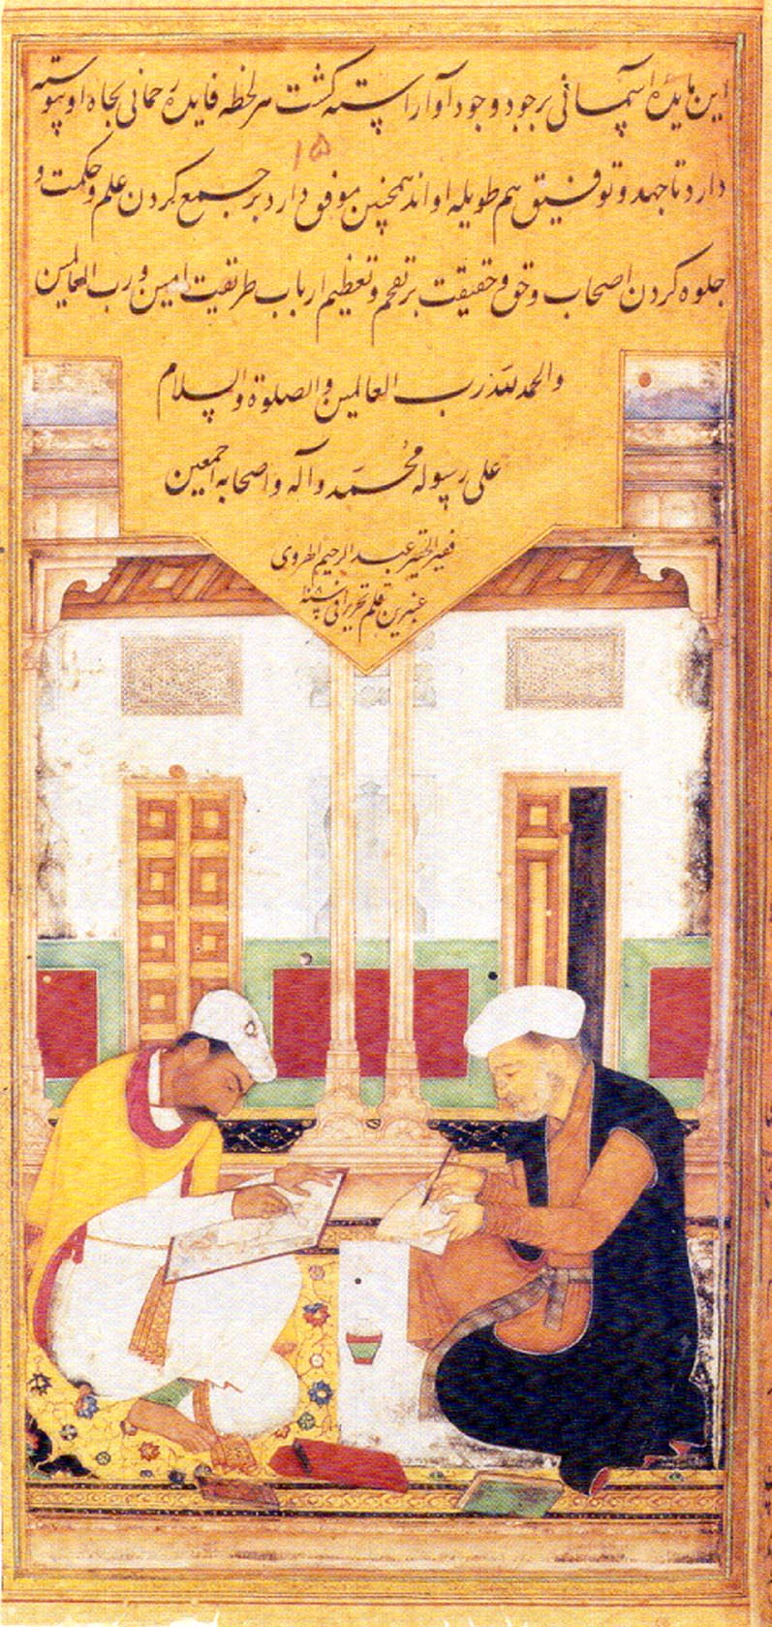
Libraries, books and paper -calligraphy
The highest of all the Islamic arts is calligraphy - the art of beautiful writing. The importance of calligraphy stemmed from the Muslim belief that the Qur'an is the literal word of Allah. Arabic script is written and read from right to left. Schools of calligraphy were established throughout the Islamic world, and both men and women became accomplished and famous scribes.
As schools of calligraphy were established, different styles of writing emerged. The two oldest styles were kufic - named after the town of Kufa, which was an early centre of calligraphy, and naskhi. Kufic was an angular script, well-suited to surface decoration in stone and mosaic. It was also used for early Qur'ans. Naskhi was a more flowing style, used also for secular writing.
ﭺلسﭻقلإجهلإسغقلإجهسغج

Slide 16
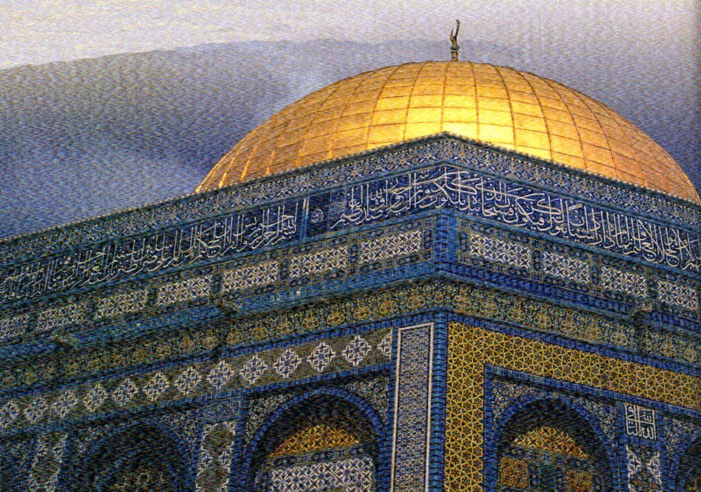
Libraries, books and paper - calligraphy and art
Arabic script became the most popular form in Islamic art. Images or statues of people were not popular as Muhammad, preached against worshipping idols. The picture is of the Dome of the Rock mosque in Jerusalem. This is one of the most important sites for Muslims as it is built over the rock from where Muslims believe Muhammad ascended to heaven.
Islamic script is
used to decorate
the building.
Tile work and
mosaics are
another form of
art often seen in
Islamic buildings.
ﭺلسﭻقلإجهلإسغقلإجهسغج

Slide 17
Science
Muslim scientists were far ahead of others in Europe at this time. Some of their knowledge came from China and India. Some came from translating and studying the writings of Greek and Roman scientists, such as Ptolomy.
Although much of their science built on what had been found out before, in many cases they extended that knowledge or developed completely new ideas.
Late in the eleventh century, books by Islamic scholars began to be translated from Arabic into Latin by Christian Europeans. Arabic versions of writings by classical philosophers and scholars (Greek and Roman) started to filter into Christian Europe in the same way and at the same time. Some of these would have been books on science.
ﭺلسﭻقلإجهلإسغقلإجهسغج

Slide 18
Science – astronomy 1
Astronomy, the study of the sun, moon and stars, was particularly important for Muslims as it allowed them to follow their faith correctly. Astronomical observations allowed them to produced tables which could be used to calculate the positions of the planets, eclipses, phases of the moon and calendars.
This meant they could accurately determine the times for daily prayers throughout the year. Prayer times are dawn, midday, afternoon, sunset and evening, so careful observations of sunrises etc could be used to show at what time these would happen in different parts of the Muslim world.
Secondly all Muslims needed to know where Mecca was from wherever they might be and this could be determined by observing the moon and the sun. Finally, the Muslim calendar is based on the phases and position of the moon. So access to tables detailing these could show when, for example, the holy month of Ramadan fell.
ﭺلسﭻقلإجهلإسغقلإجهسغج

Slide 19
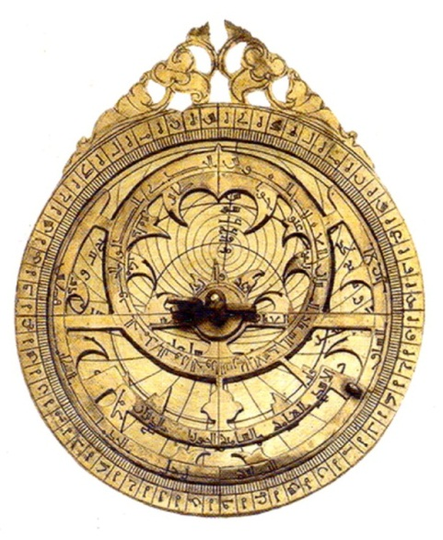
Science –astronomy 2
Early Islamic astronomers used ancient Greek works, such as Ptolomy’s, but also went further by careful, long-term observation and measurement of the objects in the sky. The Caliph Al-Ma’mum patronised astronomy and built an observatory in 828, the first in the Muslim world (possibly in the whole world). Another early observatory was built on Mount Qasiyum in Damascus.
Islamic astronomers produced astronomical tables
which continued to be used well into the
15th and 16th centuries. Some astronomical
tables included star catalogues and
explanations of astronomical instruments
like sextants and quadrants which were
used to measure the altitude of stars etc
above the horizon.
ﭺلسﭻقلإجهلإسغقلإجهسغج

Slide 20
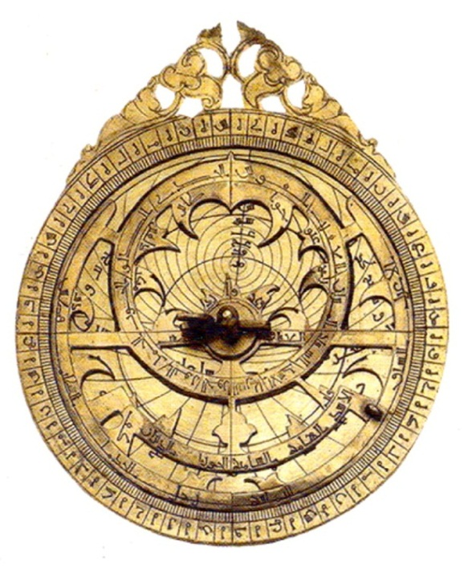
Science -astronomical instruments 1
Islamic scientists rediscovered and made improvements to astronomical instruments such as sextants, quadrants
and the astrolabe. These were probably first made
in ancient Greece but, like much ancient knowledge,
they may never have reached the west if they had
not been rediscovered by Islamic scientists.
Extensive geometrical calculations were required
to make such instruments so astrolabe makers, such
as Maryam Astrulabi and her father, had to be experts
in mathematics, astronomy and precision engraving.
When astrolabes first began to filter into Christian Europe their full potential was often not recognised, partly because instructions for their use were written in Arabic. Hence they were often only used to calculate important Christian dates, such as Easter, not for astronomical observation. Eventually, when some Europeans tried to follow the Islamic lead and embark upon true observational science they fell foul of the Roman Catholic Church, for example, the work of Nicolaus Copernicus on a sun centred universe published in 1543, resulted in him being imprisoned for blasphemy.
ﭺلسﭻقلإجهلإسغقلإجهسغج

Slide 21
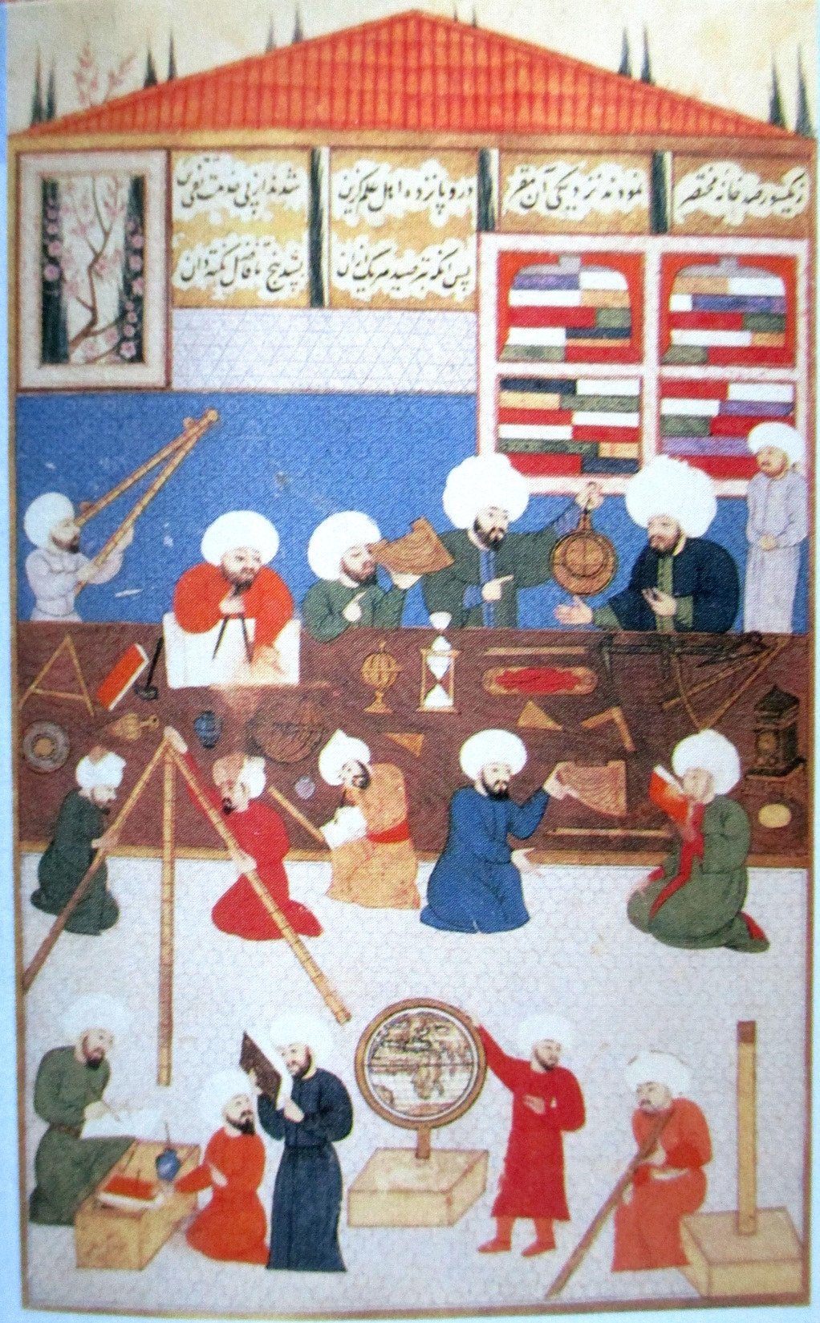
Science -astronomical instruments 2
This picture shows Muslim astronomers at work.
Can you work out how many different astronomical instruments they are using and what some of them are?
You might need to look at other sources to help you.
ﭺلسﭻقلإجهلإسغقلإجهسغج

Slide 22
Science - astronomers
Islamic astronomers knew the Earth was spherical. Tenth century Islamic astronomers Al-Battani and Ibn Yunus calculated the time of the Earth’s rotation around the sun almost as accurately as we have today.
Al-Khujandi calculated the tilt of the Earth on its axis with similar accuracy and used his figures to compile a list of latitudes of major cities. Al-Biruni also used mathematics to measure the Earth’s circumference.
Al-Sufi was the first person ever to record anything outside our galaxy, describing the Andromeda galaxy in 964. Together Islamic astronomers named and recorded the magnitudes of 1,022 stars and constellations.
Today at least 165 stars still have names linked to their Arabic names. It is likely that the first ever planetarium dates from this time too, as in the ninth century, Ibn Firnas, built a glass planetarium in his house in Cordoba.
ﭺلسﭻقلإجهلإسغقلإجهسغج

Slide 23
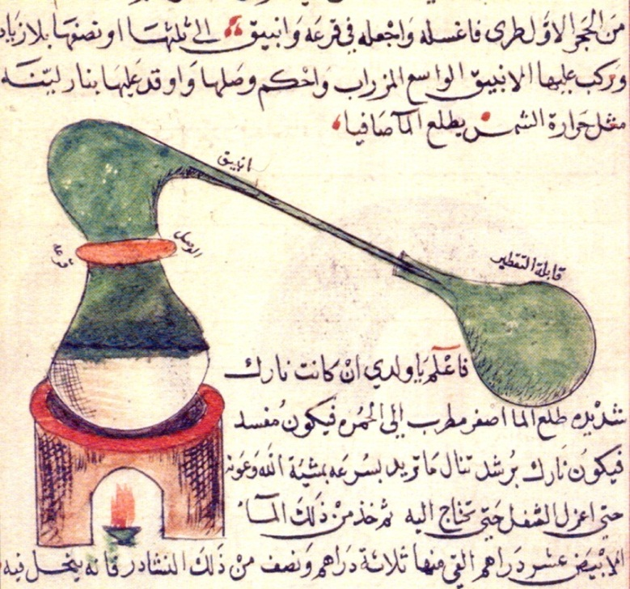
Science - chemistry 1
Muslim chemists perfected many chemical process, such as filtration, evaporation and distillation. They also discovered chemicals and developed laboratory equipment that is still used today. We even use their words today - al-kimya (alchemy/chemistry), al-qalawi (alkali) and al-iksir (elixir).
Jabir ibn Hayyan is known as the father of chemistry. He was the son of an apothecary and spent most of his time in a laboratory in Kufa, Iraq, perfecting processes like filtration,
distillation and evaporation. Distillation
was used with wine to produce alcohol
to use as a disinfectant (see medicine)
and base for inks, perfumes and
flavourings, such as rose water. They
even distilled crude oil to make kerosene
to use as fuel for lamps.
Ibn Hayyan knew that elements could
combine in a way that was too small
to see with the naked eye – so he was thinking at an atomic level around 1200 years ago! He also discovered nitric and sulphuric acids which are essential to modern chemistry.
ﭺلسﭻقلإجهلإسغقلإجهسغج

Slide 24
Science - chemistry 2
Al-Razi classified substances as animal, mineral or vegetable and made caustic soda, lead oxide and various metal alloys. He wrote up his experiments so we know he was using distillation and crystallisation in his work. Al-Razi wrote a book showing how to prepare and use many chemicals. It included information on how to work out what mixture of chemicals gave the best results.
Earth science / meteorology –
Ibn al-Haytham explained rainbows, halos and why sun or moon seem to be larger when they approach the horizon.
ﭺلسﭻقلإجهلإسغقلإجهسغج

Slide 25
Mathematics
The Arabs were the leading mathematicians of the Middle Ages. Like the scientists, they too learned much from the work of the Greeks and Romans. However, one Muslim mathematician, AI-Khwarizmi, who lived from about 780 to 850, developed a completely new type of mathematics that neither the Greeks or Romans had ever thought of. We call it algebra, from the title of his book al-jabr.
Al-Khwarizmi also used numerals which came from India, instead of Roman numerals. They are the numbers 1-9 that we use today and call Arabic numerals. He made use of another Hindu discovery as well. This was the idea of zero. This was called sifra in Arabic. AI-Khwarizmi showed zero with a dot. The Hindus used a small circle instead. People in Europe later used Arabic numerals as well. They found them much easier to use in calculations (sums) than Roman numerals.
ﭺلسﭻقلإجهلإسغقلإجهسغج

Slide 26
Mathematics
The Muslim world inherited knowledge of Greek mathematics, but this was basically only about geometry (about points, lines and curves) and a limited use of trigonometry (about triangles).
The Greek astronomer Ptolemy had developed tables for calculating the position of the sun, moon and the five planets the Greeks knew of, but these were difficult to use and involved several steps to reach an answer. Muslim scholars such as Al-Biruni, Al-Battani and Al-Khwarizmi developed an easier way to find angles and distances which we still use today, however it was hundreds of years before mathematicians in the West developed the same ideas.
Al-Khwarizmi’s work developed a whole new field of mathematics – algebra. Al-Karaji built on his work developing many of the ways mathematicians still write equations in algebra today. He also started a school of algebra which thrived for several centuries. Al-Khayyam - known today as Omar Khayyam the poet, also contributed to algebra by classifying cubic equations and extracting roots. Ibn al-Haytham attempted to classify all even perfect numbers.
ﭺلسﭻقلإجهلإسغقلإجهسغج

Slide 27
Medicine
At the time medicine was far more advanced in Islamic countries than it was in Christian Europe. The Abbasid caliphs had collected a huge library of medical books which they had translated into Arabic. Many of these, such as those from Hippocrates (ancient Greek times) and Galen (Roman times), would have been totally lost to us today if they had not been translated in this way. Islamic doctors learned from the ancient texts. This meant they examined patients carefully before prescribing treatment, as Hippocrates and then Galen had suggested.
Islamic medicine was free to all, Muslims are bound by their faith to provide treatment for the sick and frail. So all patients were treated regardless of wealth or religious background. In the West, when proper medicine developed, you would only get medical treatment from a trained doctor if you could afford to pay for it. Hospitals in the Islamic world were funded by charitable religious endowments and by money from the local rulers. The hospital in Cairo gave 5 pieces of gold to patients on leaving, so they did not have to return to work immediately.
ﭺلسﭻقلإجهلإسغقلإجهسغج

Slide 28
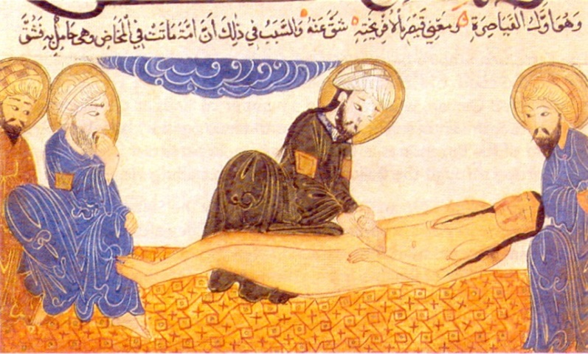
Medicine - anatomy and surgery
During most of the Greek and Roman periods dissection¹ of bodies was not allowed, so some of their ideas about anatomy were wrong. Galen dissected animal bodies but some of his ideas were still wrong.
Although some Islamic doctors recognised there were mistakes in the ancient writings, because they could not dissect bodies for religious reasons, their knowledge of anatomy did not hugely extend Greek or Roman ideas.
Surgery from ancient times and throughout the Islamic period was mainly limited to treating surface wounds and tumours, amputations, dealing with broken bones and dislocations, cataract and kidney stone removal but no procedures that delved deeply into flesh. However, improved techniques and equipment meant that such procedures were less painful and more likely to be successful in this period.
This illustration shows a Muslim doctor
delivering a baby by Caesarean section.
This was one surgical procedure that the
Muslims learned from ancient medical
texts.
¹ Cut them open to see how they worked.
ﭺلسﭻقلإجهلإسغقلإجهسغج

Slide 29
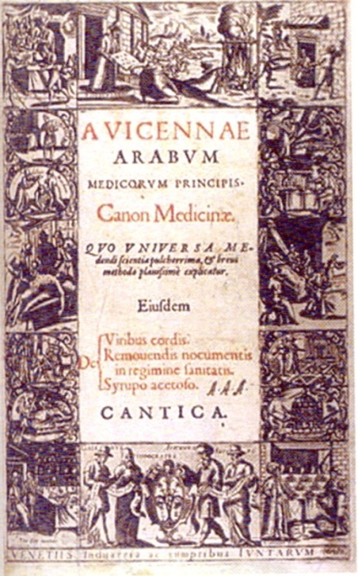
Medicine - medical developments
Muslim doctors followed the ideas of Hippocrates and Galen regarding the careful observation of patients. I doing this they developed some new ideas about diseases and how the human body works.
Al-Razi, (known in the West as Rhazes), working in tenth-century Baghdad kept detailed notes on all the patients he treated, from which he was the first to realise that measles and smallpox were different diseases. He wrote nearly two hundred books on medicine. Perhaps his most important work was a huge encyclopaedia of medicine called al-Hawi. For each disease listed in al-Hawi he gave the views of Greek, Indian, Arab and Persian writers. He then added his own observations
of patients and his own opinions about the disease.
He was not afraid to rely on his own observations
when they disagreed with the ideas of earlier doctors.
Other Islamic scholars also made huge contributions in
medicine. Ibn Sina (aka Avicenna) gathered
together all the medical knowledge of the time in
his Canon of Medicine. Later it was translated into
Latin and used in Europe until at least the 17th
century.
ﭺلسﭻقلإجهلإسغقلإجهسغج

Slide 30
Medicine – hospitals
Islam taught that sick people should be looked after and that hospitals should be built to care for them. The Umayyad and Abbasid caliphs built hospitals and trained and employed doctors and nurses to staff them. The first hospitals in eighth century Baghdad were more like hostels but did look after lepers, invalids and the destitute.
Between 872-874 the Ahmad ibn Tulun Hospital was built in Cairo. It treated people and issued medicines for free. Patients wore special ward clothes. It even had a psychiatric wing to look after people with mental health problems.
In 982 a hospital was built in Baghdad. It had a team of 24 physicians. Another ninth century hospital in Tunisia the Al-Qayrawan hospital employed female nurses from Sudan as well as a team of physicians.
The hospitals in Baghdad were very spacious and were built around garden courtyards, as Islamic doctors believed that gardens and running water helped people to get better quickly. Each included a pharmacy, library and small mosque. Qualified doctors trained medical students as well as treating the sick.
ﭺلسﭻقلإجهلإسغقلإجهسغج

Slide 31
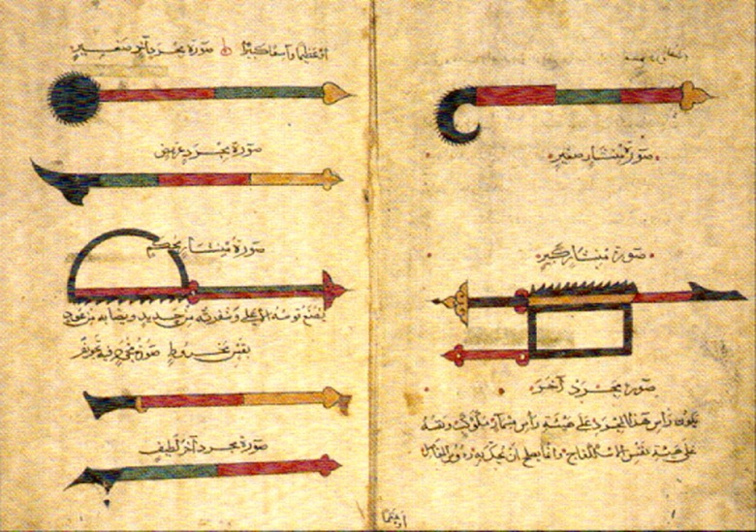
Medicine – surgery
Many of the instruments and procedures surgeons use today were first developed by Islamic surgeons. Al-Zahrawi (Abaculsis in the West) who practised in Cordoba, Spain 10th – 11th century wrote a medical encyclopedia, Al-Tasrif. This described many new surgical and dental procedures including setting broken bones in plaster, using bone fragments to replace lost teeth and a procedure for lifting sagging breasts. He was the first to use catgut to stitch internal incisions. It is still used today as it is still the only natural substance that dissolves and is accepted by the body. AI-Zahrawi used antiseptics. He also trained midwives and nurses.
Al-Tasrif also detailed, with illustrations,
over 200 surgical instruments and how,
when and where they should be used,
some of which he had developed himself.
The instruments included scalpels, saws,
knives of various shapes for different
incisions, forceps for births and special
ones for crushing kidney stones. Al-Tasrif was later translated into Latin. It was still being used at Oxford University at the end of the 18th century.
ﭺلسﭻقلإجهلإسغقلإجهسغج

Slide 32
Medicine – opthamology and pharmacy
Ophthalmology – study and treatment of the eye and its diseases. Of 30 ophthalmology books from the Islamic period, 14 still exist today, Notebook of the Oculist written by Ali ibn Isa was translated into English in 1936. The treatment Al-Mawsili developed for cataracts in the tenth century – sucking the cloudy lens out of the eye through a small incision - is essentially still the procedure used today, with a few extra technological improvements such as freezing the lens before it is sucked out.
Pharmacy – (making and using medicines) Over 1000 years ago pharmacies were operating in Baghdad. Hospitals at the time also had dispensaries. See Chemistry and investigate:
Sabur ibn Sahl, Abu al-Mansur Mwaffaq
ﭺلسﭻقلإجهلإسغقلإجهسغج

Slide 33
Technology - engineering 1
The people of the Islamic world developed a number of machines to save labour and make their work easier. Engineers even made paper models to plan engineering projects to make sure they would work.
Power to drive machinery was supplied by windmills and water wheels. Windmills came to the Islamic world from Persia in the
seventh century. They were invaluable in drier parts where waterwheels could not be used. Both were used to run mills which ground corn and to move water for use in cities, homes and for irrigating fields and gardens.
Huge waterwheels called norias, which were adapted from Roman and Persian versions, were first referred to in Islamic texts from the seventh century. Rivers were dammed to make reservoirs to hold water. Their construction methods were so good that about a third of dams built in the seventh and eighth centuries still exist today. Some dams even produced hydro power to drive mills or norias.
ﭺلسﭻقلإجهلإسغقلإجهسغج

Slide 34
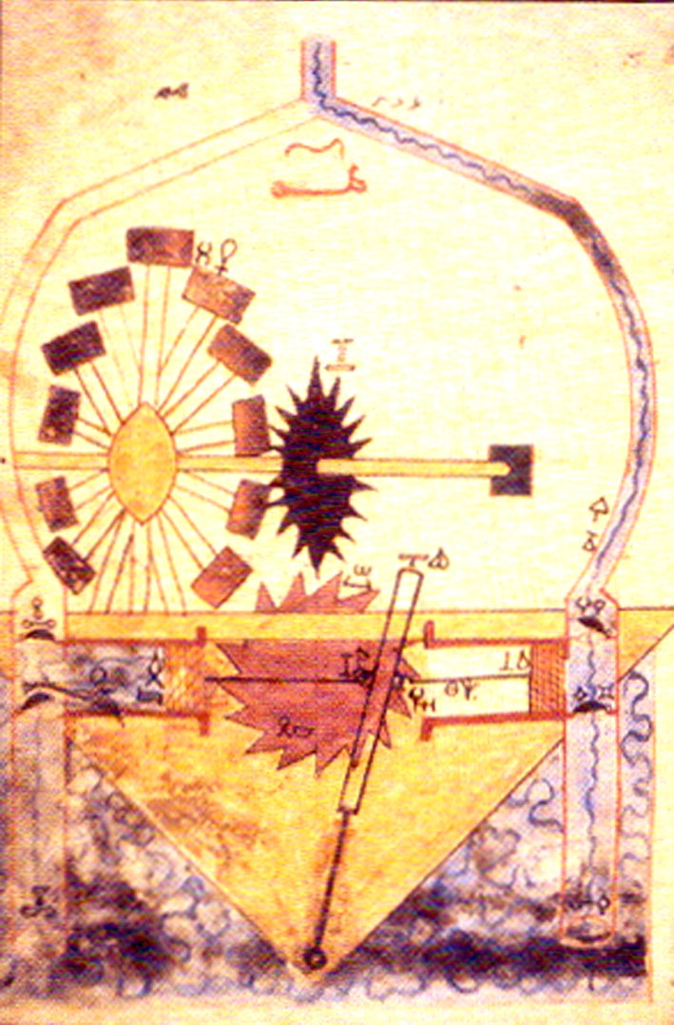
Technology – engineering 2
Many engineering projects involved water, either as a power source or in directing water to wherever it was needed. Cleanliness is important in the Muslim faith and many parts were very dry, so a good water supply was essential.
Waterwheels were used as a power source for
machines that raised water from rivers etc.
The machine in the picture used a pump with
a piston – the first piston known.
Arab engineers also built wells, dams,
reservoirs and aqueducts to supply water to
the cities. They were built so well that a third
of all dams built in the seventh and eighth
centuries still exist. Engineers dug
underground tunnels, called qanats to stop
too much water being evaporated by the sun.
Their skill in using water was even used to tell
the time. Ibn jubayr saw a water clock in
Damascus in about 1183.
ﭺلسﭻقلإجهلإسغقلإجهسغج

Slide 35
Technology - agricultural improvements
As the early Islamic civilisation spanned such a wide arc of the world and their people travelled widely within and beyond it, information about new crops, methods of cultivation and irrigation were soon being collected and distributed via agricultural manuals. Horticultural techniques such as grafting to improve cropping of fruit trees, layering to increase stocks of some plants and crossing to produce new varieties of plants were all known.
With information like this Muslims were soon raising a much wider range of crops and breeding the finest horses and sheep. In Spain, research into soil chemistry and soil erosion was being undertaken hundreds of years ago. Irrigation led to four harvests a year in Mediterranean regions where before just one harvest was usual.
Muslims spread the cultivation of rice, cotton, bananas, citrus fruits, flax (for linen cloth), saffron and sugarcane across the Mediterranean region and beyond. New land ownership rules allowing even farm labourers to keep more produce for themselves meant an improved diet full of fresh fruits and vegetables year round became available to all.
ﭺلسﭻقلإجهلإسغقلإجهسغج

