Slide 1
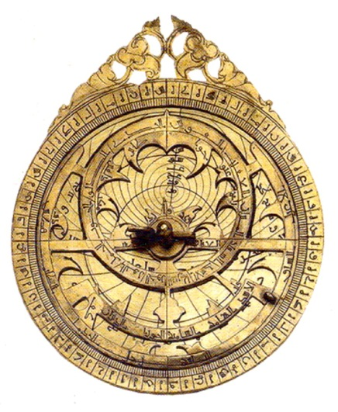
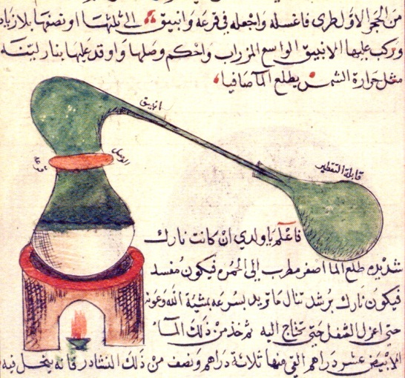
A beacon of light in the Dark Ages?:
An enquiry into the early Islamic civilization around 900 CE
Notes:
Title page, you may not wish to use this slide, the Key Question appears on the next slide.

Slide 2
This is our Key Question:
Was the early Islamic civilisation a beacon of light in the dark ages?
To answer the question, what do we need to find out first?
Notes:
A subsidiary question appears on next mouse click, you will probably need some discussion prior to revealing it.

Slide 3
What were the Dark Ages?
Dark Ages, the early medieval period of western European history. Specifically, when there was no Roman emperor in the West; or generally, the period between about 500 and 1000, which was marked by frequent warfare and a virtual disappearance of urban life. Though sometimes taken to derive from the fact that little was known about the period, the term’s more usual sense is of a period of intellectual darkness and barbarity.
Edited definition from Encyclopædia Brittanica

Slide 4
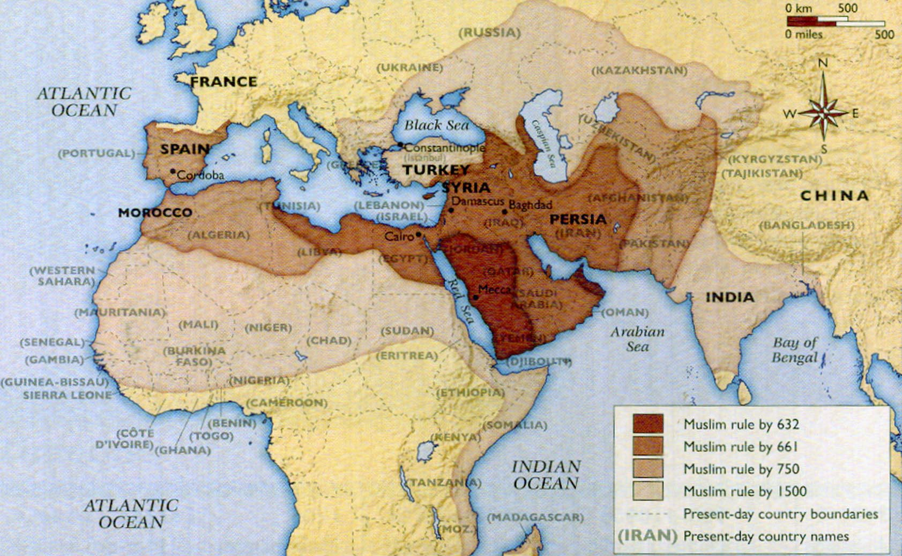
Where and when did the Islamic civilization develop?
Notes:
Need to discuss dates and the vast area concerned. Ensure pupils understand they are looking at Islamic civilization up to around 1100 CE.

Slide 5
What was life in Britain like around 900 CE?
In the early 5th century CE, around 410, Roman legions leave England to defend Rome against attackers from the East. Slowly the lack of organised authority means roads, towns and civic buildings begin to fall into disrepair. Taxes are not collected to pay for the upkeep of such structures and there is no-one in authority to organise it. Reading and writing declines because it is not being used for administrative purposes.
Later, from about 450 various groups of Saxons, Jutes, Angles and Frisians began to colonise Britain. They come from areas that were never part of the Roman Empire. Soon they began to drive out the Britons. They do not read or write. Literacy declines even further. They have their own religions and drive out Christians and ransack their churches.
When Christianity begins to spread across Britain again in the 7th century, the new monasteries become centres of learning. However they mainly concentrate on producing copies of religious texts, such as the Bible.
By the 7th century peoples from Scandinavia, the Vikings, start to raid Britain, plundering towns churches and monasteries for their riches. In 865 a great Viking army arrives in Britain and begins to take control of some Saxon kingdoms.

Slide 6
What was life in Britain like around 900 CE?
Here in the South, Wessex soon becomes the only Saxon kingdom remaining out of Viking control. Christian King Alfred, who by 871 rules Wessex, manages to defeat a faction of the Viking forces and signs a treaty dividing most of England between Wessex and the Vikings. In a brief few years of relative peace he assembles a group of scholars from Britain and Europe to try and recreate some of the writings lost from the monasteries. He also sets about making laws fairer and having religious texts translated into English (from Latin) so ordinary people can read them.
After Alfred, the Vikings resume raiding Britain. At one point the Norwegian King Cnut, also becomes King of England. Although Edward I (Edward the Confessor) eventually rules all of England, troubles with the Vikings and amongst British factions continue. Edward is a weak King and William Duke of Normandy sees his chance to invade. In 1066 the Normans take charge of Britain under him (William I/ the Conqueror).
The Normans build many of the great Cathedrals we still have today, as well as many castles to impose their authority. As France is part of the Holy Roman Empire, Latin once again becomes the language of church services and religious texts. From now on, the Roman Catholic church, backed by the Holy Roman Empire has huge influence over everyday life in England, as it already has in much of Europe.

Slide 7
Timeline Activity
With the card(s) you have been given read through them all carefully. Where would they be pasted on a timeline?
Cut them out and sequence them chronologically. You can print out and use the large timeline base if you want to.
Now all the cards are on the timeline, look along them.
Are there any pieces of information that surprise you?
Notes:
Once all the cards (RS1a) have been read out and placed along the timeline (RS1b), a second click will reveal a question to prompt consideration of the information given on the cards.

