Slide 1
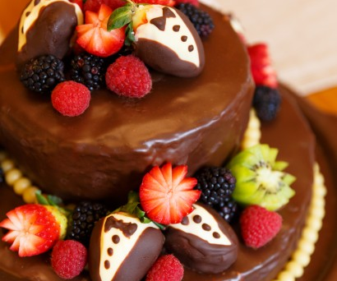
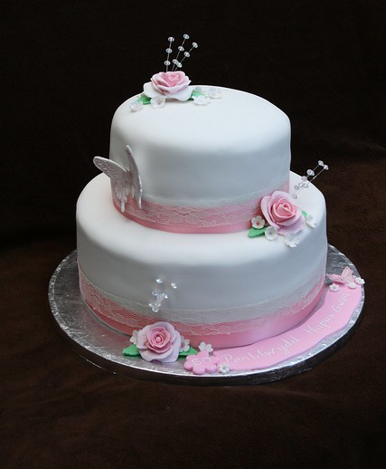

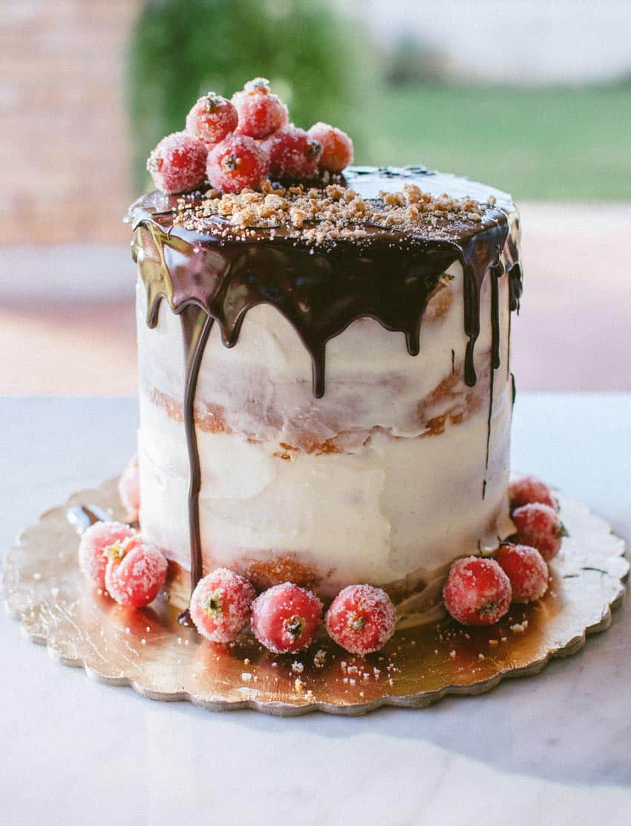
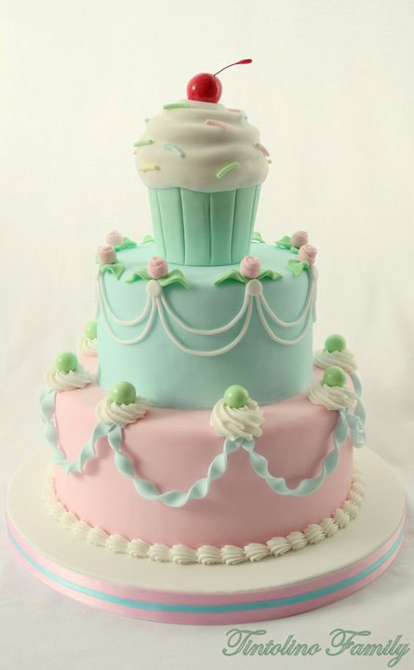
Baking
By ester
This Photo by Unknown Author is licensed under CC BY-ND

Slide 2
introduction
Baking is a fun and exiting thing to do, you can make any food and experiment with different flavours .You can challenge yourself to try lots of new things and bake for fun and for friends there are lots of websites and places you can find. If you want to learn how to bake you need to have a bit of patience and imagination that will help when you bake .There are lots of things to bake when it comes to baking including cupcakes ,cakes and cookies . You will experience lots of recipes and foods to make. Enjoy!

Slide 3
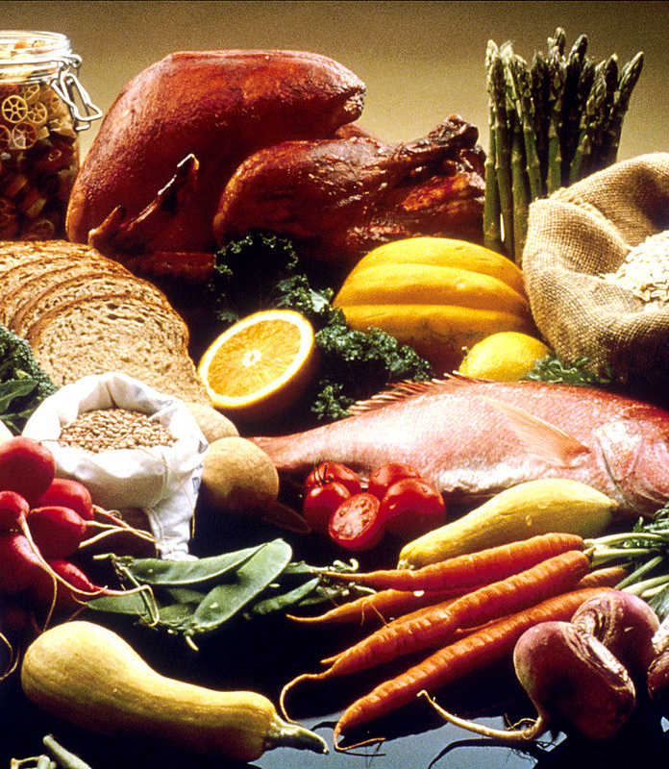
Ingredients!
You will find you will need ingredients in your foods .For pastries eggs , flour, milk, sugar, baking powder and more ingredients can have lots of different flavours some sweet some interesting some delicious and some great . There are some great flavours to try experiment with different flavours and have fun!
This Photo by Unknown Author is licensed under CC BY-SA

Slide 4
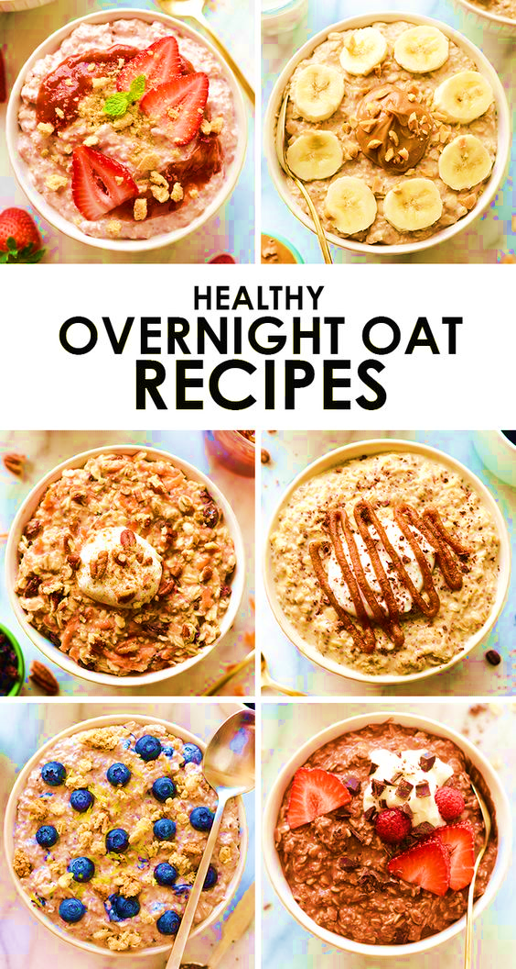
Recipes!
There are lots of recipes some are precise some not. It is very important to follow the recipes to make sure you get your baking right . Recipes use lots of different words like fold the dough gently which would mean do the sign of an eight or go one way then There are lots of techniques to learn in baking.
This Photo by Unknown Author is licensed under CC BY-NC-ND

Slide 5
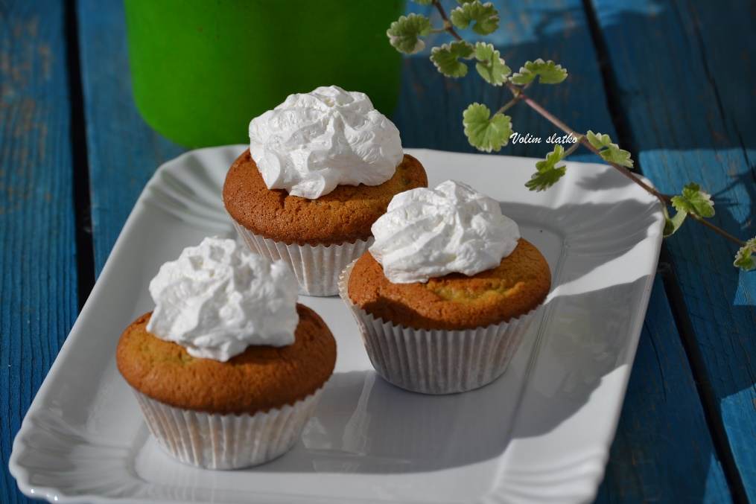
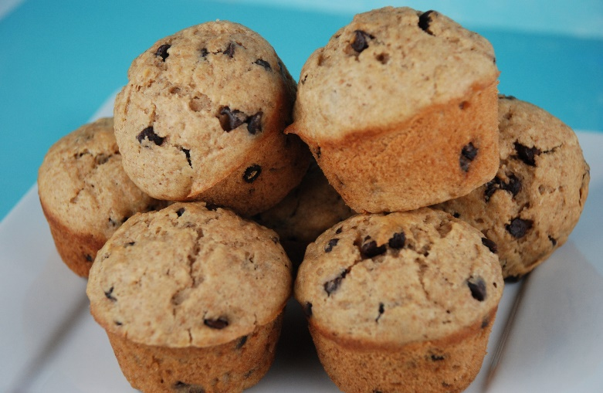
Recipe for bakewell muffin
1.Preaheat the oven to 190C/375F/gas mark 5.In a large jug add the milk ,eggs , sunflower oil and almond essence and mix.
5.When your muffins come out cool for 15 minutes ,while cooling toast the almonds on a pan at medium heat until golden brown.
Ingredients:
200g Self-Raising Flour
180g Ground Almonds
130g Caster Sugar
1 Tsp Baking Powder
250ml Milk
75ml Sunflower Oil
2 x Eggs
2 Tsp Almond Essence
Decoration:
200g Icing Sugar
2 Tbsp Water
200g Raspberry Jam
50g Flaked Almonds
2.In a large mixing bowl add the self raising flower ,ground almonds , caster sugar and baking powder.
6.Next use a cupcake corer remove the center’s of the muffins and fill with strawberry jam and put the remains of the muffin on top
3.While mixing slowly pour the liquid ingredients into the dry ingredients and mix until all of the ingredients have been fully incorporated . Then add a tablespoon of baking flowee and fold in .
7.Put the icing sugar in a bowl add a tablespoon of water (can add more)then put in a piping bag and pipe on muffins then add the almonds on top and enjoy!
4.Line a cupcake tin with tulip muffin cases then scoop and divide the mixture into 12 cases and cook for 20-25 minutes.

Slide 6
Thank you for reading
Hope you enjoy baking! Bye.

