Slide 1

Year 4 – Autumn Block 1 – Ready to Write
Step 1: Using Determiners
© Classroom Secrets Limited 2018

Slide 2
Introduction
Which sentence makes sense?
My mum bought me an new doll and an umbrella for my birthday.
My mum bought me a new doll and an umbrella for my birthday.
© Classroom Secrets Limited 2018

Slide 3
Introduction
Which sentence makes sense?
My mum bought me an new doll and an umbrella for my birthday.
My mum bought me a new doll and an umbrella for my birthday.
© Classroom Secrets Limited 2018

Slide 4
Varied Fluency 1
Underline the determiners in the sentence below.
I like this salad more than that takeaway.
© Classroom Secrets Limited 2018

Slide 5
Varied Fluency 1
Underline the determiners in the sentence below.
I like this salad more than that takeaway.
© Classroom Secrets Limited 2018

Slide 6
Varied Fluency 2
Circle the determiner that is missing from the sentence below.
____________ people agree with me.
This |  | Many |  | A
© Classroom Secrets Limited 2018

Slide 7
Varied Fluency 2
Circle the determiner that is missing from the sentence below.
____________ people agree with me.
Many
This |  | Many |  | A
© Classroom Secrets Limited 2018

Slide 8
Varied Fluency 3
Would these nouns need ‘a’ or ‘an’ as their determiner?
_______ hairdryer
_________ shower
© Classroom Secrets Limited 2018

Slide 9
Varied Fluency 3
Would these nouns need ‘a’ or ‘an’ as their determiner?
_______ hairdryer
_________ shower
a
a
© Classroom Secrets Limited 2018

Slide 10
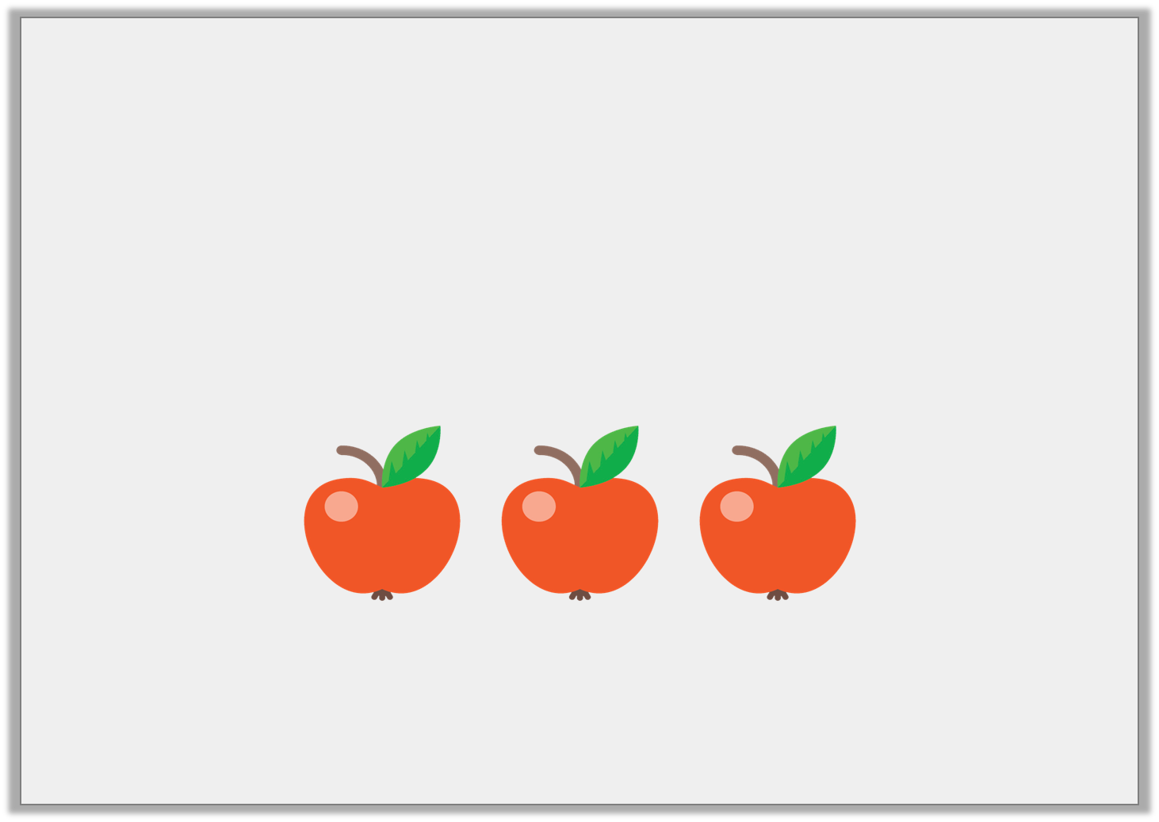
Varied Fluency 4
Circle the correct quantifying determiner for the sentence below.
Here are (few/some/less) apples.
© Classroom Secrets Limited 2018

Slide 11
Varied Fluency 4
Circle the correct quantifying determiner for the sentence below.
Here are (few/some/less) apples.
© Classroom Secrets Limited 2018

Slide 12
Application 1
Sort the determiners into the table below by deciding if they could be used before the given noun.
Noun: elephant
Possible determiners: a, an, the, my, your, some, four
Could be used | Could not be used
© Classroom Secrets Limited 2018

Slide 13
Application 1
Sort the determiners into the table below by deciding if they could be used before the given noun.
Noun: elephant
Possible determiners: a, an, the, my, your, some, four
Could be used | Could not be used
an the my your | a some four
© Classroom Secrets Limited 2018

Slide 14
Application 2
Write a different noun for each of the following determiners:
Quantifying determiners:
some __________________
three __________________
Possessive determiner:
his __________________
© Classroom Secrets Limited 2018

Slide 15
Application 2
Write a different noun for each of the following determiners:
Quantifying determiners:
some __________________
three __________________
Possessive determiner:
his __________________
dogs
houses
spaceship
© Classroom Secrets Limited 2018

Slide 16
Reasoning 1
Find and explain the determiner which is used incorrectly in the passage below.
I waited for me turn in the race. When it was time, I stood up and walked to the starting line.
© Classroom Secrets Limited 2018

Slide 17
Reasoning 1
Find and explain the determiner which is used incorrectly in the passage below.
I waited for me turn in the race. When it was time, I stood up and walked to the starting line.
‘Me’ should be ‘my’ because…
© Classroom Secrets Limited 2018

Slide 18
Reasoning 1
Find and explain the determiner which is used incorrectly in the passage below.
I waited for me turn in the race. When it was time, I stood up and walked to the starting line.
‘Me’ should be ‘my’ because it is a possessive determiner and the turn in the race belongs to the person writing.
© Classroom Secrets Limited 2018

