Slide 1



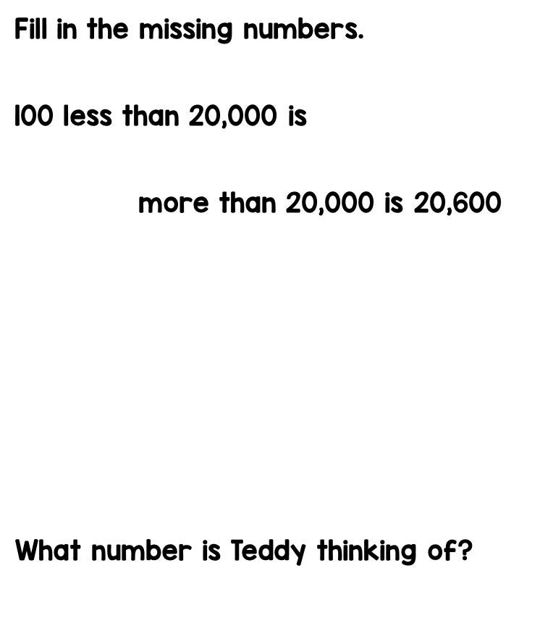
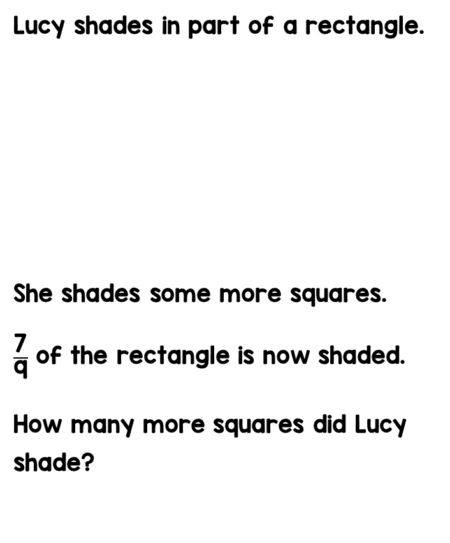




Tip- Lucy shaded 7 out of 9

Slide 2
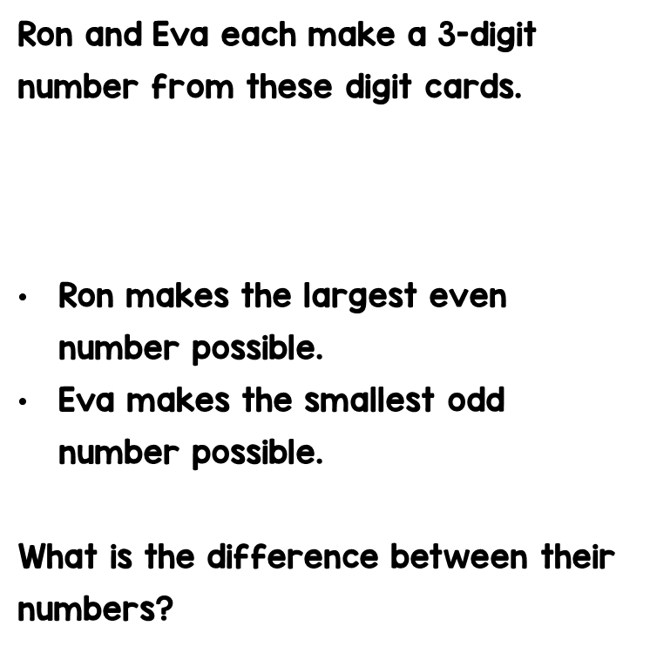






Tip- you need to subtract

Slide 3
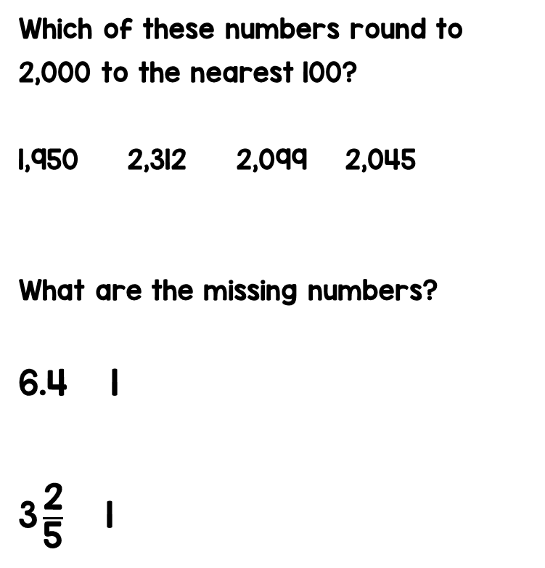

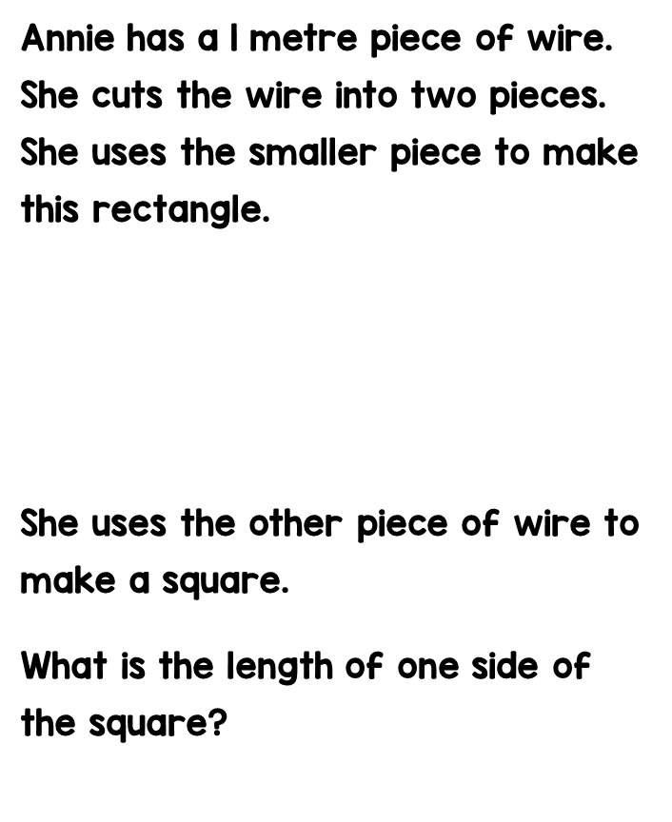
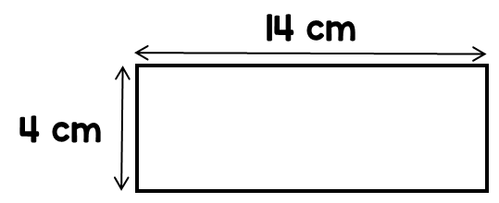

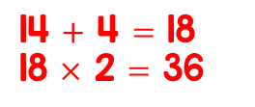



$$=$$
$$+$$
What is the perimeter of the shape above?

Slide 4




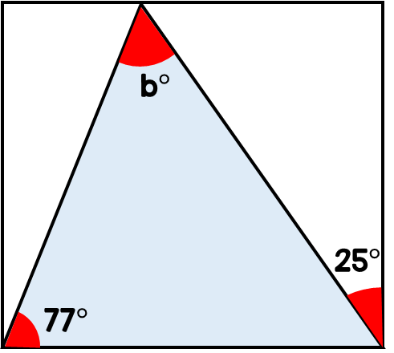




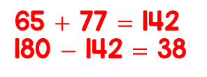


What are the missing digits?
Annie and Ron each think of a number.
The product of their numbers is 762
Work out Ron’s number.
Find the size of angle b.
I’m thinking of the number 6

Slide 5
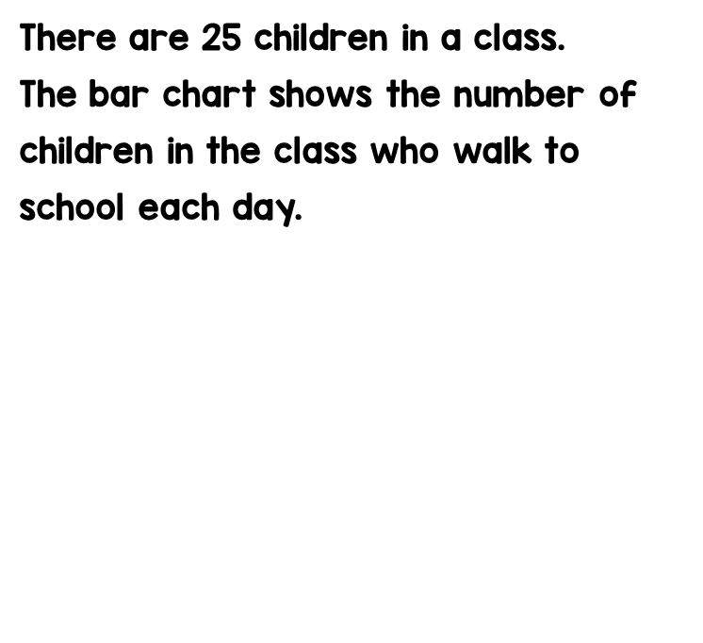
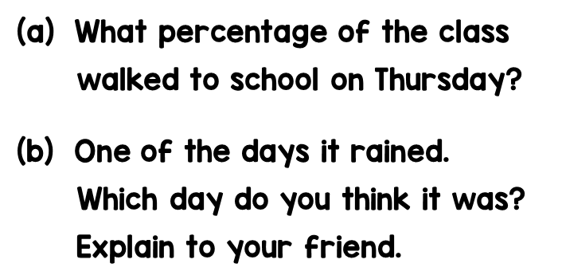

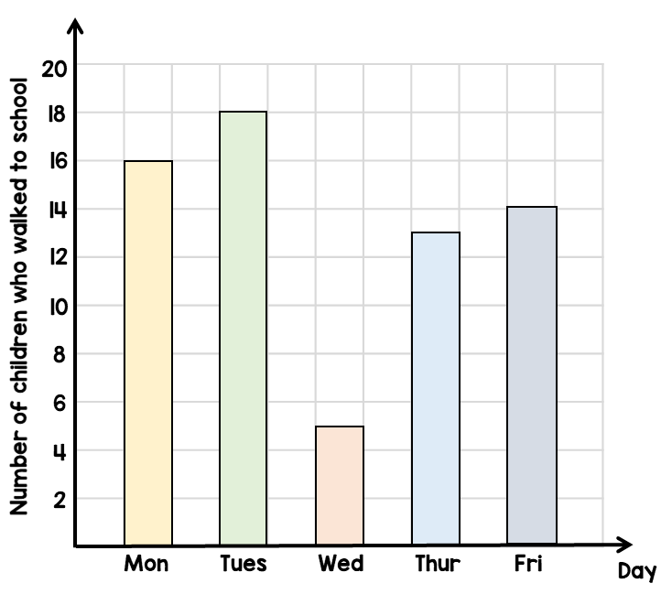

How many children

Slide 6
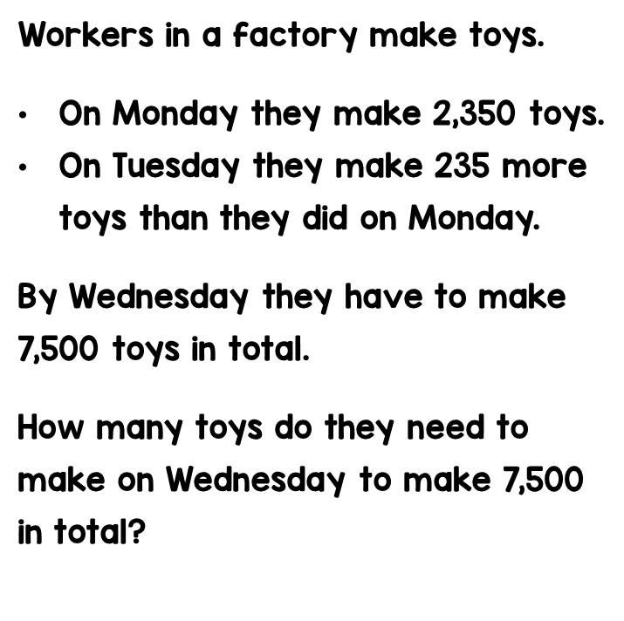
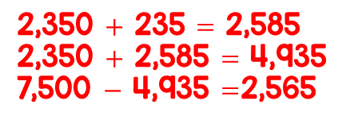

Really tricky!! Have a go but don’t worry if you get stuck! Email Mr Gibbs and he can explain it ☺

Slide 7
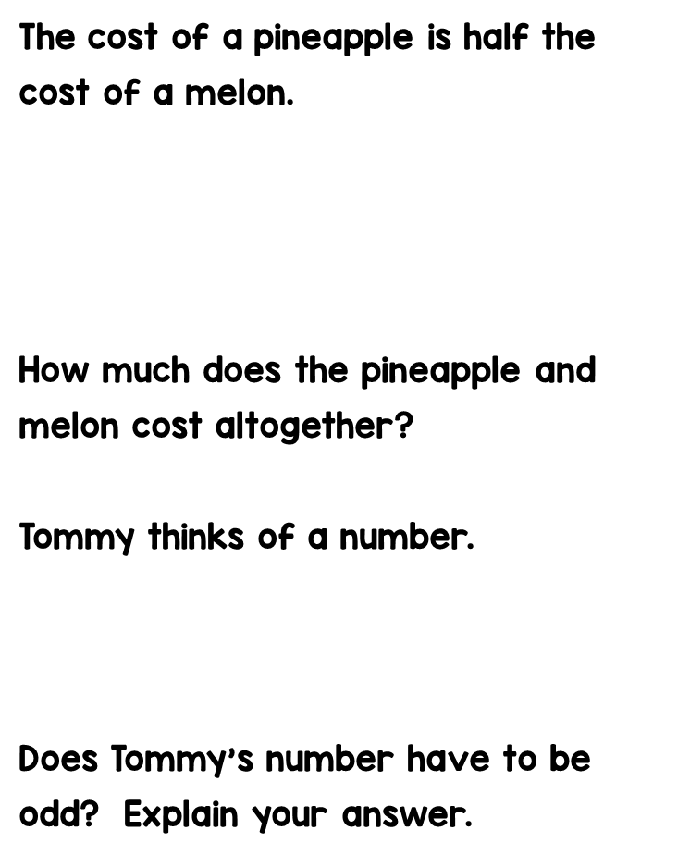








9
Tip- use coins or half £3 then 50p. Don’t forget to add them after!
£3.50 each
It is in the 5x table
Can
Answer- It can be as 25 is in the 5 times table.

Slide 8
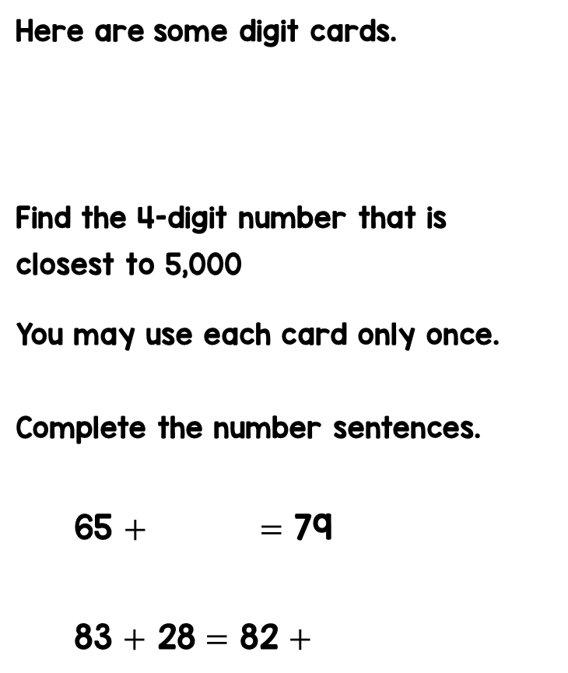






Slide 9
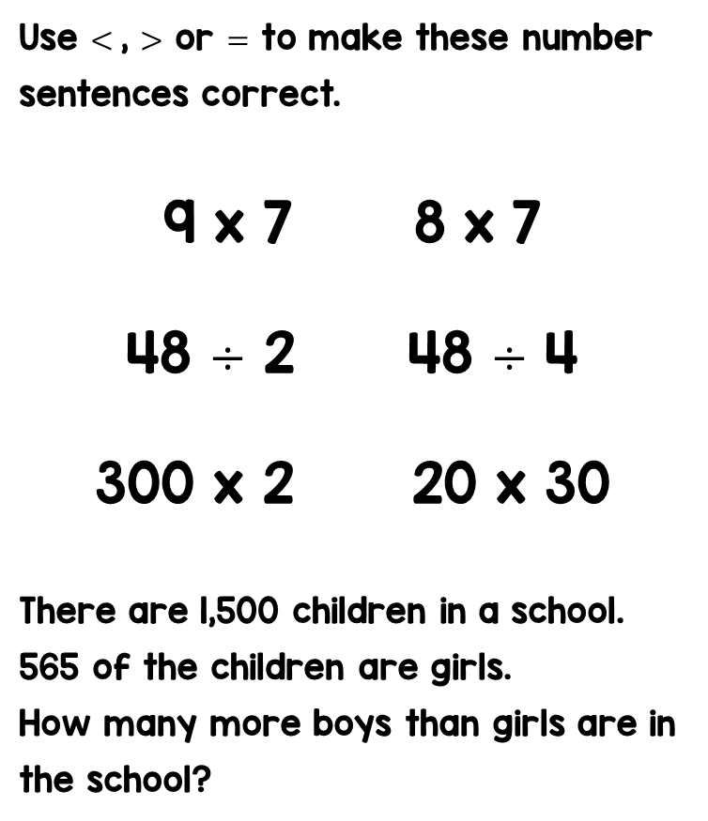






Slide 10













