Slide 1
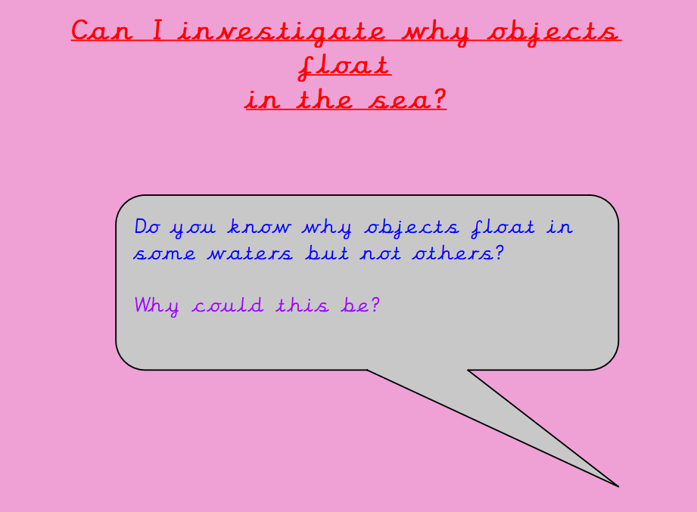

Slide 2
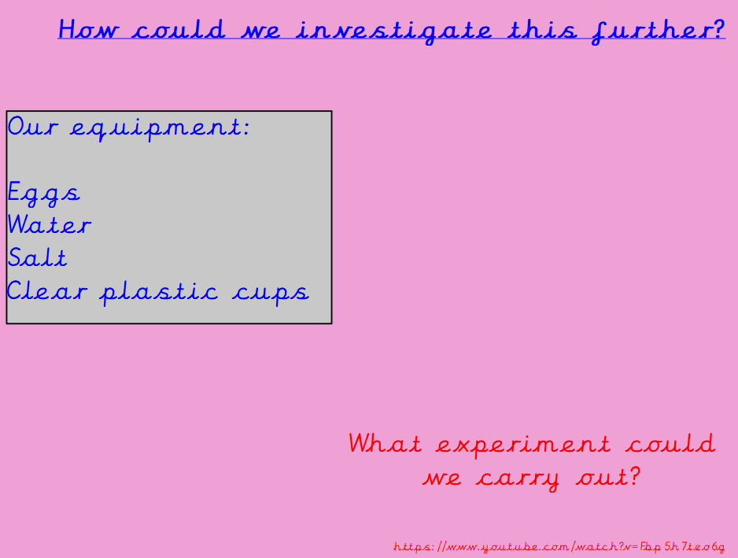

Slide 3
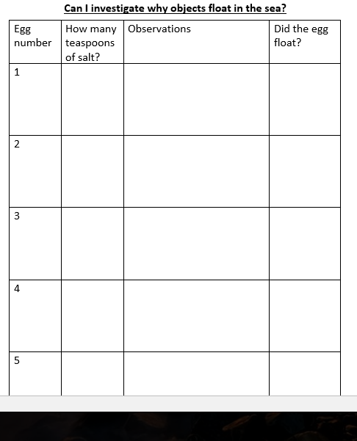

Slide 4
What did you find out?
What conclusions can you make?
Write a short paragraph explaining this.

