Slide 1
Australian Bushfires
People Help as Bushfires Burn in Australia

Slide 2



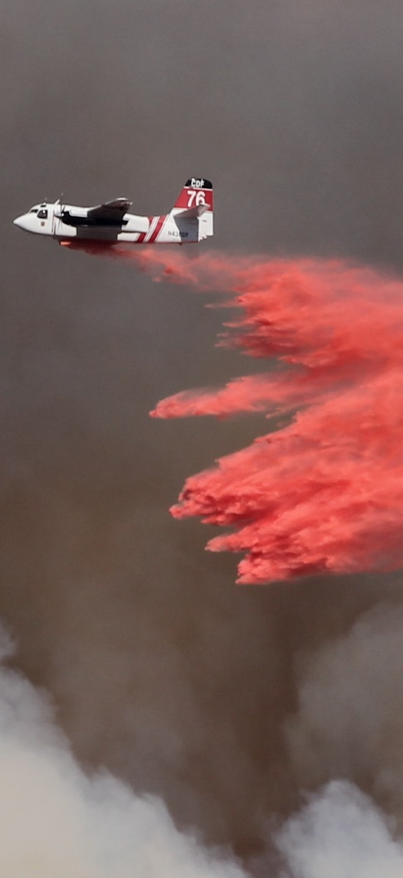
Daily News
Environment x World News x
8th January 2019
People Help as Bushfires Burn in Australia
Bushfires have caused a lot of damage in parts of Australia. Many people and charities are working to help those affected.
The fires have destroyed large areas of bush and farmland. Thousands of people have had to leave their homes and move to a safer area.
Some state governments have declared states of emergency. This means that firefighters will have extra powers to tackle the bushfires.
They are using helicopters to drop water on the area. They have also dropped a special pink powder on to the areas nearby. This is a fire retardant and will help stop the fire from spreading.
The prime minister of Australia, Scott Morrison, has said that the government will provide $2 billion in Australian dollars (about £1 billion) to fight fires and help the area recover.
Charities, such as the Red Cross, are also working hard to help those affected by the fires.
They have created centres for people who have had to be evacuated. Here, they give support, food, water and shelter to those affected by the fires.
Read the full article online here.
What are bushfires?
How are people helping?
What should I do if I’m upset by the news?
Photo: A plane dropping powder on a fire to stop it from spreading.
Notes:
Teacher Note - Please do not let the next video automatically play at the end of the clip. Please check the content in this link, including any comments, is suitable for your educational environment before showing. Twinkl accepts no responsibility for the content of third party websites.

Slide 3


Slide 4


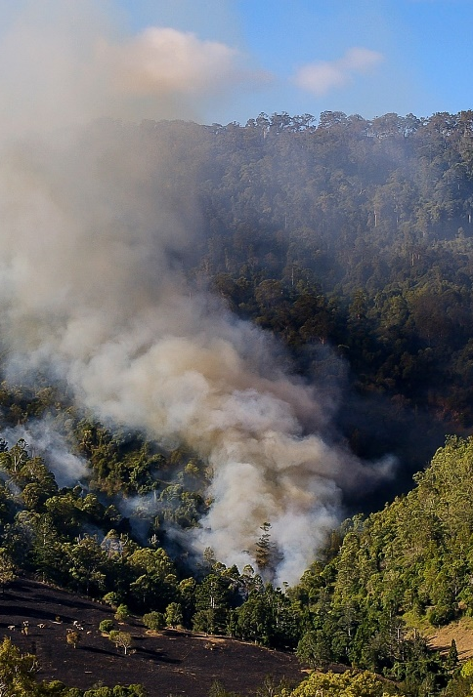
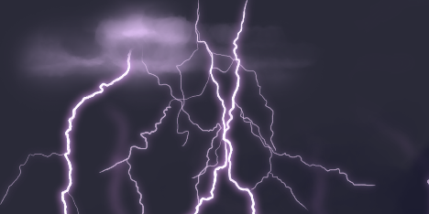


What Are Bushfires?
occur
environment
temperatures
Bushfires are large, uncontrolled fires, which occur in the Australian bushland.
High temperatures, dry conditions and strong winds mean that they can spread quickly.
Bushfires can happen naturally in this environment. Lightning can spark fires and sometimes very hot, very dry leaves can catch fire.
Bushfires can cause serious problems and some states have put in place a total fire ban.
This means that people living in the area can’t light or use a fire in the open.
Use a map or atlas to find the Australian bushland.
This includes barbeques which use solid fuel, such as charcoal, as well as campfires.
They can also have human causes, such as barbecues or fallen electricity poles.
What do you know about the Australian bushland?

Slide 5


Slide 6
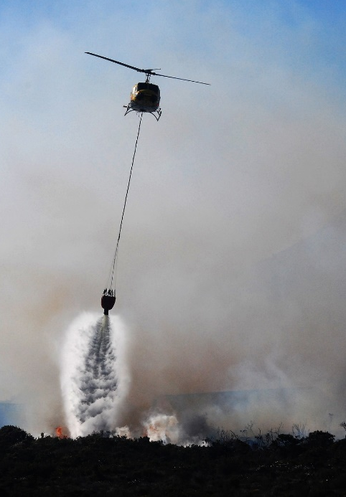

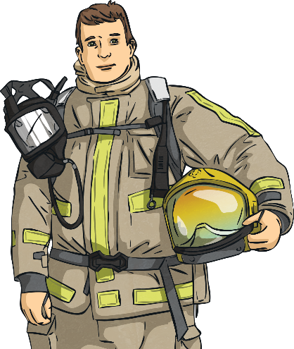
How Are People Helping?
government
equipment
community
Lots of people are working hard to help those affected by the fires. State governments have declared a state of emergency over the last few months
They are also dropping pink powder. This is a fire retardant and will help stop the fire spreading.
Charities are also helping. They have set up centres to support people.
This gives firefighters extra equipment and power to tackle the fires.
These offer support, shelter, food and water. Many people from the community have also volunteered to help.
Firefighters are using helicopters to drop water on the fires.
Work with a group to come up with ways you could help raise money.
Across the world, people are donating money to help firefighters and the charities involved.
What could your community do to help?

Slide 7


Slide 8



What Should I Do If I’m Upset by the News?
frequently
disastrous
opportunity
Some of the things we see or hear in the news are upsetting.
Remember that terrible or disastrous things are very rare – that’s why they’re in the news.
It’s normal to feel upset or worried about the news. Adults frequently do as well.
Drawing or writing about your worries might also help you to understand your emotions.
You can find out the facts about the news using child-friendly news sites.
Talking to a trusted adult can help you to feel safe and help you think of things you can do if you feel worried or upset in the future.
Learn more about what to do if the news upsets you here.
Ask yourself how you can help. We often feel better if we’ve an opportunity to help others.
What do you do when you feel upset?

Slide 9


Slide 10
Glossary
Word | Definition
emergency | A serious situation which often needs people to take action quickly.
retardant | A material which stops fire from spreading.
evacuated | Removed from a place of danger to a safer space.
shelter | Places that give protection from bad weather or danger.

