Slide 1

What people do we need in our world today?
Why?

Slide 2
What emergency services do you know?
Emergency or not an emergency?

Slide 3
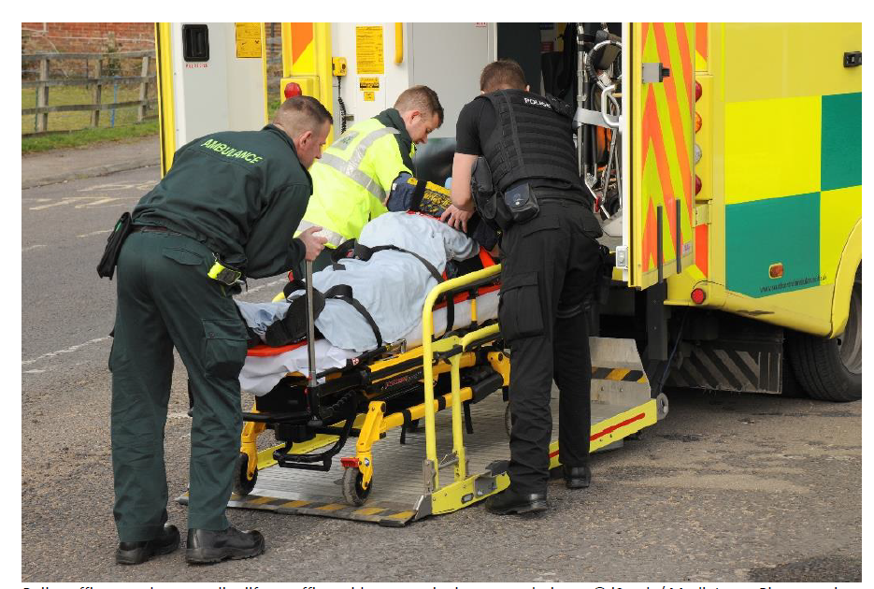

Slide 4
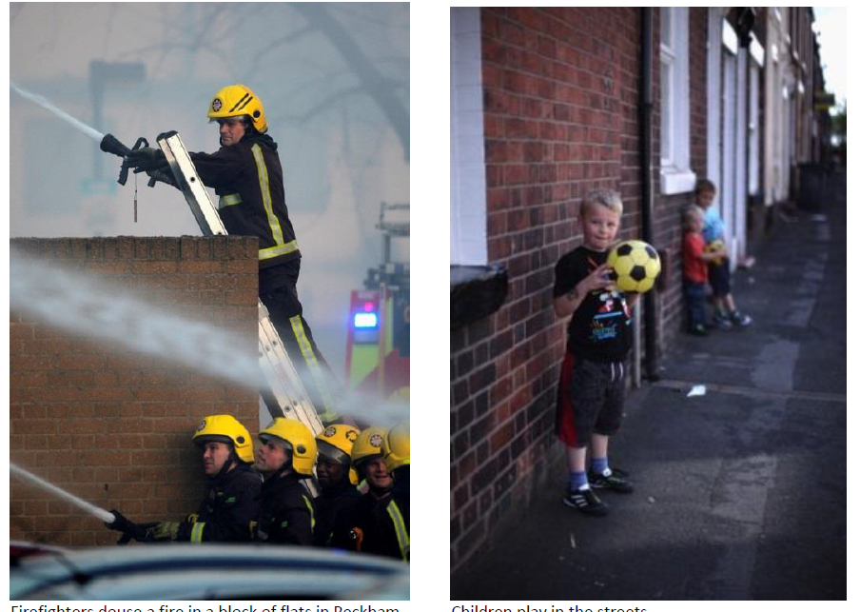

Slide 5
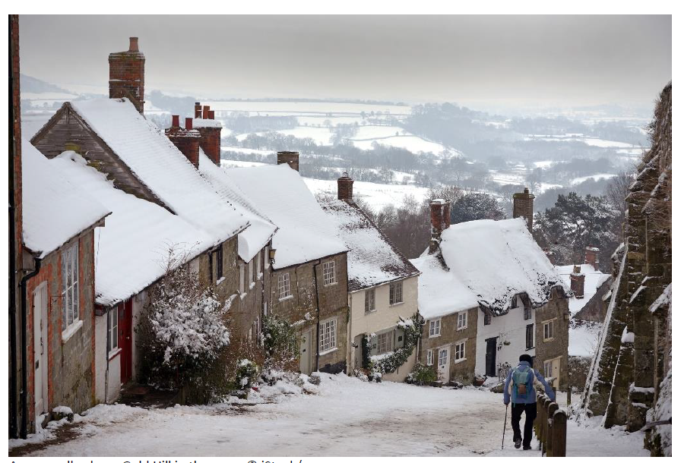

Slide 6
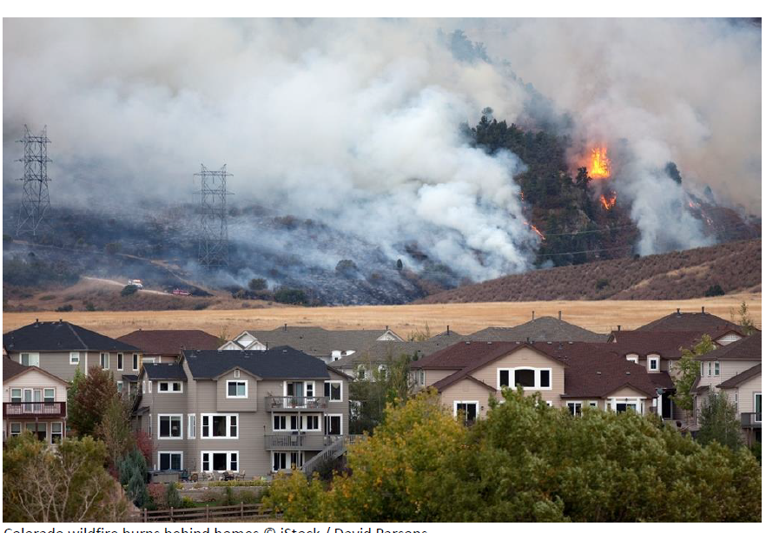

Slide 7
"A personal emergency is when an event causes some kind of risk to someone's health or welfare and which cannot be dealt with using normal available resources."

Slide 8
“it will end in tears”
Who has heard this phrase before?
What does this mean?
When can fun turn into something more serious?

Slide 9
What makes a situation serious or an emergency?
What are the common ideas, themes and characteristics?

Slide 10


