Slide 1

Woodwind Instruments
A presentation by Mrs Serena Ludford

Slide 2
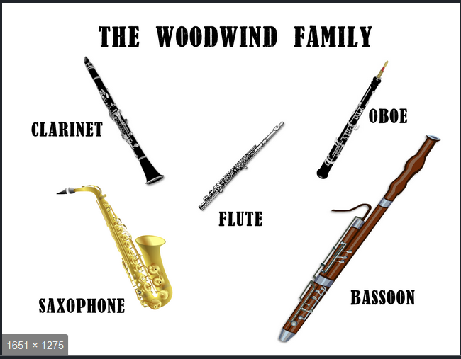
These are the instruments that make up the woodwind family.

Slide 3

This is the teacher that teaches these instruments in your school.
Mrs Serena Ludford
Hampshire Music Service

Slide 4
An introduction to the teacher
You can watch me by clicking on this link:
https://youtu.be/kEWBYYQp6DI

Slide 5
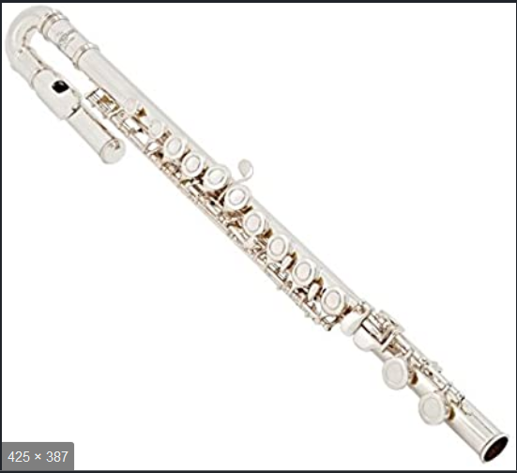
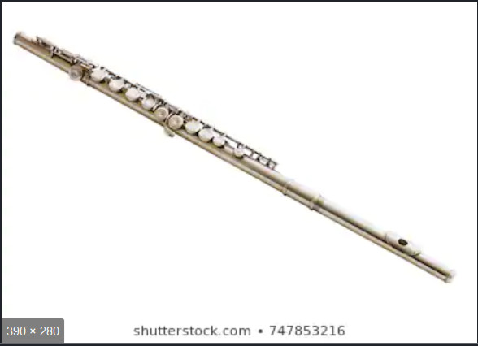
THE FLUTE: It is possible to start with a curved head (on the left below) or a ‘junior’ size instrument to make things easier and lighter weight for a smaller child. Flutes also come in a variety of sizes – the piccolo, the alto flute and the bass flute, but everyone starts learning on the usual size.

Slide 6

How to play the flute and what it sounds like
Click here for a video:
https://youtu.be/3HbxcfArOvU

Slide 7
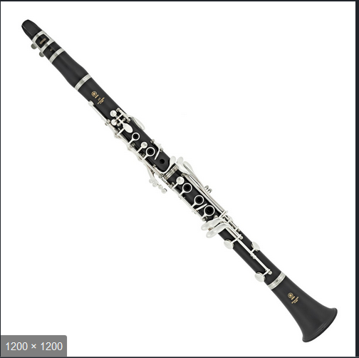
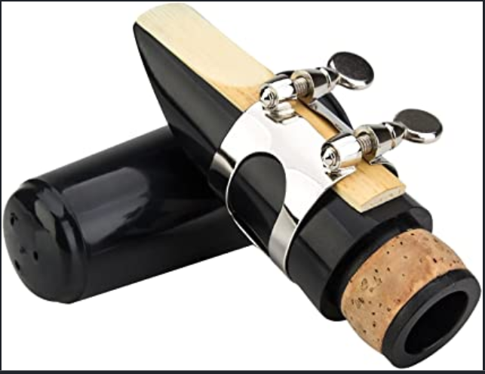
THE CLARINET: The clarinet and saxophone are both single reed instruments. You can see the reed on the mouthpiece in this photo. As with the flute, there are other sizes of clarinets – the Eb clarinet is the smallest, and there are also alto clarinets and bass clarinets. Because all the fingerings are the same, everyone starts learning on the Bb clarinet.

Slide 8
How to play the clarinet and what it sounds like
Here is a link to a video of the clarinet
https://youtu.be/_LeLcX9jdsk

Slide 9
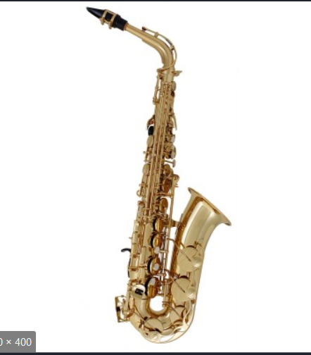
THE SAXOPHONE: The saxophone is the most modern of the woodwind instruments. Mr Sax based his design on the clarinet. Most beginners start with the alto saxophone, and there is a smaller sized alto saxophone for those with smaller fingers. There are also 3 other sizes – soprano, tenor and baritone.

Slide 10
How to play the saxophone and what it sounds like
Here is a link to a video of the saxophone
https://youtu.be/ZkG9LnBZba0

Slide 11
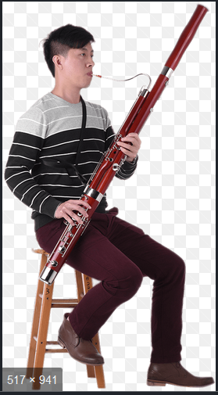
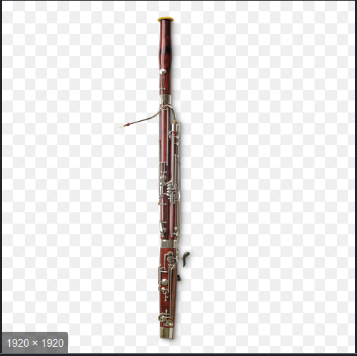
THE BASSOON: This is the lowest of the woodwind family and the only one that uses the bass clef. It is a BIG instrument, but it is possible to start on a smaller sized bassoon designed for smaller hands and arms.

Slide 12
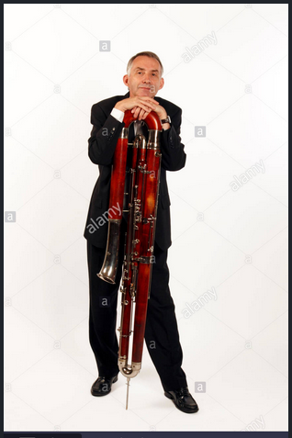
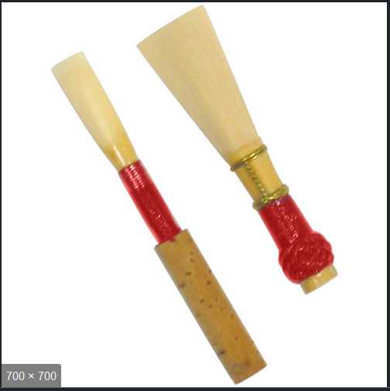
More about the bassoon: The bassoon and the oboe both use double reeds. The bassoon reed is on the right, and the oboe on the left. Both are expensive to buy (over £10) but should last a long time. If you like BIG instruments, have a look at the contrabassoon in this picture.

Slide 13
How to play the bassoon and what it sounds like
Here is a link to a video of the bassoon
https://youtu.be/mjADeLEq5uY

Slide 14
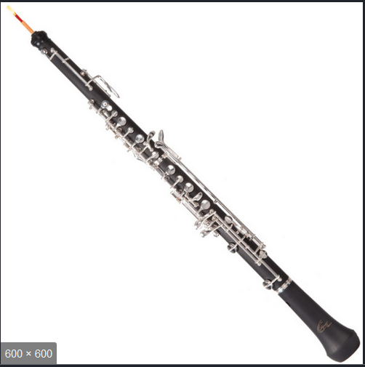
THE OBOE: Last but not least, the oboe. It is a similar size to the clarinet but is thinner, and uses a double reed, as the bassoon does.

Slide 15
How to play the oboe and what it sounds like
Here is a link to a video of the oboe
https://youtu.be/xE021TLyPEQ

Slide 16
Thank you for your time. I hope you have enjoyed reading this.
If you want any further information about your child starting to learn a woodwind instrument, please ask Mrs Malone at St Mary’s, or send me an email on:
serena.ludford@hms.hants.gov.uk
I look forward to getting to know your child from September.

