Slide 1
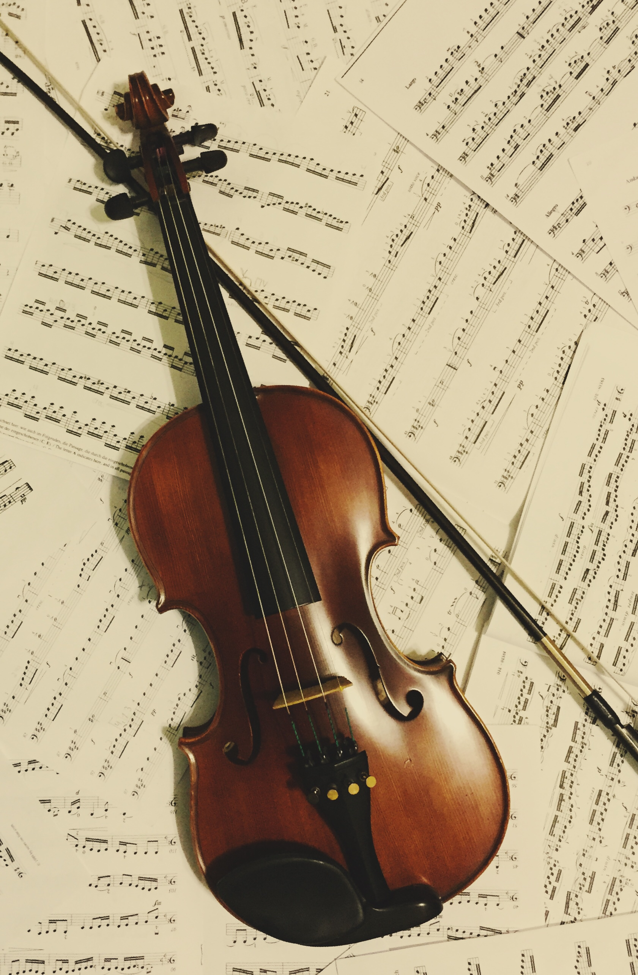
An Introduction to Violin & Viola Lessons at St Mary’s
by HMS teacher Vanessa Kershaw

Slide 2
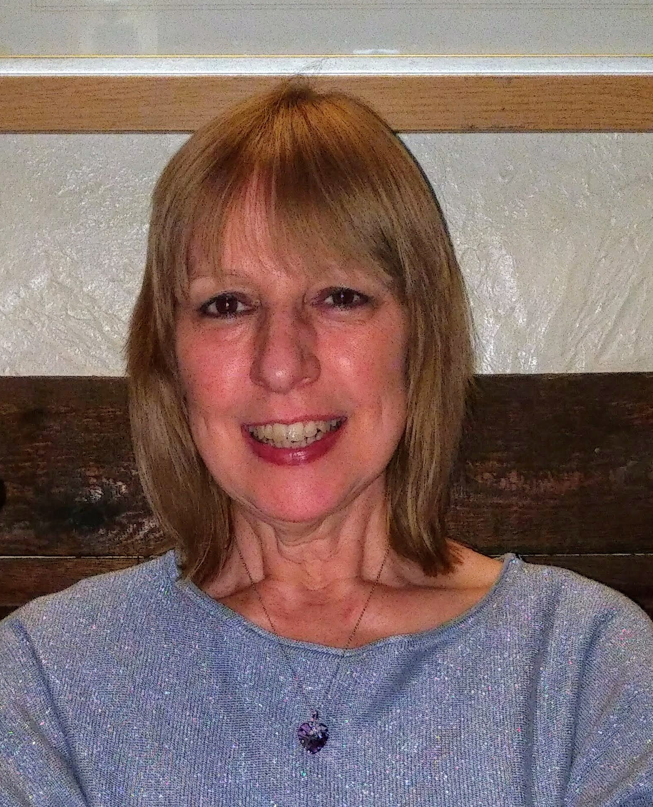
A little bit about myself
My name is Vanessa Kershaw and I am the violin and viola teacher at St Mary’s School.
I have been teaching violin/viola for Hampshire Music Service for many years and I enjoy my job immensely.
To see pupils improve and gain pleasure from playing a musical instrument is incredibly rewarding!
In addition to teaching, I love my orchestral playing. I play for West Forest Sinfonia, an orchestra that gives several concerts each year as well as accompanying choral societies. I also enjoy playing in smaller ensembles such as chamber groups and string quartets.

Slide 3
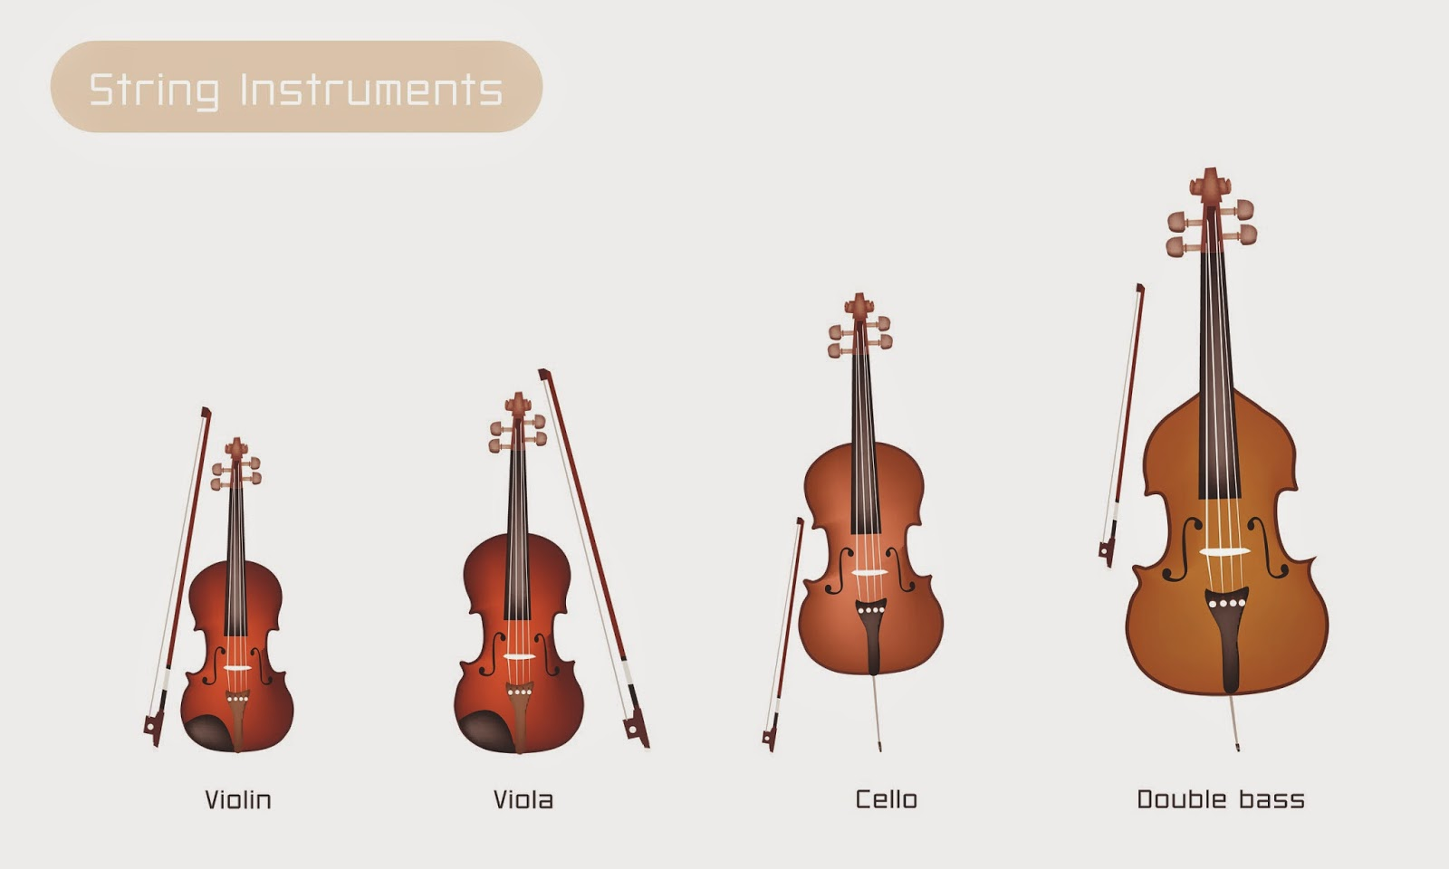
The violin and viola belong to the string family of instruments
The violin is the highest sounding member of the family and the viola is the second highest.

Slide 4
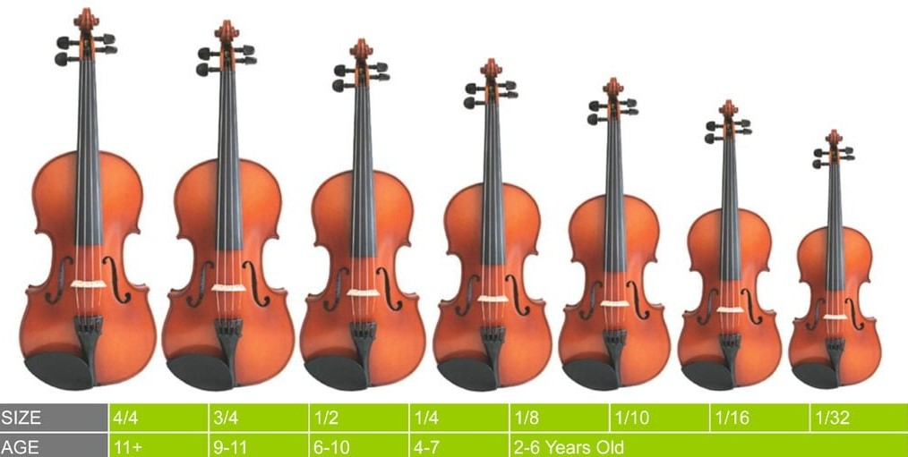
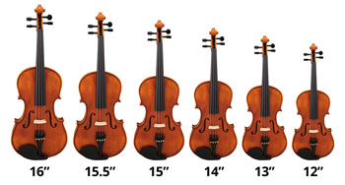
Violins and violas come in different sizes.
You will be measured to see which size you need.
There will be one just right for you!
Violins
Violas
(12” viola would be equivalent to a ½ size violin)

Slide 5
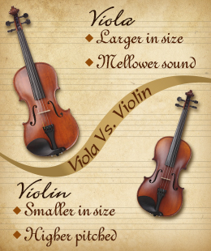
Compare the sound of the violin and viola.
The violin and viola each have four strings.
Click on the links to hear the sound of each string!
As you will hear, both instruments have G, D and A. However the violin has a higher E string and the viola a lower C string.
Violin
Viola
Violin
G D A E
Viola
C G D A

Slide 6
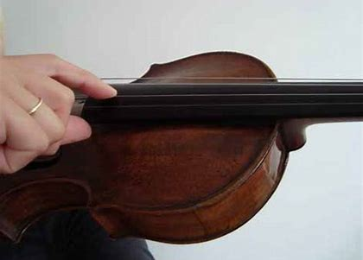
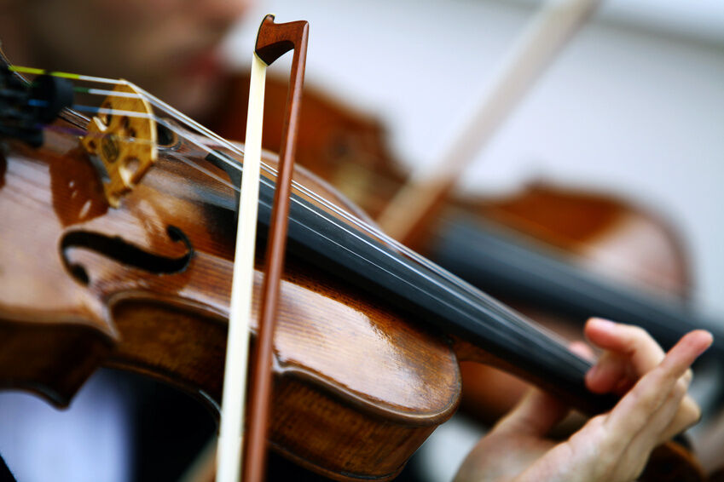
First steps……..
When you start learning the violin/viola, we normally begin by plucking the strings.
This is known as ‘pizzicato’.
This is followed by learning how to use the bow.
This is known as ‘arco’.
Then we learn how to place our fingers on the strings to change the pitch so we can get higher and lower notes.
Please see the examples and click on the links to the right showing these techniques.
Pizzicato (plucking)
Arco (bowing)
Pizzicato Polka by Johann Strauss
This features a string ensemble directed by the leader.
Grieg String Quartet no 1
This quartet (normally two violins, viola and cello) has been arranged for string ensemble.

Slide 7
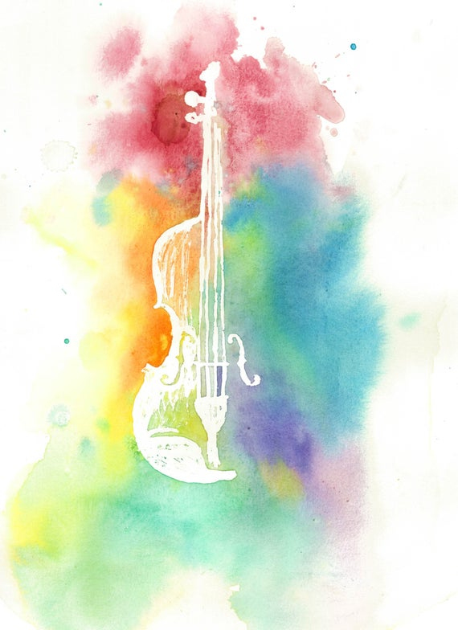
There are lots of different effects we can obtain on the violin and viola.
Here are some of them.
Please click on the links to see two of them…..
Glissando
(Sliding from one note to another)
Listen to the two violas!
Tremolo
(Shivering with the bow!)
Other effects include:-
Col Legno
(Playing with the wood of the bow)
Spiccato
(Bouncing the bow on the string)
Sul Ponticello
(Playing near the bridge to create an icy or spooky effect!)

Slide 8

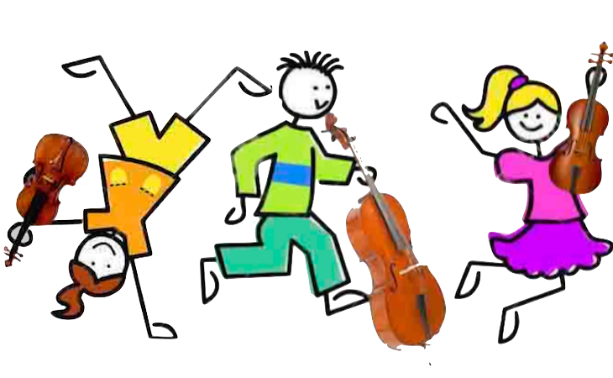
Playing in an Orchestra
As you have seen, learning to play the violin or viola will lead to the chance of playing with other people in an orchestra or string group, which is a lot of fun.
Please click on the link to see a famous piece for solo violin and string orchestra:-
'Spring' from The Four Seasons by Vivaldi

Slide 9
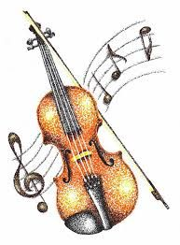
To find out more……
Sign up for lessons - lots of fun in store!
I hope you have enjoyed finding out about the violin and viola.
To sign up for lessons, please contact Mrs Malone at St Mary’s.
If you would like any further information, please feel free to email me:-
vanessa.kershaw@hms.hants.gov.uk
I look forward to meeting your child to start lessons and helping them begin their musical journey!

