Slide 1

One Family
Bible reference: 1 Corinthians 13: 4-7
UNCRC Article 1 – Everyone under the age of 18 has all the rights in the convention. We have the responsibility to respect the rights of others.

Slide 2

What makes a good family – a successful family?
What will make our class a successful family?
What will make our school a successful family?

Slide 3
Jesus taught us to treat each other in the same way that we would want to be treated.
Can you think of a time when people have done this to you?

Slide 4

We are going to share an extract from the new testament, from Corinthians chapter 13. Corinthians is a book of letters written by Paul the apostle (one of Jesus’ followers)
Paul's purpose is to express the connection between humans and God's love in Christ.

Slide 5

1 Corinthians 13: 4-7
Love is patient and kind.
Love is not jealous,
it does not brag,
and it is not proud.
Love is not rude,
is not selfish, and
does not become angry easily.
Love does not remember wrongs done against it.
Love takes no pleasure in evil, but rejoices over the truth.
Love patiently accepts all things.
It always trusts,
always hopes, and
always continues strong.
Love never ends.

Slide 6

What can we learn from that extract, what is Paul asking us to do and not to do?
What is your responsibility in ensuring we are One Family and that we do achieve more together?

Slide 7
To show that we are all part of one big family here at St Mary’s, we will be making a big display of everyone's hands!
This week we would like you to all draw around
your hand and cut it out
so that it can be added to our display.

Slide 8
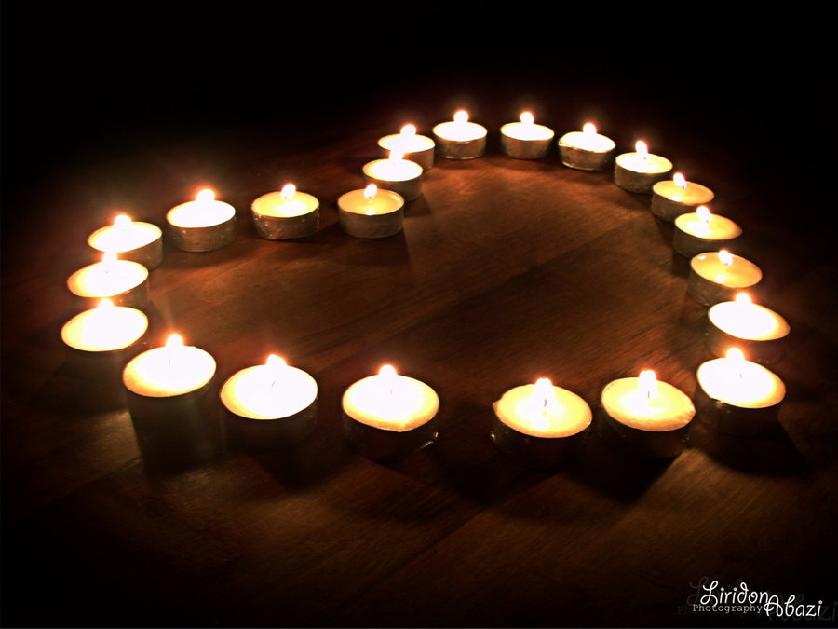
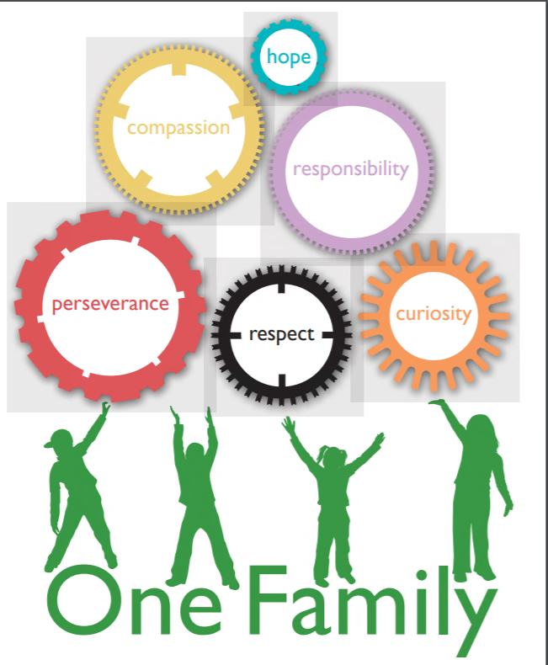
Dear God,
If I can not be brilliant, let me be kind. If I can not change the world, let me inspire just one other to do so. If I can not give away riches, let me be loving. Let me be known for kindness, for it is the greatest glory.
Let me treat everyone in my class and school with respect and in the way that I wish to be treated.
Amen

