Slide 1
One Family
Matthew 5: 43-48
United Nations Rights of the Child:
UNCRC: 1 and 2 –Everyone under the age of 18 has all the rights in the convention. We have the responsibility to respect the rights of others. The convention applies to every child whatever their ethnicity, gender, religion, abilities, whatever they say or think, no matter what type of family they come from.

Slide 2
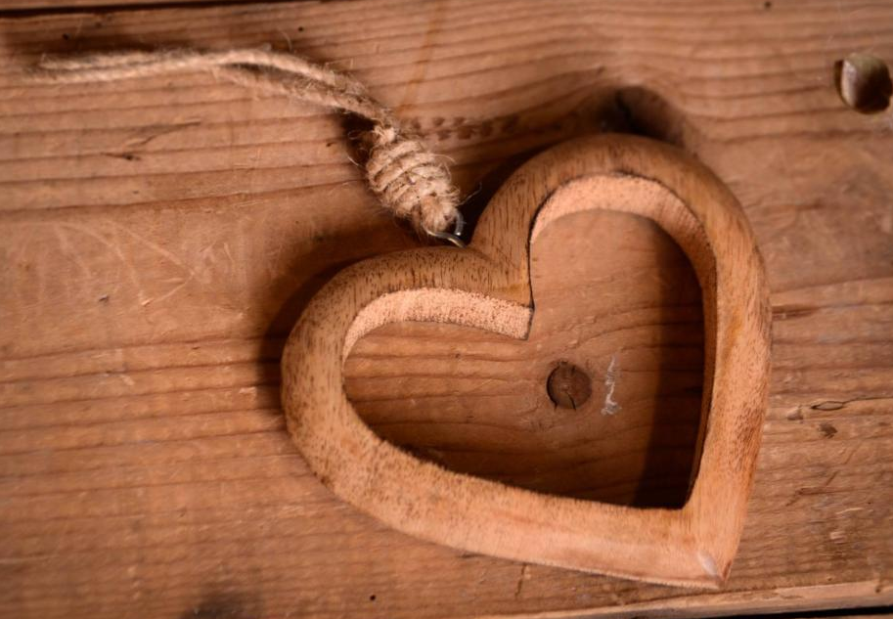


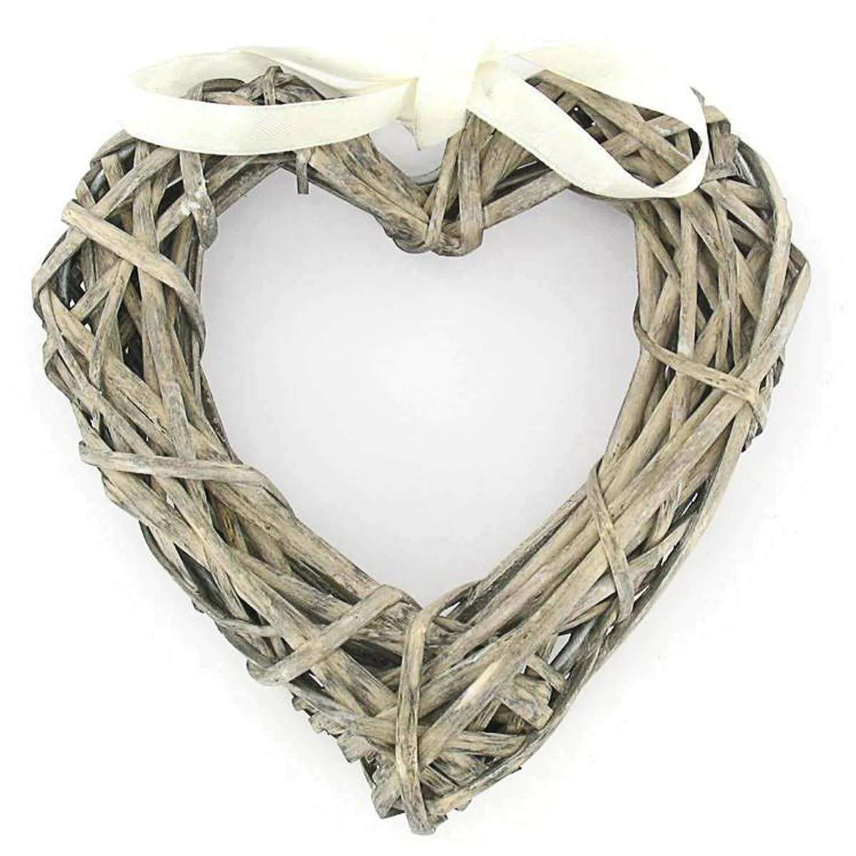

What do you think of when you see a heart?
Notes:
Class disucsion:
What do you think of when you see a heart?
Most of us would probably say that when we see a heart, we think of love.
Who do you love? Do you love your parents? Do you love your brother or sister? How about your best friend? Do you love your teacher?
It is easy to love these people, because they love us too.

Slide 3
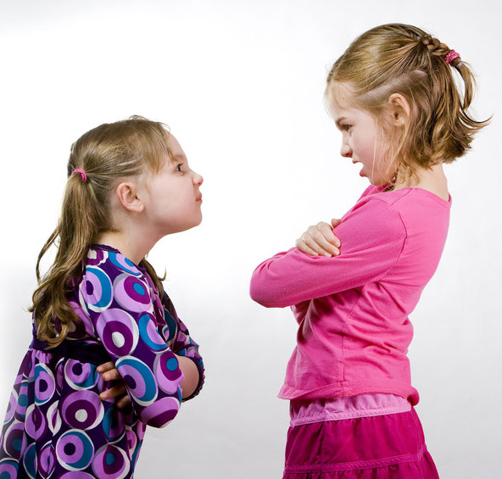
What about when someone treats us badly?
Notes:
Class discussion:
Has anyone ever treated you badly at breaktime?
Has anyone ever said something about you that was not true?
Do you love those boys and girls?
Should we really be expected to love people who are mean to us, treat us badly, and say ugly things about us?
Well, let's listen to what Jesus told us to do.

Slide 4
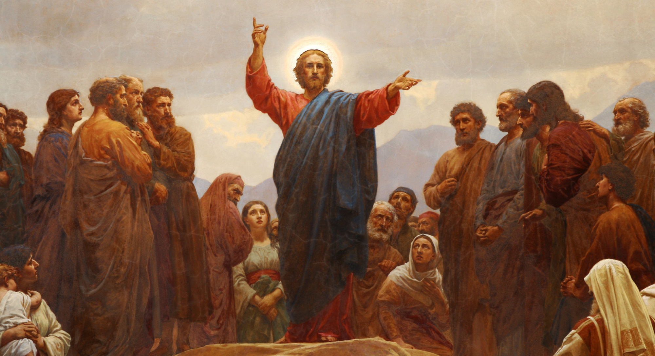
One day Jesus was teaching out on a hillside. We call his lesson that day "The Sermon on the Mount."
In his sermon, Jesus said some things that really surprised his listeners. "You have heard that you should love your neighbours and hate your enemies,"
Jesus said. "But I say, love
your enemies -- and if
someone does mean and
hateful things to you,
pray for them."
Notes:
Class discussion:
Why should we love our enemies? Jesus said that when christians love our enemies, they are acting like children of God. If we only love those who love us, will God reward us for that? If we are only kind to our friends, what is so great / special about that? Everybody does that!
It isn't always easy to love your enemies, but there are some good reasons for doing it.
It demonstrate the love that Christians have of God to others.
It sets a good example for others to follow, regardless of your faith or belief.
It turns enemies into friends.

Slide 5
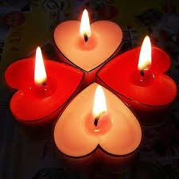
Dear God,
It is easy to love those who love us.
Help us to love our enemies so that
they might know that we are your
children.
In Jesus' name we pray, amen.

Slide 6
Notes:
Backing Track for Hymn is in community folder – Backing Tracks for Hymns – No Pianist No problem

Slide 7
He's got the whole world in His hands,
He's got the whole world in His hands,
He's got the whole world in His hands,
He's got the whole world in His hands.

Slide 8
He's got my brothers and my sisters in His hands,
He's got my brothers and my sisters in His hands,
He's got my brothers and my sisters in His hands,
He's got the whole world in His hands.

Slide 9
He's got the sun and the rain in His hands,
He's got the moon and the stars in His hands,
He's got the wind and the clouds in His hands,
He's got the whole world in His hands.

Slide 10
He's got the rivers and the mountains in His hands,
He's got the oceans and the seas in His hands,
He's got you and he's got me in His hands,
He's got the whole world in His hands.

Slide 11
He's got the rivers and the mountains in His hands,
He's got the oceans and the seas in His hands,
He's got you and he's got me in His hands,
He's got the whole world in His hands.

Slide 12
He's got everybody here in His hands,
He's got everybody there in His hands,
He's got everybody everywhere in His hands,
He's the got the whole world in His hands.

