Slide 1
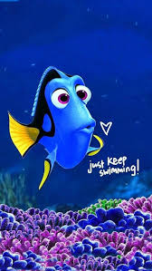
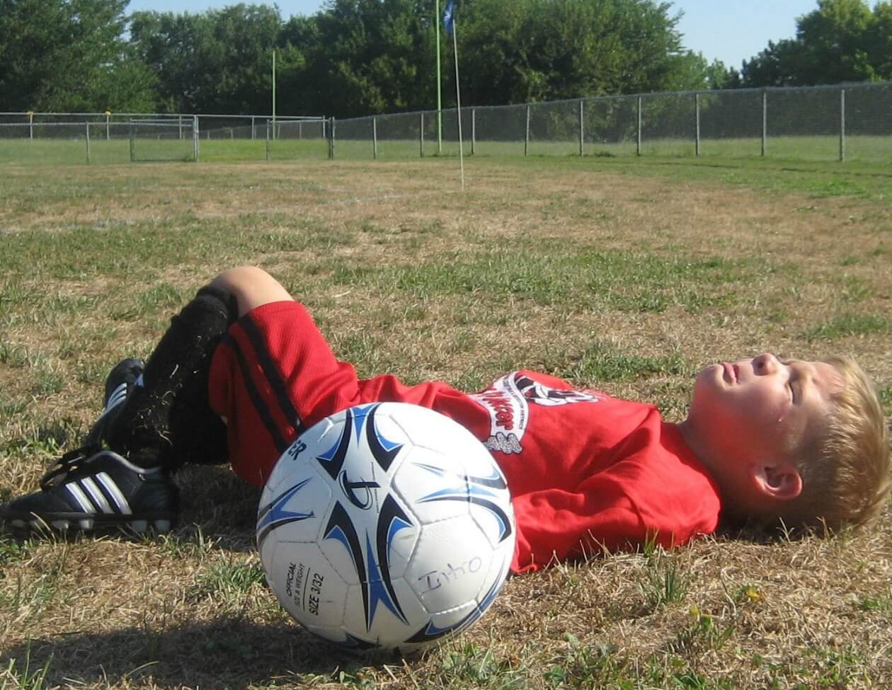
Perseverance
Jeremiah 38
United Nations Rights of the Child:
UNCRC:1 – Everyone under the age of 18 has all the rights in the convention. We have the responsibility to respect the rights of others

Slide 2
What is Perseverance?
Notes:
Discuss the meaning of the word perseverance.

Slide 3
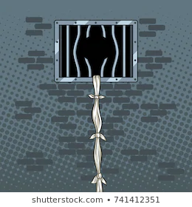
Throughout time and in stories many people have made exciting escapes from captivity by climbing up or down clothes or bed sheets that they have tied together to make into ropes.

Slide 4
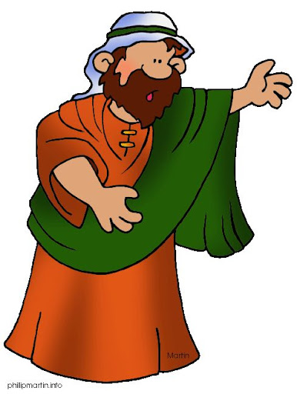
Today’s story is a story from the Old Testament about the prophet Jeremiah
Notes:
Talk about Old and New Testament. Ask children what a prophet is? A prophet is someone who brings an important message from God. Often these messages were about how people need to change in some way, so prophets were often unpopular and therefore treated badly because their message was not welcome.
Now read the story with a focus on how Jeremiah persevered. Why was it important that Jeremiah persevered?

Slide 5
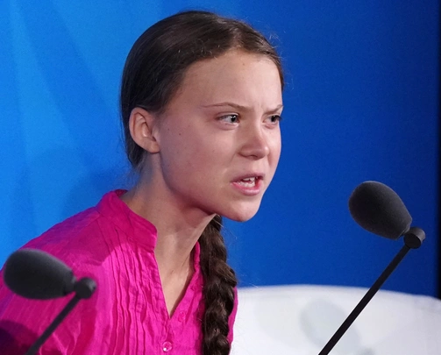
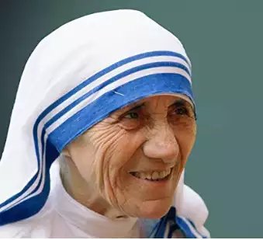
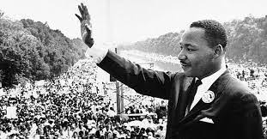
It would have been much easier for Jeremiah to keep quiet and have an easy life but he knew that he had to speak out God’s message to the King to give him a chance to change his ways.
Can you think of anyone who has persevered to get an important message across?
The pictures below may help you.
Notes:
Give the children some silent time to think about a time when they thought it was important to speak up and perhaps a time when maybe they should have but lacked the courage/perserverance to do it. There is no need to share this private reflection.

Slide 6
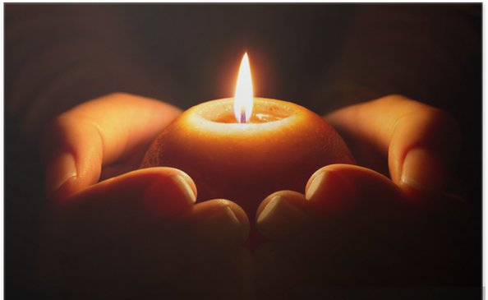
Let us pray:
Dear Lord
Sometimes it’s hard to speak up when we know things aren’t right. It is easier to pretend nothing is wrong.
Help us to know the right words to use and to have the courage to say them.
Like you did for Jeremiah, help us to persevere when speaking out for what is right.
Amen

Slide 7
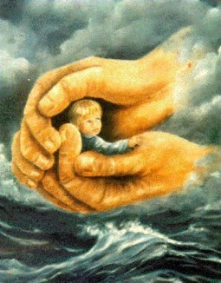

Be bold, be strong
For the Lord your God
is with you
Be bold, be strong
For the Lord your God
is with you
I am not afraid
I am not dismayed
Because I'm walking in faith and victory
Come on and walk in faith and victory
For the Lord your God is with you

