Slide 1
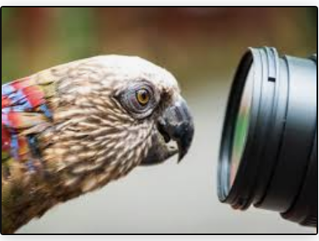
Curiosity
Revelation 7: 14 and 22:14
UNCRC: Article 13 – Children have the right to get and share information, as long as the information is not damaging to them or others.

Slide 2
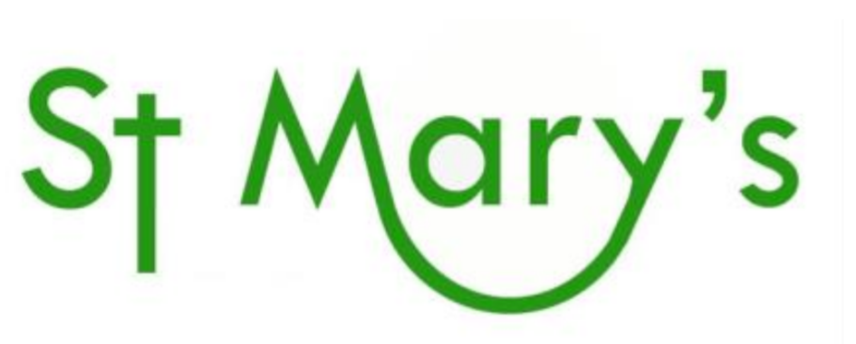
What do you know about the name of our school?
Do you have any questions about our school name?
Notes:
Discuss questions on the slide
Maybe list or record children’s questions.
Talk about asking questions as showing curiosity.

Slide 3
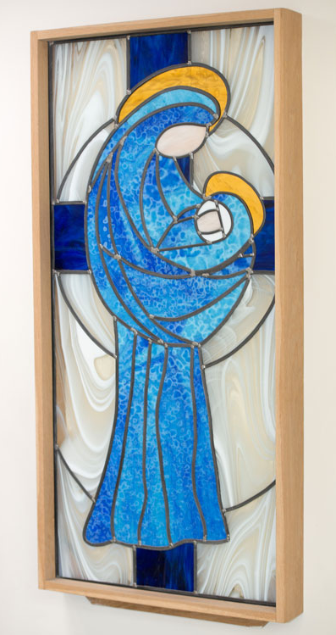
Our school is named after St Mary also called the Virgin Mary, Christian beliefs about Mary are based on stories in the Bible. The Gospel of Matthew and the Gospel of Luke say that Mary was a young woman who was engaged to be married to a man called Joseph. The Gospel of Luke says that the angel Gabriel came to Mary to tell her that she would give birth to a son. The angel told Mary that she should call her son Jesus. The angel also said that Jesus would save people from their sins.
Notes:
Share the information about St Mary from slide and talk about sharing the name with the church because that is where our school originated.

Slide 4
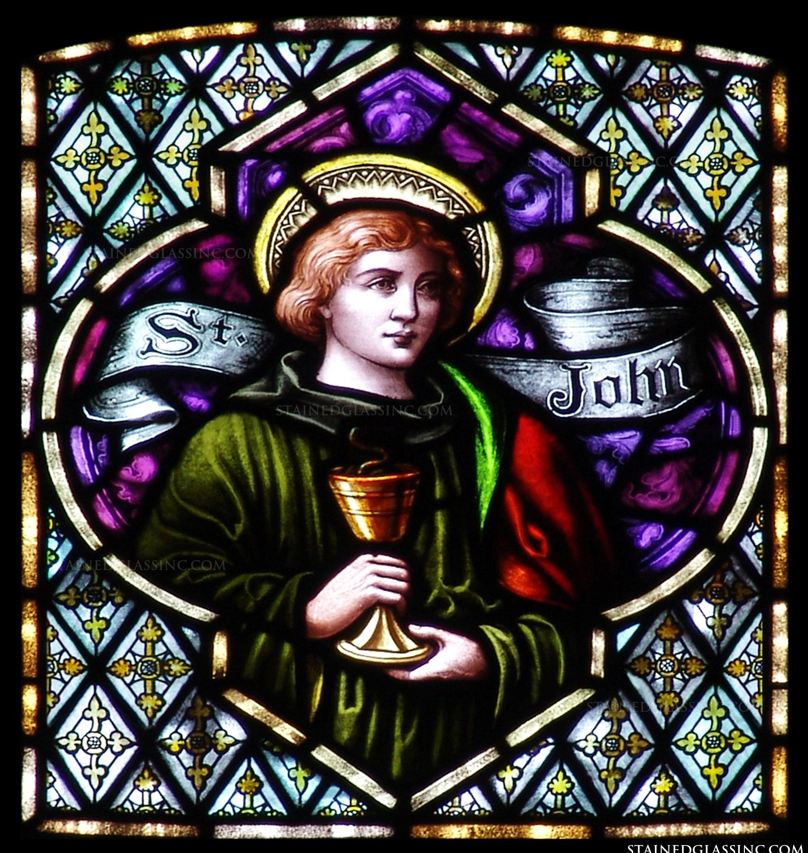
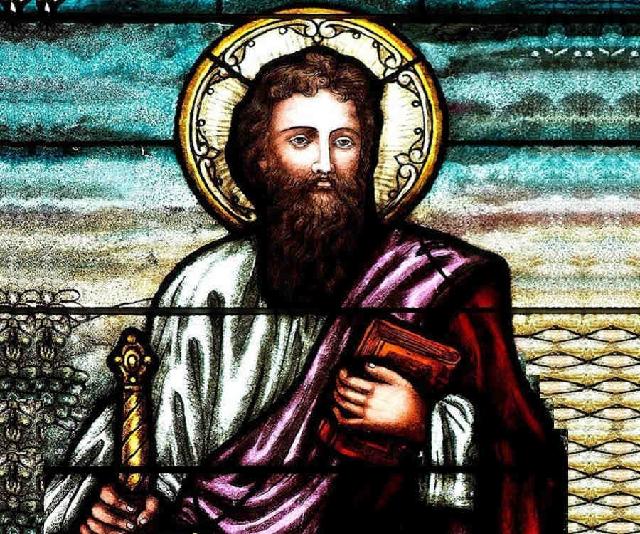
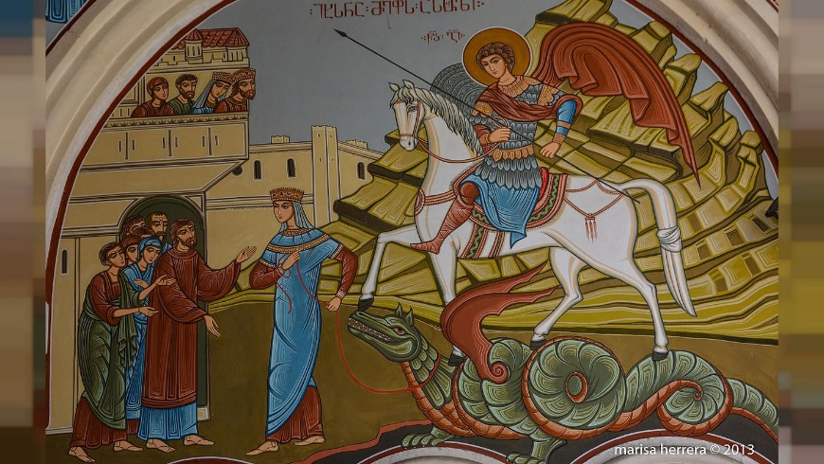
So what is a Saint?
Do you know the names of any other Saints?
Notes:
Share childrens ideas and thoughst or knowledge about what a Saint is and any they know.
Images on the slide depict from left to right St George, St Paul and St John.

Slide 5
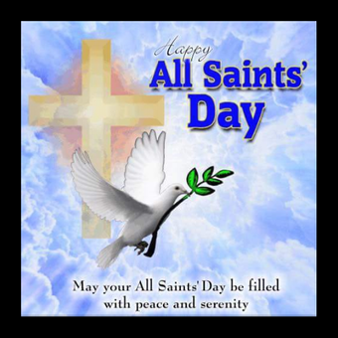
In Christianity a saint is a person who is believed to be especially close to God. Some saints are prophets, or messengers of God. Others are healers, doers of good deeds, or martyrs. A martyr is someone who is killed for belonging to a religion. Sainthood is an official status in some religions. In other religions people become saints simply because many people honour them.
Once a year the Church celebrates All Saints’ Day. This is when Christians remember the saints who have given an example in their lives of how to follow Jesus’ teaching. This Year All Satins Day was on Sunday, 1st November.
Notes:
The Saints we saw on the previous slide – St George, St John and St Paul were all followers of Jesus and they did good deeds.

Slide 6
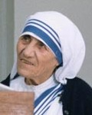
We often hear about many Saints in the bible, like Jesus’ disciples, but there are also many modern Saints.
Mother Teresa was born in Skopje the capital of the Republic of Macedonia. Her birth name was Agnes Gonxha Bojaxhiu. Her father died when she was eight and she was raised by her mother.
Agnes grew up in the Roman Catholic Church and decided to devote her life to God at an early age. When she turned 18, Agnes joined the Sisters of Loreto to become a missionary to India. She learned the local language, Bengali, and taught at the local school. In 1931, she took her vows as a nun and chose the name Teresa. She taught for many years in India becoming the headmistress at a school in eastern Calcutta.
When she was 36 years old, Mother Teresa felt the call from God to help the poor of India. She received some basic medical training and then set out to help the sick and needy. This wasn't an easy task in 1948 India. She had very little support and, while trying to feed and help the poorest of the poor, she herself was constantly hungry and even had to beg for food. She worked to help others all of her life. She worked almost up until her death on September 5, 1997. Mother Teresa died on 5 September 1997 at the age of 87.
Some years later, in 2016, Pope Francis recognised Mother Teresa as a saint.
Notes:
Read / share information on slide about Mother Teresa.
Question - why do you think she is now recognised as St Mother Teresa? What did she do during her life that makes her a ‘saint?’

Slide 7
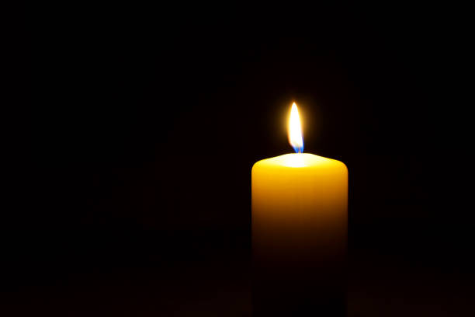
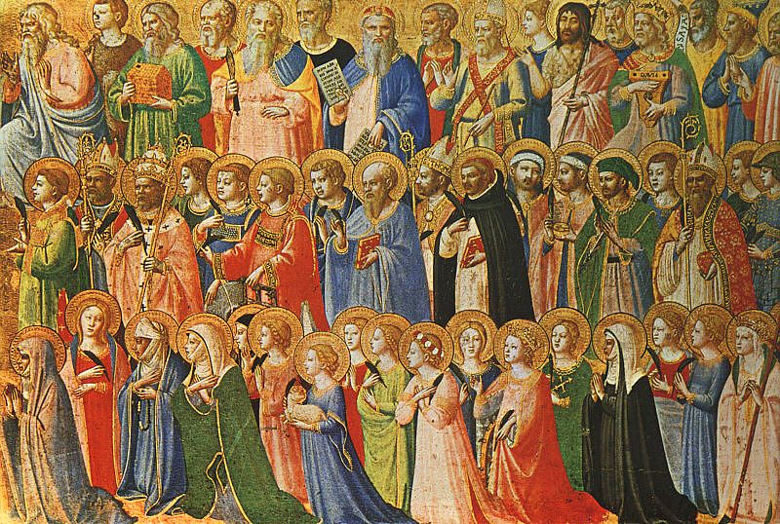
Dear God,
We give thanks for the lives of the saints.
Help us to learn from them
and follow their good example.
Amen.

