Slide 1
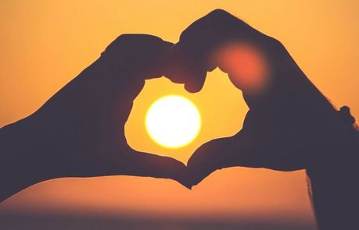
One Family
Proverbs 15.4
UNCRC:1 – Everyone under the age of 18 has all the rights in the convention. We have the responsibility to respect the rights of others

Slide 2

What do you think is the world’s most dangerous weapon?

Slide 3


What if we said the most powerful weapon was in our classroom and in our homes?
What do you think it would be then?
Everyone has this weapon
We can all choose when to use it
We can clean this weapon
This weapon helps us with speaking, reading, eating and tasting our food

Slide 4
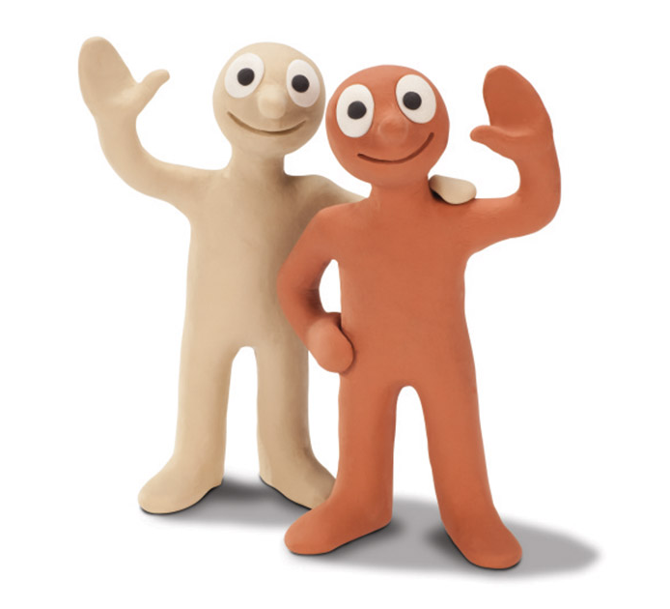
We are going to watch a video about Morph and Chas. Morph is made of terracotta clay and his best friend, Chas, is made of cream-coloured clay. They do not talk clearly, but it is easy to guess how they’re feeling from their tone of voice and body language.
(If you are working at home, please ask your parents for help opening the video on YouTube!)
Watch the video very carefully because you will be asked some questions about it afterwards!
https://www.youtube.com/watch?v=Edi1rTitpqU

Slide 5
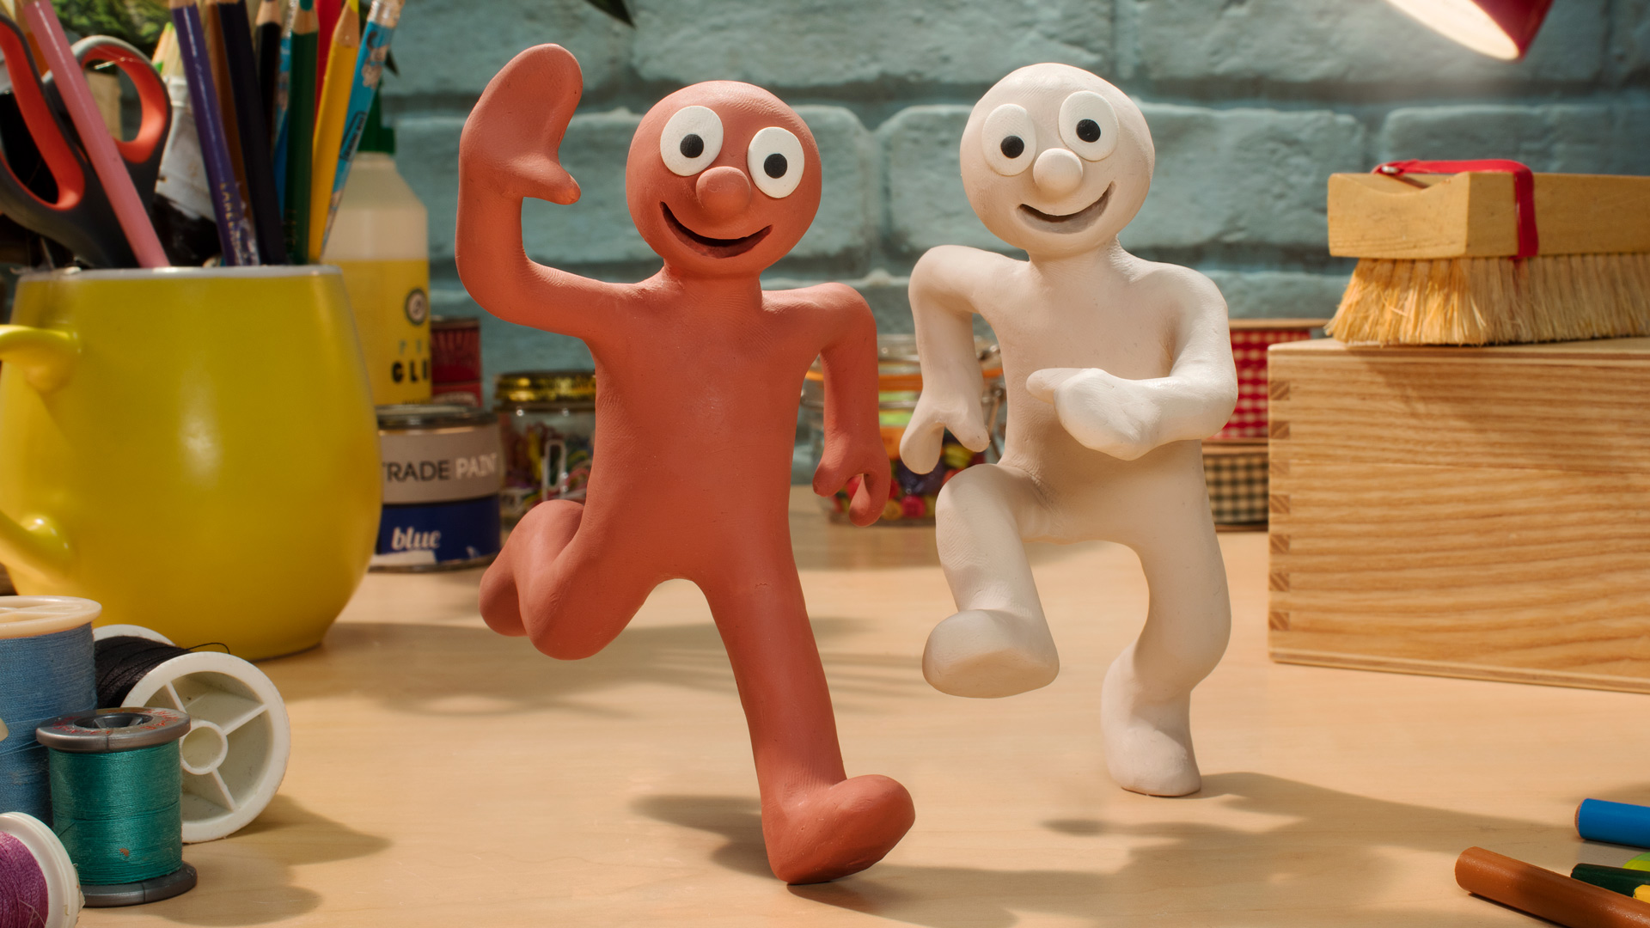
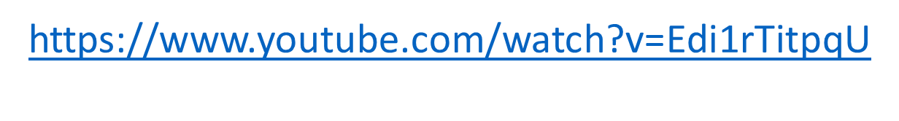
What did you like (or dislike) about the animation?
What do you think Morph’s name means?
What did you notice about Morph and Chas?
How do we know how the characters are feeling if we can’t understand what they are saying?
Watch the video again and this time concentrate hard on the characters’ body language, how they move.

Slide 6

So why are our tongues a dangerous weapon?
If we speak to people in a horrible way, it is likely to cause a nasty response, which could result in a playground argument and falling out with our friends. Sometimes, things that we say could result in a person showing bullying behaviour or encourage a group of children to gang up against another child. Our words are powerful and make a difference.

Slide 7

There is a book in the Bible called Proverbs that has a lot to say about the tongue.
What do you think these verses from the book of proverbs mean?
‘Those who guard their mouths and their tongues keep themselves
from calamity.’ (Proverbs 21.23)
‘Kind words bring life, but cruel words crush your spirit.’
(Proverbs 15.4)
‘Without wood, a fire goes out; without gossip, a quarrel dies down.’
(Proverbs 26.20)
Share your thoughts with your class or family at home.

Slide 8
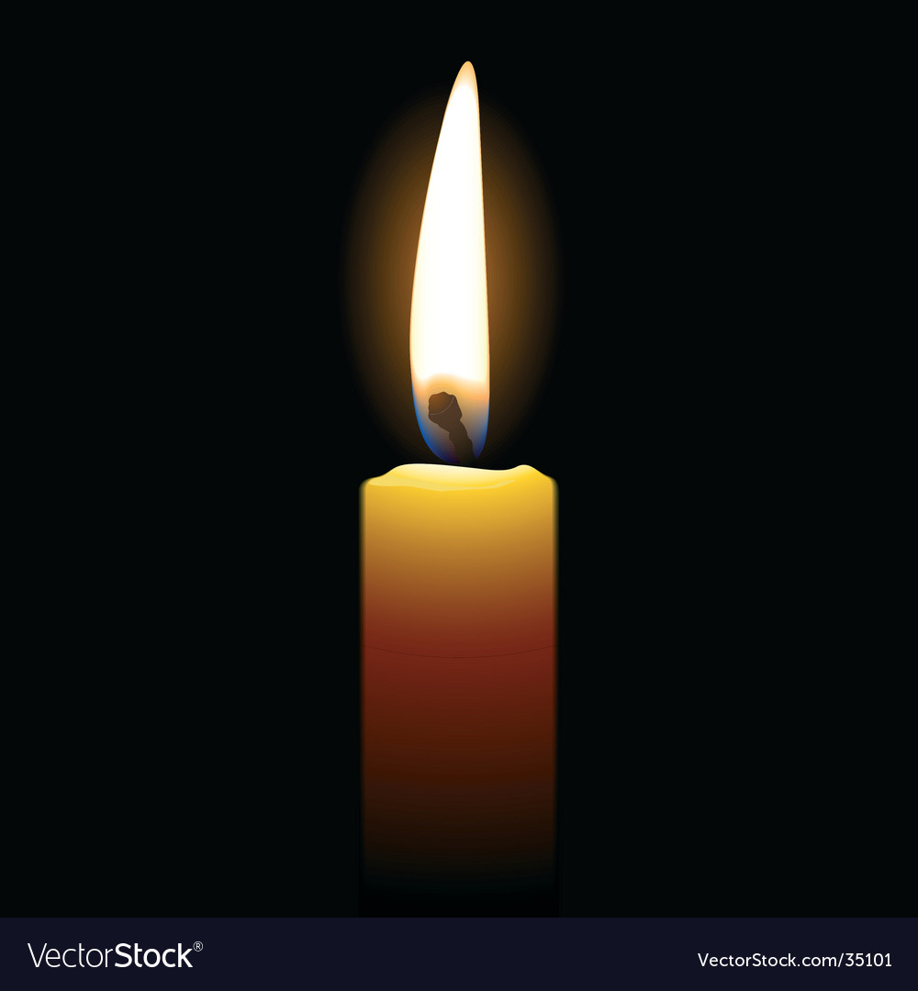
Dear God,
Thank you that we have control over the world’s most dangerous weapon.
Thank you that we can use our tongues to say good and helpful things to one another.
Please help us to learn to be kind to our friends, even if they are not being nice to us.
Amen.

Slide 9


