Slide 1
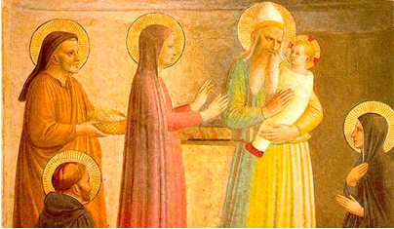
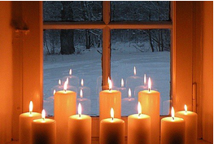
Respect
Luke 2:21-40
United Nations Rights of the Child:
UNCRC:1 – Everyone under the age of 18 has all the rights in the convention. We have the responsibility to respect the rights of others

Slide 2
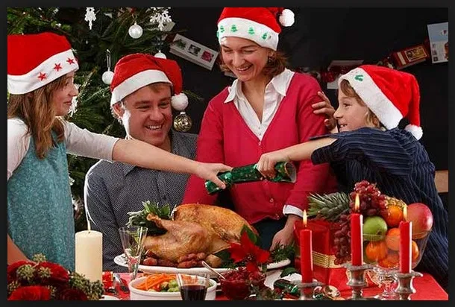
Christmas seems so long ago now! What happy memories do you have of Christmas Day or the days around it?
Perhaps you were able to meet a family member you haven’t seen for a while?
Maybe you got a gift that you really treasure?
You may have enjoyed some virtual calls with friends and family!
Notes:
With class or child talk through questions / thoughts on slide.

Slide 3
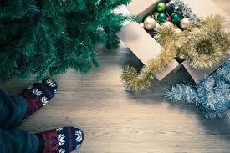
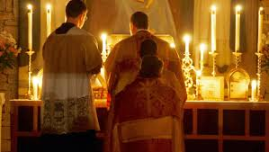
For Christians the Christmas season doesn’t finished until tomorrow! This day is known as Candlemas.
While most of us will have taken down our Christmas decorations 12 days after Christmas day, many in other Christian countries historically remove them after Candlemas.
On Candlemas, many Christians bring their candles to their local church, where they are blessed and then used for the rest of the year; for Christians,
these blessed candles serve as a symbol of Jesus Christ, who referred to Himself as the Light of the World.

Slide 4
Lets Find out more about the Christian Festival of Candlemas.

Slide 5
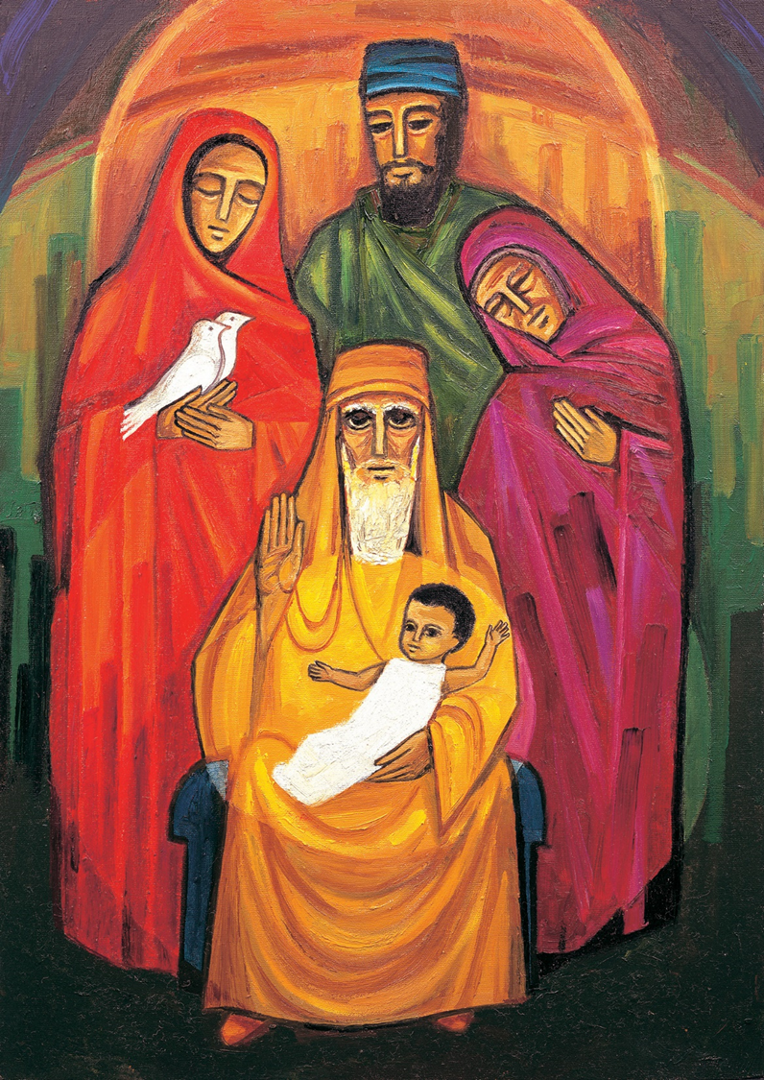
Look carefully at this picture.
It was painted by some nuns at a convent called Turvey Abbey.
When we are trying to find the truth, we need to ask many questions. In today’s worship we will be trying to discover more about the faith of an old man as he waited patiently for God to fulfil his promise.
We will ask three questions starting with the words who, what, where.

Slide 6

Who do you think is in this picture?
Notes:
Share children’s ideas – this picture is actually Simeon, Anna and Mary and the infant Jesus.

Slide 7

What is each character doing with their hands?
It might give a clue about an event that inspired this painting!
Notes:
Joseph appears to have his arms around Mary and Anna in a gesture of protections.
Mary is holding two doves, which she has brought to the temple as a thank offering for her new baby. Anna has her hand on her heart symbolising her prayer of thanksgiving for the child.
Simeon has his right hand lifted as a sign of blessing, with his other hand he is holding the child and Jesus has his arms outstretched towards the world.
Anna has her hand on her

Slide 8
Where are the different characters looking?
Notes:
Anna, Mary and Joseph are looking at Jesus. Simeon and Jesus are looking out towards the world.

Slide 9
This story is about an old man called Simeon and an old woman called Anna; they were waiting for somebody special to arrive. God had promised that they would see the Saviour of the World before they died. Even when others thought they were foolish, they were sure that God would keep his promise.
They were waiting for the Saviour of the World to come. God had said that they would see him before they died. Time was running out. Simeon and Anna were now very old but still they were sure God would keep his promise.

Slide 10
They waited in the Temple. Together Simeon and Anna watched as worshippers came to the holy place and then left, but none was Saviour of the World. Sometimes people would make fun of Simeon and Anna. “You are old, you will die soon. You have waited in vain. You must have been mistaken.” But they had courage. They believed that God would keep his promise.
Simeon and Anna believed that God would reveal it to them. And that is exactly what happened. One day Simeon looked up and saw Mary and Joseph climbing the steps of the Temple. Mary was carrying the baby Jesus in her arms. They had brought two white doves as a thank you offering for the precious child and from that moment Simeon saw the baby, he knew, God had kept his promise.

Slide 11
These were the words Simeon said:
Now, Lord, you have kept your word: let your servant go in peace.
With my own eyes have seen the salvation
which you have prepared in the sight of every people:
a light to reveal you to the nations and the glory of your people Israel.
(Luke 2.29-32)
These are the words of the Nunc Dimittis. They are spoken by Christians to this very day, often at times of worship in the evening or night.

Slide 12
Time for reflection:
Simeon knew that Jesus would bring light to the world with his message of love and peace.
This is why long ago before electricity Christians brought their candles to the church on the feast of Candlemas to be blessed.
In services around the world today candles are still li in churches as Christians pray for the light of Christ to shine in the dark places of the world where there is a war and suffering.

Slide 13
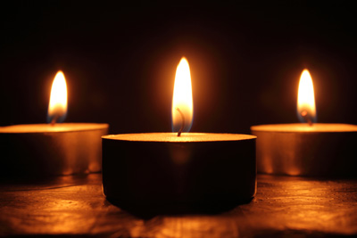
Candle, burn with golden fire in the darkest night;
Jess help us follow you;
make our whole world bright.

Slide 14
Praise Him, Praise Him!
Praise Him in the morning,
Praise Him in the noon-time,
Praise Him, Praise Him!
Praise Him when the sun goes down.
Trust Him, Trust Him!
Trust Him in the morning,
Trust Him in the noon-time,
Trust Him, Trust Him!
Trust Him when the sun goes down. 1/2

Slide 15
Serve Him, Serve Him!
Serve Him in the morning,
Serve Him in the noon-time,
Serve Him, Serve Him!
Serve Him when the sun goes down.
Praise Him, Praise Him!
Praise Him in the morning,
Praise Him in the noon-time,
Praise Him, Praise Him!
Praise Him when the sun goes down. 2/2

