Slide 1
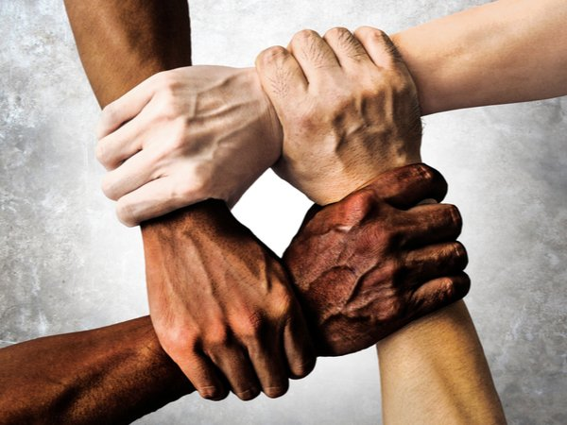
Respect
Matthew 7.12
United Nations Rights of the Child:
UNCRC:1 – Everyone under the age of 18 has all the rights in the convention. We have the responsibility to respect the rights of others

Slide 2

Introduction
Click on the Youtube link below
https://youtu.be/_Q4d8PGDJH8

Slide 3
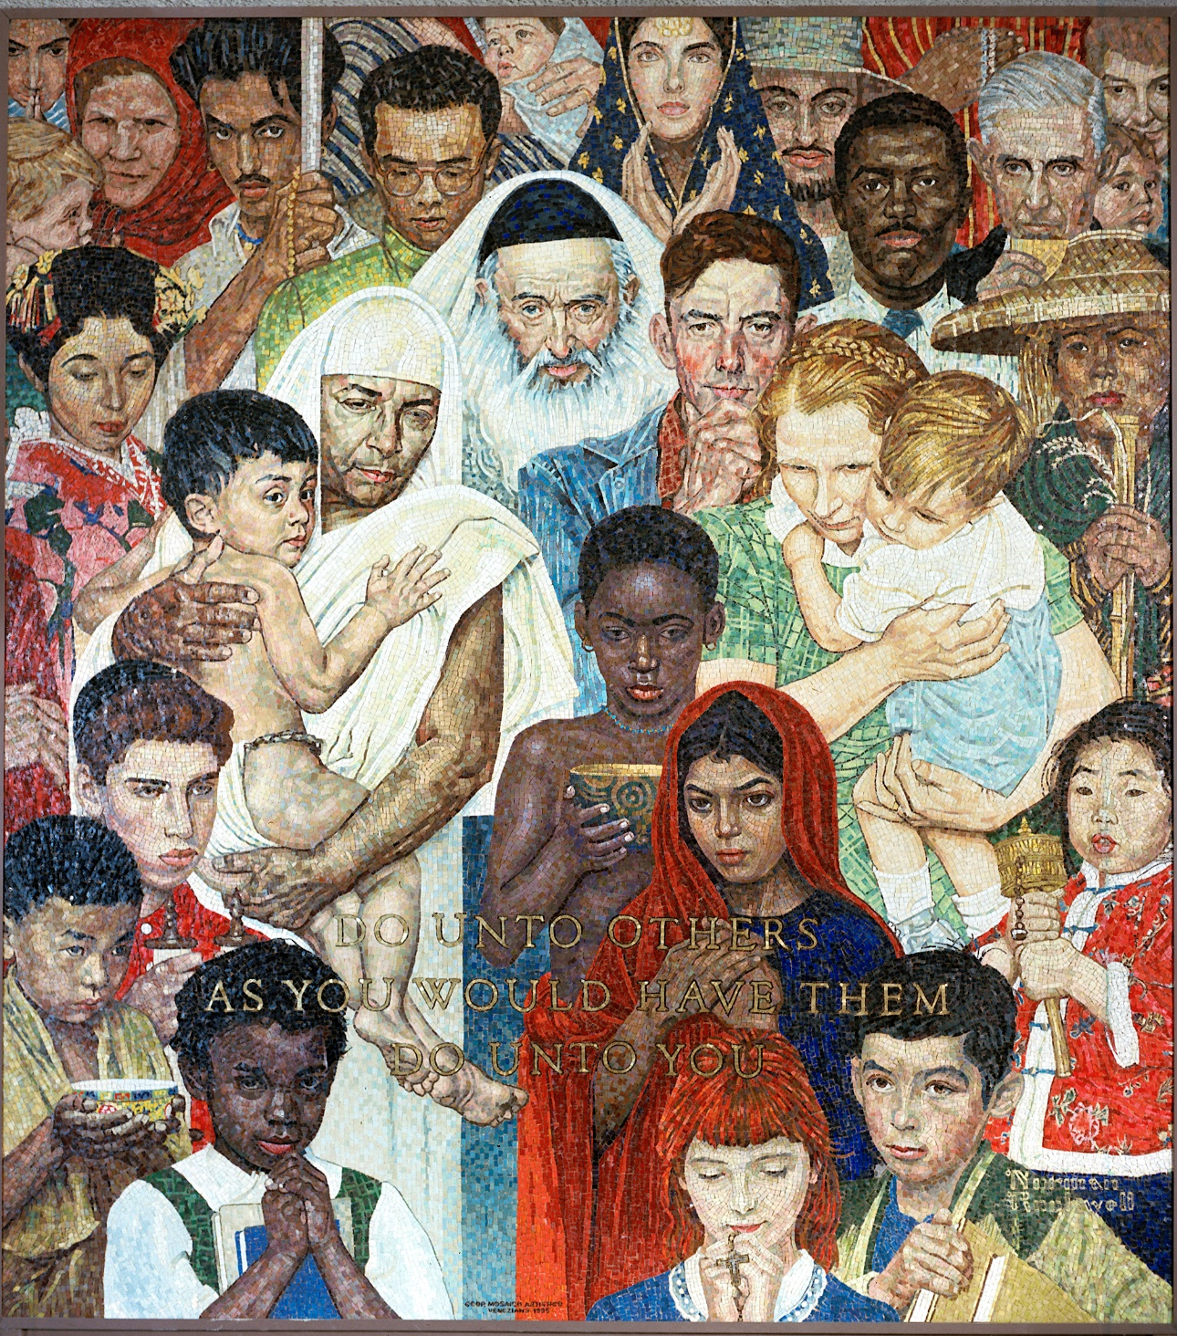
What the Bible says: Matthew 12:7
Do for other people the same things you want them to do for you.
Article 2: UNCRC
The Convention applies to everyone, whatever their race, religion, abilities; whatever they think or say, whatever type of family they come from.
Now look at the picture carefully - What can you see?
Now think about this in terms of respect and how we should treat every single human being.

Slide 4
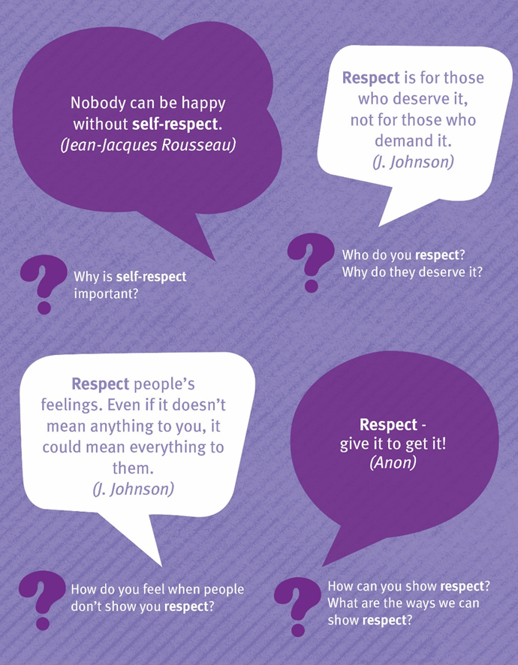
Have a look at each quote and then think about the questions.
Share your answers.

Slide 5
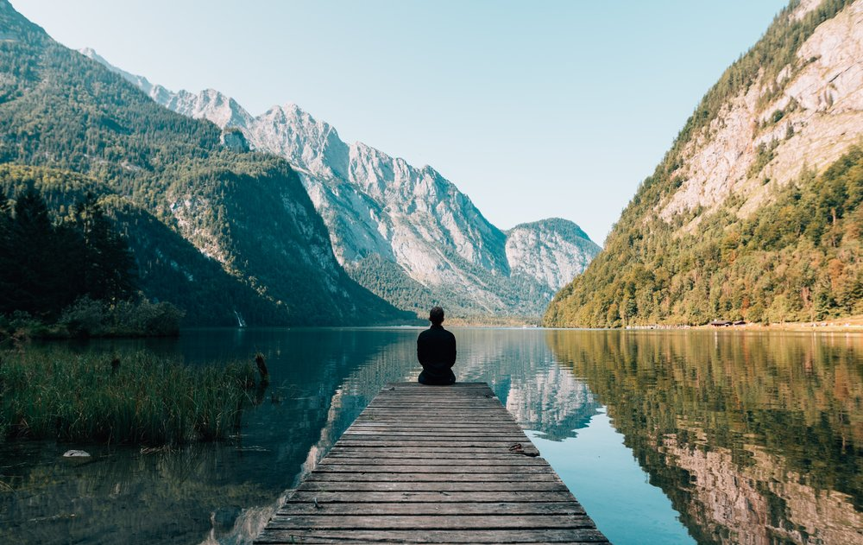
Quiet reflection
Think about the picture and the poster that we have already looked at
Is there anything you need to do to show yourself respect – any behaviours you could change?
Are there any ways that you could show more respect for others?

Slide 6
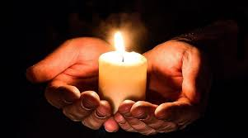
Prayer of St Francis of Assisi
(you may well know this as a hymn)
Lord, make me an instrument of your peace;
where there is hatred, let me sow love;
where there is injury, pardon:
where there is doubt, faith;
where there is despair, hope
where there is darkness, light
where there is sadness, joy.
O divine Master, grant that I may not so much
seek to be consoled as to console;
to be understood, as to understand;
to be loved, as to love;
Amen

Slide 7


