Slide 1


Perseverance
Luke: 4- Jesus in the Wilderness
UNCRC: Article 1 – Every child has rights under the UNCRC so you have the responsibility to respect each other

Slide 2
Introduction
Click on the link below for this week’s introduction. (There are also a few notes on the slides to help you.)
https://www.youtube.com/watch?v=aQqcD0Vz44s&feature=youtu.be

Slide 3
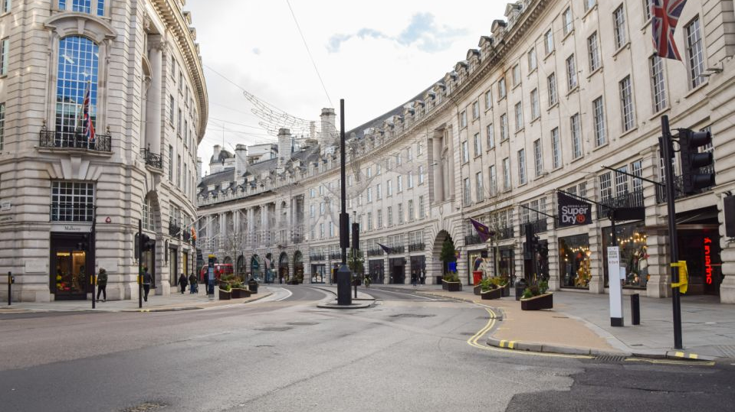
Notes:
This is a picture of Regents Street in London during the first lockdown – usually one of the busiest shopping streets in the country. Look at the additional notes to help discussion, considering: Do you like silence? Could you cope completely on your own? What if you had no phone, computer, games console or TV? Would there be anything good about this silence?

Slide 4
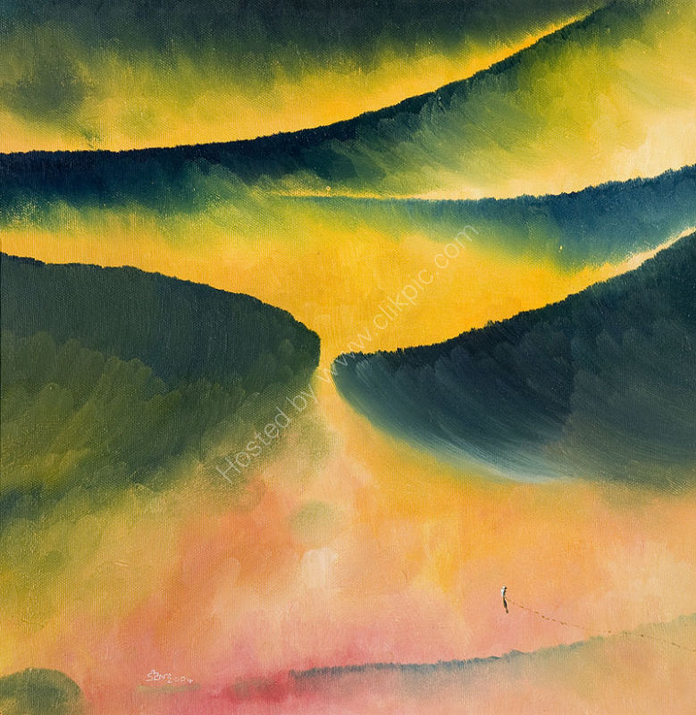
‘Jesus in the Wilderness.’
Neil Thorogood.
How does the painting make you feel?
Can you spot the figure at the bottom?
What can you remember about the story of Jesus in the Wilderness (desert)?
Why do you think the artist painted it this way?
What was he trying to say about Jesus’ time in the wilderness?
Notes:
The next slide will give you a reminder about the story – after Jesus was Baptised he went out into the wilderness to think and pray about what God wanted him to do. He spent 40 days thinking about what he was going to teach and what sort of leader he would be.

Slide 5
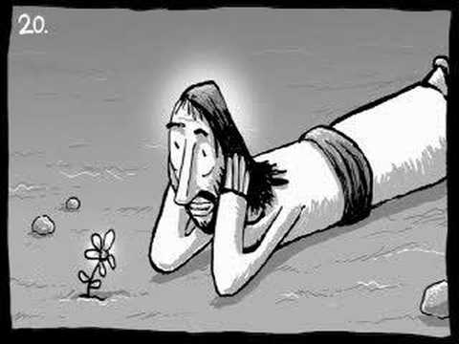

Watch the short film quietly and think about what Jesus would have experienced.

Slide 6
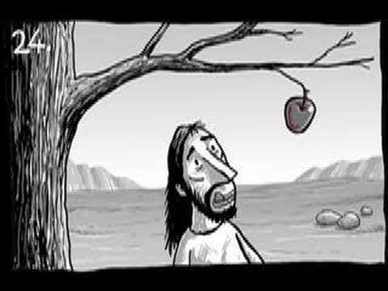
Take minute to think about the film. Can you come up with a question starting - I wonder Why…
If…
What…
When…
Who….
Whether ?

Slide 7
Jesus needed time alone to listen to God and to work out what to do next
We also need some quiet time and space. At school we do this after lunch – have you shared this with your parents. Is this something that you can do in your family?

Slide 8
Now find a quiet place and think about all that we have seen, heard and talked about.
Dear God,
Thank you for all the people and fun and excitement in our lives.
Sometimes life can feel too busy and too full.
Show us how to take time to be quiet and still
Help us feel calm and peaceful.
Amen.
As we enter the period of Lent, you may also want to think of some small sacrifices you could make. For example giving of your time to do something for someone else. Take a look at the 40Acts website for some ideas: www.40acts.org.uk

Slide 9


