Slide 1
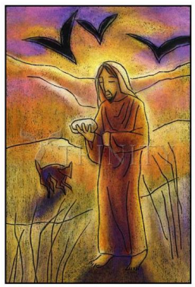
Perseverance
Matthew 4:1-11
UNCRC: Article 1 – Every child has rights under the UNCRC so you have the responsibility to respect each other

Slide 2
Good Morning St Mary’s
Click here for an introduction from Mrs Lillywhite
https://youtu.be/fEfpqMP0xuw

Slide 3
Think about these questions and share your ideas with your family or friends in school.
What’s your favourite food? Why?
What would you eat for a special celebration?
What would it be like to go without food? For a whole day? For longer? What would be the hardest thing?
Do you prefer eating by yourself or sharing with other people?
During Lent Christians sometimes decide to give up sweets or chocolate. This reminds them of when Jesus was in the wilderness and went without food – for forty days.

Slide 4
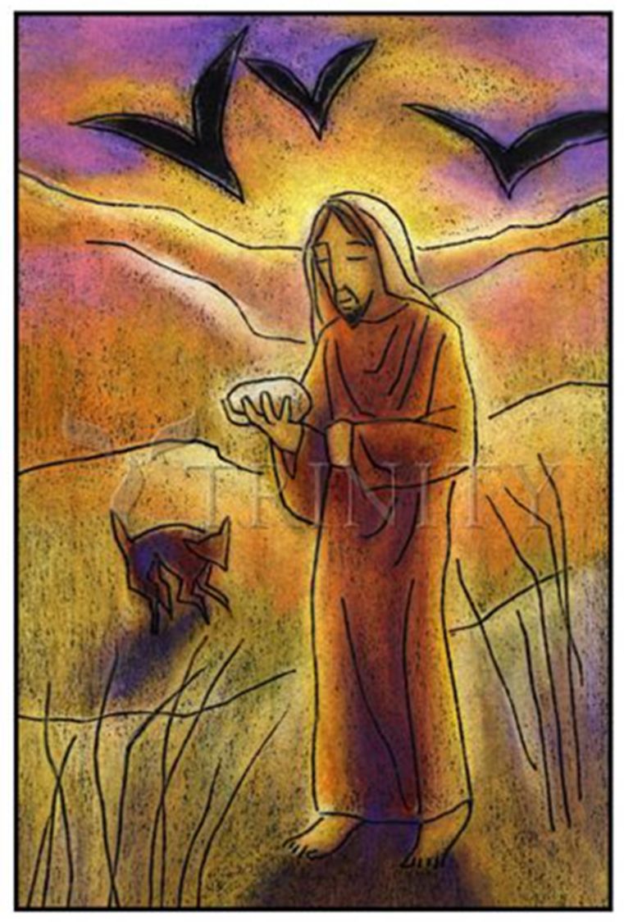
This week’s reflection is based on a painting by Julie Lonneman, an American Catholic artist.

Slide 5

Look at this painting of Jesus in the desert (wilderness).
What do you notice about it?
What else can you see?
Can you spot something that no one else in the class or at home with you will have noticed?
There are no right or wrong answers!

Slide 6

The painting shows Jesus being tempted to turn stones to bread.
What do you think Jesus meant when he said, ‘Life is more than just food’? That’s a striking thing for someone to say who hasn’t eaten for forty days!
What things do you think Jesus thought were more important than food?
What do you think life is about?
Being happy?
Helping others?
Making the world a better place?
Enjoying yourself?
Living life to the full?
What else do you think is important in life?

Slide 7
Julie Lonneman has a quote from Mother Teresa pinned up in her studio, which she says inspires her work. This is one answer to the question of what life is about.
‘I can do things you cannot, you can do things I cannot. Not all of us can do great things. But we can all do small things with great love.’
Lonneman says that she can’t do great things for God, but she can paint, so that’s what she does. It might only be a small thing, but she does it with love.

Slide 8
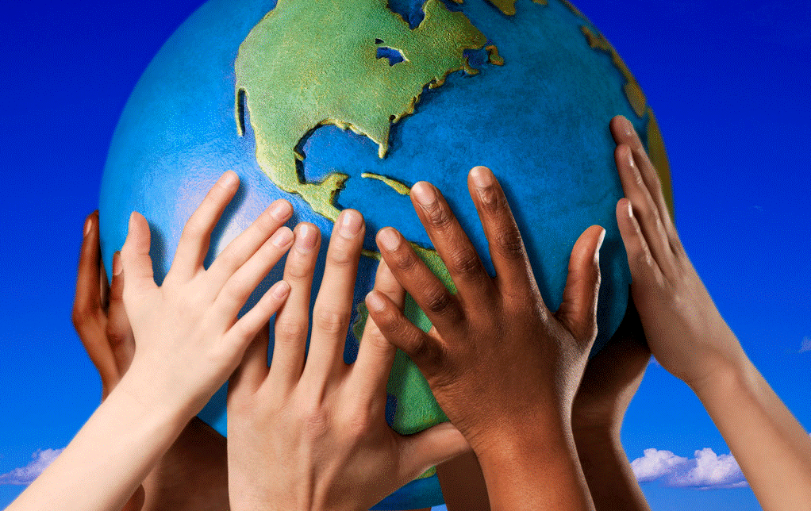
When Jesus was in the wilderness, he was listening to God to find out what was important and how he should live his life. When he returned to the town, he called a small group of followers to work with him and started to teach people about God’s kingdom.
What small, great things can you do?
Is there someone you can help?
Do you have a gift which you should be
developing and using?
Is there a cause or issue in the community or
in the world that you feel strongly about that
you should be telling other people about?
Share your ideas of what small great things you could do.

Slide 9
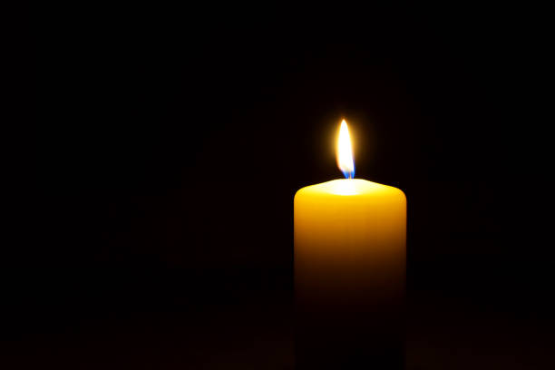
For our closing prayer, you might like to close your eyes or look at the picture of Jesus in the wilderness or at the candle.
Dear God,
We can’t all do great things,
but we can do small things with great love.
Help is to know what’s important in life,
and to live our lives to the full.
Amen.

Slide 10


