Slide 1

Responsibility
Matthew 4: 18-20
United Nations Rights of the Child: UNCRC: Article 28 – Every child has a right to an education. We have the responsibility to persevere and do our best.

Slide 2

Welcome Back
To make the return to school successful we must all work together and support each other

Slide 3
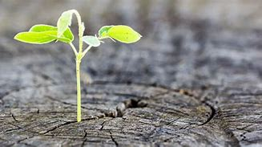

Slide 4
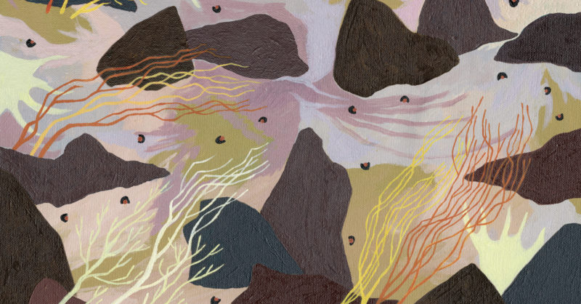

Slide 5
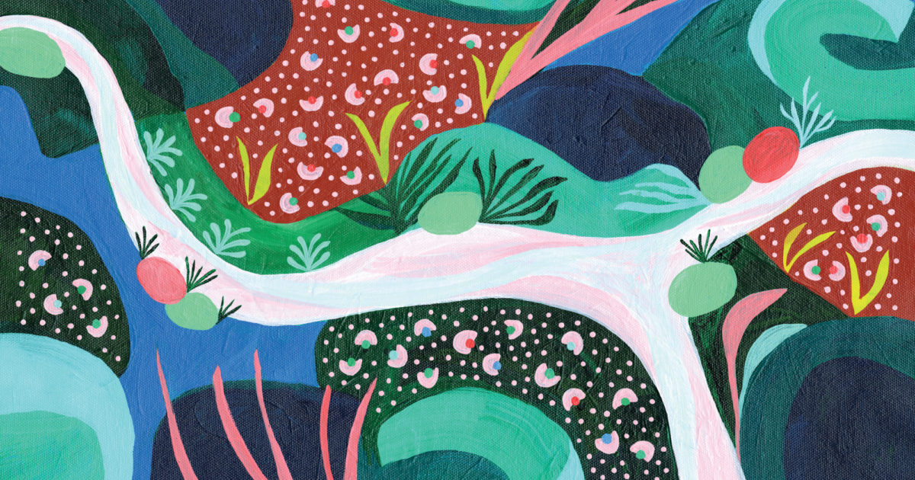

Slide 6
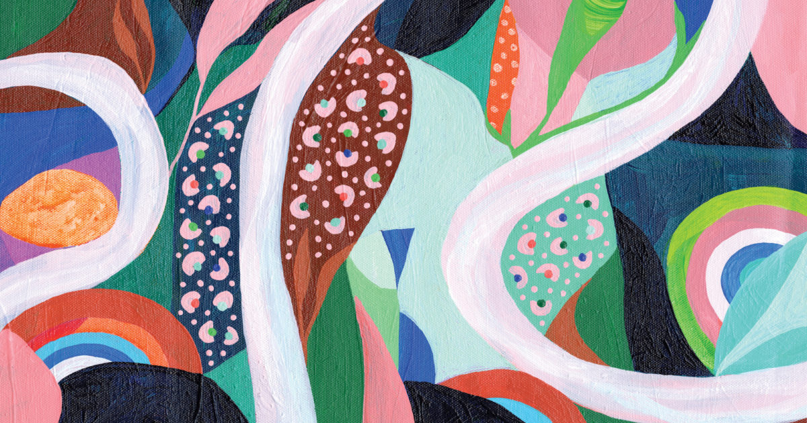

Slide 7
Hope is….

Slide 8
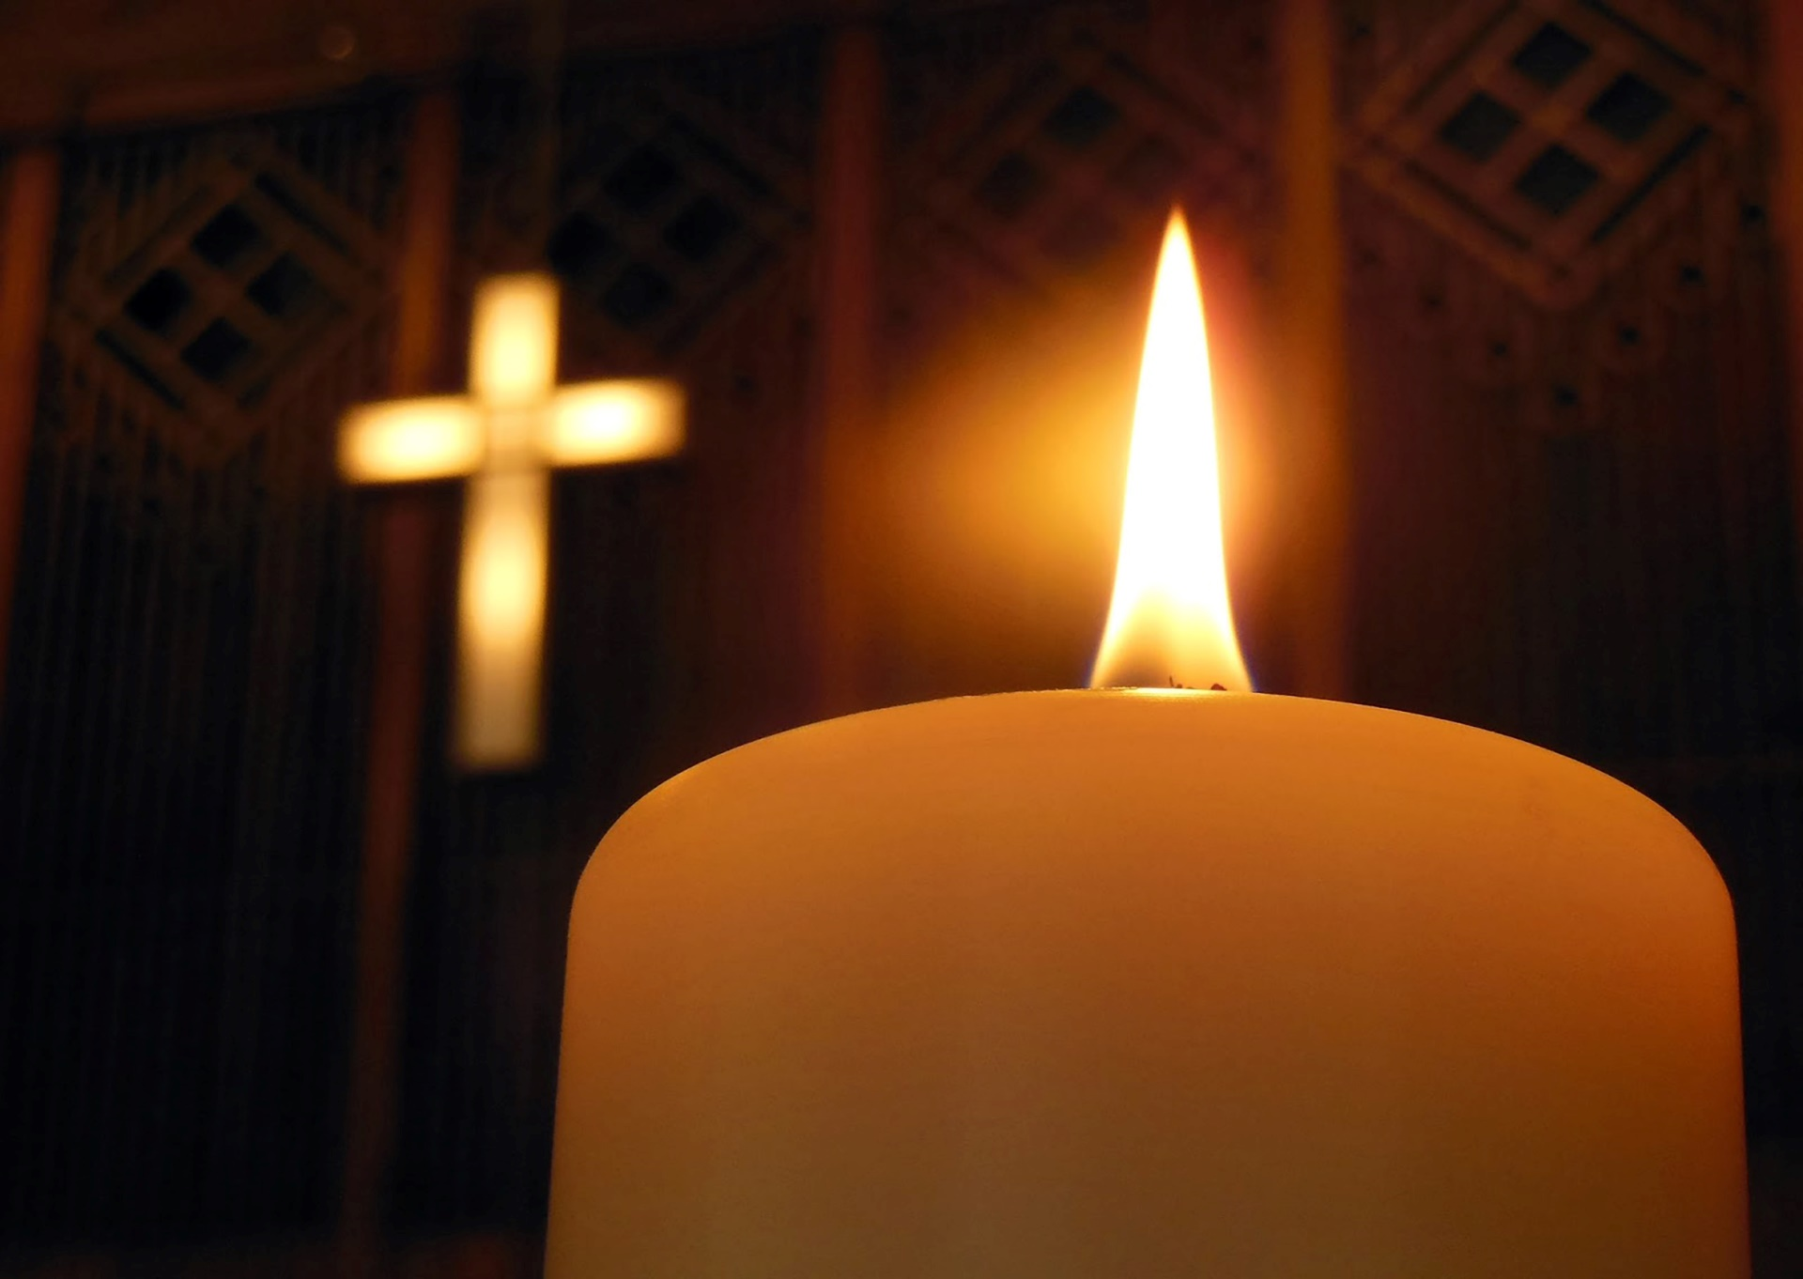
Let us pray
Dear God,
Life can be hard sometimes.
Thanks you that there is always hope.
Help us to trust you when things are difficult
And work together to make the world a better place.
We pray for people who have lost hope
And ask that you will help them too.
Amen

Slide 9
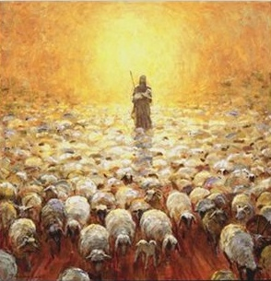
THE LORD’S MY SHEPHERD,
I’ll not want.
He makes me lie in pastures green.
He leads me by the still, still waters,
His goodness restores my soul.

Slide 10
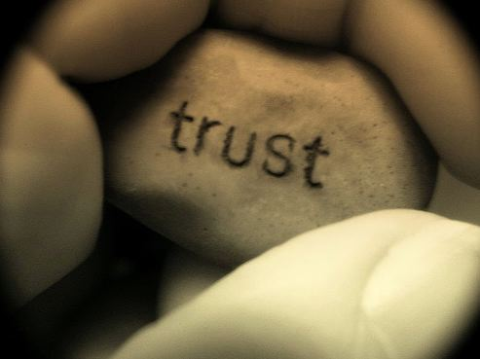
And I will trust in You alone.
And I will trust in You alone,
For Your endless mercy follows me,
Your goodness will lead me home.
(Descant)
I will trust, I will trust in You.
I will trust, I will trust in You.
Endless mercy follows me,
Goodness will lead me home.

Slide 11

He guides my ways in righteousness,
And He anoints my head with oil,
And my cup, it overflows with joy,
I feast on His pure delights.

Slide 12
And I will trust in You alone.
And I will trust in You alone,
For Your endless mercy follows me,
Your goodness will lead me home.
(Descant)
I will trust, I will trust in You.
I will trust, I will trust in You.
Endless mercy follows me,
Goodness will lead me home.

Slide 13
And though I walk the darkest path,
I will not fear the evil one,
For You are with me,
and Your rod and staff
Are the comfort I need to know.

Slide 14
And I will trust in You alone.
And I will trust in You alone,
For Your endless mercy follows me,
Your goodness will lead me home.
(Descant)
I will trust, I will trust in You.
I will trust, I will trust in You.
Endless mercy follows me,
Goodness will lead me home.

Slide 15


