Slide 1

Responsibility
1 Corinthians 13
United Nations Rights of the Child: UNCRC: Article 28 – Every child has a right to an education. We have the responsibility to persevere and do our best.

Slide 2
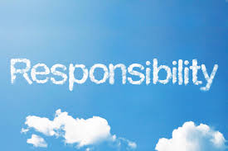
Who knows what responsibility means?

Slide 3
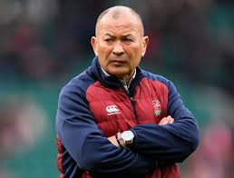
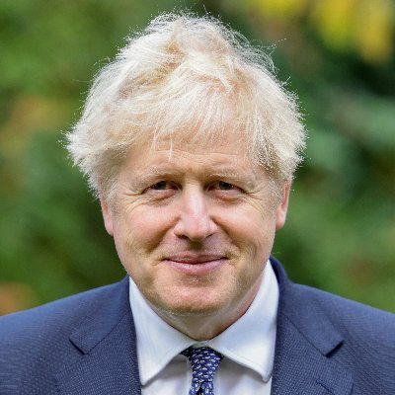
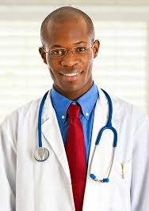
What are these people responsible for?
Notes:
Eddie Jones – England rugby coach
Boris Johnson
Doctor
There are some things that different people are responsible for, aren’t there? But there are also things that we all can be responsible for.

Slide 4
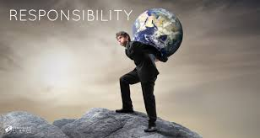
What things are we all responsible for?
Notes:
Discuss as a class. You may want to jot the ideas down to refer to throughout the week.

Slide 5
We are responsible for taking care of others and putting others first.
We are responsible for learning and making the best of ourselves.
We are responsible for making sure we take care of the planet.

Slide 6

The biggest responsibility we have is to love each other.

Slide 7
Corinthians 13: the gift of love
If I speak in the tongues of mortals and of angels, but do not have love, I am a noisy gong or a clanging cymbal.
And if I have prophetic powers, and understand all mysteries and all knowledge, and if I have all faith, so as to remove mountains, but do not have love, I am nothing.
If I give away all my possessions, and if I hand over my body so that I may boast, but do not have love, I gain nothing.
Love is patient; love is kind; love is not envious or boastful or arrogant or rude. It does not insist on its own way; it is not irritable or resentful; it does not rejoice in wrongdoing, but rejoices in the truth. It bears all things, believes all things, hopes all things, endures all things.
Love never ends.
Notes:
Read the verse to the class and ask them if this tells us how we can love each other.

Slide 8

Notes:
Now introduce the children to how we are going to show responsibility this week.

Slide 9


Slide 10
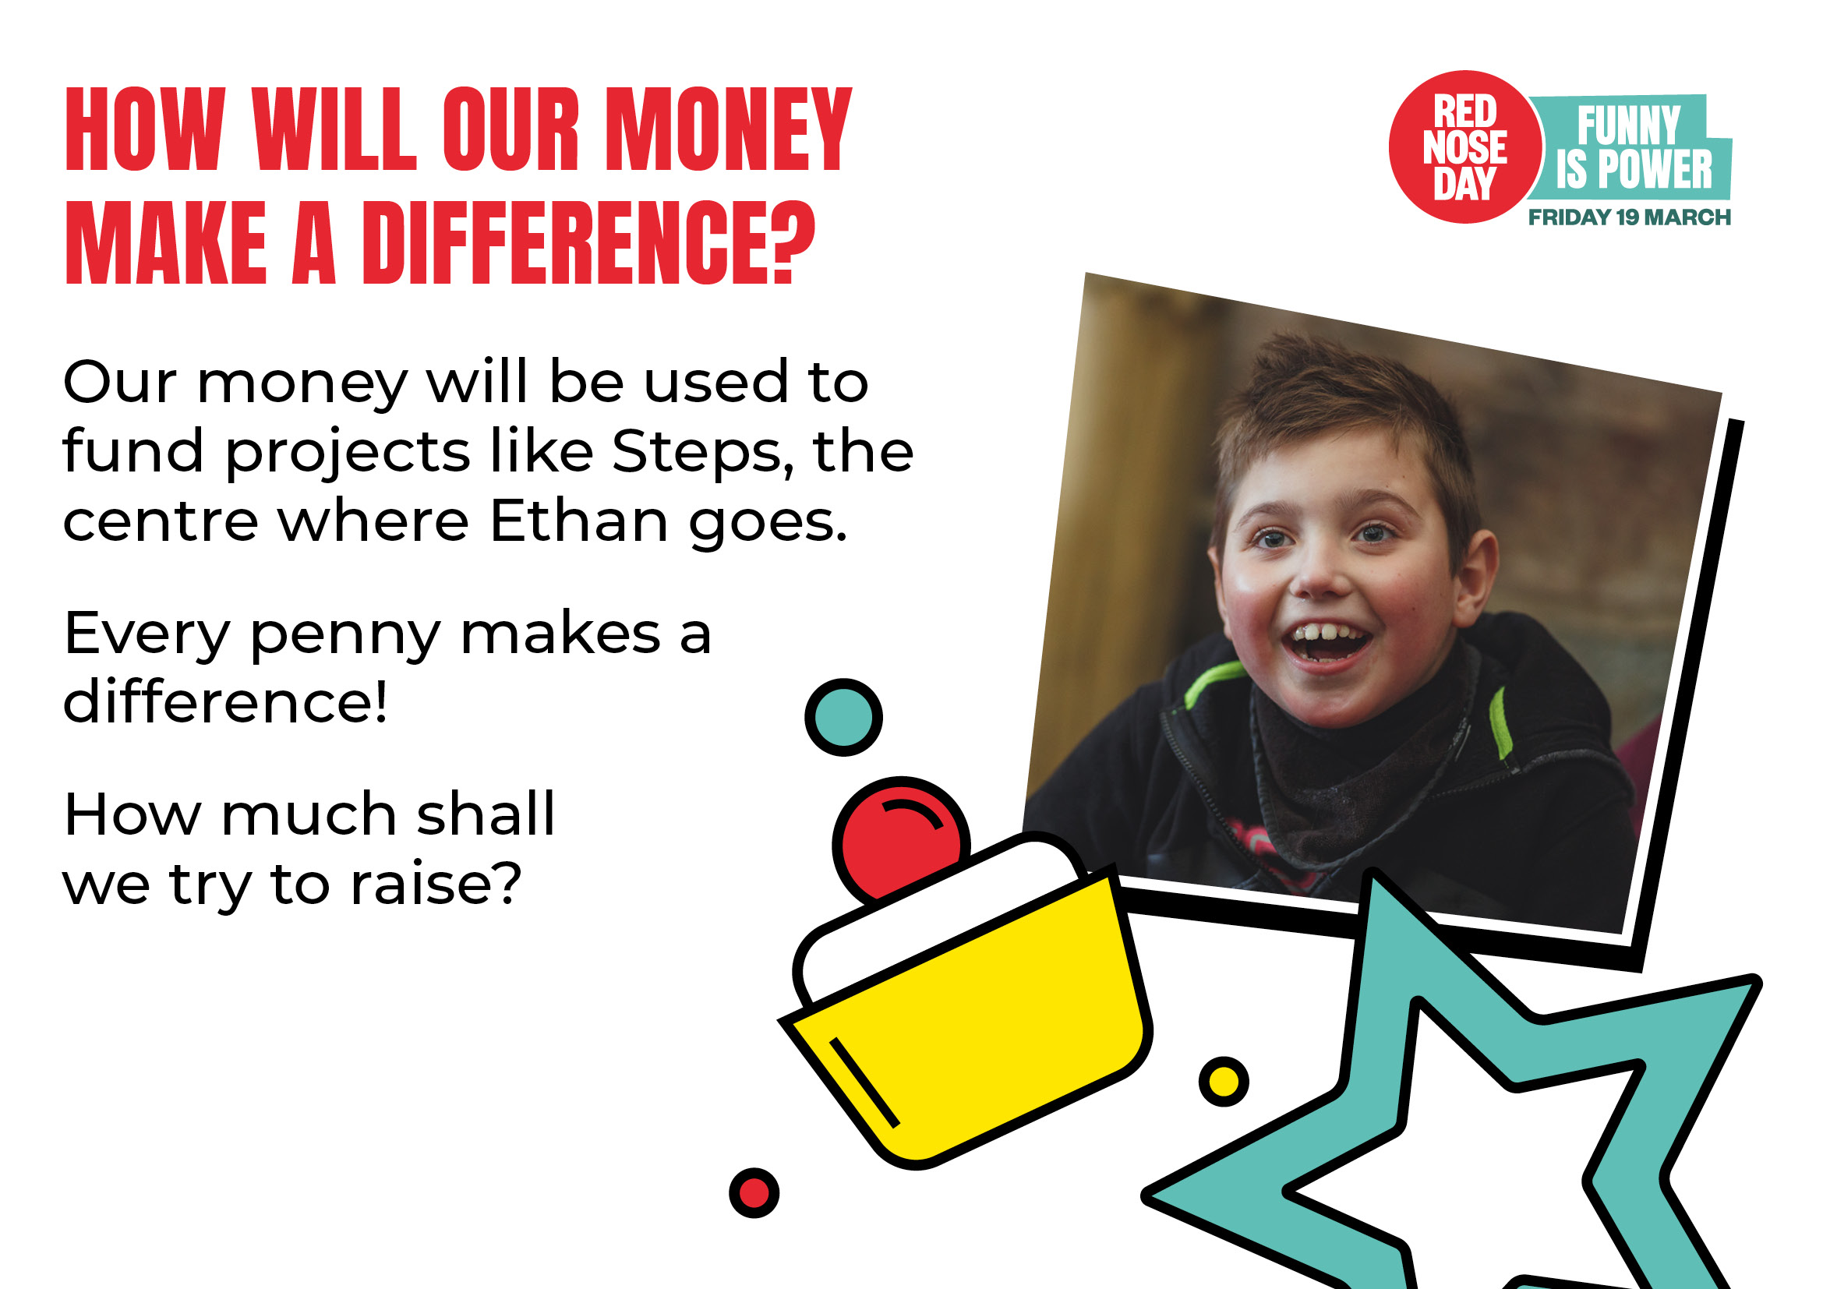

Slide 11
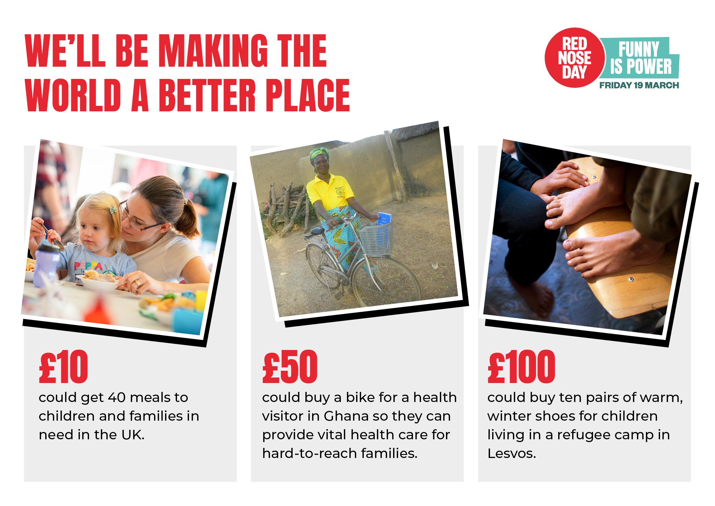

Slide 12


Slide 13
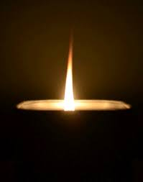
Lord,
Help us to put others first and to take care of the people around us.
Thank you for your love for us.
Amen.

Slide 14

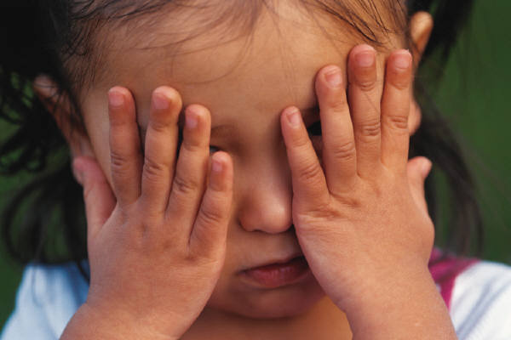
Someone’s crying, Lord,
kum ba yah!
Someone’s crying, Lord,
kum ba yah!
Someone’s crying, Lord,
kum ba yah!
O Lord,
kum ba yah!

Slide 15
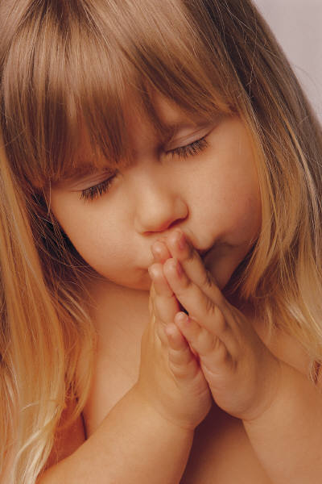
Someone’s praying, Lord, kum ba yah!
Someone’s praying, Lord, kum ba yah!
Someone’s praying, Lord, kum ba yah!
O Lord,
kum ba yah!

Slide 16
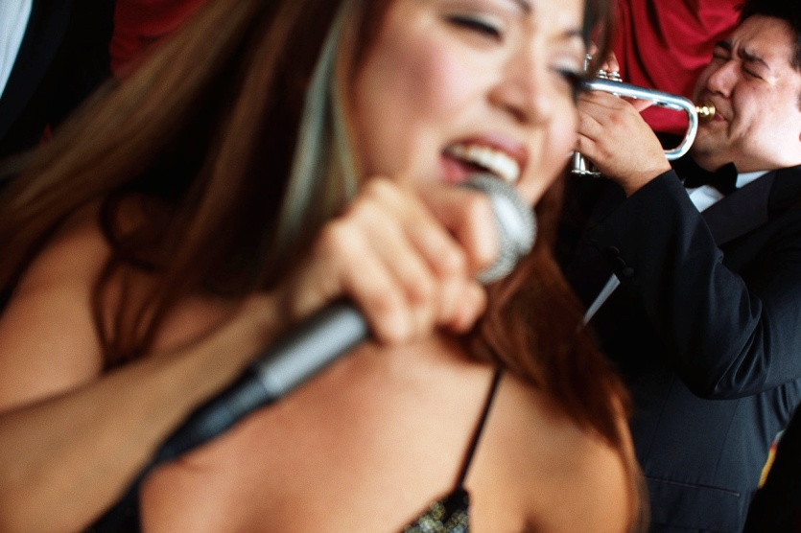
Someone’s singing, Lord, kum ba yah!
Someone’s singing, Lord, kum ba yah!
Someone’s singing, Lord, kum ba yah!
O Lord,
kum ba yah!

Slide 17
Kum ba yah, my Lord,
kum ba yah!
Kum ba yah, my Lord,
kum ba yah!
Kum ba yah, my Lord,
kum ba yah!
O Lord,
kum ba yah!

