Slide 1

Welcome to Year 5
E
Achieving More Together
Parents’ Information Evening

Slide 2

Overview of meeting
E
Meet the team
What are the topics in Year 5?
Reading
Additional information
Communication with school

Slide 3
Meet the team…
E
Mr King (Team Leader and White Class teacher)
Miss Bennison (Mitchell teacher)
Mrs Stephens (Brunel teacher)
Mrs Buckey – Learning Support Assistant
Mrs O’Beirne– Learning Support Assistant
Mrs White – Learning Support Assistant
Mrs Quick - French
Mrs Malone – Music
Miss Fogarty – Maths

Slide 4
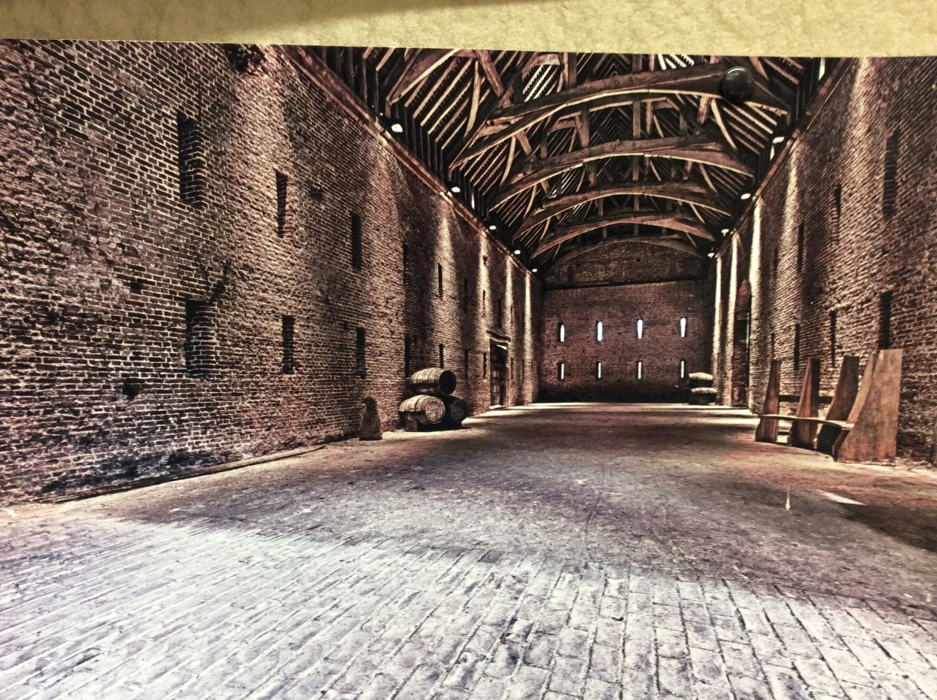

Learning – for your child
H
Autumn 1 How Significant was Basing House? History-led topic.
Autumn 2 Is Anybody Out There? Science-led topic.

Slide 5
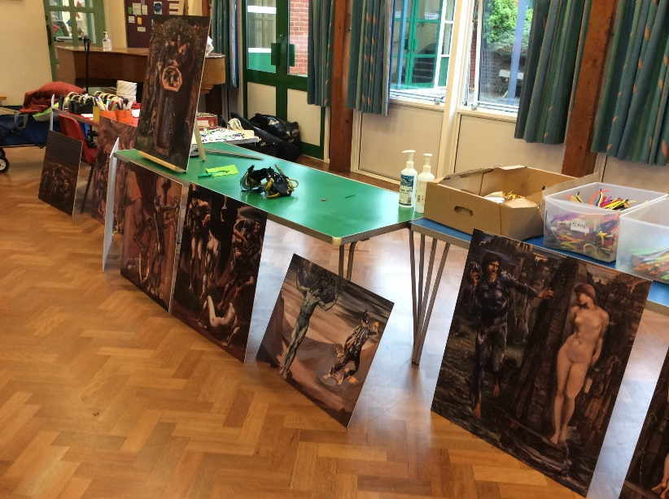
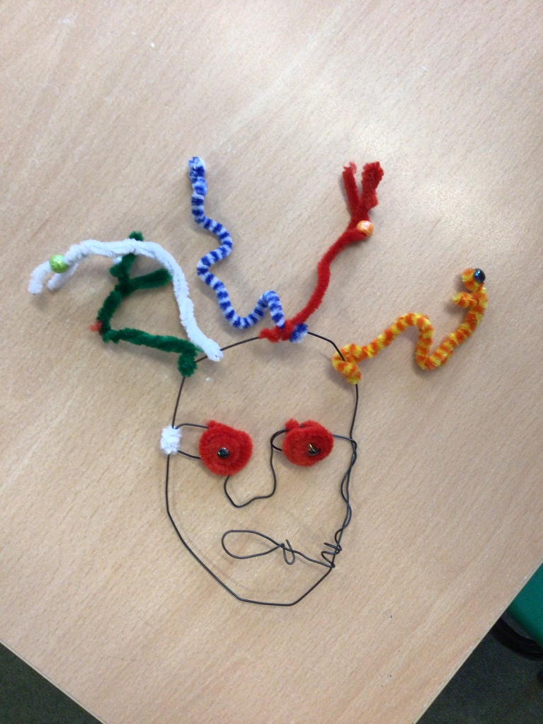
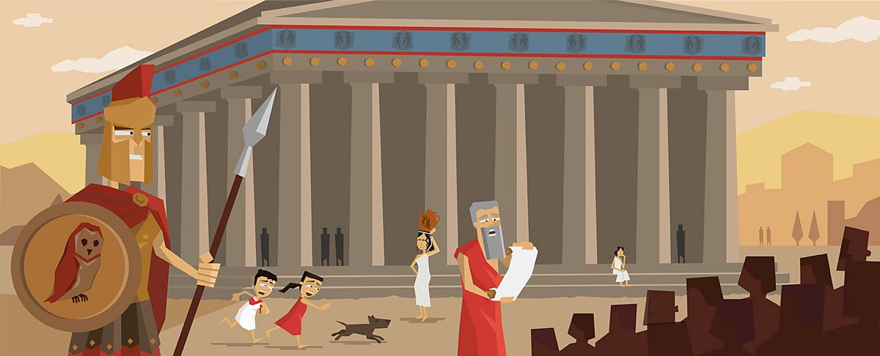
Learning – for your child
S
Spring: What Did the Ancient Greeks Ever Do For Us? History-led topic.

Slide 6

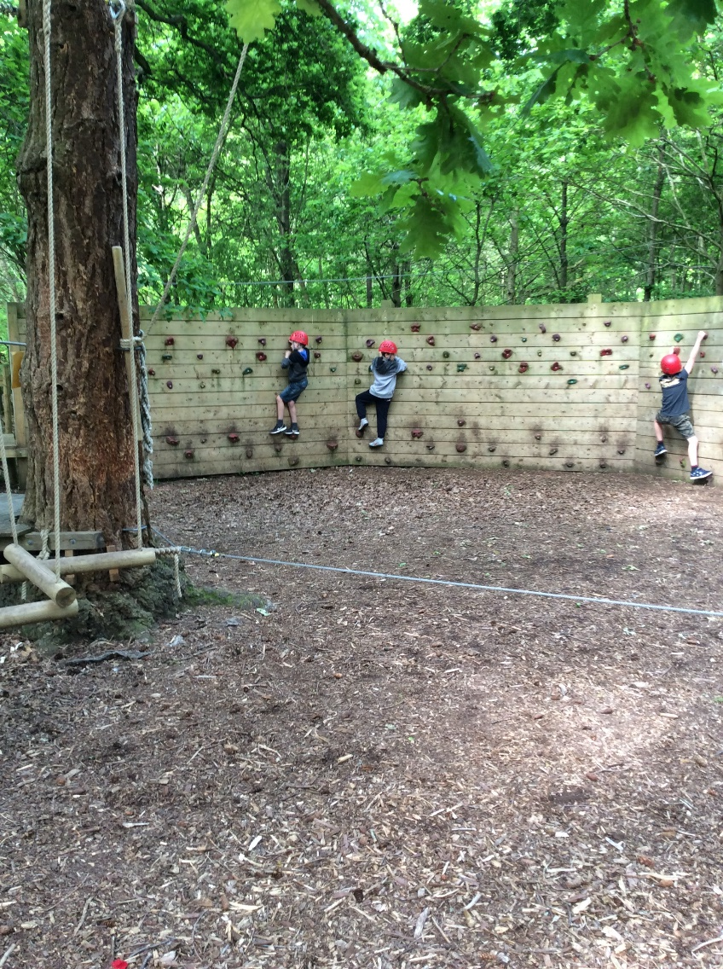
Learning – for your child
S
Summer: Brazil vs UK: A world apart? Geography-led topic.

Slide 7

Reading with your child
E
In Year 5, we encourage the children to be independent with their reading.
However, it is still important for your child to read and enjoy books with you.
Reading with your child enables them to have valuable discussions about what they have read and clarify anything that they do not understand.

Slide 8
Anything else?
S
Home learning through Google Classroom
Friday to Thursday (or before)
Independence
Skills cards
Times Table Rockstars/Education City/Anton
Multiplication tables
Changes to our school behaviour policy and our approach to behaviour in school
Notes:
Home learning
Please encourage your child to complete their home learning independently. There will be two main tasks each week & spellings. NEW – if we think your child needs more practise we will send home a little something. Please complete this and then return. E.g. subtraction practise or perhaps using complex sentences
Spellings
Each week we have a rule that we teach the children. There are 5 words that go with the rule to practise here but we may also test 5 others. It is the rule that needs to be learnt! In addition are 5 words from the high frequency word list that they are working through. They need to know how to use them in a sentence.
Reading
Please hear your child read as often as you can and to discuss what they have read and ensure you / they sign or initial their reading record whenever you hear them read or talk about what they have read. 4 times a week is the minimum.
Times tables
Continue to keep up with learning tables for the Times Table. Your child should now know them all & division facts.

Slide 9
Turn it around!
E
We’ve moved away from ‘Yellow, orange and red’ sanctions.
Turn it around is the whole-school approach with a focus on restorative reflection when things don’t work well.
This reinforces the need to reflect on mistakes when they happen.
If children do end up missing time at break/lunch, this time is more purposeful.
It allows parents to have a greater understanding of their child’s behaviour in school and what/why it happened. Reflection on behaviour doesn’t have to end as they leave the school building!

Slide 10
Celebrating positive behaviours
S
We still have class points to reward children for positive behaviours which ultimately lead up to a class treat which is decided in advance.
Children are also able to earn stamps for continued positive behaviour and for following the school rules consistently.

Slide 11
Communication
S
Website
Whole-school newsletters
Termly newsletters
Email/phone
Face-to-face

Slide 12

E
Achieving More Together
Thank you for taking the time to view our parent information slides.
We are looking forward to working alongside you this year.
Notes:
All

