Slide 1

Welcome to the
Year 6
Parents’ Briefing
Mrs Parsons– Davies Class
Mrs Gill– Nightingale Class
Miss Dee – Russell Class
LSA support: Mrs Alvarez, Miss Whittingham, Miss Edney
Music, French and Maths: Mrs Malone, Mme Quick and Miss Fogarty
Notes:
HP

Slide 2

What will we be
doing this term?
Notes:
AG

Slide 3
Autumn: Extreme Earth
Spring: Let Me Entertain You
Summer: Wise World and
school production.
Enrichment and school trips
RAF visit and Science Centre visit – Autumn
Calshot – Autumn
Bikeability – Autumn
Globe Theatre Visit– Spring
Winchester Cathedral – Summer
Southampton Art Gallery in school visit– Summer
Summer Party – Summer
Year 6 Production – Summer
Notes:
NS

Slide 4
How will homework
be organised?

Slide 5
Handed out on Thursday and collected in on the following Wednesday.
Daily homework skills cards (on a needs basis) and there may be Mathletics tasks (children have their own login details).
The homework will be set on Google Classroom to enable online completion.
Children need to complete entries in their reading record at least five times per week - please still read with your child.
Please do not labour over homework. If there is a problem, stop and see your child’s teacher. Communication is vital!
Notes:
SG

Slide 6





Notes:
SG

Slide 7

Notes:
HD
Emotional well being
Content child = a successful learner
Chatter matter box
Weekly circle time
Encouraging positive and open mind sets
Head Teacher Award
Stamp rewards
Class Rewards/ Homework Award
Star of the Week
Behaviour Policy
Phones and sleep

Slide 8
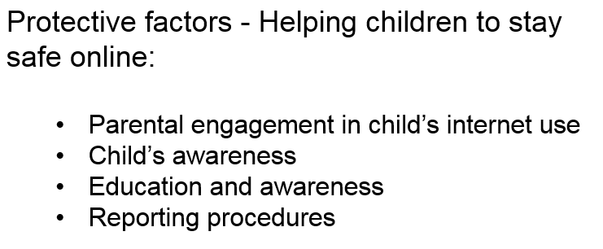
E-Safety in Year 6
Notes:
NS
Meeting up together outside of school without adult supervision

Slide 9
  SATs – Week beginning 12th May 2025
Additional information regarding SATs will be given to parents in February 2025.
Monday 12 May 2025 | Grammar, Punctuation & Spelling - Paper 1 Grammar, Punctuation & Spelling - Paper 2
Tuesday 13 May 2025 | English Reading
Wednesday 14 May 2025 | Maths Paper 1 (Arithmetic) Maths Paper 2 (Reasoning)
Thursday 15 May 2025 | Maths Paper 3 (Reasoning)
Notes:
HP

Slide 10
  Additional Information
Parent Helpers
PE days - Tuesday and Friday
Uniform
Prefects
Notes:
SG

Slide 11
Secondary School
Application Form
https://www.hants.gov.uk/educationandlearning/admissions
Applications are already open. They will remain open for the next 46 days! Make sure you put down more than one choice!
Deadline for completed forms: 31st October 2024.
Do not miss this date! Late applications are not processed until after the notification date in March!
National notification date: 3rd March 2025.
Notes:
HP
Don’t just put down one school.
Put at least one catchment school down as if you don’t get your first or second choice, you will get the catchment choice instead.

Slide 12
  Thank you for your time and for
  coming along this evening.
Any questions?
Notes:
SG

