Slide 1
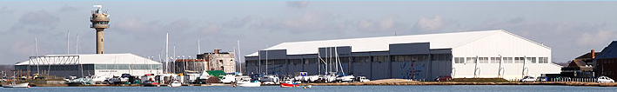

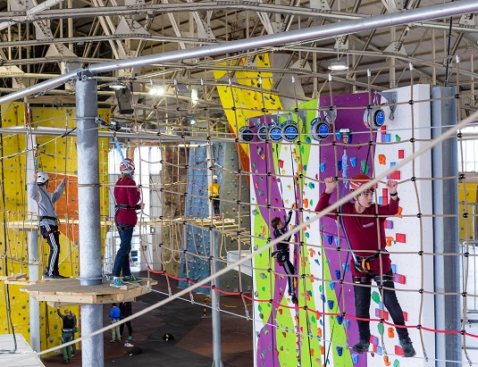
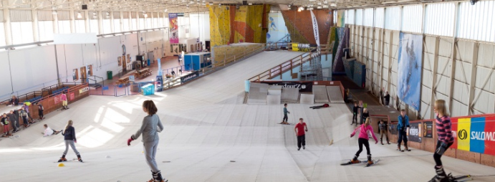
Calshot Residential Trip 2025

Slide 2
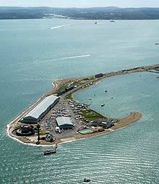
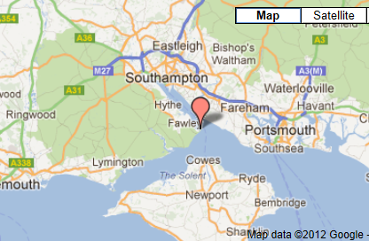
Where is Calshot?

Slide 3
Why do we go?
To develop skills of independence and confidence in a non-familiar setting
To develop team-building and cooperation skills especially with others who are not friends
To build resilience when facing new challenges

Slide 4
When will we be going?
We are currently booked in for Calshot on 20th – 24th October 2025.
This is confirmed and is the week before half term.

Slide 5
Costs involved
Cost: £490
This price includes the cost of the coach, food and accommodation.
Either paying in full, with no deposit needed, by 13th December 2024
Or a non-returnable £115 deposit by 13th December 2024 and then 6 instalments of £62.50 between January and June 2024.
Letters will go out soon to book your child’s place and pay deposit or full amount.
Support is available – tick the box on the letter

Slide 6
Activities:
Day:
Skiing
Climbing
Archery
Initiative/team challenges
Crate Stack
Beach Bonanza
Kayaking
Aero Trek
Orienteering (New Forest)
Ringos
Evening:
Games Night
Film Night
Epic Engineering
Quiz Night

Slide 7
A typical day at Calshot
7:00 Wake up and inspections
8:00 Breakfast
9:00 Morning activities
12:45 Lunch
1:45 Afternoon activities
6:00 Evening meal
7:00 Evening activities
8:30 Get ready for bed, shower time, quick inspection
9:00 Lights out

Slide 8
How do we support the children?
Every year, we have children who feel anxious about Calshot. We also have a lot of children who are incredibly excited.
We provide the children with:
As much information as possible about the trip.
Opportunities to speak with adults and children who have experienced the trip before to discuss any worries.
Year 5 will write letters to themselves, in the summer term, to open just before the trip .
We will work with you, as parents, to cater to the needs of your child in the best way we can.

